Slide 1
Entrepreneurship in Food
1st Follow-up Meeting 12th December 2023
HSWT University of Applied Sciences
& Hawassa University, Ethiopia
Anja Weber, Yitna Tesfaye, Tirusew Teshale, Girma Moges

Slide 2
Agenda
1. Welcome
2. Feedback from students
3. Why start an entreprise in food processing?
4. Accessing the course
5. How to learn online
6. Questions & Answers
Course start: 28th November 2023
Course end: 14th February 2023

Slide 3
Welcome
1. Welcome by the lecturers
2. Welcome to new participants
3. Poll:
Which form of entrepreneurship is your favourite?
Which kind of business is your favourite?
Which consumer trend do you think plays a big role at the moment?
Survey Questions
Notes:
https://hswt.zoom.us/survey/iSfEdyEEnFtl-q9D_f8jKzVBn1803skGUBWqsOdYravZWY100KY.rmustmz1j6ia39Q1/view?id=EBdr_F2wTy-l7rX2973EFg#/sharePreview

Slide 4
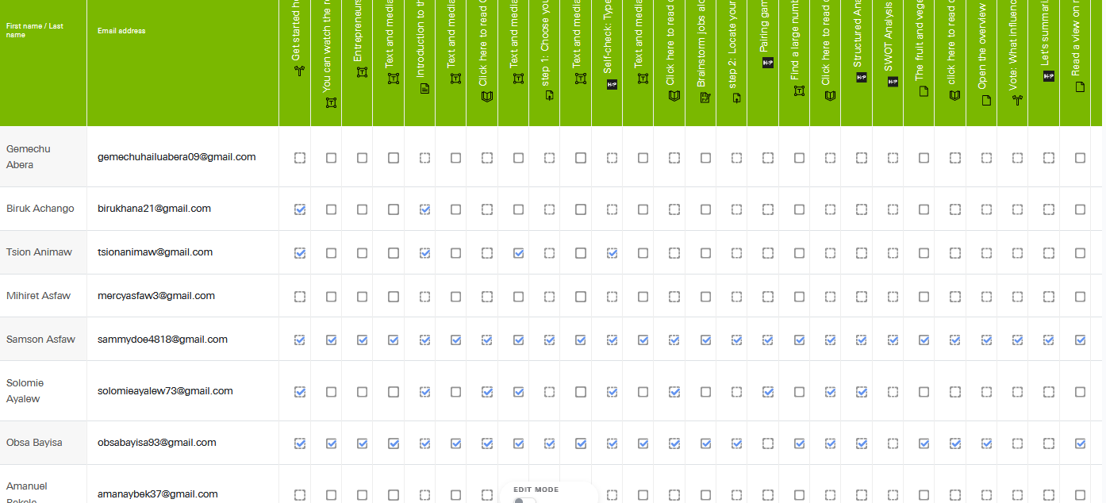
Feedback from students
Notes:
So far 13 of 46 participants have submitted their first assignment

Slide 5
Feedback from students
Did you encounter any problems?
What do you like about the course?
Notes:
https://hswt.zoom.us/survey/iSfEdyEEnFtl-q9D_f8jKzVBn1803skGUBWqsOdYravZWY100KY.rmustmz1j6ia39Q1/view?id=EBdr_F2wTy-l7rX2973EFg

Slide 6
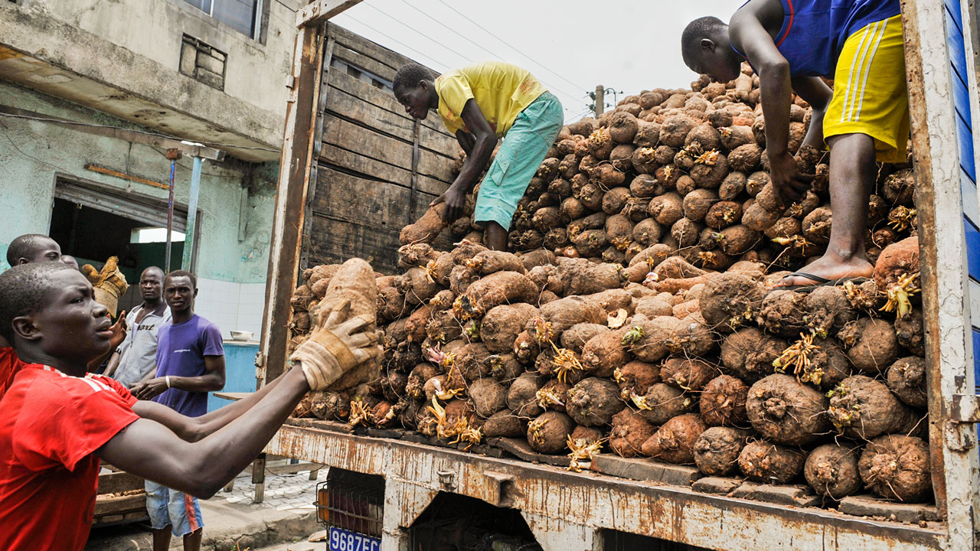
Why start an entreprise in food?
Risk of crop loss due to spoilage
(post-harvest losses)
Farmers sell quickly at give-away prices
A few months later prices increase due to shortage
Notes:
It relies on your own motivation and willingness to work through the modules and engage with the topic. More important than achieving a certain number of points by rushing through the modules will be that you use this opportunity to learn to your own advantage. However,

Slide 7

Why start an entreprise in food?
Food processing is a means to:
Reduse post-harvest losses
Enable longer storage
Generate increased income
-> greater food security
-> better nutrition & health
Notes:
Ask students which reasons they can name

Slide 8
Why start an entreprise in food?
Food processing is more than food preservation!
Food can either be processed –
For immediate consumption (e.g. restaurant, etc.)
To add value to basic raw materials
To change its properties (texture, falvour, etc.
To generate income
To increase variety and value in people‘s diets
Notes:
Food preservation is the most common food technology carried out at household level. = Good home management! Their own snacks, preserves, baked goods, etc. Usually carried out by women. On-farm preservation at low cost with no special equipment (utensils that are part of the home already). Distribution only to people they are in direct contact with.

Slide 9
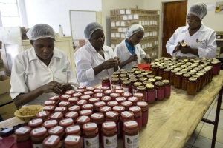
Why start an entreprise in food?
Food processing can be done either –
by using simple techniques & equipment
Simply for preservation
Using greater technical know-how and machines
Low-cost or with higher financial commitment
By adding value
Notes:
Ask students which reasons they can name

Slide 10
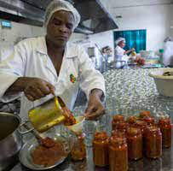
The choice of business depends on:
The type of finished product
The expected length of storage
The level (scale) of production
The financial capacity of the owner
The expected customers‘ requirements
Notes:
Ask students which reasons they can name

Slide 11
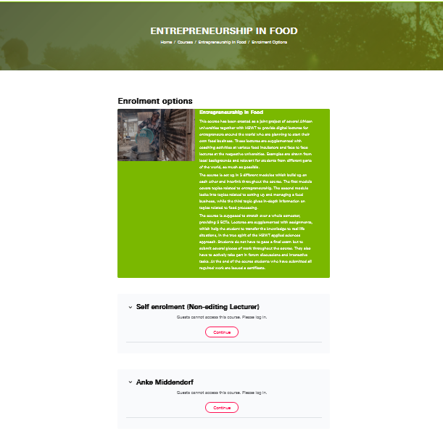
How to access the course
https://wbmoodle.hswt.de/course/view.php?id=3451
Click on continue under
„Self enrolment (Non-editing Lecturer)“
Notes:
https://wbmoodle.hswt.de/course/view.php?id=3451

Slide 12
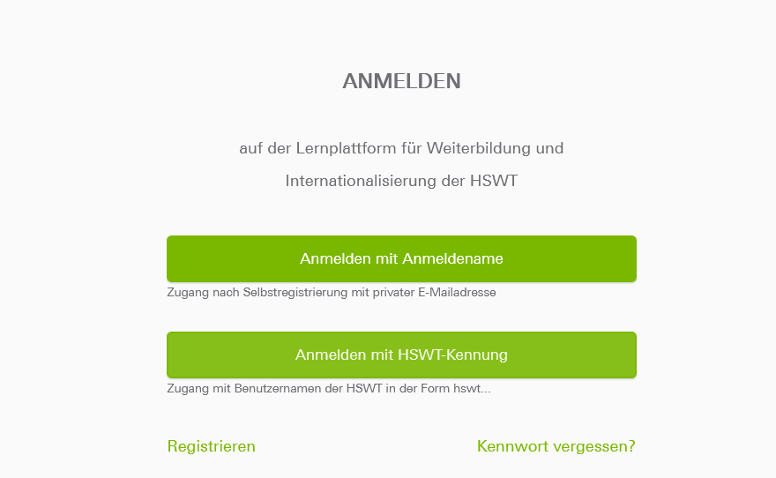
How to navigate through the platform
If you are already registered, click here
If you forgot your password, click here
If you are not yet registered, click here
Notes:
https://wbmoodle.hswt.de/course/view.php?id=3451

Slide 13
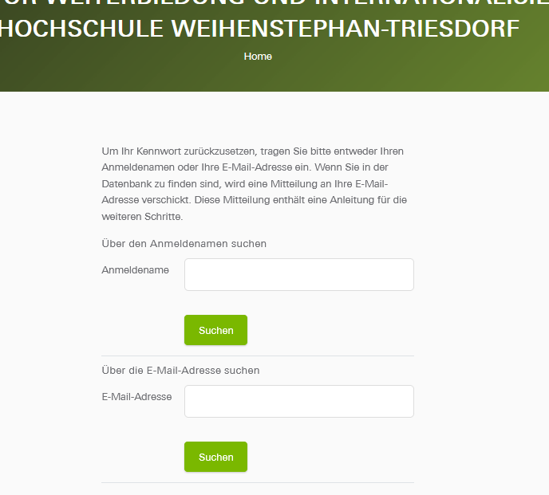
How to navigate through the platform
You can search for your account here,
By using your account name
Or you can search for it by entering your email address here
Then click ‚Suchen‘,
Which means search
Notes:
https://wbmoodle.hswt.de/course/view.php?id=3451

Slide 14
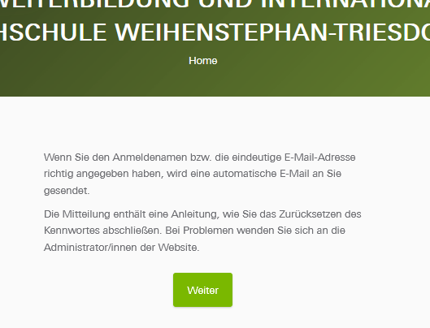
How to navigate through the platform
The next window that opens tells you that an email was send to your address
Notes:
https://wbmoodle.hswt.de/course/view.php?id=3451

Slide 15
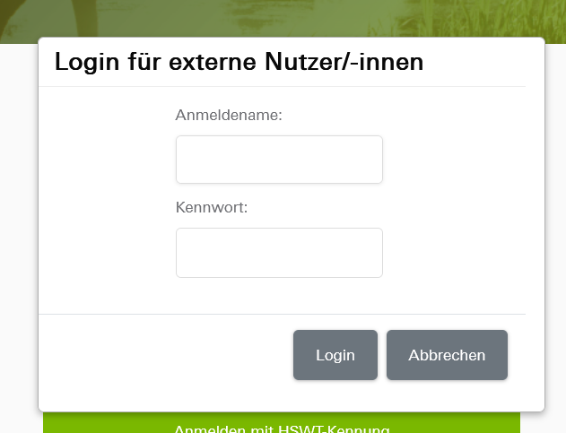
How to navigate through the platform
1. Enter your user
name here
(the one with only
small letters without
an empty space)
2. Enter your
password here
3. Then click here
Notes:
https://wbmoodle.hswt.de/course/view.php?id=3451

Slide 16
How to succeed in online learning
Establish a productive learning environment
Working on assignments from a slouched position and scolling Instagram at the same time is not ideal if you aim to be productive.
2. Set a schedule for completing and reviewing assignments
Avoid stress by allocating specific times to work on your online class. Keep
track of due dates for assignements.
3. Seek virtual interactions with your peers
Learning works better if you have a sense of collaboration and community.
Make use of the forum sections.
4. Use the ‘chunking’ strategy to section out tasks
Work on one lesson or or assignment, then give yourself abreak before you
come back and do the next chunk.

Slide 17
How to succeed in online learning
Find Ways to Stay Motivated
You are adults and need to take responsibility for your learning. Especially in
this course nobody will force you to finish tasks. They are an offer for you to
use. You can try these strategies to overcome “down-times”:
Think about how you can turn the assignment or task into a usufull tool for later
2. Imagine yourself on a path toward mastering the subject
Tell yourself: This is not something I must do, this is something I need to do
to achieve my goals,”
3. Problem-Solve on Your Own
As you adjust to working online, it’s important to remember that most
questions can be answered when you read instructions carefully and when
you go over each module properly

Slide 18
How to succeed in online learning
. 9. Focus on Your Self-Care
It’s completely understandable if you need to step away from the computer for a few hours or if you need to take a day to sleep-in. Taking the time to recover is necessary and you shouldn’t feel bad about it.
10. Have Compassion for Others
Remember that individuals everywhere are going through many of the same experiences you are right now. Have patience towards those who might not know how to use online tools or who may be taking a longer time to adjust to this "new normal.“ Never leave discouraging or mean comments online. They hurt!

Slide 19
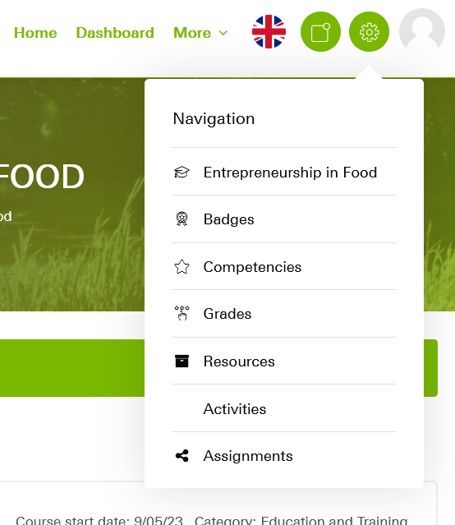

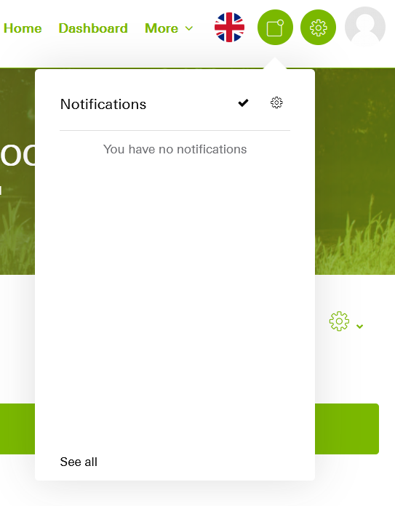
How to navigate through the platform
Change your language settings to English here
Notes:
https://wbmoodle.hswt.de/course/view.php?id=3451

Slide 20
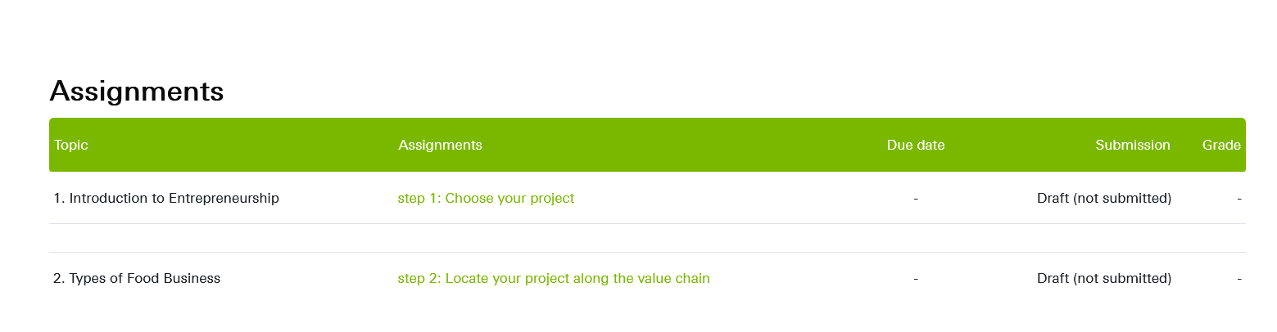
How to navigate through the platform
If you click here,
you can see all your due assignments and their status
Notes:
https://wbmoodle.hswt.de/course/view.php?id=3451

Slide 21
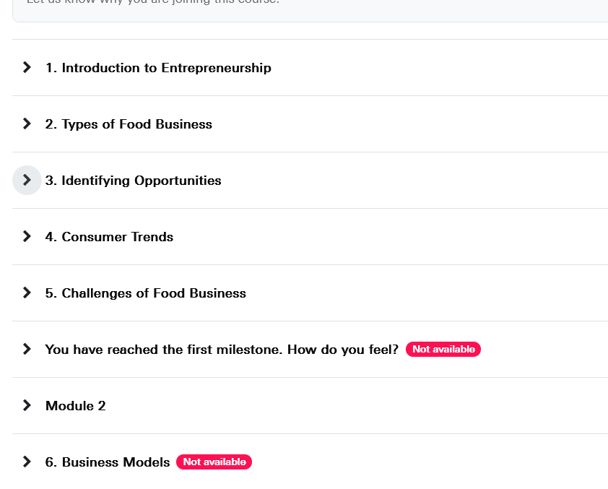
How to navigate through a lesson
Click on the arrow to open a lesson
Milestone 1 and Module 2 are still locked
Notes:
https://wbmoodle.hswt.de/course/view.php?id=3451

Slide 22
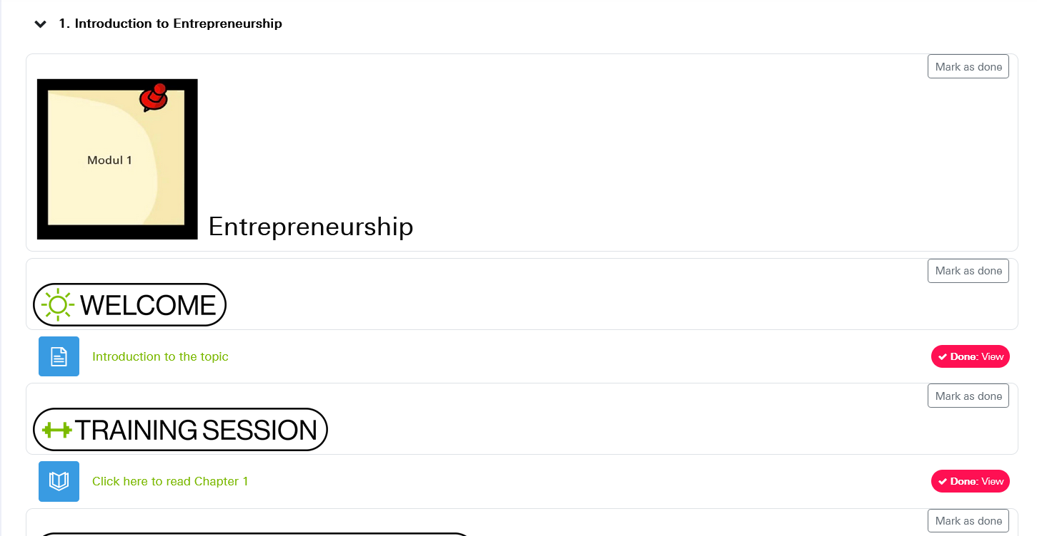
How to navigate through a lesson
Non-mandatory sections
you can mark as ‚done‘
to keep track of what
you have done already
Mandatory activities are marked in read
Click on the headlines to open a section
Notes:
https://wbmoodle.hswt.de/course/view.php?id=3451

Slide 23
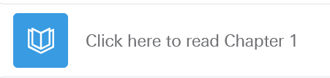
How to navigate through a lesson
Notes:
https://wbmoodle.hswt.de/course/view.php?id=3451

Slide 24
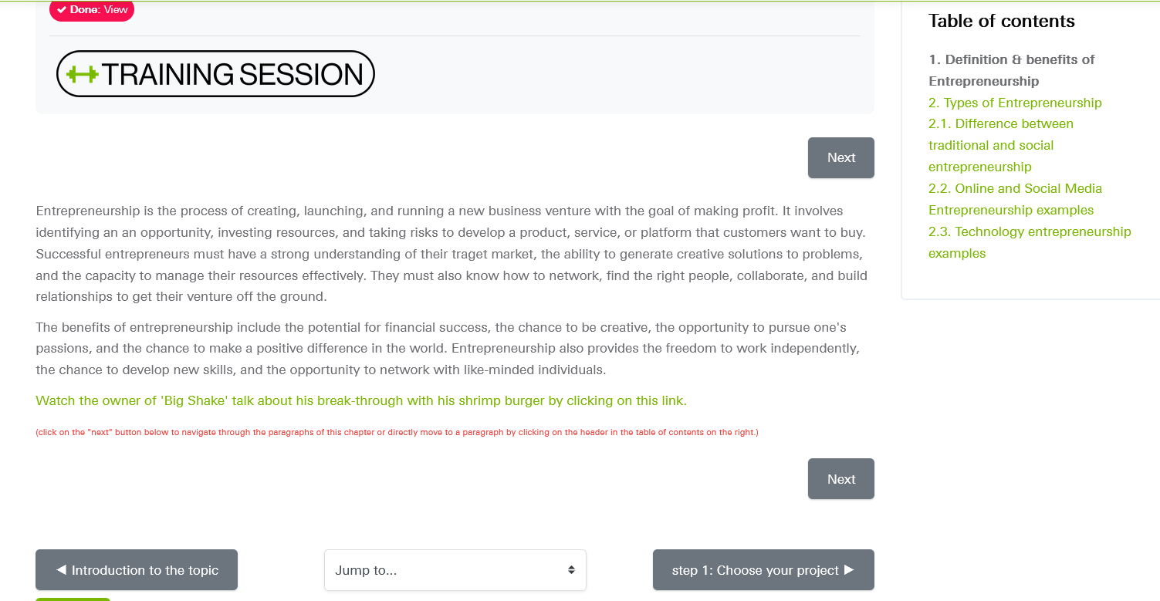
How to navigate through a lesson
Here you see where you are
Here you can see your status for this section
Here you have an overview over the next chapters.
You can also directly select a chapter from here.
By using this button you can navigate backwards to the previous section
This is the chapter you are reading
By clicking on this button you navigate to the next section of the lesson
By clicking on the ‚next‘ button you move to the next chapter
Notes:
https://wbmoodle.hswt.de/course/view.php?id=3451

Slide 25
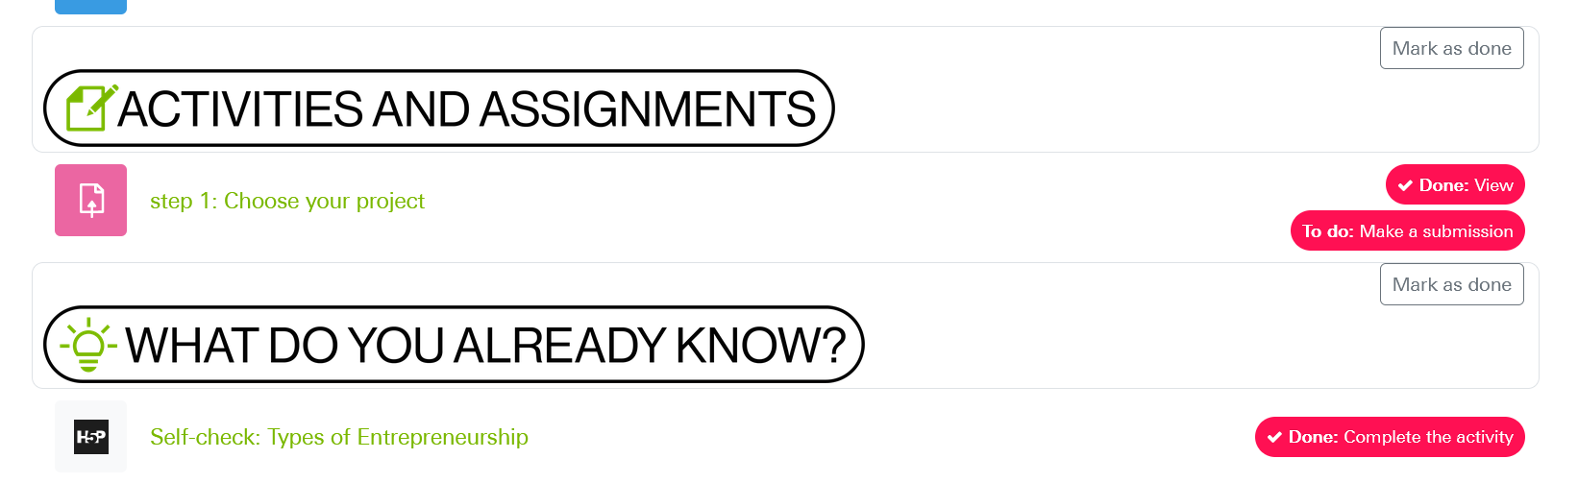

Assignments
Here you see what is required
Click on the headline to open the activity
Notes:
https://wbmoodle.hswt.de/mod/choice/view.php?id=166125

Slide 26
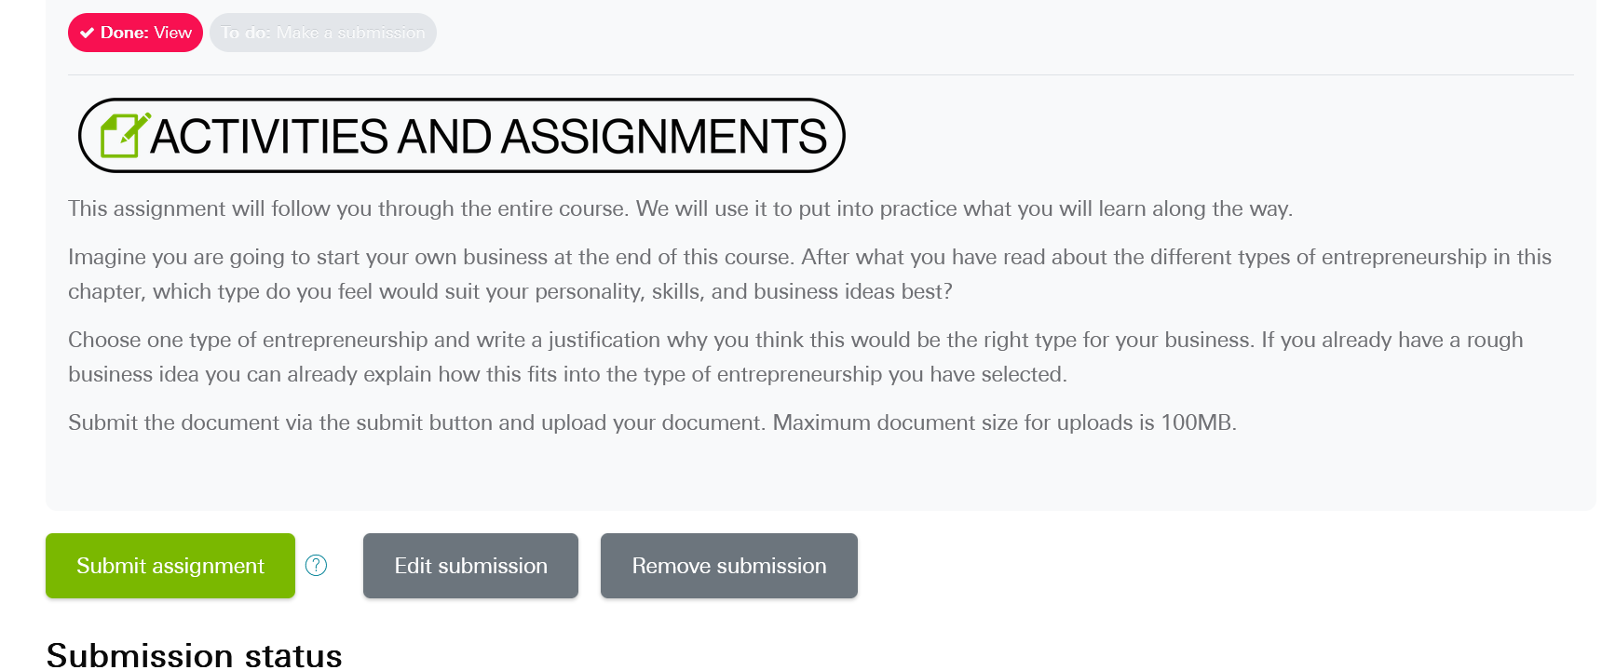
Assignments
Click on the
Notes:
https://wbmoodle.hswt.de/mod/choice/view.php?id=166125

Slide 27
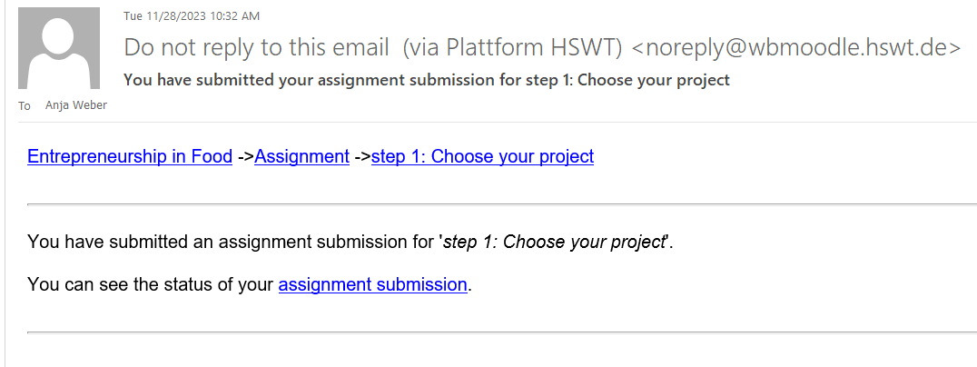
Assignments
You will receive a confirmation email after submitting your work
Notes:
https://wbmoodle.hswt.de/mod/choice/view.php?id=166125

Slide 28
Assignments
Here you see what is required
Click on the headline to open the activity
Notes:
https://wbmoodle.hswt.de/mod/choice/view.php?id=166125

Slide 29

Quick Knowledge Checks
Notes:
https://wbmoodle.hswt.de/mod/hvp/view.php?id=164710

Slide 30
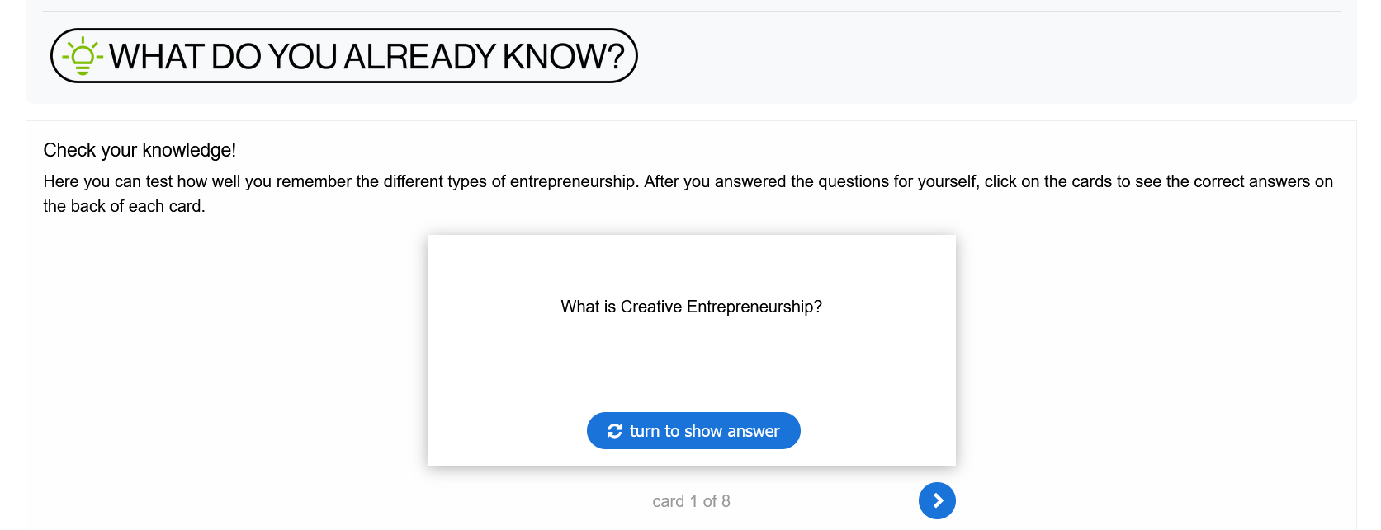
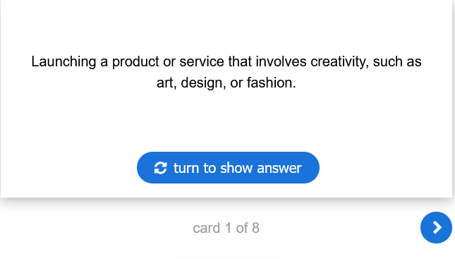
Quick Knowledge Checks
Notes:
https://wbmoodle.hswt.de/mod/hvp/view.php?id=164710

Slide 31
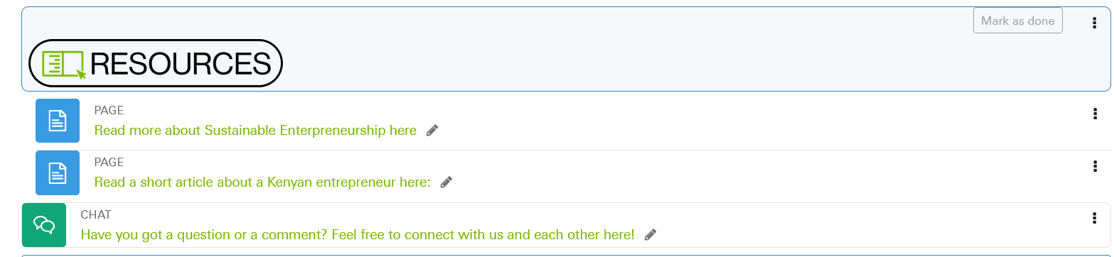
Resources
Click on the headlines to open the resources. Some will download to your device.
Resources are not mandatory.
However, they are a great source of further information!
Here you can connect with us or with each other, place questions, comments or discussion topics!
Notes:
https://wbmoodle.hswt.de/mod/hvp/view.php?id=164710

Slide 32
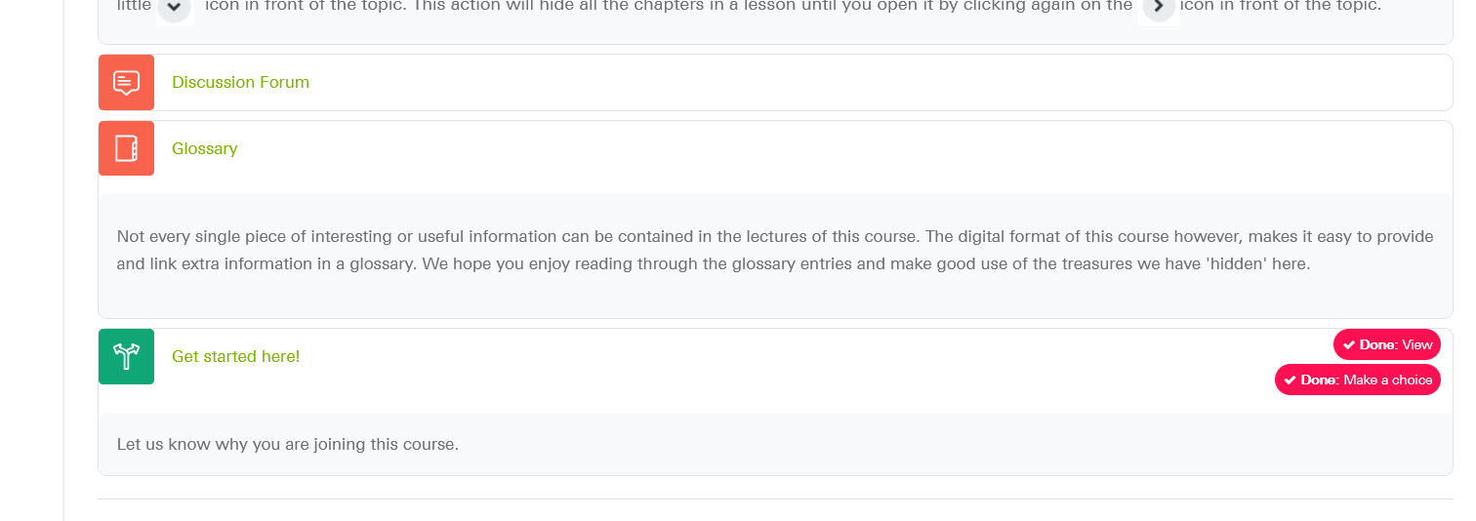
Special features
https://wbmoodle.hswt.de/mod/choice/view.php?id=166125
Get started here!
Notes:
https://wbmoodle.hswt.de/mod/choice/view.php?id=166125

Slide 33
What do you think?
https://wbmoodle.hswt.de/mod/forum/post.php?reply=56447#mformforum
Please click on the link to write a sentence about:
1. what you feel is important for your generation &
2. what kind of business ideas or formats can be successful in this day and age.
You can collect points through your participation in this forum.
Each new topic started by you and each answer to a topic that was started by someone else will give you 5 points.
You should aim to get 50 points minimum in this forum. It will remain open throughout the entire course.
Notes:
https://wbmoodle.hswt.de/mod/forum/post.php?reply=56447#mformforum

Slide 34
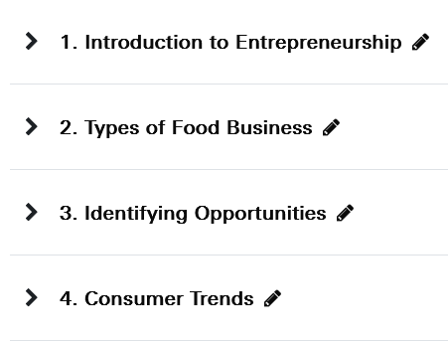
Next online meeting:
Tuesday, 12th November

Slide 35
Do you have any questions?

Slide 36
Thank you for your interest.
We enjoy working with you.
Anja Weber, Yitna Tesfaye, Tirusew Teshale, Girma Moges

