Slide 1
Entrepreneurship in Food
Kick-Off Meeting 28th November 2023
HSWT University of Applied Sciences
& Hawassa University, Ethiopia
Anja Weber, Yitna Tesfaye, Tirusew Teshale, Girma Moges

Slide 2
Agenda
1. Welcome
2. Introduction of the course
3. Course arrangements
4. Questions & Answers

Slide 3
Welcome
1. Introduction of the lecturers
2. Getting to know each other
Poll Questions
Notes:
https://hswt.zoom.us/survey/iSfEdyEEnFtl-q9D_f8jKzVBn1803skGUBWqsOdYravZWY100KY.rmustmz1j6ia39Q1/view?id=EBdr_F2wTy-l7rX2973EFg#/sharePreview

Slide 4
Introduction to the course
Course start: 28th November 2023
Course end: 14th February 2023
Course remains open until 15th July 2023
This course consists of 24 topic lessons that build up on each other.
They are clustered in 3 modules:
Entrepreneurship
Business Development
Food Processing

Slide 5


Slide 6
Course structure
This course is a self-learning course.
The course is designed in such a way that you should be able to finish it in
1 semester by working through the course material for 30 min per day and working on your assignments for another 30 min per day.
You should be able to complete 1 - 3 lessons per week,
some are shorter and some are more time consuming.
This is equivalent to 3 ECTs.
Notes:
It relies on your own motivation and willingness to work through the modules and engage with the topic. More important than achieving a certain number of points by rushing through the modules will be that you use this opportunity to learn to your own advantage. However,

Slide 7



Lesson structure
Each lesson consists of:

Slide 8

How to navigate through the platform
https://wbmoodle.hswt.de/course/view.php?id=3451
Notes:
https://wbmoodle.hswt.de/course/view.php?id=3451

Slide 9
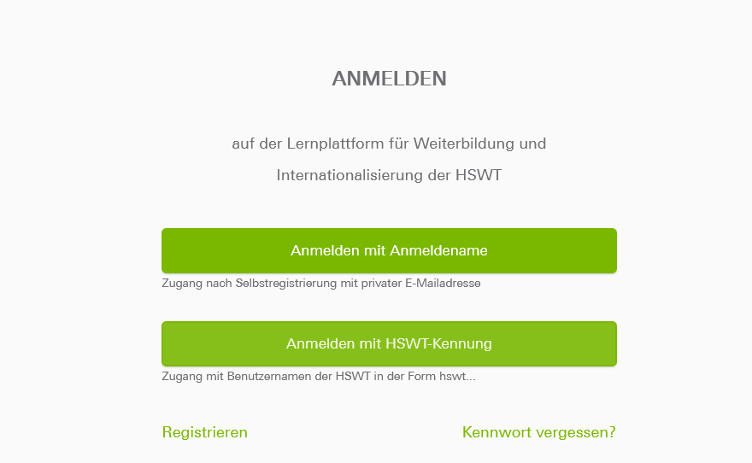
How to navigate through the platform
If you are already registered, click here
If you forgot your password, click here
If you are not yet registered, click here
Notes:
https://wbmoodle.hswt.de/course/view.php?id=3451

Slide 10
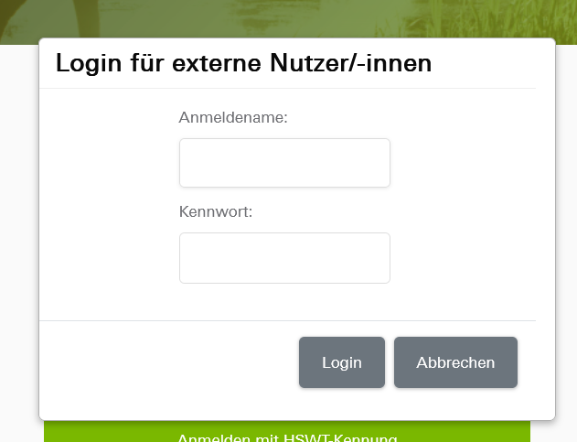
How to navigate through the platform
1. Enter your user
name here
(the one with only
small letters without
an empty space)
2. Enter your
password here
3. Then click here
Notes:
https://wbmoodle.hswt.de/course/view.php?id=3451

Slide 11
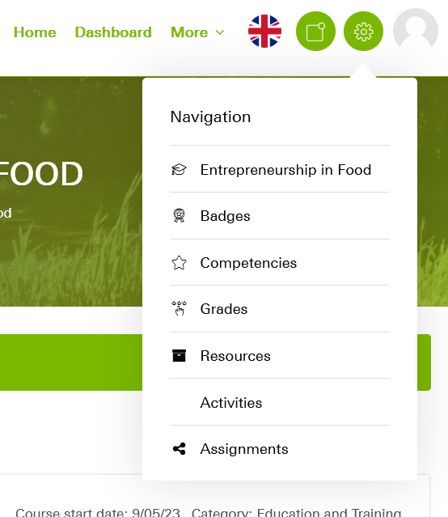

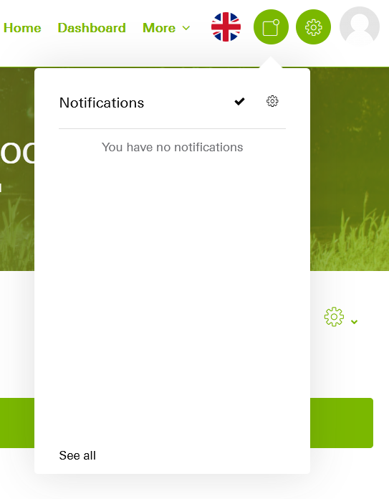
How to navigate through the platform
Change your language settings to English here
Notes:
https://wbmoodle.hswt.de/course/view.php?id=3451

Slide 12
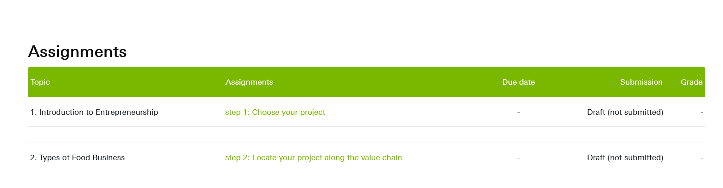
How to navigate through the platform
If you click here,
you can see all your due assignments and their status
Notes:
https://wbmoodle.hswt.de/course/view.php?id=3451

Slide 13
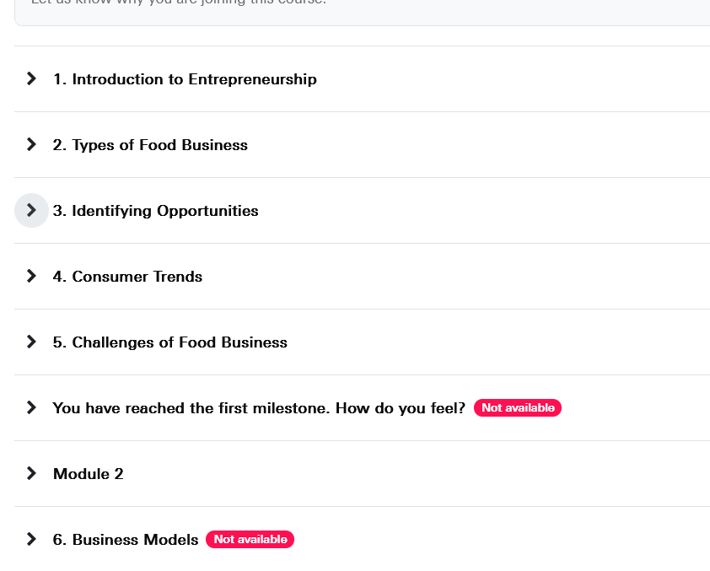
How to navigate through a lesson
Click on the arrow to open a lesson
Milestone 1 and Module 2 are still locked
Notes:
https://wbmoodle.hswt.de/course/view.php?id=3451

Slide 14
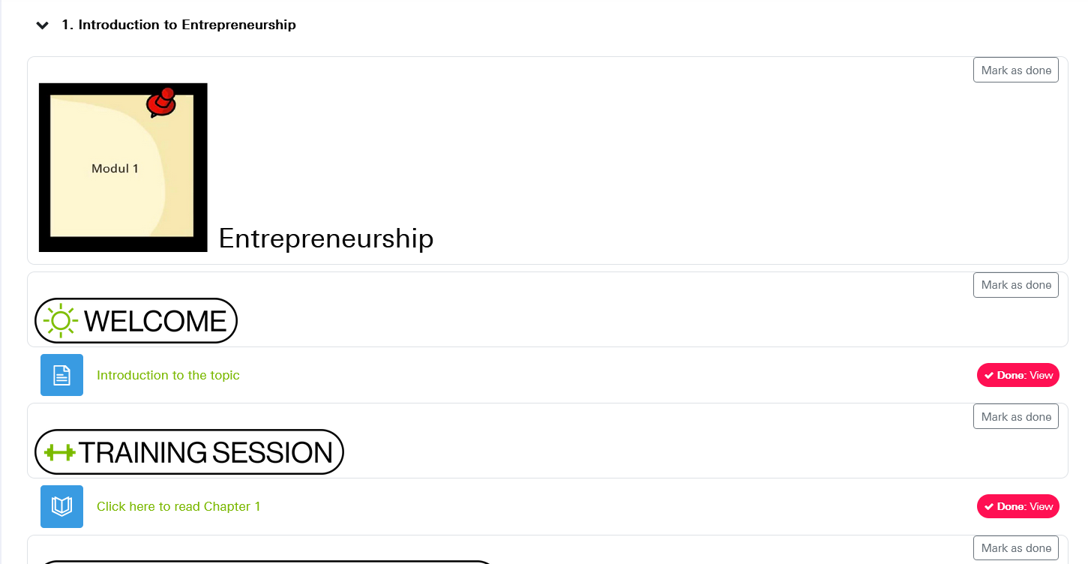
How to navigate through a lesson
Non-mandatory sections
you can mark as ‚done‘
to keep track of what
you have done already
Mandatory activities are marked in read
Click on the headlines to open a section
Notes:
https://wbmoodle.hswt.de/course/view.php?id=3451

Slide 15
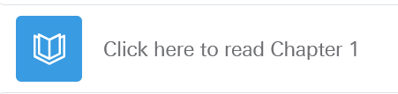
How to navigate through a lesson
Notes:
https://wbmoodle.hswt.de/course/view.php?id=3451

Slide 16
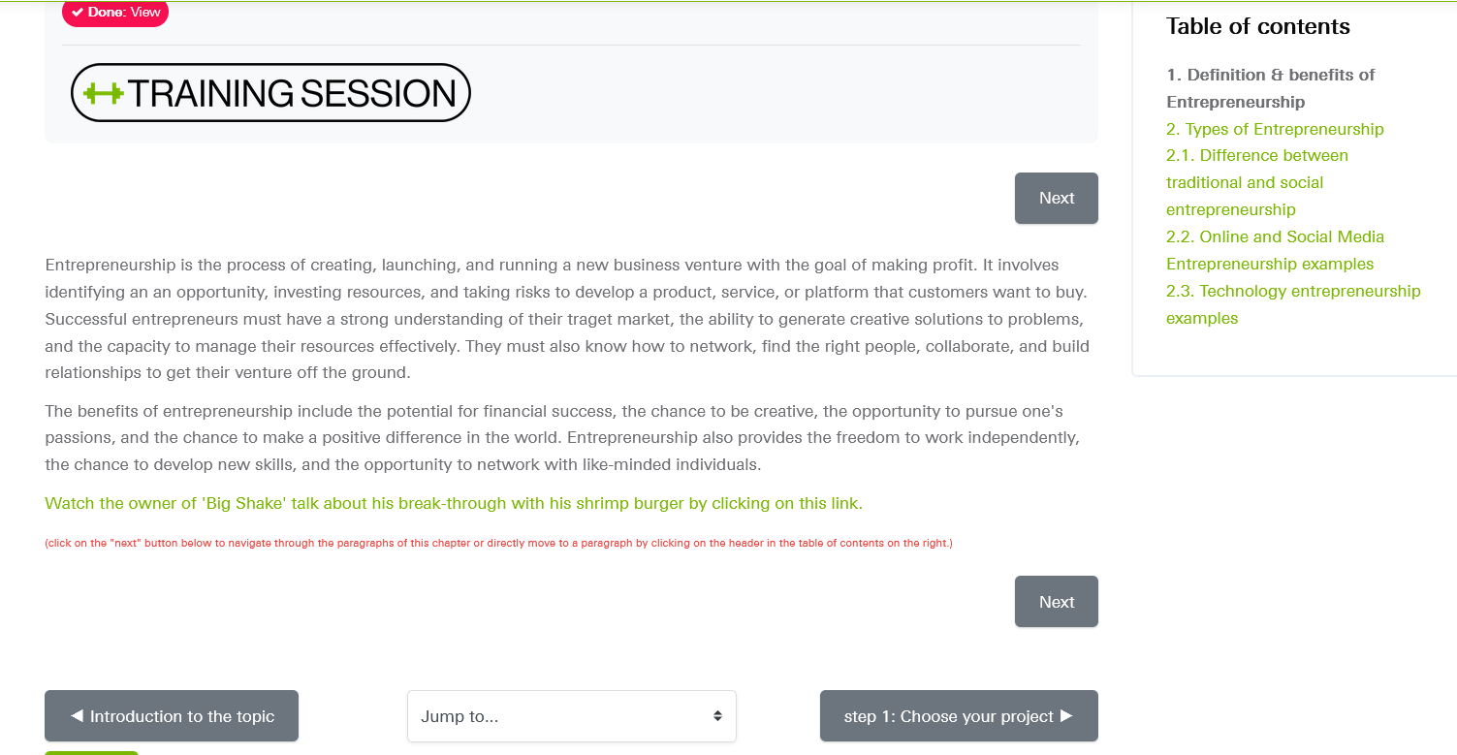
How to navigate through a lesson
Here you see where you are
Here you can see your status for this section
Here you have an overview over the next chapters.
You can also directly select a chapter from here.
By using this button you can navigate backwards to the previous section
This is the chapter you are reading
By clicking on this button you navigate to the next section of the lesson
By clicking on the ‚next‘ button you move to the next chapter
Notes:
https://wbmoodle.hswt.de/course/view.php?id=3451

Slide 17
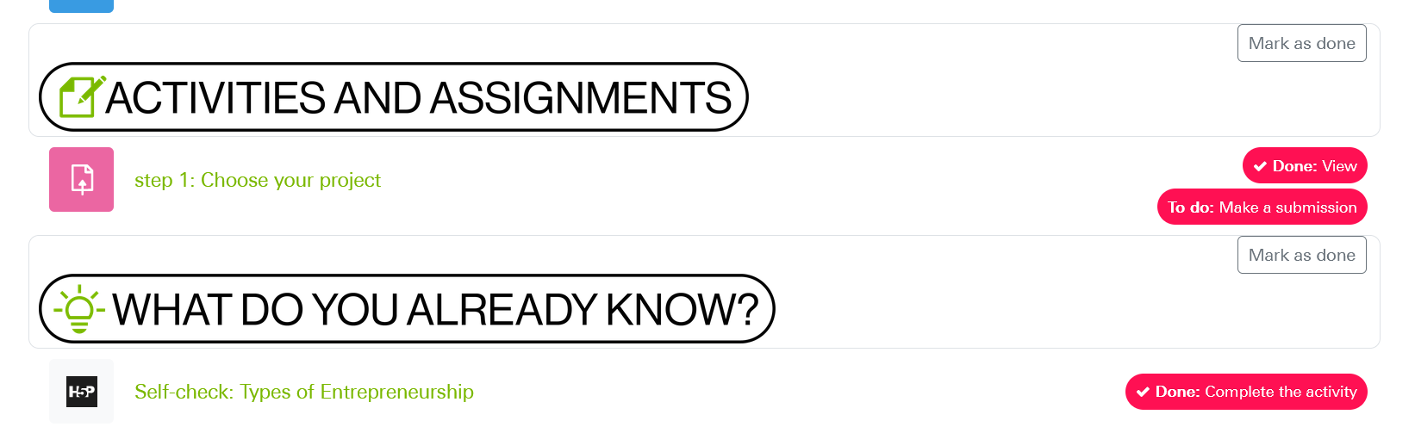

Assignments
Here you see what is required
Click on the headline to open the activity
Notes:
https://wbmoodle.hswt.de/mod/choice/view.php?id=166125

Slide 18
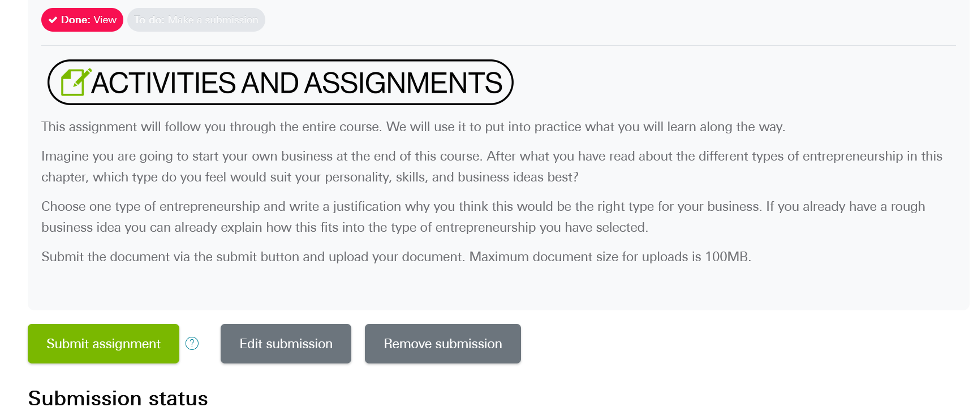
Assignments
Click on the
Notes:
https://wbmoodle.hswt.de/mod/choice/view.php?id=166125

Slide 19
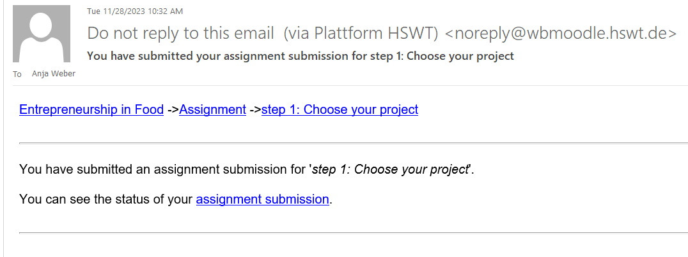
Assignments
You will receive a confirmation email after submitting your work
Notes:
https://wbmoodle.hswt.de/mod/choice/view.php?id=166125

Slide 20
Assignments
Here you see what is required
Click on the headline to open the activity
Notes:
https://wbmoodle.hswt.de/mod/choice/view.php?id=166125

Slide 21

Quick Knowledge Checks
Notes:
https://wbmoodle.hswt.de/mod/hvp/view.php?id=164710

Slide 22
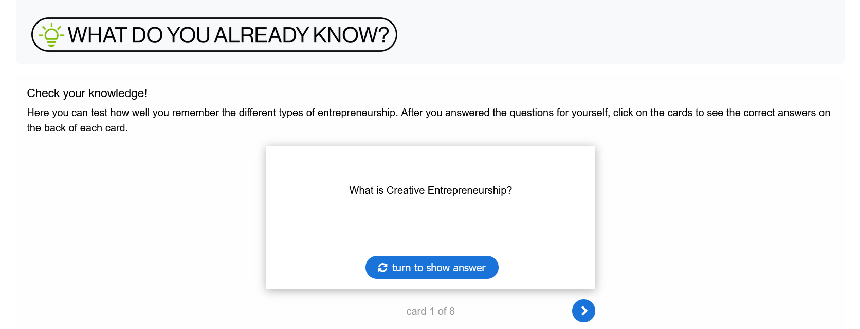
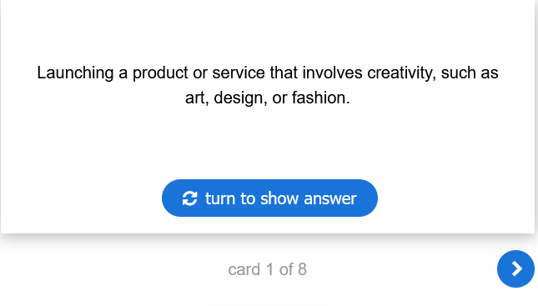
Quick Knowledge Checks
Notes:
https://wbmoodle.hswt.de/mod/hvp/view.php?id=164710

Slide 23
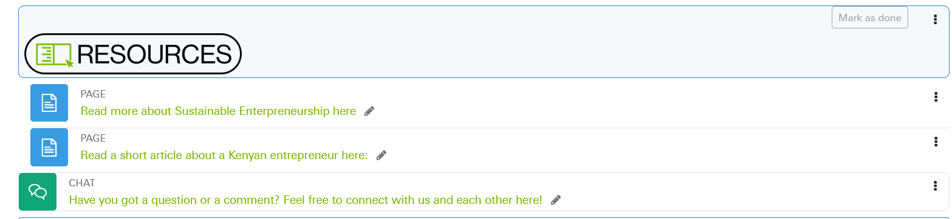
Resources
Click on the headlines to open the resources. Some will download to your device.
Resources are not mandatory.
However, they are a great source of further information!
Here you can connect with us or with each other, place questions, comments or discussion topics!
Notes:
https://wbmoodle.hswt.de/mod/hvp/view.php?id=164710

Slide 24
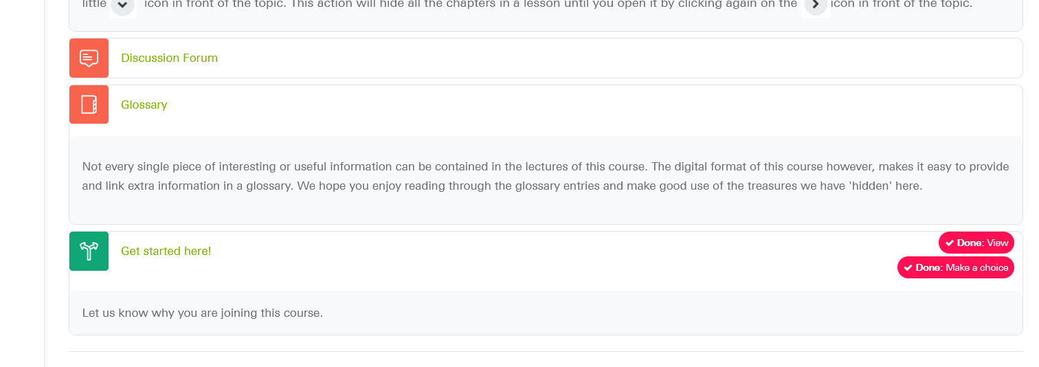
Special features
https://wbmoodle.hswt.de/mod/choice/view.php?id=166125
Get started here!
Notes:
https://wbmoodle.hswt.de/mod/choice/view.php?id=166125

Slide 25
What do you think?
https://wbmoodle.hswt.de/mod/forum/post.php?reply=56447#mformforum
Please click on the link to write a sentence about:
1. what you feel is important for your generation &
2. what kind of business ideas or formats can be successful in this day and age.
You can collect points through your participation in this forum.
Each new topic started by you and each answer to a topic that was started by someone else will give you 5 points.
You should aim to get 50 points minimum in this forum. It will remain open throughout the entire course.
Notes:
https://wbmoodle.hswt.de/mod/forum/post.php?reply=56447#mformforum

Slide 26
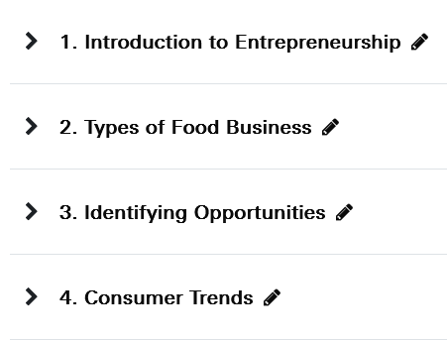
Next online meeting:
Tuesday, 12th November

Slide 27
Do you have any questions?

Slide 28
Thank you for your interest.
We enjoy working with you.
Anja Weber, Yitna Tesfaye, Tirusew Teshale, Girma Moges

