Slide 1

Facilitator & Mentor Handbook
2026

Slide 2
Table of Contents
1
Welcome & Program Foundations | 3 - 7
Introduction to Online Tools | 8 - 18
Course Structure & Session Outline | 19 - 39
Adult Learning & Facilitation Basics | 40 - 49
Communication Essentials | 50 - 56
Learner Engagement & Retention | 57 - 66
2
3
4
5
6

Slide 3

1
Welcome
&
Program Foundations

Slide 4








E-INTERNSHIP
The AgriMocks E-internship is an ERASMUS virtual exchange program, co-funded bei the European Union and coordinated by the University of Applied Sciences Hochschule Weihenstephan-Triesdorf (HSWT), Germany, in collaboration with BizMetrics, South Africa, Entrepreneurship Development Institute (EDI), Ethiopia, Häme University of Applied Sciences (HAMK), Finland, Hawassa University, Ethiopia, Kumasi Institute of Tropical Agriculture (KITA), Ghana, NICOSA, South Africa, University of the Freestate (UFS), South Africa, Université Gaston Berger (UGB), Senegal, and the Western Balkan Institute (WEBIN), Serbia.
Until the first quarter of 2028 it will serve 2500 young adults as an opportunity for international exchange and collaborative learning in an virtual company internship and mentorship setting.
The purpose of this handbook is to provide associated facilitators and mentors, who come on board the AgriMocks program as volunteers and network partners (FOPs) with a guideline to the program and resource materials.
I would like to thank the following organizations and associated individuals for their contributions:

Slide 5
AGRI MOCKS Mission & Vison Statements
Mission Statement
To empower and equip unemployed and under-employed youths with skills in agriculture, climate-smart rural development, and entrepreneurship through innovative online training, intercultural exchange, and community engagement. We foster personal growth, civic participation, and career readiness by offering digital tools, mentoring, e-internships, and collaborative learning experiences grounded in values of trust, respect, and co-creation.
Vision Statement
A world where young people—regardless of background—are empowered with the skills, mindset, and opportunities to lead sustainable rural development, embrace intercultural collaboration, and contribute meaningfully to their communities and the global economy.

Slide 6
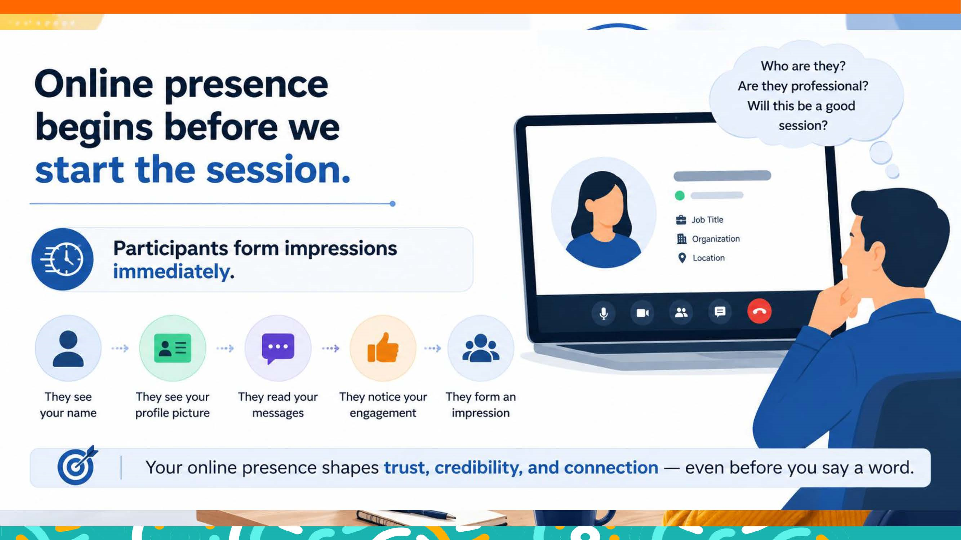
Welcome
As a mentor in this program, you play a crucial role in helping young adults navigate a transformative 6‑week learning journey. You are not a teacher, supervisor, or evaluator. You are a coach, a guide, a role model, and a supportive partner in their growth. You are the human anchor in a complex, multi‑layered learning experience.
Your purpose is to help participants:
Build confidence and self‑awareness
Develop teamwork and communication skills
Navigate intercultural collaboration
Engage with the entrepreneur’s challenge
Apply online learning content to real project work
Develop a pitch deck step‑by‑step
Stay motivated, organized, and on track

Slide 7
Understanding the Program Structure
The internship has three interconnected tiers:
Self‑Paced Online Learning
Entrepreneur Sessions (Team‑Based Problem Solving)
Weekly Mentoring Sessions (90 minutes)
Participants complete modules on:
Career guidance
Innovation & entrepreneurship
Business modeling
Project development
Civic engagement & advocacy
Your role:
Help teams understand the challenge
Surface open questions
Support productive teamwork
Facilitate reflection after each session
Your role:
Coach individuals and teams
Facilitate discussion
Support teamwork
Guide pitch deck development
Monitor progress
Prevent drop‑out

Slide 8
2
Introduction
to
Online Tools

Slide 9
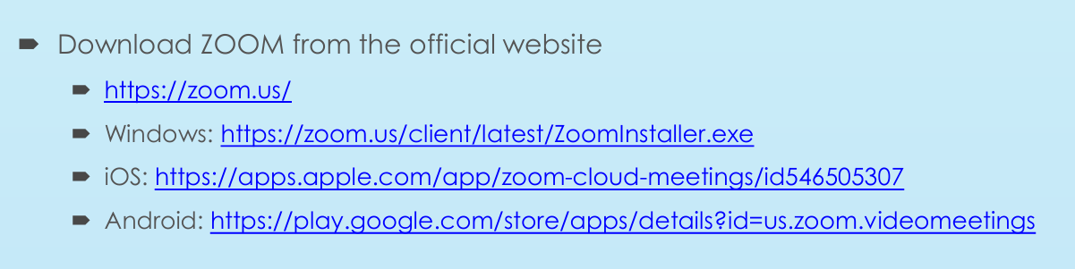
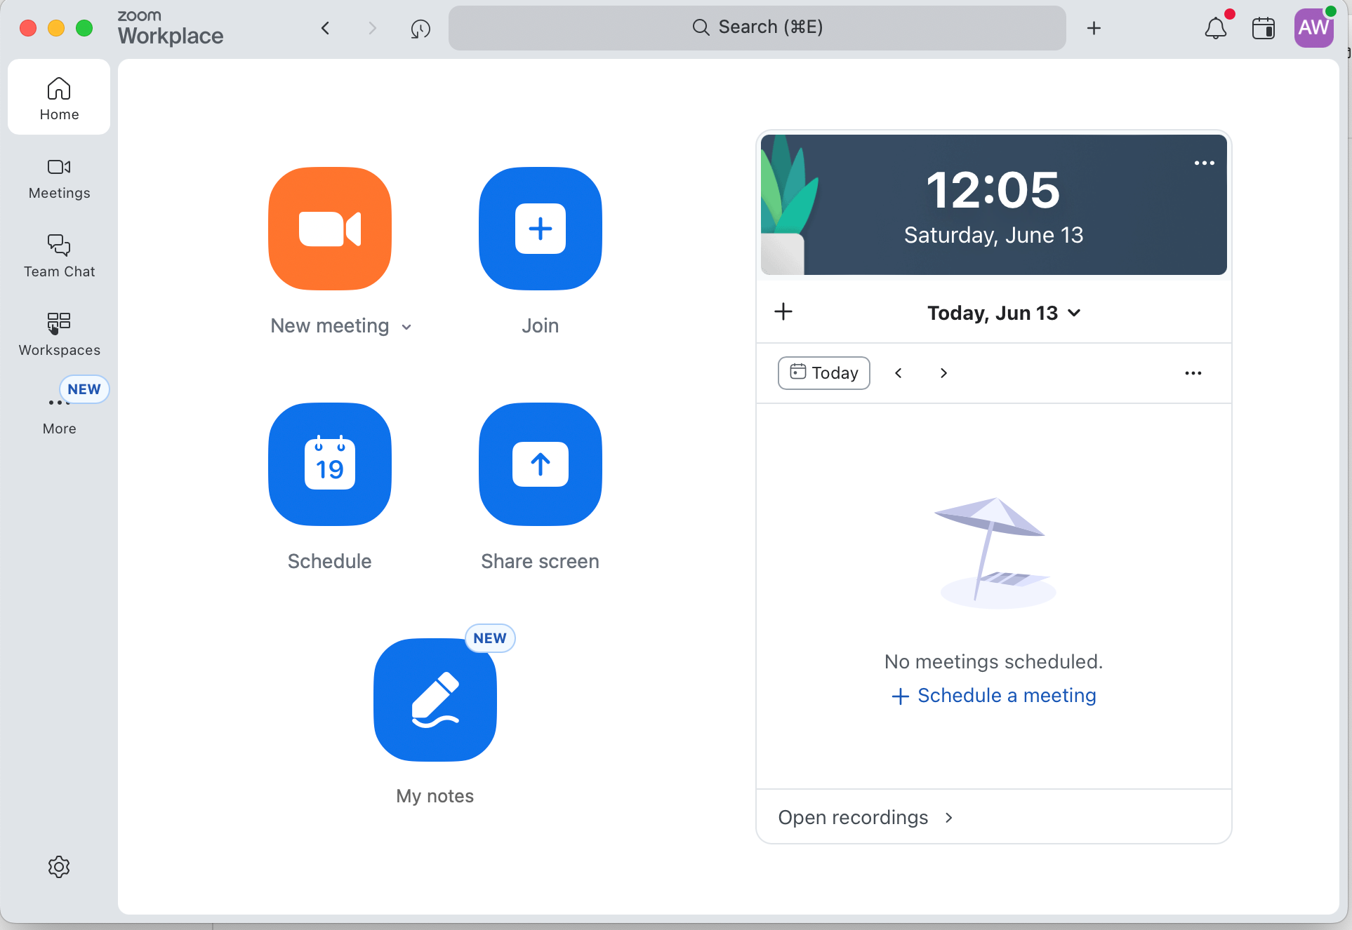
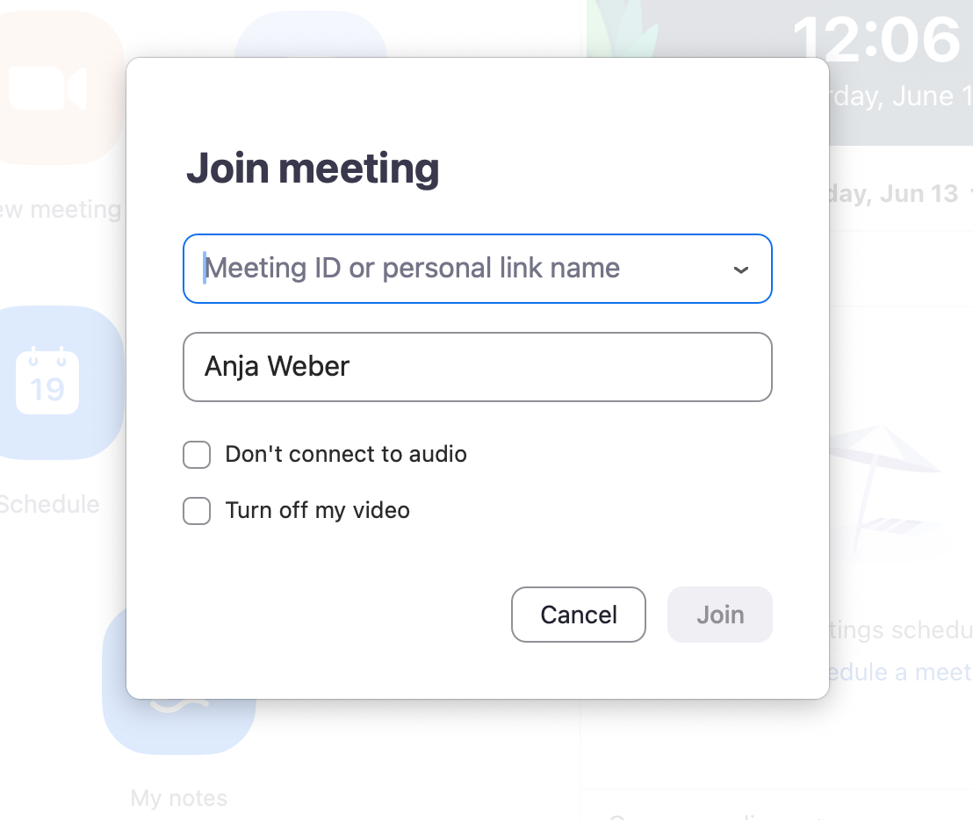
Introduction to ZOOM Tools
If you haven’t done so yet, we advise you do download the ZOOM app to create a ZOOM workspace on your desktop. This will help you integrate zoom meetings into your calendar, join meetings and create whiteboards, polls, etc. before a meeting.
In your ZOOM worksplace you can
join meetings
see schedules meetings
review & create polls/quizzes
find & create whiteboards
Once you click on join meeting, enter the meeting ID in the mask as well as your name.

Slide 10
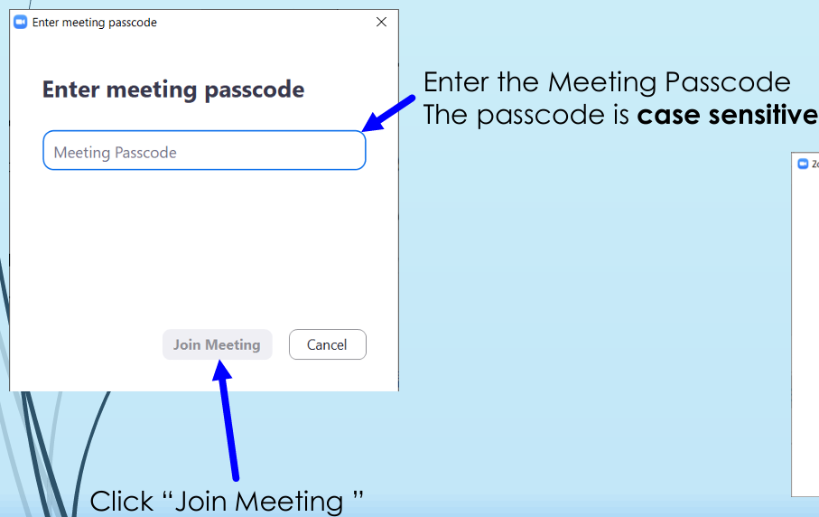
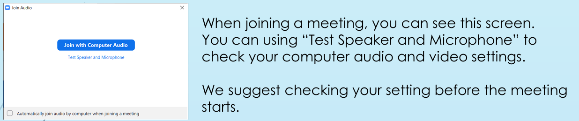

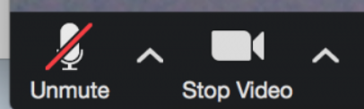
All AgriMocks online meetings will be scheduled and hosted by HSWT. You do not need to schedule your own meetings.
The AgriMocks Meeting ID is always: 427 825 0055
The passcode is always: 1iYYWj
In the bottom left corner on the tool-bar, you can find the buttons for audio and video settings. If the icon is crossed with a red line, you are muted, or your camera is switched off, respectively. You can unmute yourself (or switch your camera on) by clicking on these icons. You can also quickly unmute yourself by pressing on the space bar on your keyboard. As long as you keep it pressed, you will be unmuted. Once you release the space bar, you will automatically be muted again.
With Alt + M you can quickly mute all participants (except for the host), in case a participant has unmuted themselves and has a noisy background.
Always join your scheduled meeting a few minutes before the start to ensure your audio and video settings are correct and everything is working fine before you are being joined by participants.

Slide 11
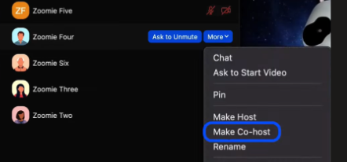

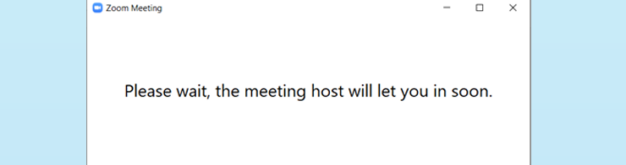
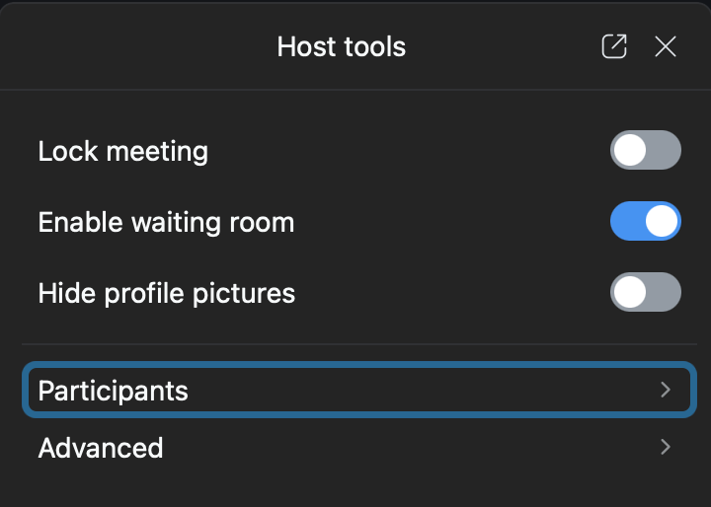
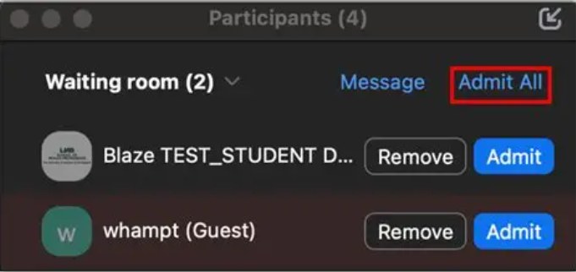

Click on the Participants button in the tool-bar at the bottom of your sreen to open the list of participants in the meeting. Select the participant you want to make co-host or host of the meeting. A co-host has the same tools and rights available as the host. They can start, record, and end the meeting, admit participants from the waiting room, and select participants’ settings.
Participants will be kept in a waiting room if the join before the start of the meeting. They need to be admitted manually Once the meeting starts, the host or co-host should close the waiting room so that all late-comers can entzer the meeting directly and do not need to be admitted manually.
Clicking on th Host-Tools button in the tool- bar at the bottom
will open a window on the right side of the screen, where the enable waiting room option can be switched off.

Slide 12
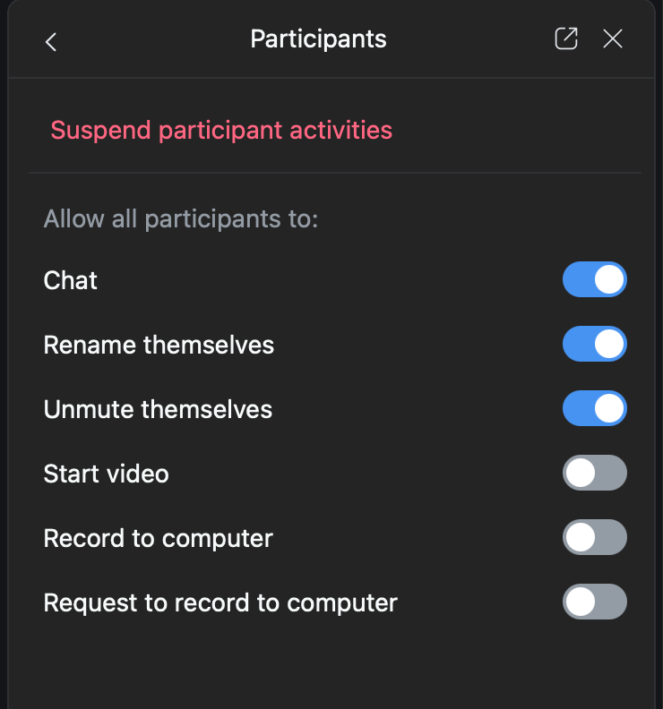
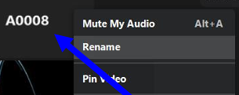
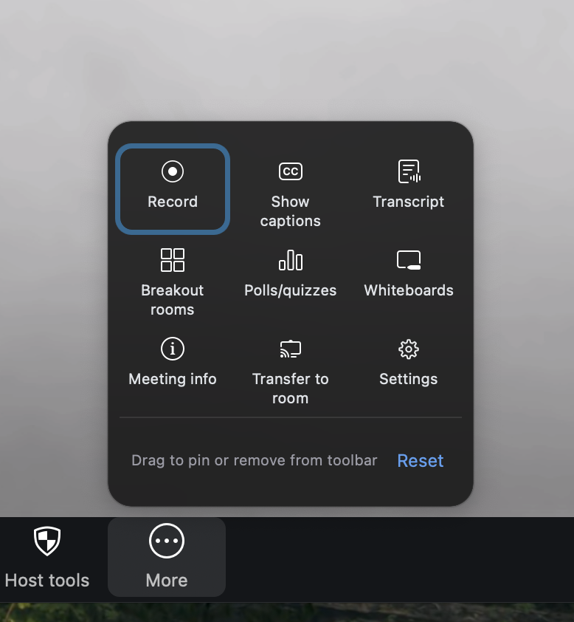
Participants’ settings can be accessed either through the hHost-Tools icon in the tool-bar at the bottom of the screen, and then clicking on Participants, or by clicking on the small arrowhead next to the Paticipants icon in the tool-bar, and then on Host-Tools for participants. Either way a window will open on the right side of the screen, where the settings should look as follows:
If a participant forgot to set their name before the start of the meeting, their name might show up as the type of device they are using to join the meeting. To be able to communicate effectively, it is important to be able to address everyone yby name. Therefore, ask everyone to rename their zoom account. Participants can rename themselves by clicking on the name displayed underneath their “tile” and then on rename.
As a host or co-host you also have a larger number of options that open under the more icon on the right in the tool-bar.
Always remember to record all meetings. With Alt + P you can pause the recording (e.g. during a short break) and also restart the recording again.
Under settings you can change or blurr your background and touch up your appearance.

Slide 13
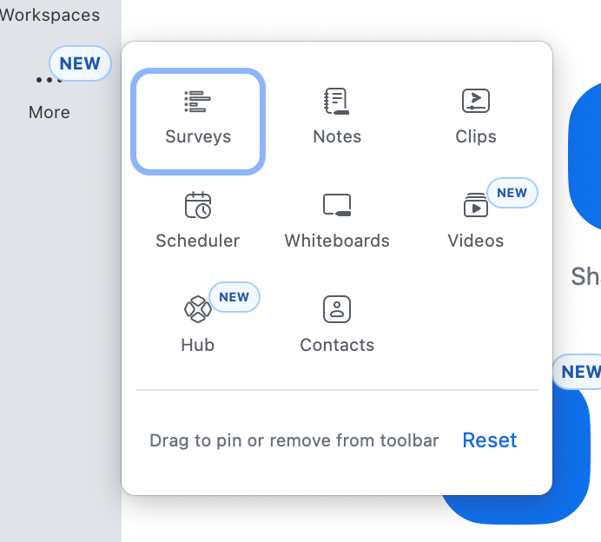
You can create new whiteboards and surveys in your zoom workplace by clicking on the more… option in the tool-bar on the right hand side of your zoom workplace. Once theya are created and saved, you can always access them again later, during a meeting.
Opening polls and whiteboards can also be done by clicking on the more icon in the tool-bar , and then on either
Polls/quizzes
or
Whiteboards
You can then choose in a next step
if you want to create a new poll/quiz
Or whiteboard, or if you want to use an
Existing one, that you created in advance.
In the same section you also find the option to create breakout rooms for smaller group work or group discussions.
If you are not fmiliar with how to set up breakout rooms please watch this video https://youtu.be/UwwZtQYWwQ0

Slide 14
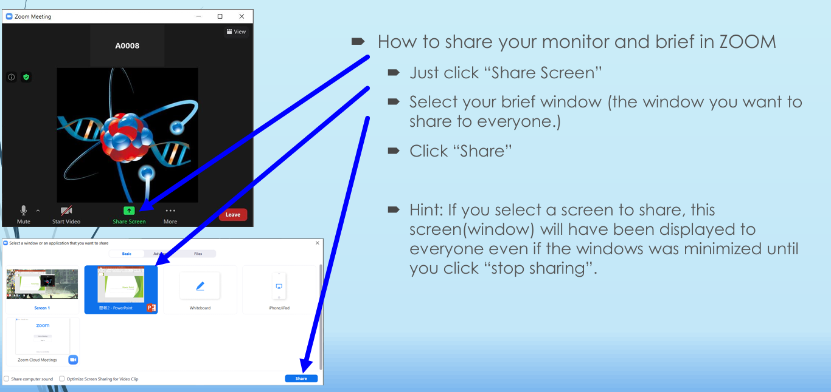

Slide 15
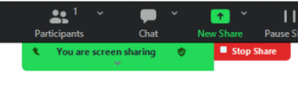

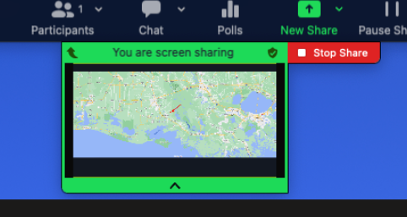
Once you are sharing your screen, the gren sharing bar will appear. Clicking on the little upward arrow on the left will pin this bar to the top of your screen so that it doesn’t obstract your view . If however you want to pin it to the bottom of your screen (e.g. if you need to see the presentation button in powerpoint), you can again click on the now visible little downward arrow on the left.
If you hover your cursor over the green screen sharing bar, a little arrowhead will appear in the center. Clicking on this arrowhead will open a small window that shows the view, which your participants are seeing. You can use this to check if your screen is sharing correctly and if the participants are seeing your screen. This is especially useful when starting to share or changing the shared screen. Clicking on it again, will close the view.
To stop sharing a screen, click on the red Stop Share button.

Slide 16
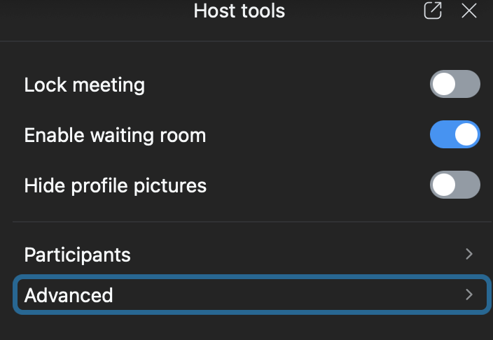
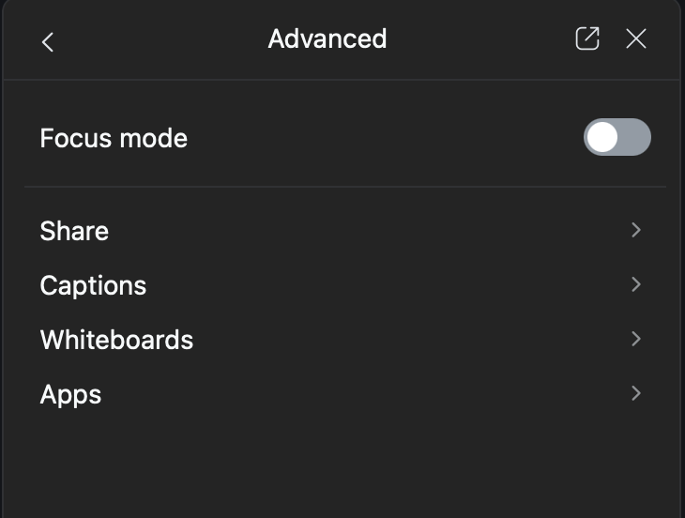
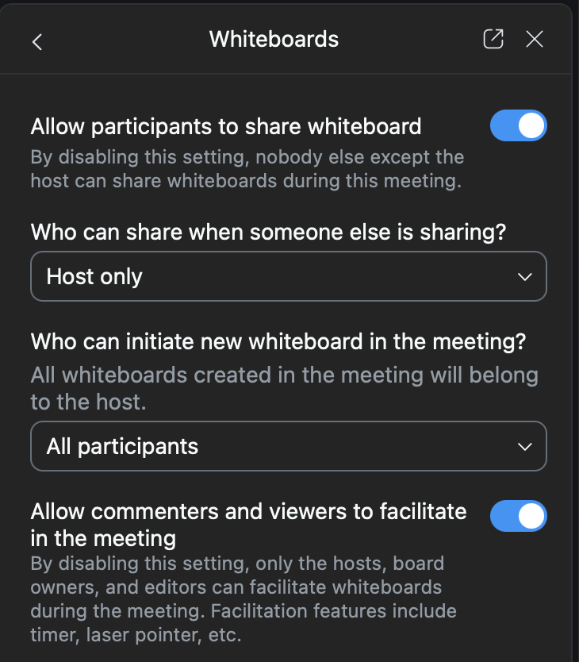
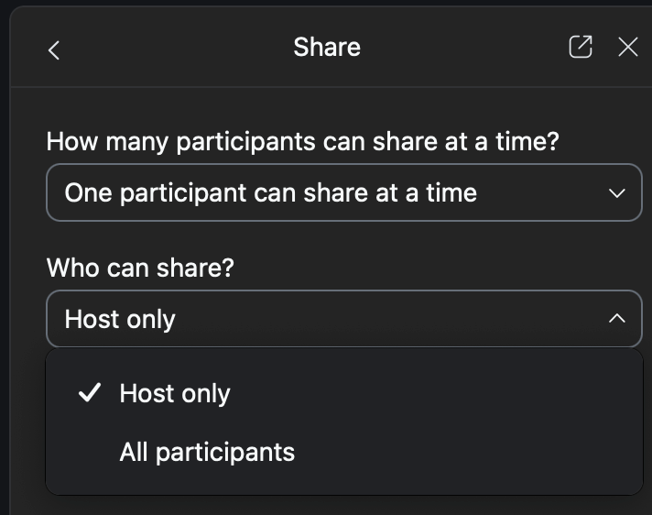
If you want to enable other participants to share their screen in the meeting or to use whiteboards either in the meeting or in breakout rooms, make sure to adjust the settings under Host-Tools, Advanced accordingly.
This is one of the reasons why you should always enter the meeting room a few minutes before the meeting t ensure all settings are correct, all needed whiteboards are accessible, etc.

Slide 17
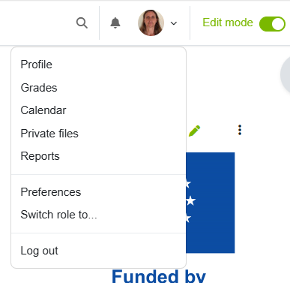
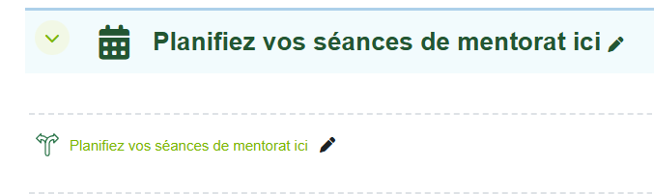
Scheduling a session on Moodle
The AgriMocks Moodle platforms (English and French) offer a scheduling tool, where Facilitators, Entrepreneurs and Mentors can schedule sessions they are offering. Participants can then select the sessions they would like to attend and book a space.
Course: AgriMocks-MOOC_2026 | Plattform HSWT
Tile: Planifiez vos séances de mentorat ici | AgriMOCKS French | Plattform HSWT
Go to the Engish or French moodle paltform (links above) and open the schedule tool.
Make sure your role is set to Lecturer and you have switched Edit mode on.
These options can be found in the top right corer of your screen, next to your profile picture.)

Slide 18
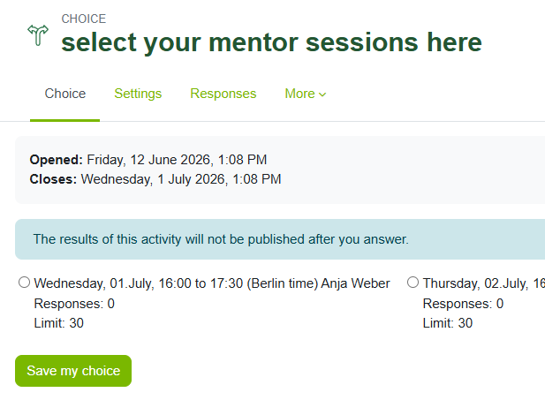
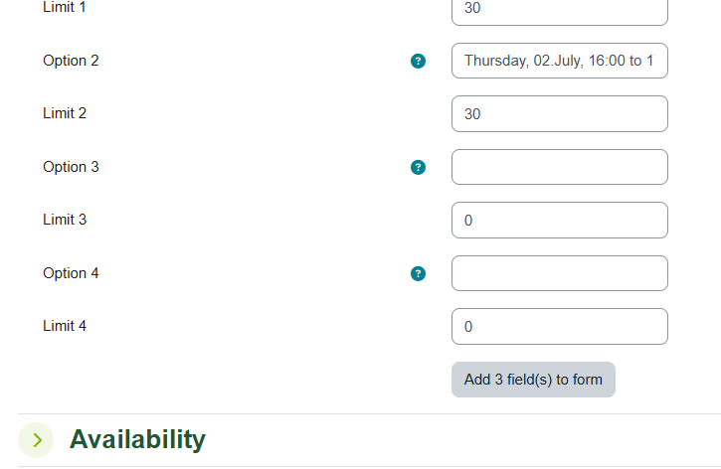
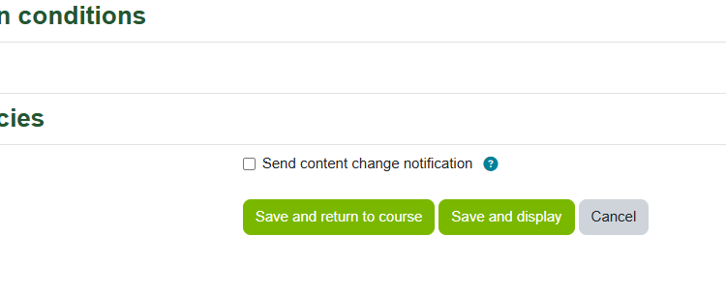
If no empty Option fields are available, you can add more lines by clicking on the “Add 3 field(s) to form” button.
Once the Choice tool opens in a new window, click on the Settings Tab in thr bar above to open the entry mask. Scroll down until you find n empty Option and enter your session details in the following format:
Weekday, date, time (from to), time yone, your name (and possibly if the session is held in English or French, if posting in the opposite language moodle).
In the Limit line below your entry, enter the number of participants who can join that session. Scroll down again and click on one of the green Save buttons.

Slide 19
3
Course Structure
&
Session Outline

Slide 20
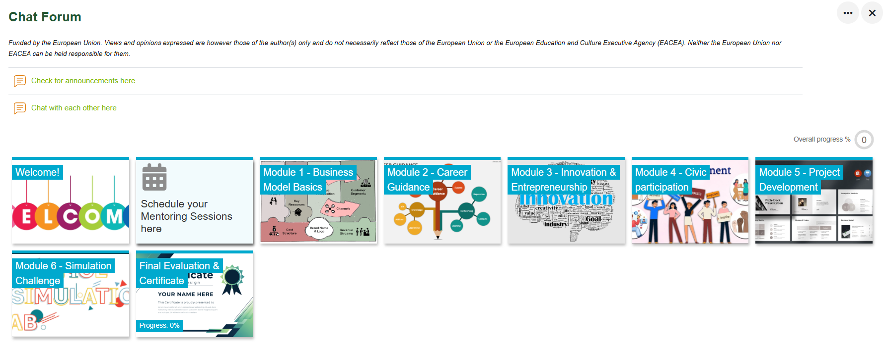
The MOOC platform
Course: AgriMocks-MOOC_2026 | Plattform HSWT

Slide 21
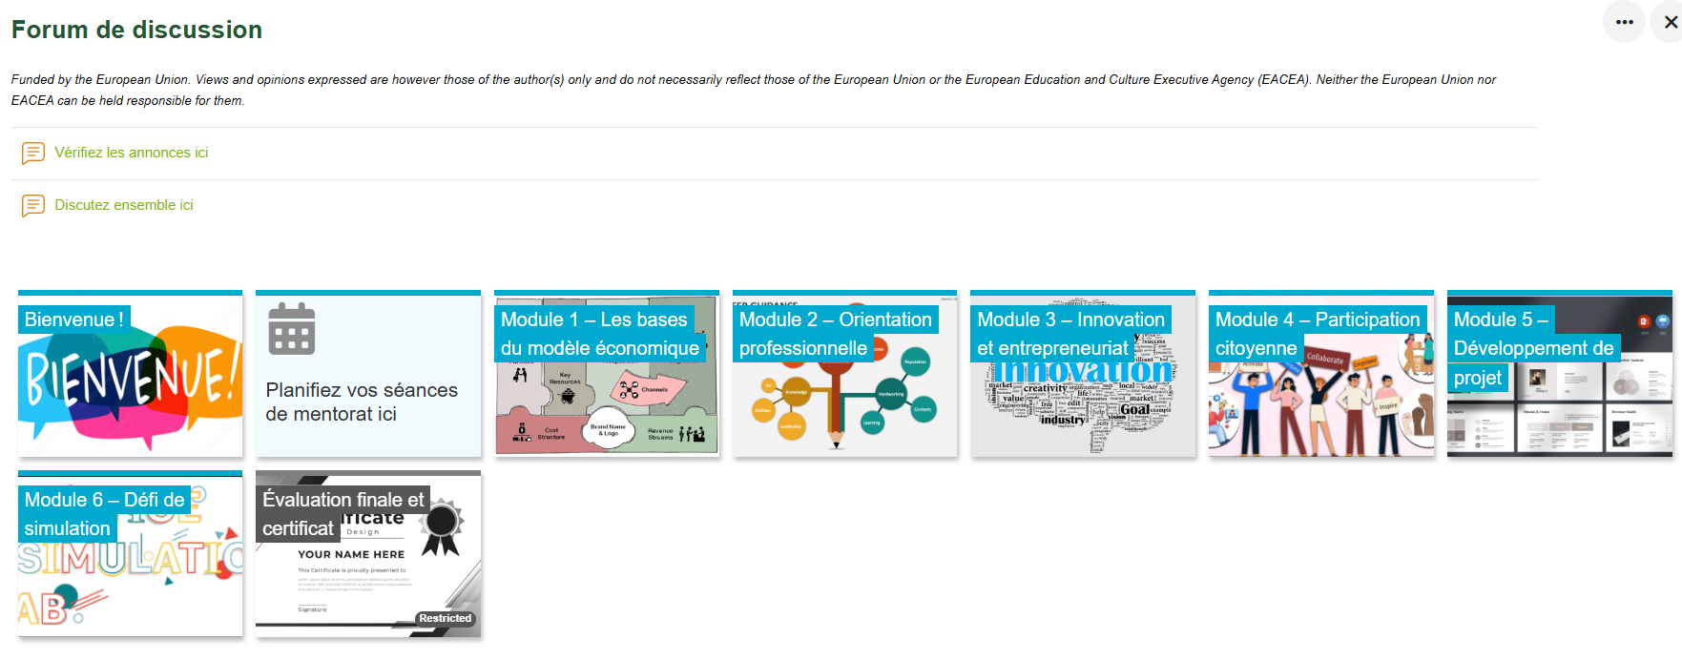
MOOC stands for Massive Open Online Course, and provides a platform where learners can access learning materials any time and at their own convenience and pace.
The AgriMocks MOOC is hosted on the HSWT wbmoodle platform and is available in English and French.
Course: AgriMOCKS French | Plattform HSWT

Slide 22
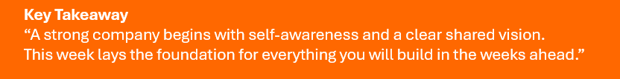
Week 1 - 2
Learning Objectives
Foundations: Building Your Virtual Company
By the end of Week 1, participants should be able to:
Navigate the virtual co-working space and online communication tools effectively.
Reflect on their strengths, values, and intercultural teamwork style.
Collaborate with peers to form a virtual company, define roles, and understand how teams function.
Explain the basic components of a business model (using the Business Model Canvas).

Slide 23
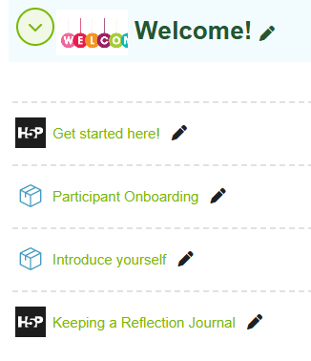
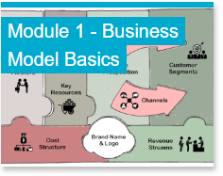
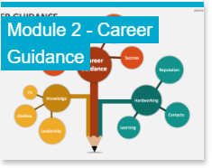
The MOOC platform – week 1 & 2
Entrepreneur-led Sessions – week 1 & 2:
Collaborate with peers to form a virtual company, define roles, and understand how teams function
Get to know the entrepreneur and his/her story
Get to know the entrepreneur’s business model
Identify which kind of jobs/roles are needed in the company
Present Job Applications & receive feedback
Conduct Mock Job Interviews
Identify a problem the team would like to address during the course

Slide 24
Self-Awareness & Intercultural Teamwork
Session Duration: 90 minutes
Purpose: To help participants discover their personal strengths, working styles, and how to collaborate across cultures.
Session Outline:
Welcome & Icebreaker (10 min) to build rapport (e.g. “One Truth and one Lie/one Dream”)
Group Activity (30 min) Refer to Treasure hunt activity, then, in breakout groups, share one personal strength and how it might contribute to a team project.
Mini-Lecture (10 min) (e.g. on Self-awareness, how to write a self introduction for a CV or application letter.)
Link to company play (30 min): “Which roles in a company would suit you best or interest you most?” Participants do an online personality test. (30 min)
Debrief or Reflection & Q&A (10 min)
Materials: Slides, links to reflection tool, personality quiz, online personality test
Week 1 & 2 - Mentor-lead Session

Slide 25
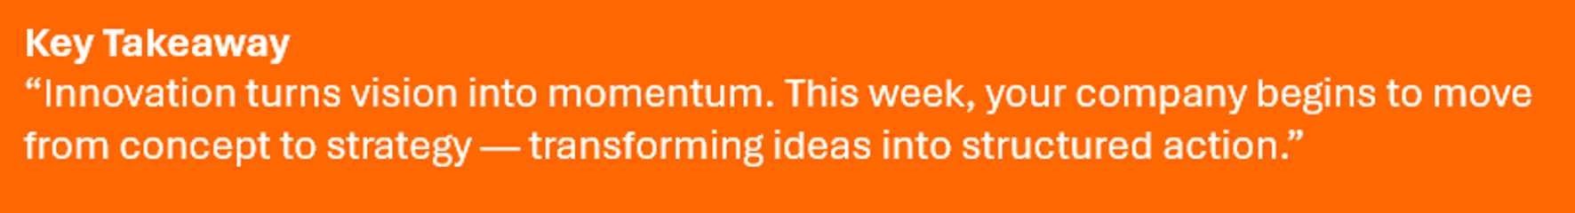
Week 3
Learning Objectives
Business & Innovation: Turning Ideas into Strategy
By the end of Week 2, participants should be able to:
Explain how entrepreneurship contributes to community and rural development.
Identify types of innovation (product, process, social, and environmental).
Translate learning into a first strategic plan for their virtual company.
Strengthen collaboration and creative problem-solving skills within a team.

Slide 26
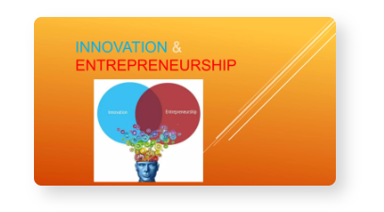
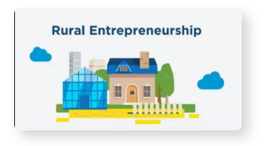
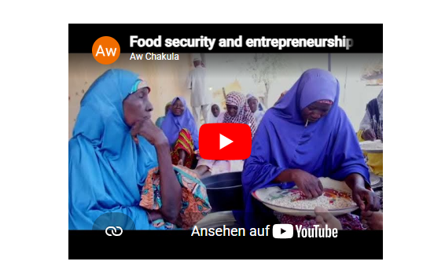
The MOOC platform – week 3:
Explain how entrepreneurship contributes to community and rural development.
Identify types of innovation (product, process, social, and environmental).
Entrepreneur-led Sessions - week 3:
Translate learning into a first strategic plan for their virtual company.
Discuss a collaborative brainstorming segment where participants ask:
What issue connected to the business could be amplified
What change the entrepreneur would like to see
What audiences matter most
What small, realistic advocacy actions could be taken
Participants are expected to deepen their understanding of how innovative business models drive inclusiove development, and apply that knowledge to shape their first strategic plan.

Slide 27
Innovation & Global Teamwork
Session Duration: 90 minutes
Purpose: To explore creative thinking tools and practice teamwork in developing an innovation mindset
Session Outline:
Welcome & Icebreaker (10 min) (e.g. “Innovation sparks” game: each participant names one everyday object or situation that needs improvement.)
Mini-Input (10 min) (e.g. a) The Innovation Cycle: Inspiration → Ideation → Implementation → Feedback → Improvement; or b) SDGs, sustainability and innovation)
Group Activity (30 min) In breakout rooms brainstorm one innovative feature that could improve the entrepreneur’s company. Roughly map the company and improvements on a Canvas.
Debrief (15 min) Share top ideas
Integration Task (20 min) Begin drafting your company’s First Strategic Plan outlining key goals and innovative elements.
Q&A and closing remarks
Materials: Slides, innovation cycle video or SDGs picture, BMC template on padlet or whiteboard
Week 3 - Mentor-lead Session

Slide 28
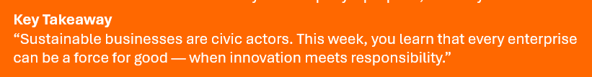
Week 4
Learning Objectives
Civic Participation: Business for Impact
By the end of Week 3, participants should be able to:
Explain how civic participation, advocacy, and campaigning can influence social and environmental change.
Identify ways an entrepreneur‑led company can engage responsibly in advocacy and public issues.
Analyze a relevant issue and define clear advocacy objectives and tactics for addressing it.
Collaborate with teammates to create a mini advocacy plan and reflect on their role as civic leaders.

Slide 29
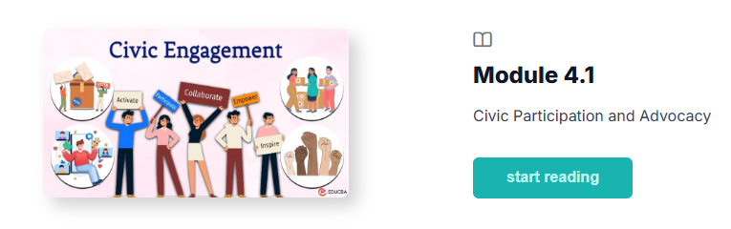
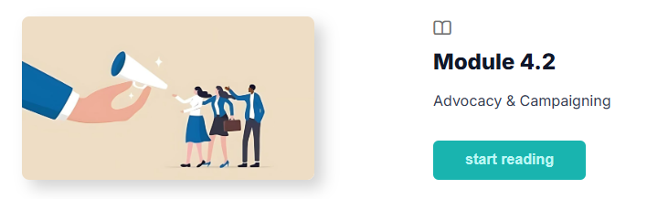
The MOOC platform - week 4:
Explain how civic participation, advocacy, and campaigning can influence social and environmental change.
Entrepreneur-led Sessions – week 4:
Identify ways an entrepreneur‑led company can engage responsibly in advocacy and public issues
Explore the broader issue landscape connected to the entrepreneur’s business
Map key stakeholders who shape or are affected by this issue
Discuss which groups (consumers, communities, policymakers, NGOs, industry bodies) matter most and how each one influences the issue.
Define the change the entrepreneur would like to see

Slide 30
Civic Participation & Leadership
Session Duration: 90 minutes
Purpose: To inspire participants to think of themselves as active changemakers and to understand leadership through civic action.
Session Outline:
Welcome & Kick-off (10 min) Quick poll: “What’s one social or environmental issue you care about?”
Mini-Input (15 min) Youtube video or case study (e.g. “Civic participation in the digital age”; “How young people influence change”; “Examples of youth-led advocacy initiatives”).
Group Activity (30 min) In breakout rooms select one social issue relevant to them brainstorm possible civic actions
Debrief (20 min) Teams present their idea and give & receive feedback on feasibility, social value, etc.
Reflection (15 min) Participants share on “What kind of leader do I want to be in my company and community?”
Materials: Slides, SDG pictures, links to videos or case studies
Week 4 - Mentor-lead Session

Slide 31

Week 5
Learning Objectives
Project Development: From Ideas to Action
By the end of Week 4, participants should be able to:
Describe the key components and stages of developing a project proposal.
Understand the essentials of writing a clear, compelling project proposals to attract funding.
Apply practical project planning tools to structure both their virtual company’s next steps and their community project idea.
Advance their community impact project by drafting the core elements of a proposal that will later feed into their pitch deck.

Slide 32
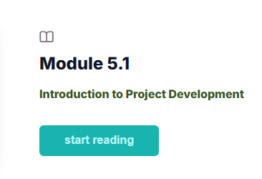
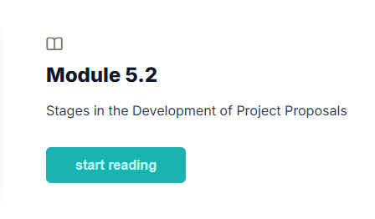
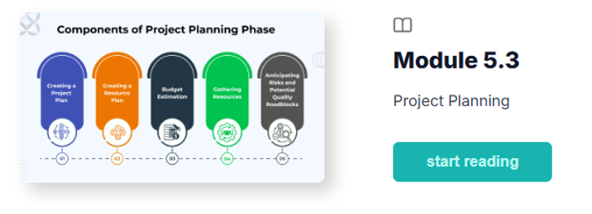
The MOOC platform – week 5:
1. Describe the key components and stages of developing a project proposal.
2. Understand the essentials of writing a clear, compelling project proposals to attract funding
3. Apply practical project planning tools to structure both their virtual company’s next steps and their
community project idea.
Entrepreneur-led or Teamworking sessions - week 5:
Identify ways an entrepreneur‑led company can engage responsibly in advocacy and public issues.
Participants continue working on the issues from week 3
Discuss suggestions, ideas and approaches and receive feedback
Learn how to design and fund impactful projects, while applying these principles to both – the virtual company and their community project idea

Slide 33
Innovation in Practice
Session Duration: 90 minutes
Purpose: To connect project design principles to innovation ideas, while reflecting on how project design abilities strengthen their future career pathways.
Session Outline:
Welcome & Kick-off (10 min) Under the motto: “How project design skills translate into real‑world opportunities — in entrepreneurship, employment, and community leadership”, participants share one insight from the week’s learning materials.
Mini-Input (15 min) Making your ideas visible. Learning to write proposals helps you structure your idea and also means learning to communicate your value and your vision. Examples of youth or early‑career professionals who turned a small project idea into a funded initiative, internship opportunity, or job role.
Group Activity (45 min) present your work on the pitch deck and receive mentor and peer feedback
Reflection (20 min) (e.g. “How can I apply what I learned this week to my future career?”, “How does turning an idea into a structured plan change how I see myself as a leader or innovator?” or “What makes a project realistic and fundable – and how can our team ensure, we are solving the right problem?”)
Materials: Slides, links to videos or case studies
Week 5 - Mentor-lead Session

Slide 34
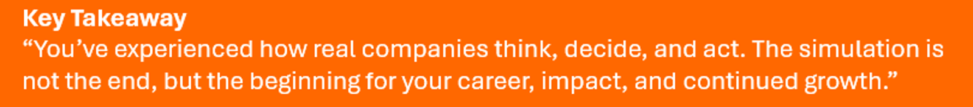
Week 6
Learning Objectives
Integration & Preparation: Ready for the Real World
By the end of Week 5, participants should be able to:
Integrate learning from all modules into a coherent strategy.
Strengthen teamwork, communication, and presentation skills.
Apply business, innovation, and sustainability principles in a simulated company environment.
Demonstrate leadership, collaboration, and problem-solving under real-world pressure.
Finalize outputs in collaboration with mentors.
Reflect on their professional growth and future career goals.

Slide 35
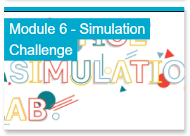

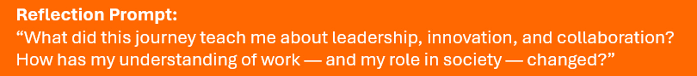
The MOOC platform & Simulation – week 6:
Apply all accumulated knowledge, teamwork, and creativity to solve a simulation challenge — and celebrate the journey through competition and reflection
Purpose: Experience real-time effects of decision-making on company
Day 1 – Briefing & Team Setup
Receive the entrepreneur’s challenge scenario and introductions.
Define priorities and assign simulation roles (CEO, CFO, HR lead, Marketing lead, etc.).
Set initial strategy and company goals.
Day 2 & 3– Decision Sprints & Recap Session
Teams complete multiple timed “business sprints”: making strategic, financial, and operational decisions in response to live updates from the simulation engine. Mentors act as facilitators.
At the end of the simulation Mentors/Facilitators and Participants come together for a final round of feedback and training assessment

Slide 36
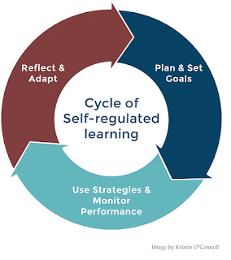
Supporting self-paced learning
Your role is to help mentees:
Understand key concepts
Connect learning to the project
Stay on schedule
Reflect on insights
Ask questions like:
“What did you learn this week that helps your project”
“What concept was confusing”
“How can you apply this idea to your pitch deck”

Slide 37
Weekly pitch-deck development steps:
Week 2
User & Stakeholder Insights
Who are the users
What do they need
What are their pain points
Week 3
Solution Ideation
Week 4
Business Model & Feasibility
Key activities
Key partners
Resources
Risks
Week 5
Week 6
Final Pitch Deck
Finalize slides
Practice pitch
Prepare Q&A
Test & Validation
Present your idea to users
Test assumptions
Gather feedback
Week 1
Problem Understanding
What is the problem
Who experiences it
Why it matters
Identify users Map stakeholders Define needs and pain points
Define the problem Understand context Draft problem statement
Brainstorm solutions
Select one
Draft value proposition
What is the most effective way to solve the problem
How does our solution create clear value for users
What assumptions must be true for this solution to work
How will this solution generate revenue
What are the main costs and resources required
Is the solution feasible and scalable
Which assumptions are most critical to validate
What is the simplest test we can run to learn quickly
What did we learn, and what needs to change
What is the clearest narrative that connects problem → solution → value
How do we demonstrate evidence, traction, or validation
What is our ask (funding, partnership, support) and why it’s justified

Slide 38
Free Mentoring session 90 min outline
0–10 min | Emotional Check‑In: “How are you arriving today” ;“One word for your week”
10–20 min | Review Last Week’s Goals: What worked? What was challenging? What needs follow‑up?
20–40 min | Project & Pitch Deck Progress: Review weekly milestone. Clarify questions. Give feedback. Identify next steps.
40–55 min | Learning Integration: Discuss key concepts from the online platform. Connect theory → project. Encourage reflection.
55–75 min | Teamwork & Entrepreneursession support: Prepare for upcoming entrepreneur session. Clarify roles. Identify open questions. Strengthen communication.
75–85 min | Planning & Accountability: Set goals for next week. Identify risks. Agree on check‑ins.
85–90 min | Closing: One insight and/or One commitment and/or One appreciation.

Slide 39
Mentoring session dialogue outline
Part 1: Building the relationship (not more than 1 minute) Greetings, small talk, happy to see you, how have you been, etc.
Part 2A: Defining the scope (establish the topic for the session) Which topic do you want to talk about today
Part 2B: Define the objective (establish the goal for the session) What would you like to achieve in this session? How would you know you have reached there? How will it feel whan you have reached there?
Part 3A: Analyzing the problem: What about the topic troubles you? Causes you problems? Why? What happens? How do you react?
Part 3B: Solution Finding Process/ “Unearthing” the solution What could be the cause? And what could be the cause behind this? Is it a structural issue? Behavioural? Attitude? Related to someone else, etc.
Part 4A: Identifying the solution If you think about, what you ave just described, where do you feel this is going? Where do you want to go with this? Do you see an opportunity to make changes? What happens if you apply this…?
Part 4B: Commitment to change What do you want to do next? Until when? What will it look like, once you have domne this?
Part 5: Let the mentee summarize the commitment and action plan. Tell me again, how you are planning to organize your next steps. Ensure it is specific by asking when? How? If necessary.
Part 6: Closing of session, Confirm the next meeting date and time and goal for the next session. See you on.. I am excited to hear about your experience/progress on… Looking forward to…

Slide 40
4
Adult Learning
&
Facilitation Basics

Slide 41
Who are you mentoring?
Young Adults in Transition often –
Are still forming professional identity
Feel insecure about their skills
Struggle with time management
Fear making mistakes
Are unsure how to communicate professionally
May hesitate to speak in groups, especially if they perceive a language barrier
Come from diverse cultural backgrounds
Your mentoring should be:
Encouraging
Non‑judgmental
Patient
Clear
Empowering
Your presence can make the difference between a participant thriving or dropping out.

Slide 42
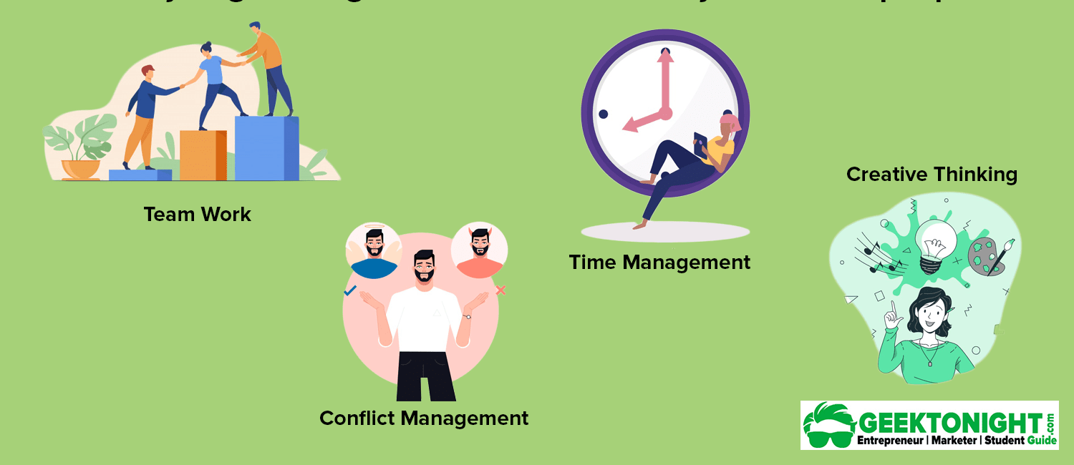

What are the typical developmental needs and challenges of young adults?
Need to learn how to give and
receive constructive Feedback
Need for learning
opportunities
Need for confidence, identity, belonging
Empathy
Lack of organizational and self-organizational skills
Inadequate problem solving skills
Lacking adaptability
Fear of failure, silence in groups
(interculturalcommunication barriers),
overwhelm
Lack of experience
Notes:
To be benefitial., mentoring needs to be adapted or if you wish customized to the needs of the mentee.
What are the Developmental needs and Typical challenges young adults face?
Need for confidence, identity and belonging
Fear of failure, silence in groups (especially in foreign language and intercultural settings) and overwhelm,
They often lack organizational and self-organizational skills,
And need opportunities to learn and experience in safe environments.
Mentors help teach and develop soft skills

Slide 43
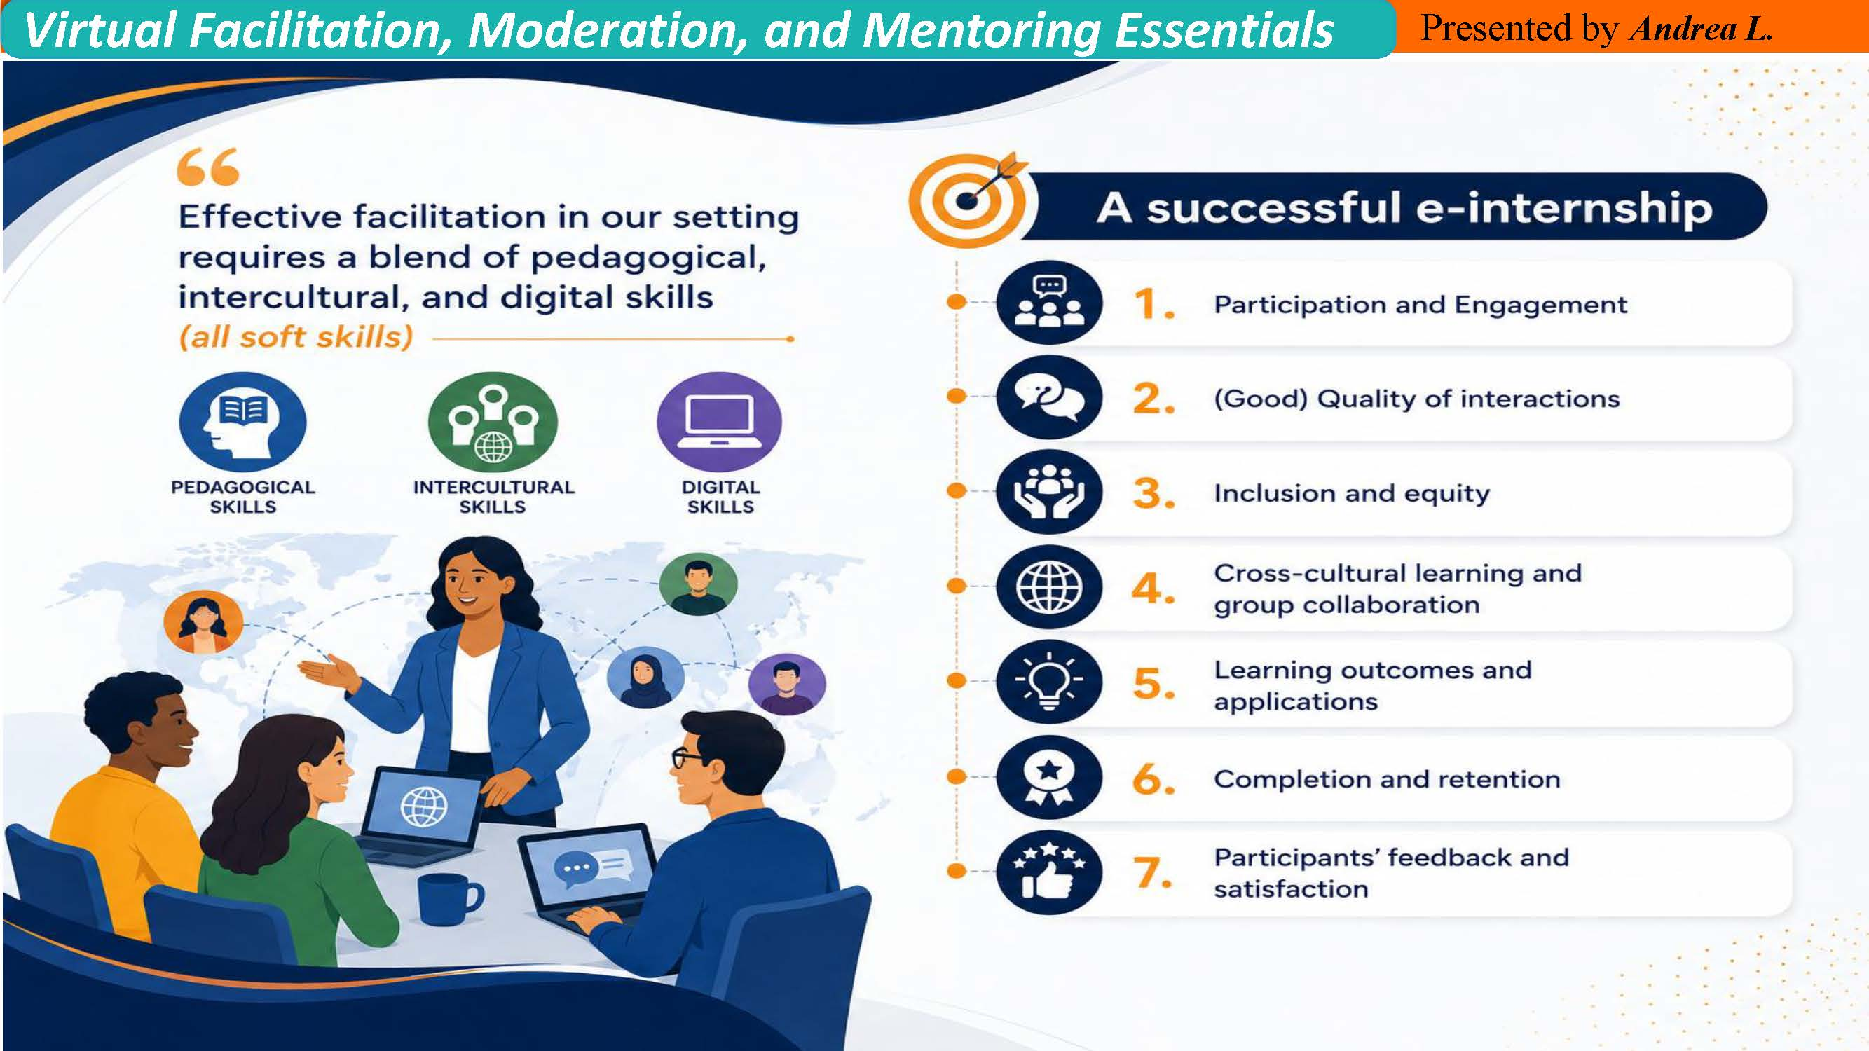

Slide 44
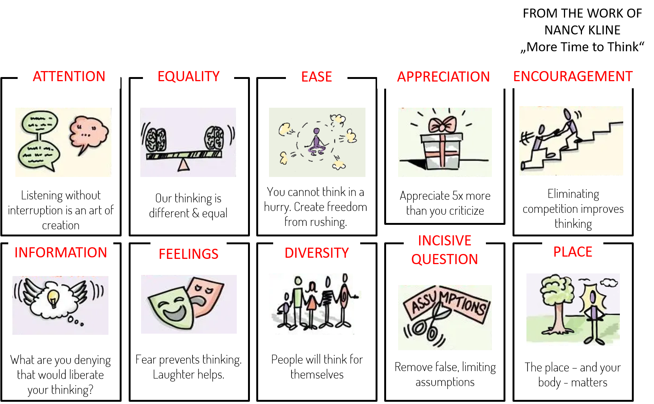
HOW TO THINK BETTER

Slide 45

Code of conduct
Let’s….
create a safe space
be open to receiving thoughts and perspectives from everyone
treat others fairly and with respect
help others feel valued and appreciated
discover instead of assume
create a sense of belonging
build and maintain trust
ensure that our interactions are free from discrimination or favoritism
try to enable people to reach their full potential
strive to do what’s right, even when it isn’t easy
back up our values with actions
maintain professional boundaries
encourage inclusion and respect
report concerns to the program management team

Slide 46




Slide 47

rules & regulations
Focus on relationship
Mentorships need to be built on trust and respect. Mentoring sessions are confidential.
As a mentor, offer support rather than direction.
Practice active listening - People think best when they feel fully heard
  Give full attention – model professionalism, no interruptions, no fixing, no steering.
  Create ease – slow down, remove pressure, allow silence.
  Ask liberating questions – “What assumption might be limiting your thinking?”
  Mentors do not solve the mentees’ problems or offer solutions, nor do they do the work for the mentee. Instead, help your mentees to discover their own solutons. Make sure you are hearing correctly what they are saying so that they feel understood. Your role is to facilitate communication and teamwork by keeping mentees engaged and progressing.
Meet consistently and follow up
Mentors must commit to 90 min online sessions per week six week in a row. Hold your mentees accountable. Mentors must also plan to attend a 1.5 hour review sessions per term to help improve the training.
What a mentor does not need to do
Mentors are not supposed to assist their mentees financially or with other resources than knowledge, information, wisdom, patience, networking opportunities, etc. Mentors do not need to solve mentees‘ personal problems, nor be available 24/7.

Slide 48






Slide 49




….continued

Slide 50
5
Communication Essentials

Slide 51



Communication
Modeling professional communication:
Setting expectations early
Teaching communication etiquette
Modeling professional behavior
Encouraging quieter participants and equal participation
Helping mentees connect theory → practice → project
Helping mentees manage time
Depending on the relationship and prior experience with the speaker, the listener tends to prioritize one of the 4 layers of a communicated message.

Slide 52
4 Types of Communicators
To be able to model good and professional communication, it is important to reflect on one’s own communication style. Communicating in I-messages does not come naturally to most people and needs some practicing.
Facilitators and mentors should also help participants become more aware of their way of communication and let them practice changing you-mesaages into I-messages.
Participants, who are regularly silent, might need encouragement to take control over certain situations to open up in a group setting. This requires a safe space and an atmosphere of trust and respect for all participants.
If in any case a participant communicates in a passive-aggressive manner, this should always raise a red flag. In that case the facilitator should stop the conversation and allow the participant to explain their position and emotions, and to manage a possible conflict situation.
Passive
Does not want control
Aggressive
Needs control
Passive Aggressive
Feels out of control
Assertive
Knows that you can only control yourself
Reacts with:
Silence
Reacts with:
You-messages
Reacts with:
Snarky side remarks
Reacts with:
I-message

Slide 53



Asking Questions
Asking good questions is one of the most important qualities of a good facilitator or mentor. The facilitator/mentor should always remember that the solution for any problem needs to be developed by the “problem-owner” themselves. The facilitator/mentor should not be the one offering solutions but instead guide the participant or team through the process of understanding their problem and digging for solutions by asking the right questions.
Questions are also a good way to create a space in which participants feel safe, welcome and heard. The way questions are asked determines the kind of answers that can be generated. In case that only a quick short answer is desired, a closed-ended question should be asked. In online meetings this can be important to avoid that a participant “high-jacks” the meeting. If however a more detailed elaboration is desired, the question has to be asked in a open-ended way.
Use powerful open-ended questions that promote reflection, like:
“What do you think is the core issue here”
“What would help you move forward”
“What did you learn about yourself this week”

Slide 54

Assertive Listening in online settings
Once a question is asked, the next step to a successful conversation and professional communication is “listening”. Only if a speaker feels heard and perceives the listener as truly interested in what is being said, will the speaker continue to open up and feel encouraged to disclose more information. Therefore, besides asking the right kind of questions, assertive listening is another important skill for facilitators and mentors.
How can we practice active or assertive listening?
Listen fully – Be present, maintain eye contact, avoid interrupting, give full attention and also pay attention to tone and emotion
Reflect back what you hear - “So what I’m hearing is…” or “It sounds like you’re feeling…”
Clarify - Ask questions that help you understand the deeper meaning, not just the surface words.
Validate emotions and feelings
Avoid interrupting or “fixing” too quickly
Stay respectful and calm - Assertive ≠ aggressive. You’re aiming for clarity, not dominance.
Active Listening online must be more intentional, more explicit, and more structured.
“Online, active listening is not just hearing the words — it’s compensating for everything we can’t see. It means showing the mentee that you are fully present, even through a screen.”. Presence must be visible. Understanding must be verbalized. Empathy must be explicit. Silence must be managed, not feared, and distractions must be reduced.

Slide 55


Good feedback is kind, clear, specific, and actionable.
Participants should be shown the video “Austin’s butterfly, which can be found in the zoom video library (see below) or on youtube https://youtu.be/E_6PskE3zfQ?si=OwTp74MB3V0dUt-wse
The 5-finger-feedback method should also be taught to participants by letting them draw the outline of their hand on a piece of paper, and adding the prompts as seen on the left. This can be kept as a reminder in front of them, when practicing feedback. Alternatively, the 3‑Part Feedback Model may be used:
1. What’s strong, 2. What’s unclear, 3. What’s next?
You can find videos saved to the zoom library under the more button and play them by clicking on the play icon.

Slide 56

Supporting Intercultural Communication
Normalize different communication styles
Encourage curiosity, not judgment
Encourage equal speaking time
Assume positive intent
Encouraging Self‑Awareness
Help mentees reflect on:
Strengths
Interests
Values
Work habits
Career aspirations
Highlight strengths of diverse perspectives
Dealing with Intercultural Miscommunication
Encourage curiosity
Clarify intentions
Facilitate a respectful conversation
Help clarify misunderstandings gently

Slide 57
6
Learner Engagement
&
Retention

Slide 58

How to prevent drop-outs?
Behavioral signs
Camera off often
Delayed responses
Short, one‑word answers
Not volunteering ideas
Missing small tasks or deadlines
Not asking questions
What to do?
Watch for silence, withdrawal
Reach out early
Encourage & support
Celebrate small wins
Keep mentees engaged
Support time manage-ment & self-regulation
Early warning signs of disengagement
Participation signs
Not contributing to team discussions
Letting others speak for them
Turning up late or leaving early
Not engaging in chat or reactions
Emotional signs
Low energy or flat tone
Irritation or defensiveness
“I don’t know” becoming frequent
Avoiding eye contact
The team is stuck or shows weak pitch deck progress
Help them define criteria
Encourage brainstorming
Guide them to a decision
Introduce milestones
Assign roles
Provide structured feedback

Slide 59
How to prevent drop-outs?
Model vulnerability
Mentors can say:
“I don’t have all the answers either.”
“It’s okay to be unsure — that’s part of learning.”
Make the space predictable
Young adults feel safer when they know:
the session structure
what’s expected
how long things take
Consistency builds trust.
How to Create Psychological Safety
Set explicit norms
“All ideas are welcome.”
“We don’t interrupt.”
“Questions are a sign of engagement.”
Psychological
safety online
must be designed,
not assumed.
Normalize mistakes
“This stage is confusing for everyone.”
“You’re not behind — you’re learning.”
Use structured turn‑taking
This prevents dominant voices from taking over:
“Let’s hear from each person for 30 seconds.”
Validate contributions
“That’s a helpful point.”
“Thanks for sharing that — it adds a lot.”

Slide 60
Encourage peer support
Pair them with a supportive teammate
Let them co‑work in breakout rooms
How to prevent drop-outs?
Slow down the pace
“Let’s take this one step at a time.”
“What’s the part that feels heaviest right now”
When a mentee is overwhelmed, mentors should avoid “fixing” and instead co‑regulate.
Handling disengagement or overwhelm
Reduce pressure
“You don’t need to be perfect — just present.”
“It’s okay to ask for help.”
Break tasks into micro‑steps
“What’s one thing you can do in the next 24 hours”
“Let’s choose the smallest next action.”
Offer options
“Would you prefer to work on the problem statement or the user insights first”
“Do you want to speak now or type in the chat”
Follow up with a short message after the session: “You did well today.”

Slide 61
How to prevent drop-outs?
Reach out privately
A short, warm message works wonders:
“I noticed you seemed a bit quiet today. How are you doing”
“Anything I can support you with this week”
Re‑engagement is about invitation, not pressure
How to Re‑Engage Mentees
Young adults disengage when overwhelmed. Mentors can say:
“Let’s pick one small thing you can do before next session.”
“What feels manageable right now”
Give them a meaningful role
People re‑engage when they feel needed:
“Could you lead the next check‑in”
“Would you summarize the team’s ideas”
Reconnect them to purpose
“What part of this project feels most interesting to you”
“What would you like to get out of this experience”
Celebrate small wins
Even tiny progress helps rebuild momentum.

Slide 62
How to prevent drop-outs?
Keep them simple and fast
Examples:
“One word for your energy today.”
“What’s one thing on your mind as we start”
“On a scale of 1–5, how present do you feel right now
Check‑ins are the mentor’s most powerful tool for reading the room.
How to run effective check‑ins
Ask follow‑up questions
If someone says “2/5”:
“Thanks for sharing. Anything you need from us today”
Use visual or interactive tools
Emojis
Polls
Chat responses
Quick reactions
These lower the barrier for shy participants.
Use check‑outs too
“What’s one thing you’re taking away”
“What’s one small step you’ll take next”
Normalize all answers
“All numbers are welcome.” “Thanks for being honest.”
Notes:
Let’s use the emoji function in zoom. Do you all know where to find and how to post an emoji? Those who know, please explain to and guide the others. I would like to see an emoji from each of you that reflects how you feel about todays training.

Slide 63
More Warm-up or Check-in exercises
When facilitating the Self Awareness sessions it is helpful to start with an ice.breaker to get the conversation going. This could be done with some light herted questions, that participants answer in turns.
Example questions
If you could describe your personality in an ice cream/soft drink/food flavor, which would it be and why?
If you could be any animal, which would you be?
If you won a million dollars, what would you do with it?
What is the best thing somebody has ever said to you/about you (or quote that you have read)?
If money, education and training was no problem, what would you do as your profession?
Who was your hero growing up?
Who is your favorite person in the world?
If you were a vegetable/fruit which would you be?
Would you rather start a colony on another planet or be the leader of a small country on Earth?
If you could have any super power, which would it be?
What skill or talent do you wish you had?
Go on a Virtual Road Trip
If your paerticipants do not object they might turn on their camera and share their surroundings so that others get to explore a new part of the world! It is best to announce this the week before, so that everyone can be prepared to share confidently.

Slide 64


To help participants to get to know each other and to create a light-hearted atmosphere at the beginning of a session you might play:
Two Truths and a Lie/one Dream
Each participant shares three statements about themselves, of which one must be a lie and the other two are true. Alternatively, instead of a lie they might also state one dream they have always wished for, but have not yet obtained.
If you have enough time, the participant can be asked follow-up questions about each statement to try to detect which are the truths and which statement is the lie. Or the other participants simply make their guesses (with their reasoning behind their choice) and the correct answer is then revealed.
Either include the image above as part of your presentation or pull it up as a whiteboard from the zuum whiteboard library, where it has been saved for your convenience Let participants annotate the picture by marking the figurine in the image that best represents their current feeling about any given situation. This can be used at the start and again at the end of the E-internship, it can be used midway to check on how participants feel about the atmosphere in the team, how they feel when receiving feedback, how they progress with their pitch deck, etc.

Slide 65
Monitoring & Evaluation
The AgriMocks program will regularly schedule review and evaluation sessions, which facilitators and mentors are requested to attend.
Issues to monitor are:
Any technical challenges using the program platform or relevant technology.
Any challenges engaging in program activities or conversations
Any challenges communicating with program management team
Any challenges communicating with mentees
Mentee engagement and retainment ratio
Any other structural obstacles that cause issues in program implementation
Any content or group related issues (regular difficulties to grasp concepts, complaints, conflicts, inappropriate behaviour, etc.)
Any important upcoming program dates, events, activities, or milestones
The program managment team should regularly analyze data collected by the platform, which includes log-in and usage data, as well as the content of mentor mentee interactions, to ensure that participants are not sharing inappropriate information or otherwise violating program rules, and tpo identify issues that may need additional support, coaching, or encouragement to participate.

Slide 66



Your Impact
By mentoring in this program, you are helping young adults:
Build confidence
Discover their strengths
Learn to collaborate across cultures
Develop entrepreneurial thinking
Create a meaningful project
Take a step toward their future
Your presence matters more than you know!

