Slide 1

ERASMUS Virtual Exchange (EVE)
AGRI-MOCKS
Jour Fixe 24.02.2025
Anja Weber
24th February 2025
Notes:
Anja

Slide 2
Agenda
Status of Consortium Agreements and financial information forms
Status of budget distributions
KOM planning (date, visa requirements, venue, hotel, EDI responsibilities and workshop costs, etc.)
What to expect from the KOM
Next steps
AOB
Hochschule Weihenstephan-Triesdorf | Agri-Mocks | 2025
Notes:
https://www.mentimeter.com/app/presentation/alc84n1bioqsiyxdpp87trtwqrpykeve/kd8hbf4vxgri/edit
Anja

Slide 3
Status reports (Tarja)
Consortium Agreements and financial information forms
Budget distributions (40% Prepayment)
Hochschule Weihenstephan-Triesdorf | Agri-Mocks | 2025
Notes:
Anja

Slide 4
KOM planning
Date
Visa requirements
Venue
Hotel
EDI responsibilities and workshop costs
etc.
Hochschule Weihenstephan-Triesdorf | Agri-Mocks | 2025
Notes:
Anja

Slide 5
KOM – what to expect
EDI will host the project kick off meeting (KOM) in Addis Ababa, Ethiopia.
KOM will be dedicated to:
discussing grant agreement and programme rules
project design and cooperation of partner in implementing the project
work packages and deliverables
budget issues
implementation package and
project procedures.
Partners will devise the detailed work plan with ganth chart and will discuss important sequences and milestones in implementation.
Hochschule Weihenstephan-Triesdorf | Agri-Mocks | 2025
Notes:
Anja

Slide 6
KOM – further topics
Initial framework for Sustainability plan development
Quality assurance instruments (Project Quality Architecture toolkit, matrix, e-instruments)
Dissemination plan including plan of publishing posts on social networks
Guidelines for constitution of project structures (Project Steering Committee, e-Internship Programme Committee, and CDE team on dissemination, etc.)
Hochschule Weihenstephan-Triesdorf | Agri-Mocks | 2025
Notes:
Anja

Slide 7
Next steps
KOM logistics
Project teams formation
Online meetings to agree on implementation tools and templates that should be devised until KOM
Preparation: implementation package to be presented at KOM
(HSWT & UGB )
Preparation of Quality assurance instruments:
- PQA toolkit,
- PQA matrix,
- e-instruments
(WEBIN)
KOM
Hochschule Weihenstephan-Triesdorf | Agri-Mocks | 2025
Notes:
Vadym

Slide 8
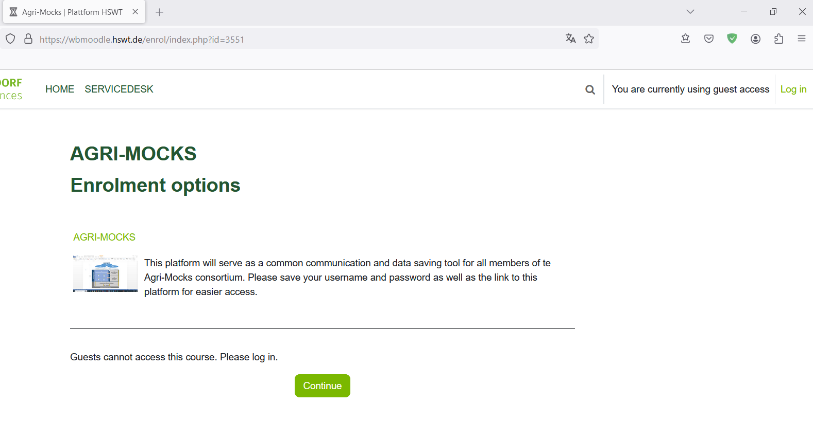
Agri-Mocks platform
link:
https://wbmoodle.hswt.de/course/view.php?id=3551
Click on:
Log in
Hochschule Weihenstephan-Triesdorf | Agri-Mocks | 2025
Notes:
Johanna

Slide 9

Agri-Mocks platform
Click on:
‚Registrieren‘
to register a user account
Hochschule Weihenstephan-Triesdorf | Agri-Mocks | 2025
Notes:
Johanna

Slide 10
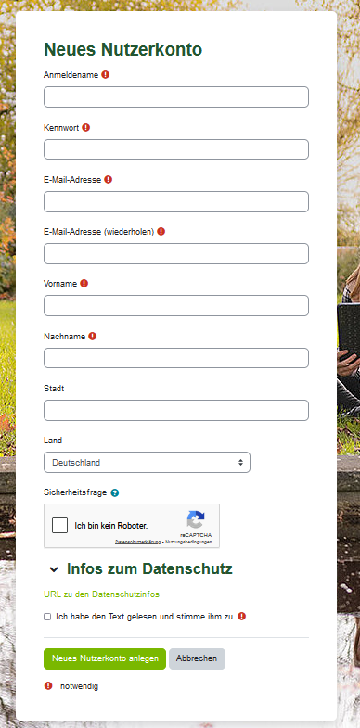
Register a user account
Anmeldename: Username
Kennwort: Password
E-Mail Adresse : email address
E-Mail Adresse(wiederholden): repeat email address
Vorname: First name
Nachname: Surname
Stadt: location
Land: country
Tick box: I am not a robot (Captcha)
Tick box: Ich habe den Tex gelesen… (I agree with the data protection rules)
Click on ‚Neues Nutzerlonto anlegen‘
Hochschule Weihenstephan-Triesdorf | Agri-Mocks | 2025
Notes:
Johanna

Slide 11
Agri-Mocks platform
Click on:
‚Anmelden mit Anmeldename‘
Hochschule Weihenstephan-Triesdorf | Agri-Mocks | 2025
Notes:
Johanna

Slide 12
Please make sure to take note of
your user name and password
for future reference!
You will receive an email from HSWT moodle admin requesting you to confirm your email address by clicking on the provided link. Please do so. Let me know once your account is active so that I can enroll you.

Slide 13
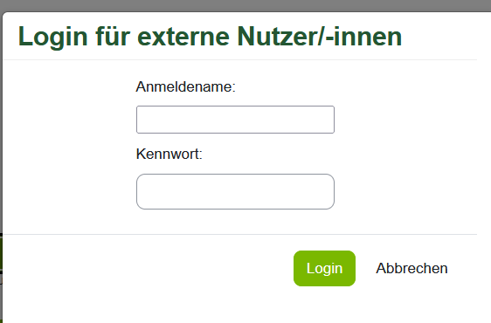
Log into your user account
1. Enter your user name
(only small letters and no empty space, but can contain „_“, „-“, „.“ or „@“)
Enter your Password
Click here
to log in
Hochschule Weihenstephan-Triesdorf | Agri-Mocks | 2025
Notes:
Johanna

Slide 14

AOB?
Hochschule Weihenstephan-Triesdorf | Agri-Mocks | 2025
Notes:
Anja

Slide 15
Thank you!
See you soon!
Anja Weber
Hochschule Weihenstephan-Triesdorf | Agri-Mocks | 2025

