Slide 1

WELCOME
The Meeting will start at 2pm CET
(in a few minutes)
Thank you for your patience!

Slide 2
WELCOME
Training of Trainers (ToT)
for Virtual Facilitators and Mentors June 8th – 10th, 2026
Day 3:
Recap of the two days - Anja
Simulation and Company play – Matt
Q & A - Yitna

Slide 3
RECAP of the past 2 days
Training of Trainers (ToT)
for Virtual Facilitators and Mentors June 8th – 10th, 2026
Day 1:
Overall Structure of E Internship Program - Anja
Virtual Facilitation, Moderation, and Mentoring Essentials - Andrea

Slide 4
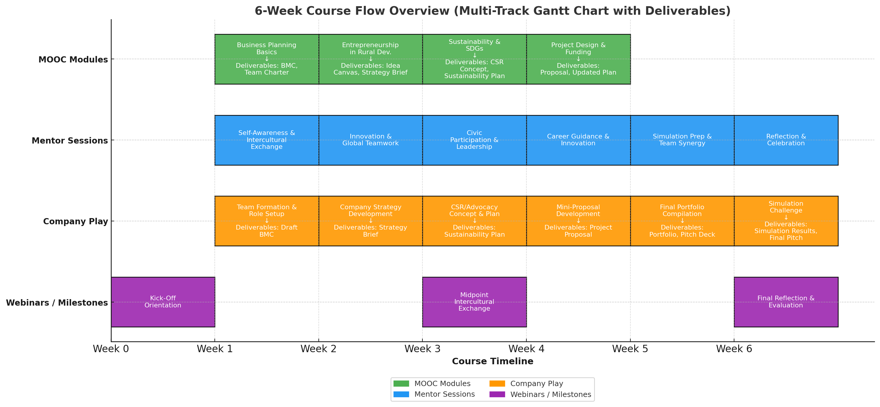



COURSE OVERVIEW
BMC & Career Guidance
BMC & Career Guidance
Innivation & Entrepreneur-ship
Civic Participation & Advocacy
Project Development
Simulation
KOM
Self-Awareness & Intercultural Teamwork
Innovation & Global Teamwork
Civic Participation & Leadership
Innovation in Practice
Recap
Build a team & define roles
Get to know the entrepreneur
1. Strategic plan
The company and SDGs
Working on the pitch deck
Simulation
Midpoint Intercultural Exchange
Final Refelection & Evaluation

Slide 5
Week 1: Kick-Off-Meeting
Orientation and digital proficiency
Week 2: Self-Awareness & Intercultural Teamwork
To help participants discover their personal strengths, working styles, and how to collaborate across cultures.
Week 3: Innovation & Global Teamwork
To explore creative thinking tools and practice teamwork in developing an innovation mindset
Week 4: Civic Participation & Leadership
Week 5: Innovation in Practice
To connect project design principles to innovation ideas, while reflecting on how project design abilities strengthen their future career pathways.
Week 6: 3-day simulation & Closing Session
To inspire participants to think of themselves as active change-makers and to understand leadership through civic action
Experience real-time effects of decision-making on company
Weekly Sessions Outline

Slide 6
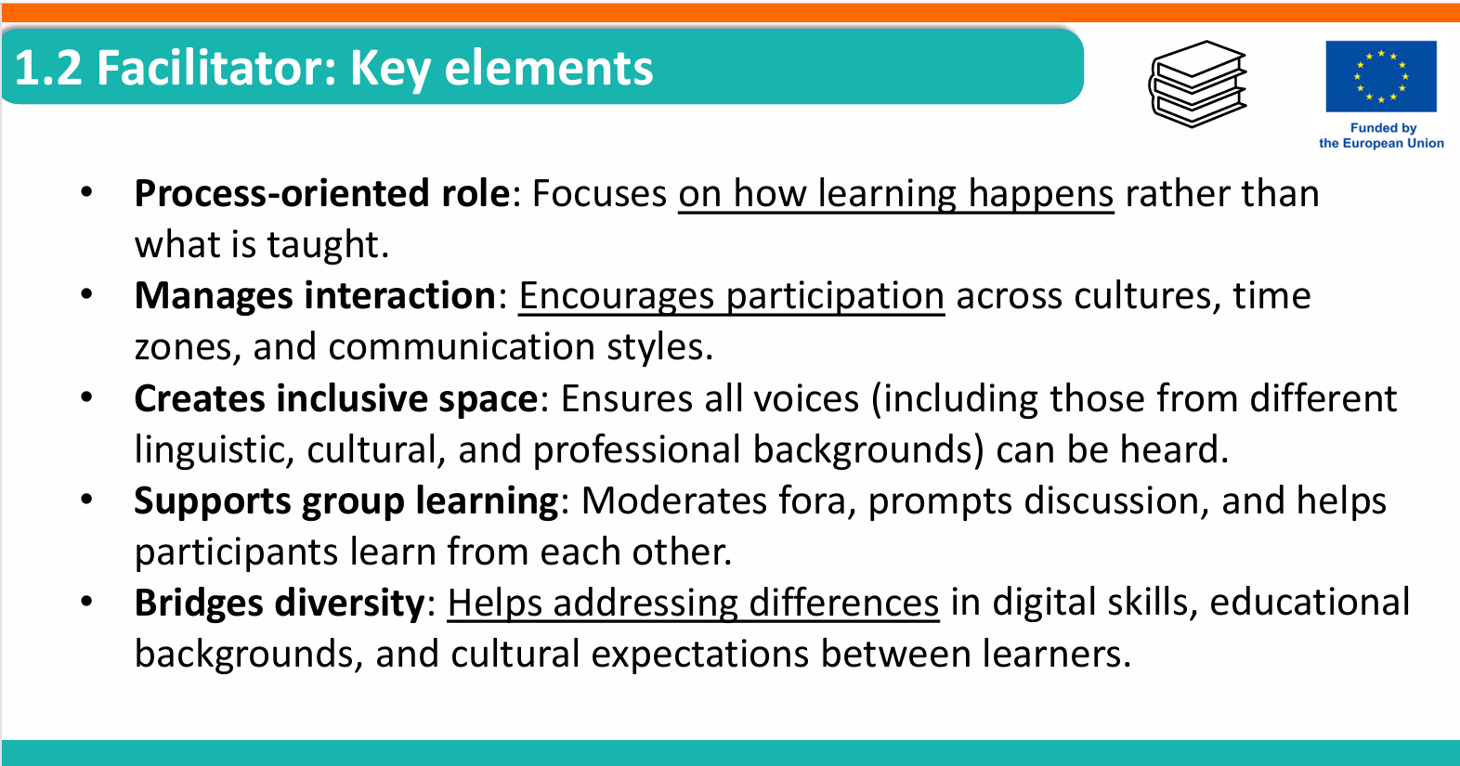

Slide 7
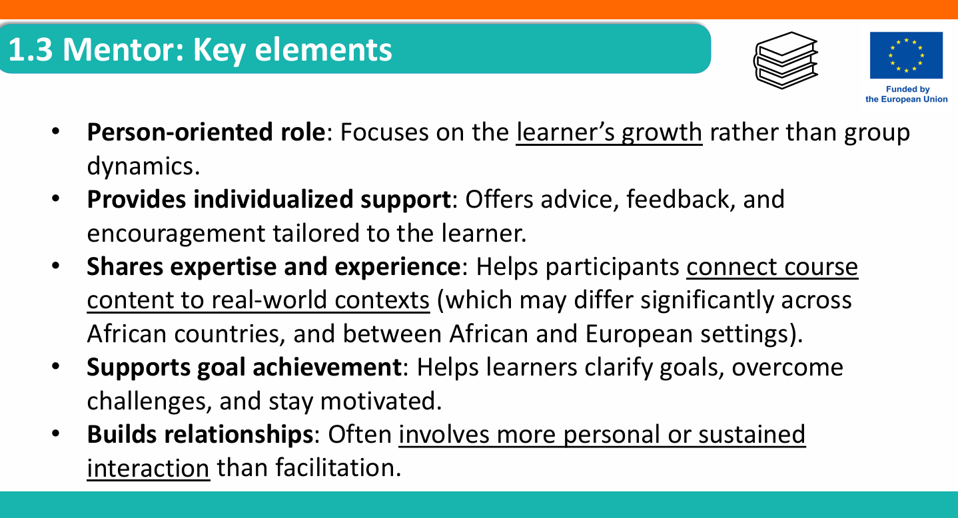

Slide 8
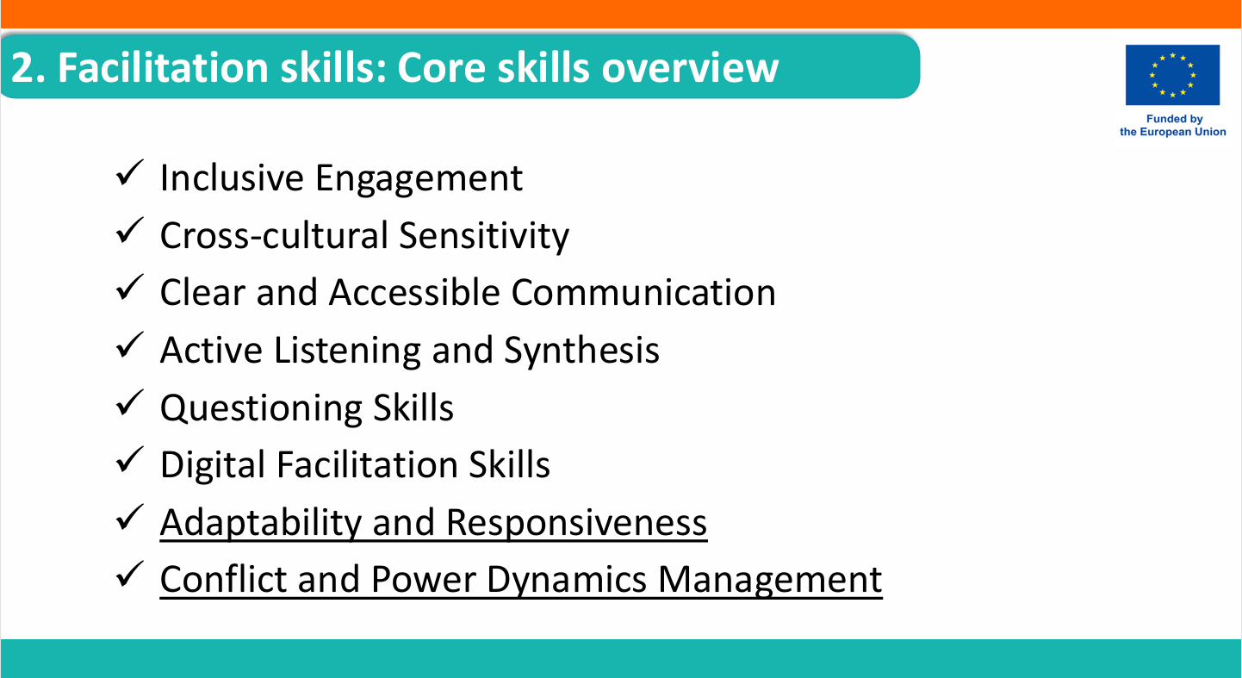

Slide 9
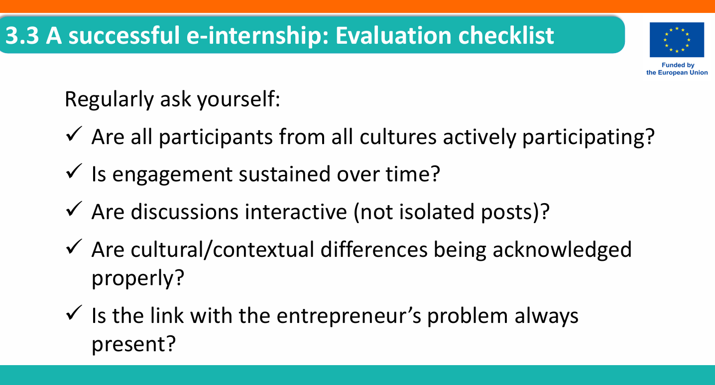

Slide 10
RECAP of the past 2 days
Training of Trainers (ToT)
for Virtual Facilitators and Mentors June 8th – 10th, 2026
Day 2:
Communication, Online Presence and Managing Discussions - Yitna
Effective Mentorship: Roles, Skills, and Supporting Mentee Development - Anja

Slide 11
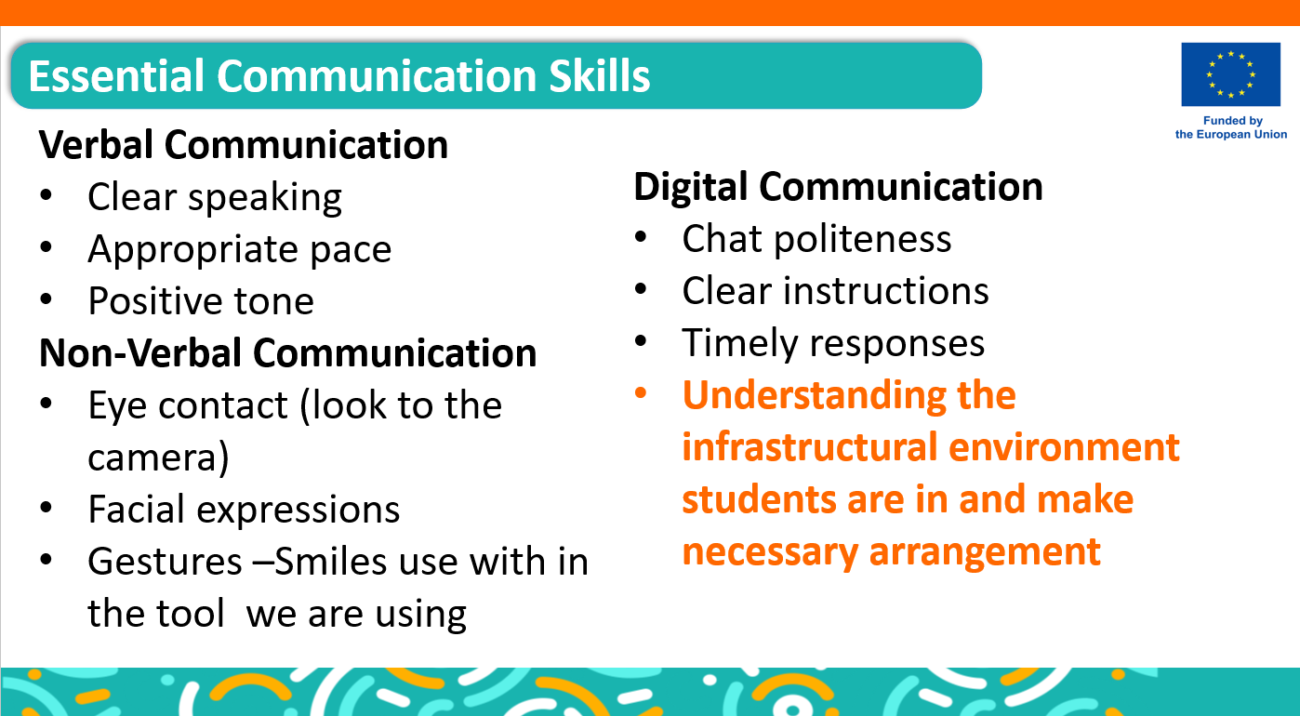

Slide 12
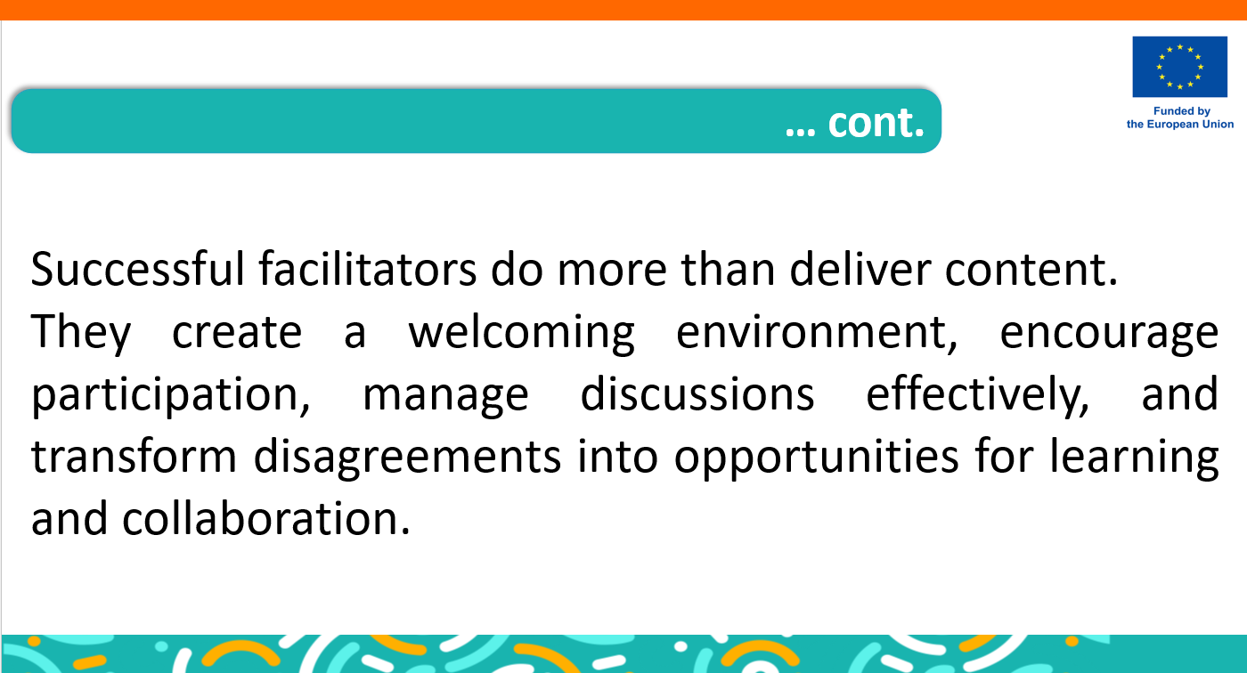

Slide 13

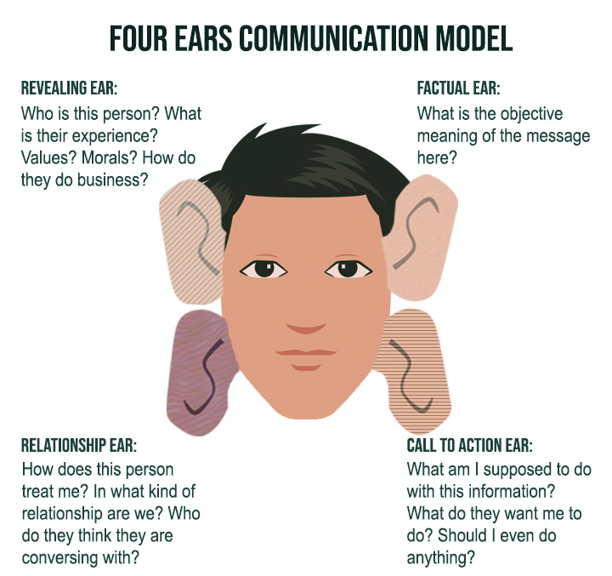


Slide 14


Are you already
going home?
How would the same message sound in the 4 different types?
Passive –
Silence (just a look)
Aggressive –
(you message) “…..”
Passive-Aggressive –
(Snide side remark) “…”
Assertive –
(I message) ”....”
Notes:
Aggressive –
“Are you ALREADY going HOME?” Do you expect me to finish by myself, You are always the first to leave
“Passive aggressive “Some people .. W´the work doesn’t finish itself
Assertive “I will always leave soon.! I need help finishing this.”

Slide 15
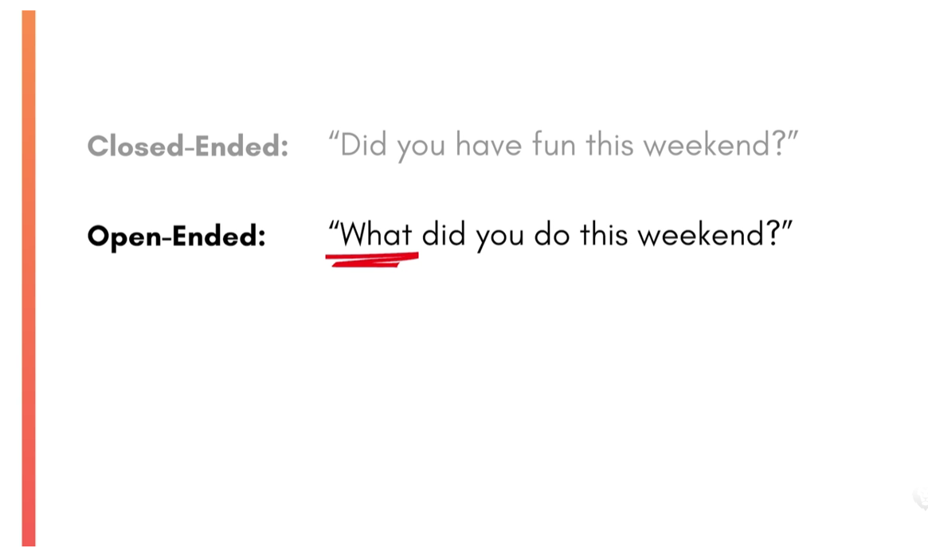
Asking Questions

Slide 16

Active Listening
Waiting for your turn to talk
Listen to understand
Notes:
Hold the space for the conversation. The coachee will start with what is present and familiar to them. Listen to understand, ask if necessary. Dont comment.
So if I understand you correctly…
Correct me if I am wrong, what you are trying to say is…
Ask question to let the coachee reach down deeper towards the hidden, uncomfortable issues. like, how does that feel like right now, what would happen when/if…/ what does that remind you of …
If the coachee makes a problem statement, may be a root cause analysis is a good way to understand the problem better and find a solution

Slide 17


Slide 18





Awareness of diverse
backgrounds
Asking develop-
mental and
reflective
questions
Encouraging mentees
to bring their full selves
Supporting inter-
cultural communication
Avoiding assumptions

Slide 19

How to prevent drop-outs?
Keep them simple and fast
Examples:
“One word for your energy today.”
“What’s one thing on your mind as we start”
“On a scale of 1–5, how present do you feel right now
Check‑ins are the mentor’s most powerful tool for reading the room.
How to run effective check‑ins
Ask follow‑up questions
“Thanks for sharing. Anything you need from us today”
Use visual or interactive tools
Emojis
Polls
Chat responses
Quick reactions
These lower the barrier for shy participants.
Use check‑outs too
“What’s one thing you’re taking away”
“What’s one small step you’ll take next”
Normalize all answers
“All answers are welcome.” “Thanks for being honest.”
Notes:
Let’s use the emoji function in zoom. Do you all know where to find and how to post an emoji? Those who know, please explain to and guide the others. I would like to see an emoji from each of you that reflects how you feel about todays training.

Slide 20
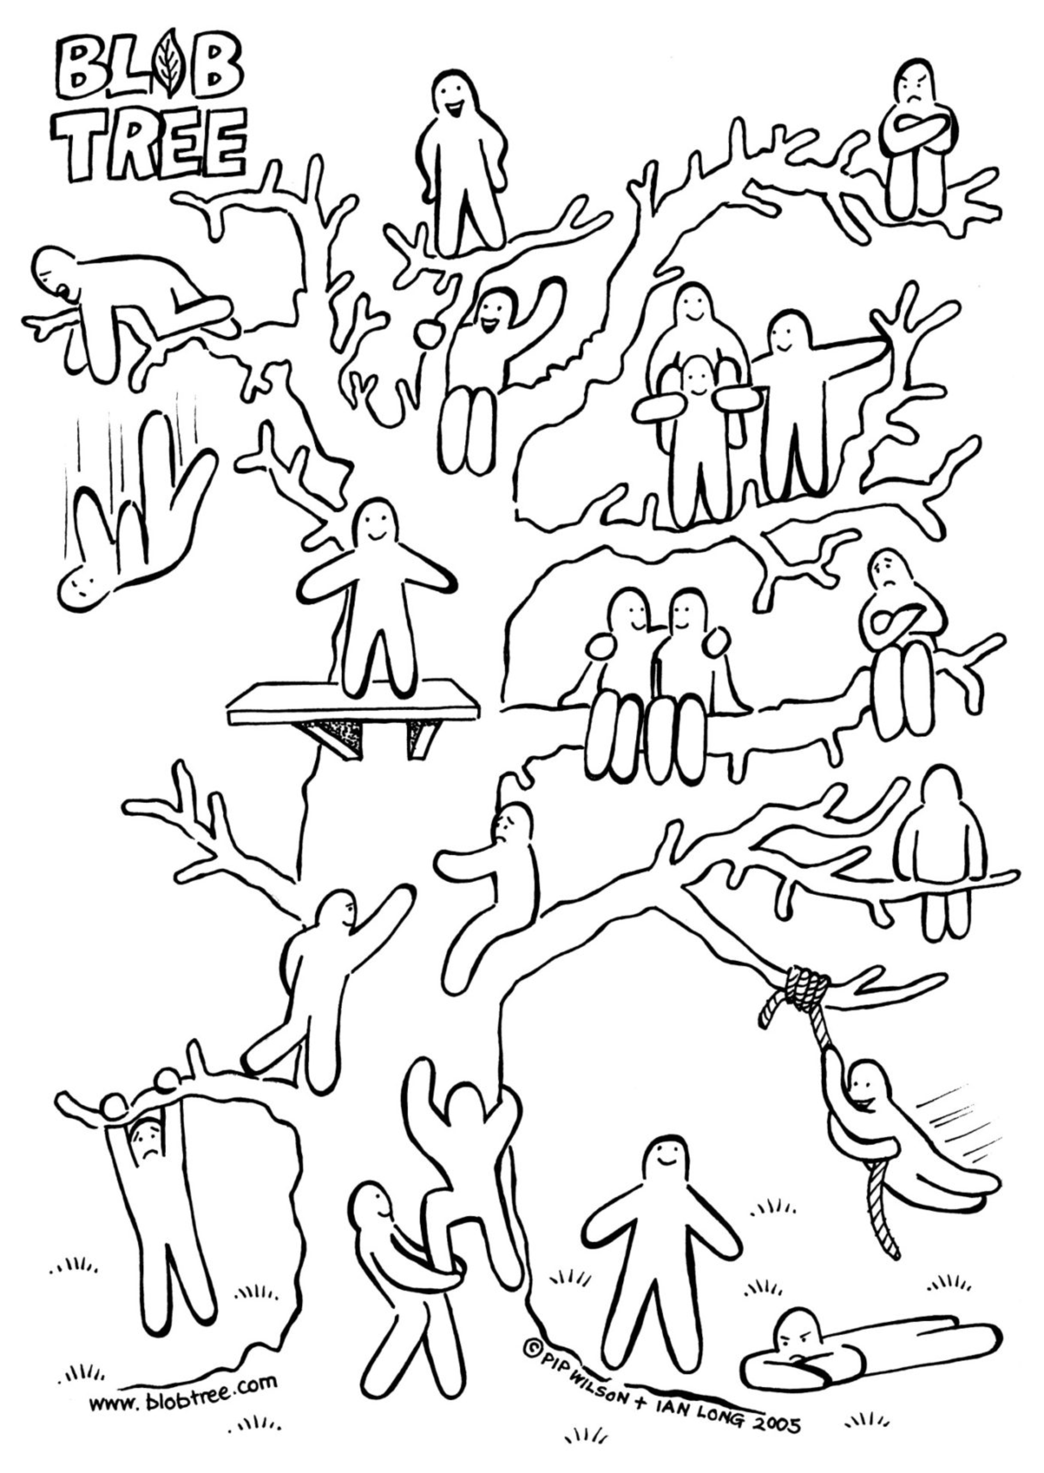
HOW DO YOU FEEL TODAY
About becoming a facilitator or mentor?
Notes:
I will open this picture on an interactive whiteboard and then invite you to úse the pen tool to mark one of the little mannekins on the te, that describes your feelings best. Tell us yor name, where you are joining us from and if you feel like you are just hanging on for dear life, have only just started to think about mentorship, feel securelz settled but think there is more room for improvement, or do you even already feel completely on top of things?

Slide 21
Mentor Handbook
2026

