Slide 1

AGRI-MOCKS KOM
WELCOME
EDI
Day 1 - 28.04.2025

Slide 2
AGRI-MOCKS KOM
Agenda
Day 1 - 28.04.2025

Slide 3
KOM Agenda
Day 1 – Monday, 28th April (afternoon)
Welcome - EDI
Get to know each other (self introductions, 5 min each)
Introduce your participants (proto persona) – Interactive
Logistic issues - ?
Dinner (where?)
Day 4 – Thursday, 1st May
Unpacking the Work Packages – Interactive
Lunch
Developing the Gantt Chart - Interactive
Day 2 – Tuesday, 29th April
Reporting: GA, CA, Sigma, Finances & Co. – Anja & Tarja
Input 1: The Power of Feedback - Anja
Lunch
Quality Architecture- WEBIN
Project Management Structure - WEBIN
Day 5 – Friday, 2nd May (morning)
Appointing of Committees - ?
Friends of the Project (FOP) -?
Lunch
Departure or afternoon cultural program
Day 3 – Wednesday, 30th April
Strategic Planning workshop – Anja
Input 2: Barriers and Enablers in EVE – Anja
Lunch
Input 3: New ways in learning – Anja & Emad Helmy
Dissemination and Communication – UFS

Slide 4
Rules of engagement
Let’s….
create a safe space
be open to receiving thoughts and perspectives from everyone
treat others fairly and with respect
help others feel valued and appreciated
discover instead of assume
create a sense of belonging
build and maintain trust
ensure that our interactions are free from discrimination or favoritism
try to enable people to reach their full potential
strive to do what’s right, even when it isn’t easy, rather than just what policies and procedures demand
back up our values with actions
Please add….

Slide 5
AGRI-MOCKS KOM
Introduce yourself
Interactive - Day 1 - 28.04.2025

Slide 6


Anja Weber
HSWT
Notes:
I grew up on a farm with a grandmother who was a trained hotel chef and who taught me how to process food. I remember butchering ducks with her when I was just 2 years old. I first studied arts to become a highschool teacher, and then joined a 400 ha organic farm in Germany together with my husband, who is a farmer. There, I set up food processing and a farm shop. In 1997 we sold our shares in the farm and moved to Tanzania, where we worked as managers on a large church-owned farm. Until 2003, I was in charge of the food processing units (bakery, dairy, butchery and fruit processing), marketing and sales.
I think one of my biggest talents is to be able to convert learning content into learning formats that are approriate for the respective audience.

Slide 7

Notes:
For example a children‘s book on soils published with FAO

Slide 8
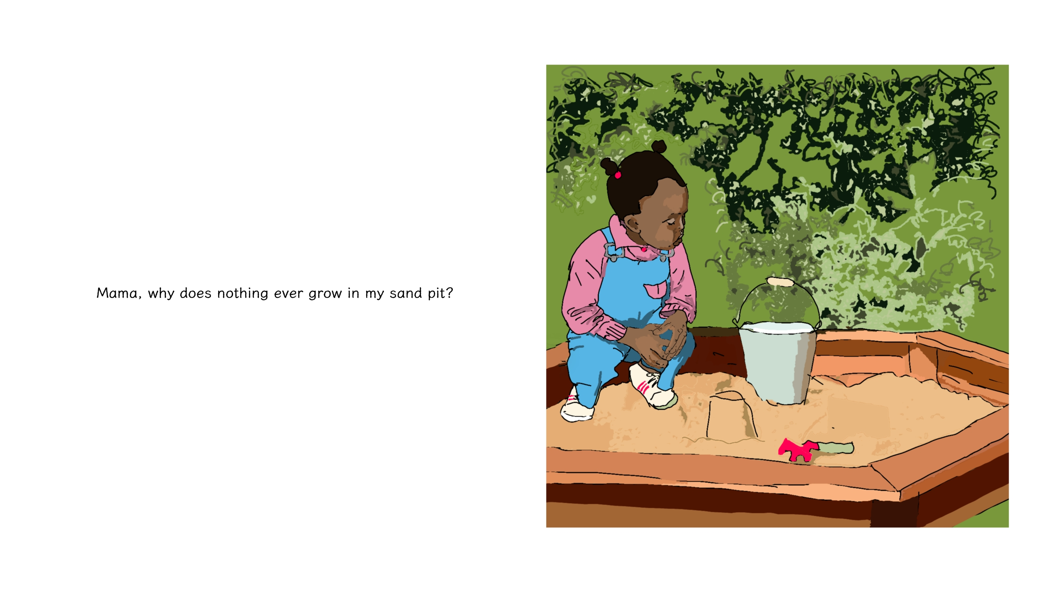

Slide 9
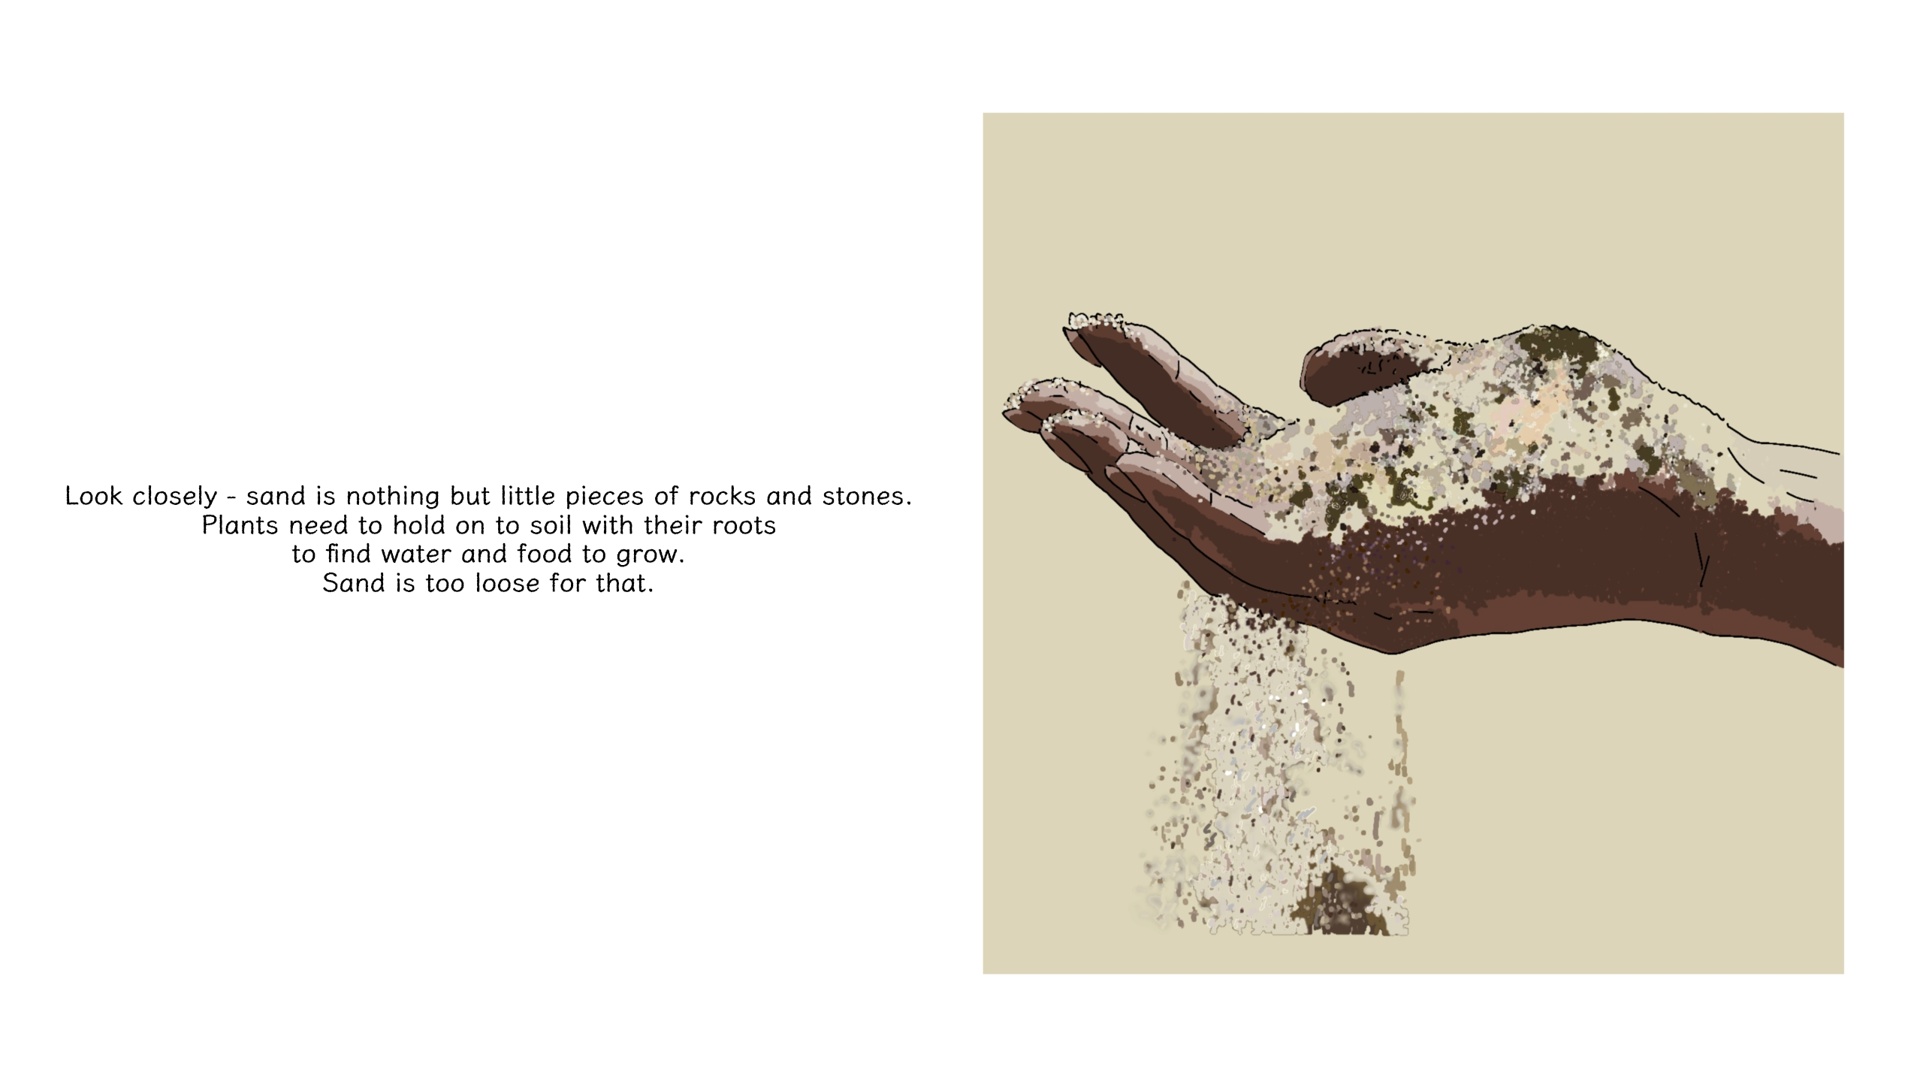

Slide 10
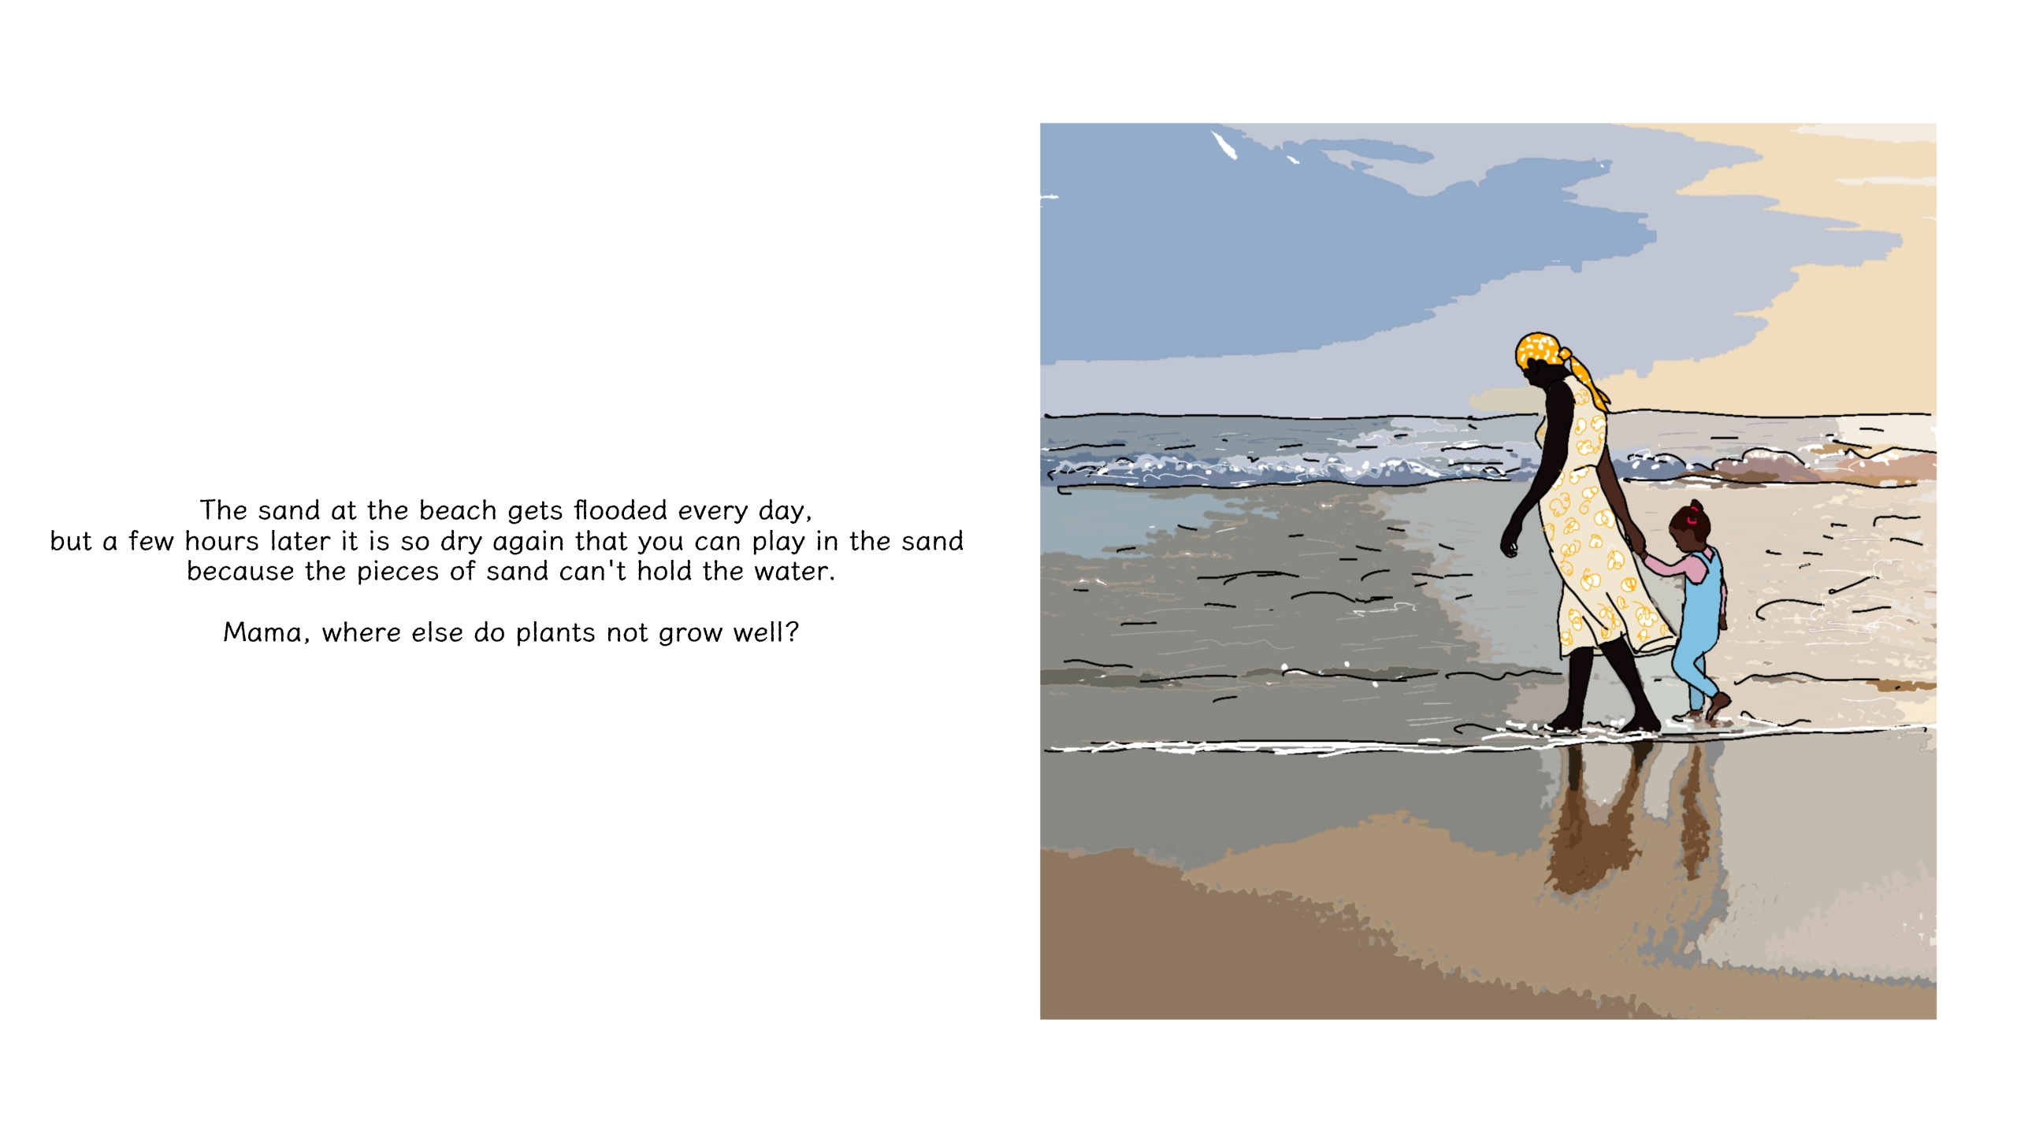

Slide 11
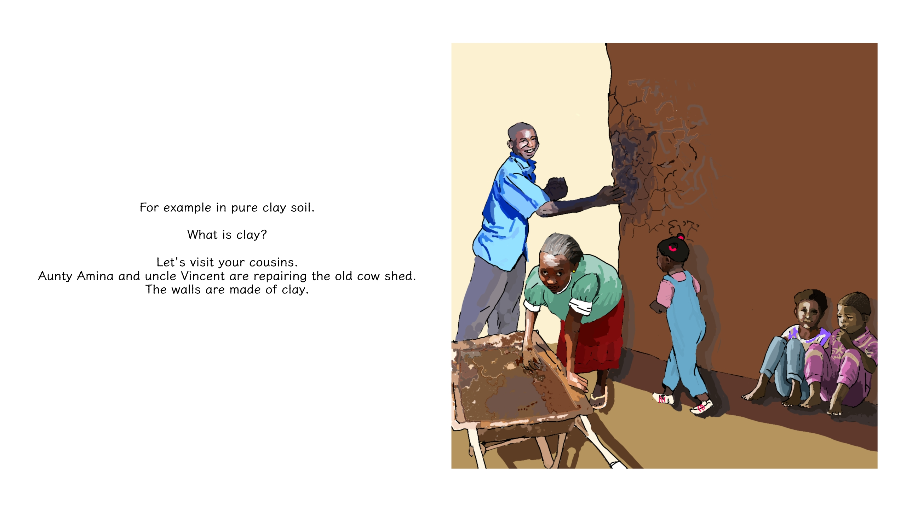

Slide 12
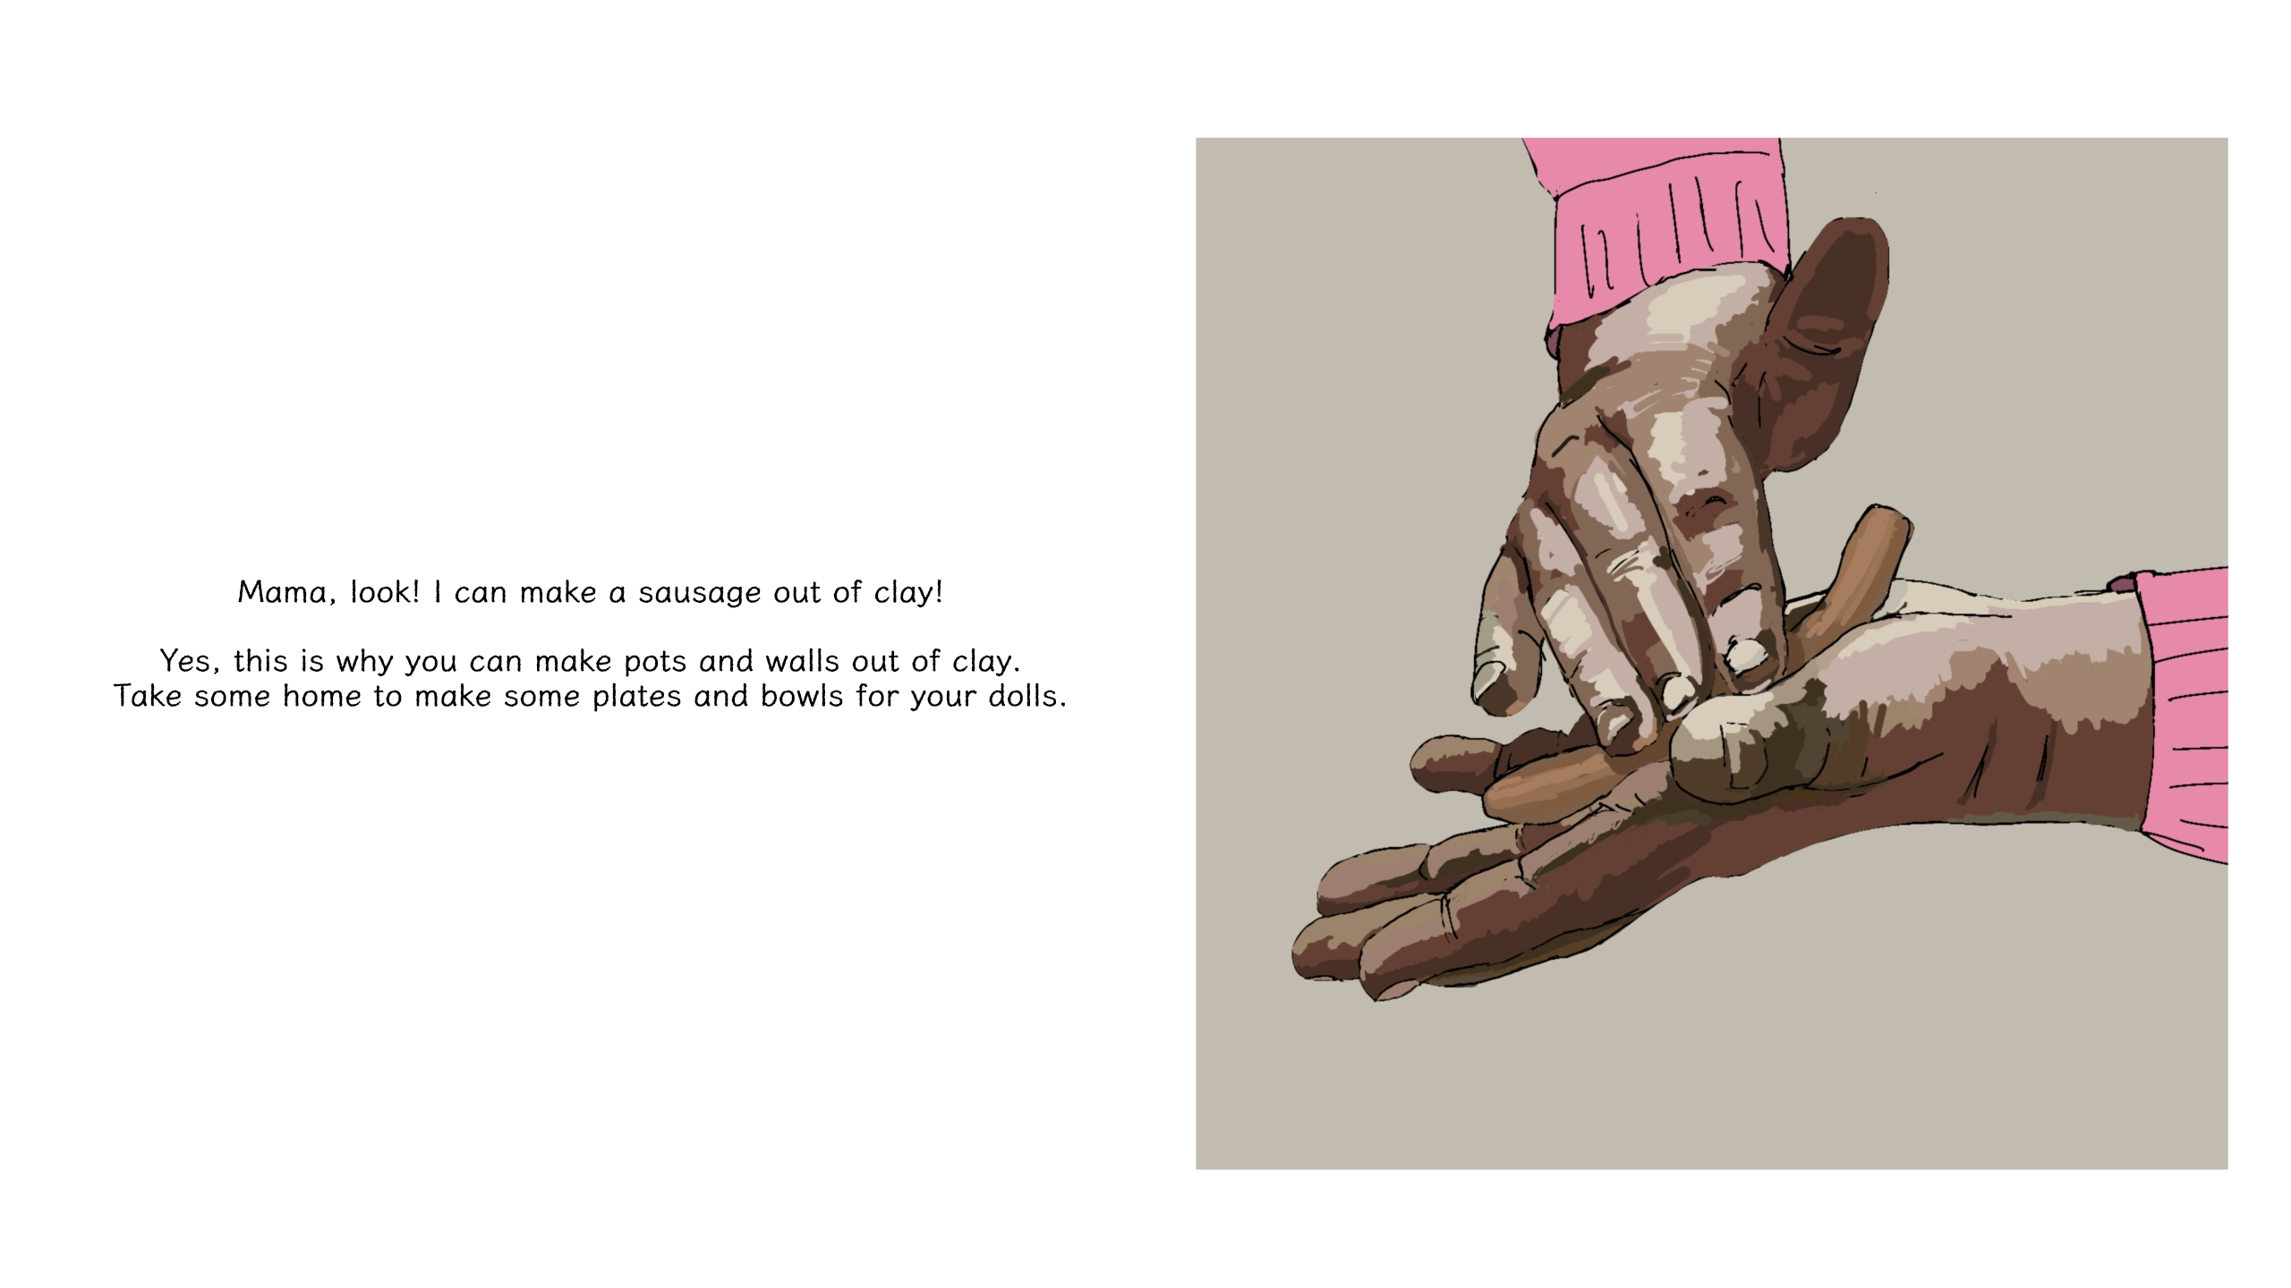

Slide 13
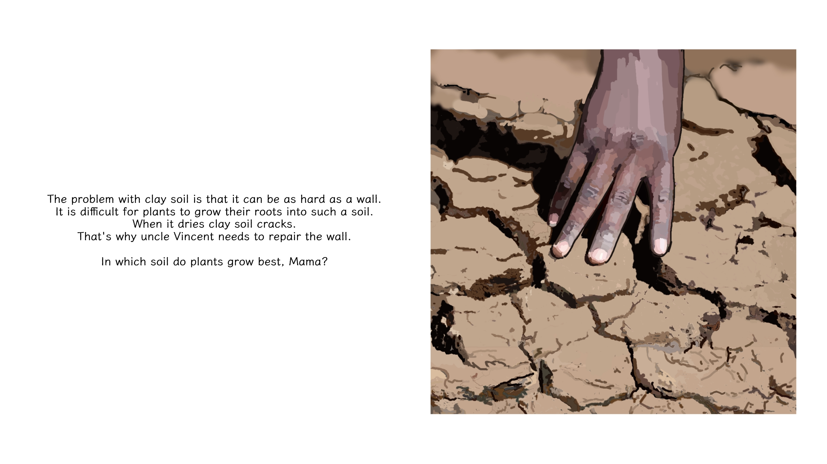

Slide 14


Slide 15
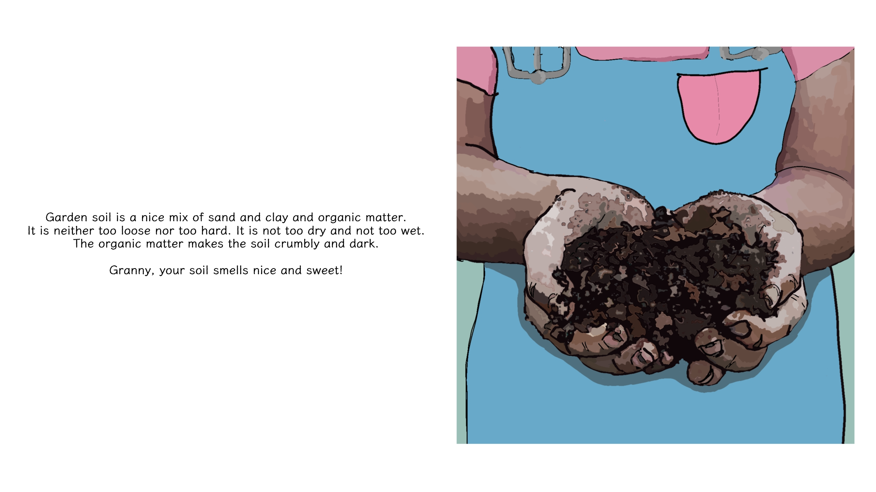

Slide 16
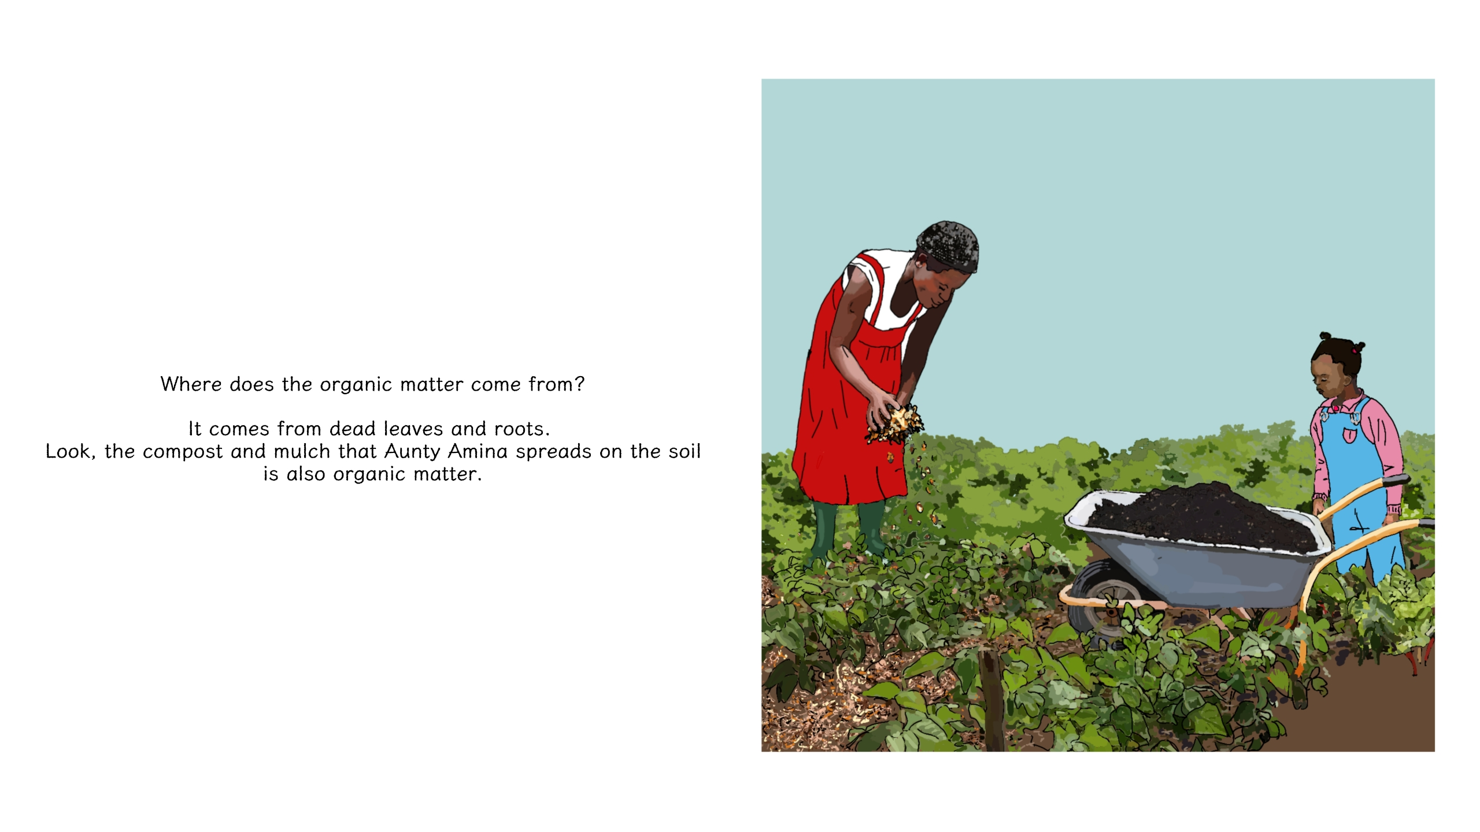

Slide 17


Slide 18
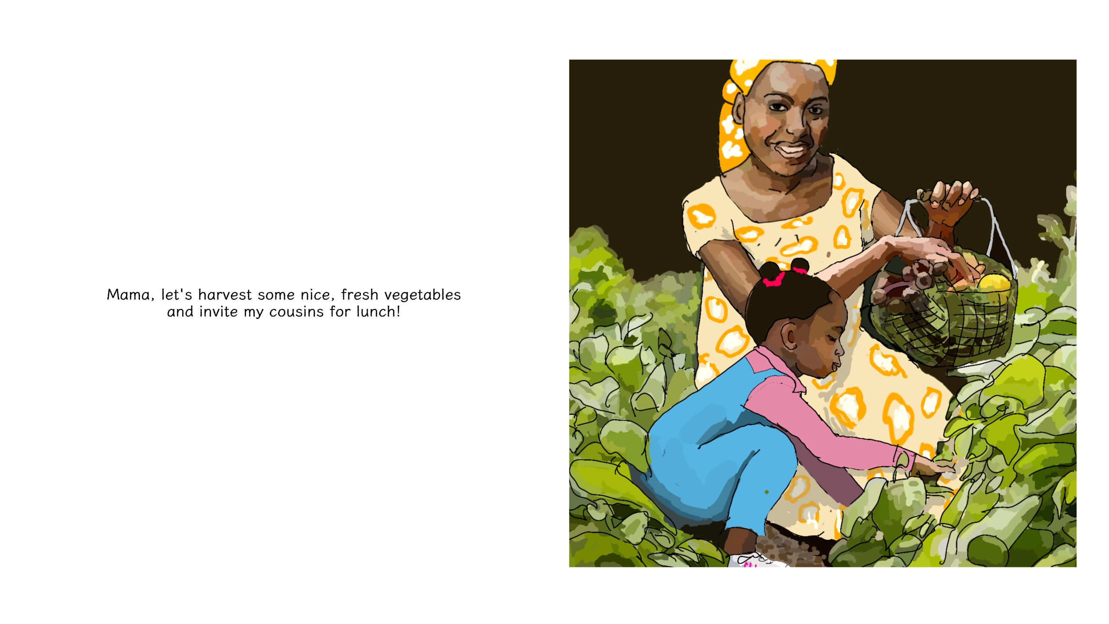

Slide 19

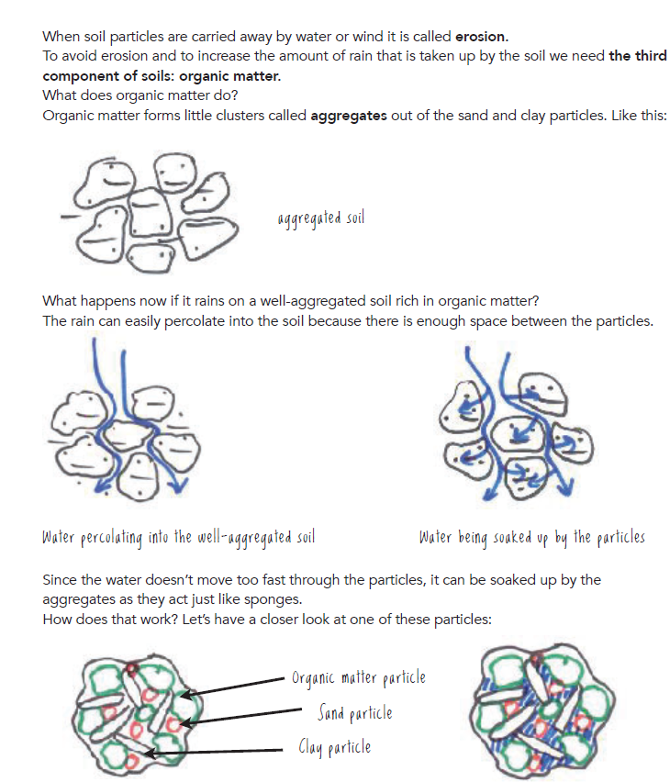
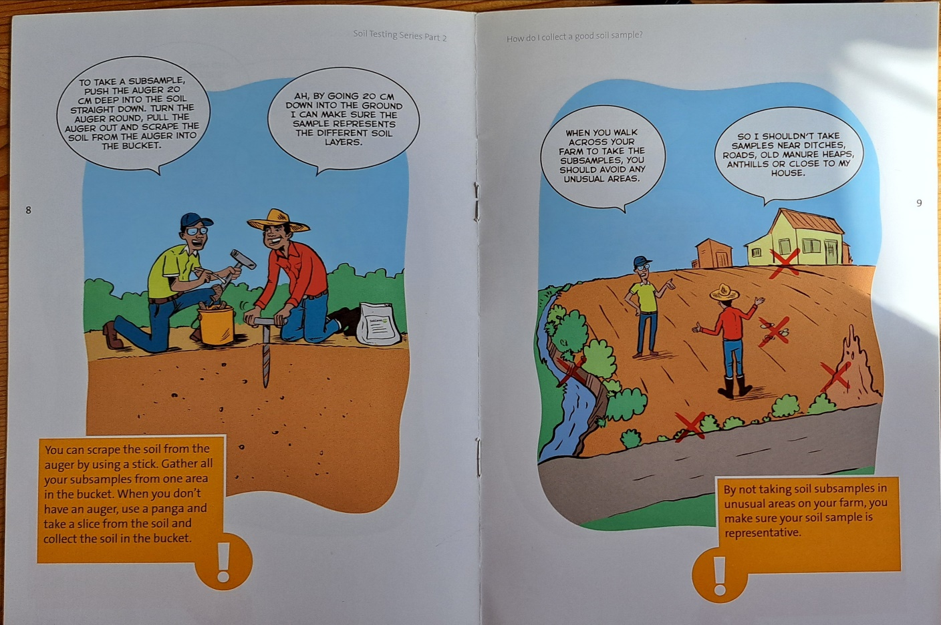
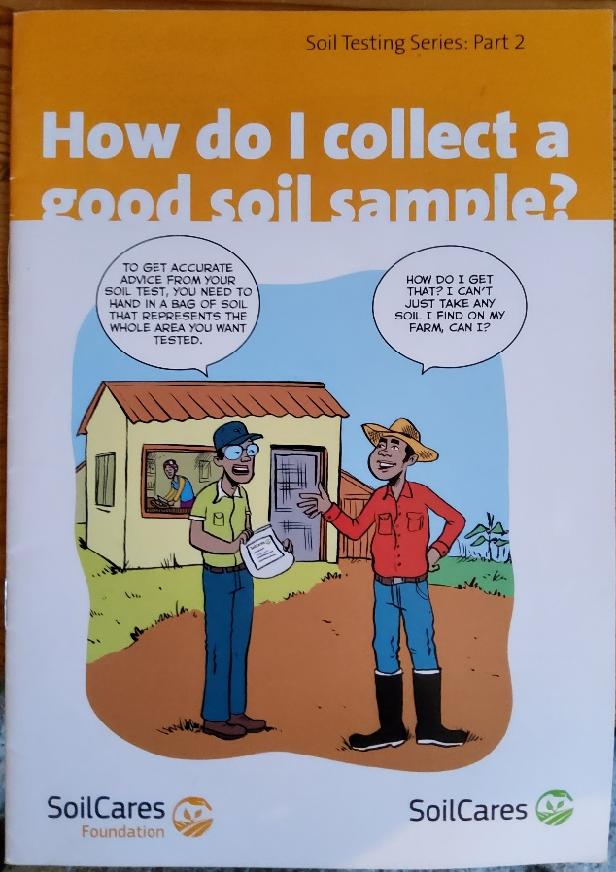
Notes:
A soil fertility management manual for smallholder farmers with simple infographics, or a comic book to teach farmers how to take soil samples.

Slide 20
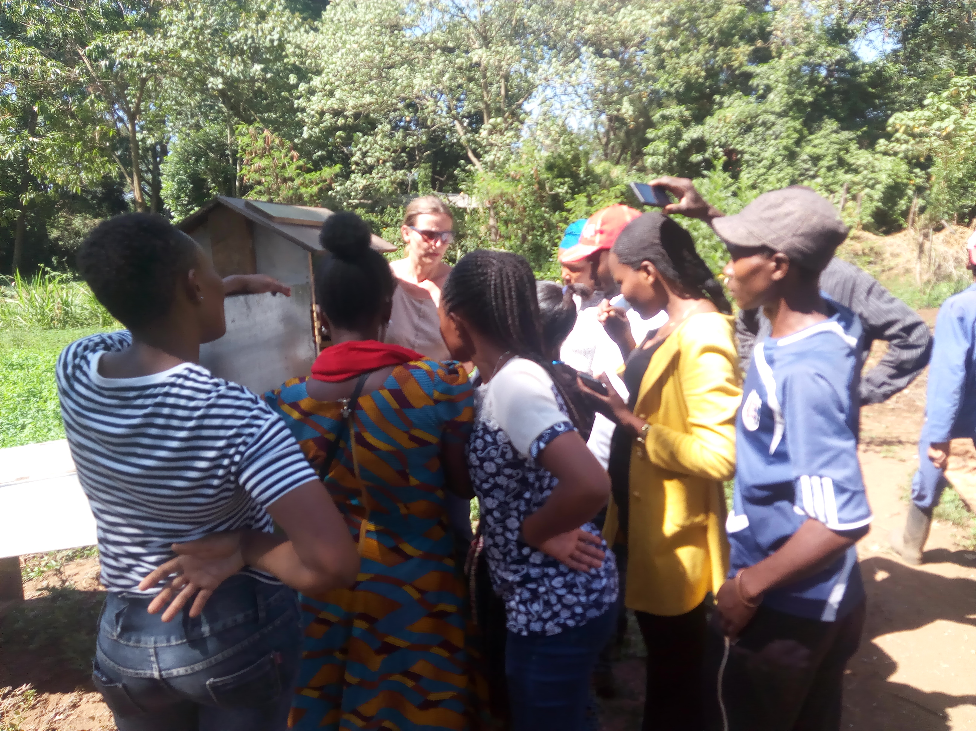
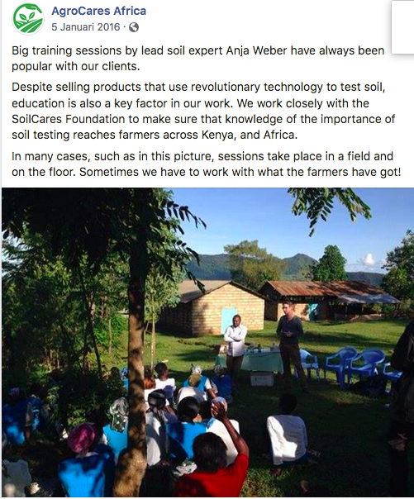
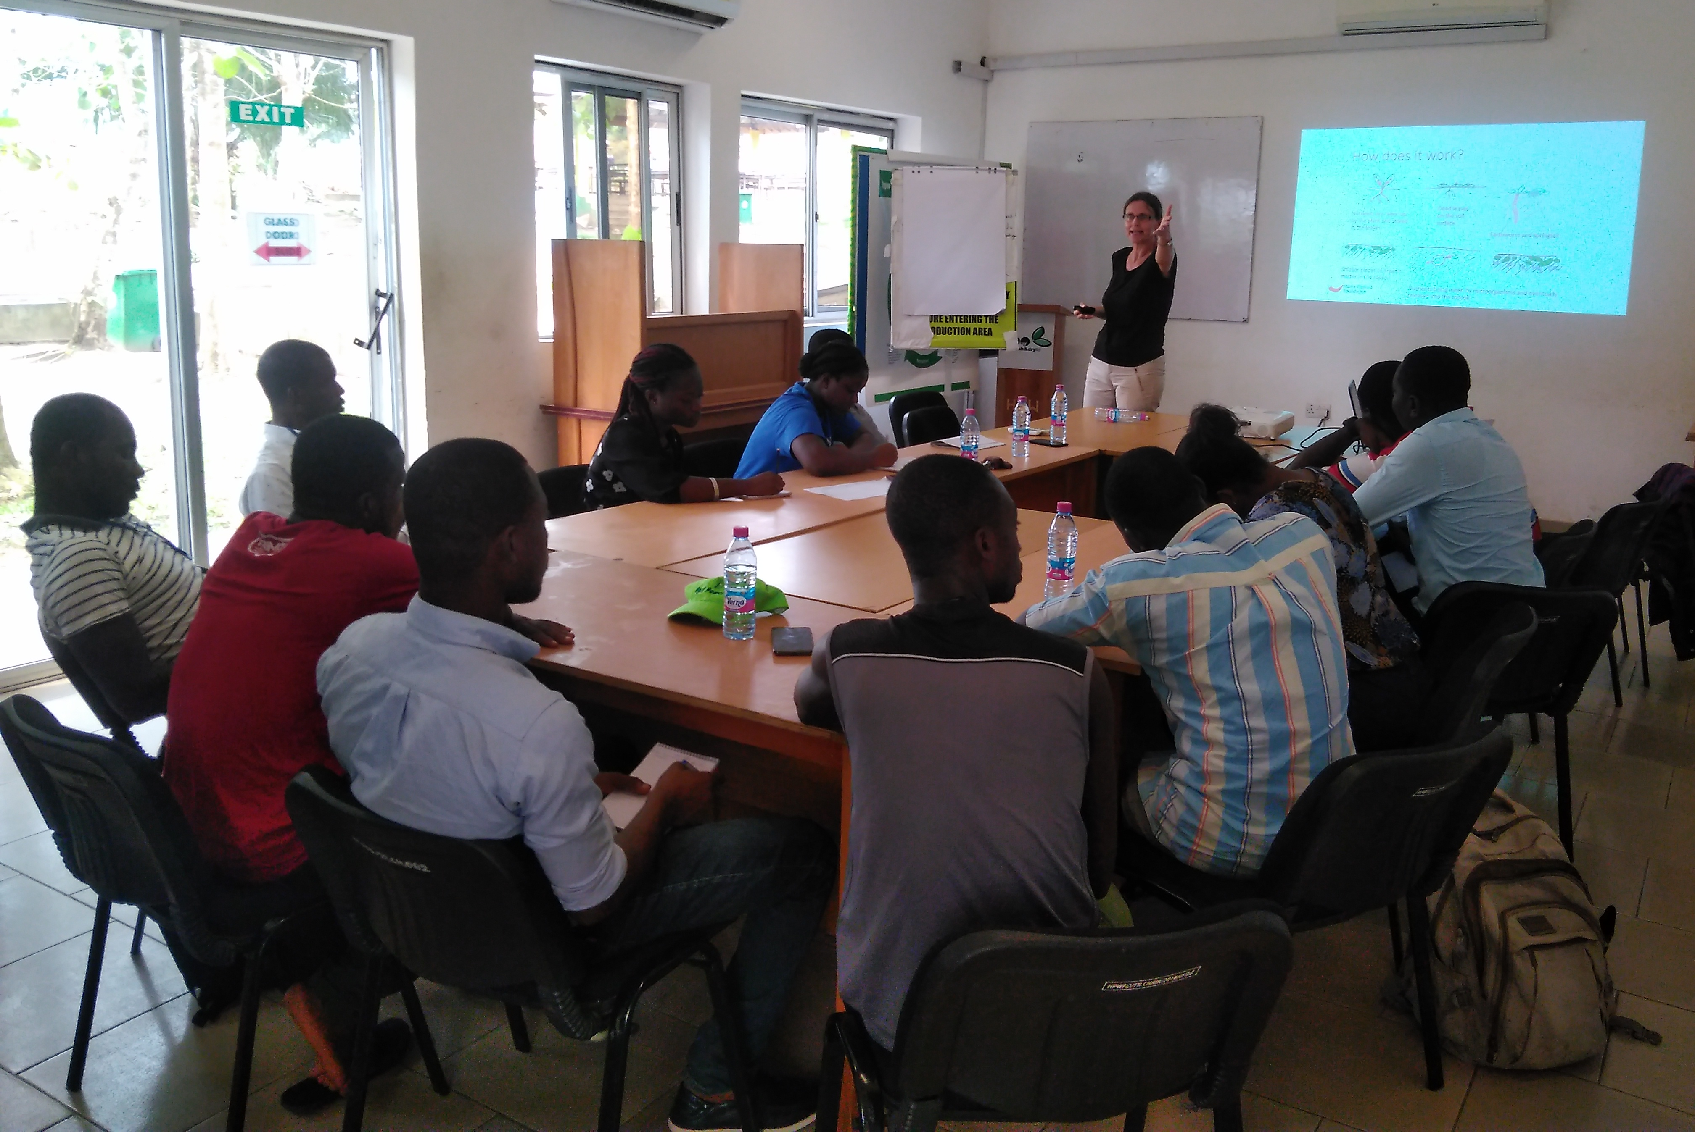
Notes:
I have a double Masters degree in educational Science and Social Behavioral Science with a Major in Organisational Management and worked for 25 years in Africa, as a manager, entrepreneur but also trainer and consultant. Hereyou see me conducting a soil fertility trainings in Kenya, working with a Tanzanian women‘s group to set up a mango drying business or assisting a large company, HPW in Ghana, to reduce waste in their processes.

Slide 21
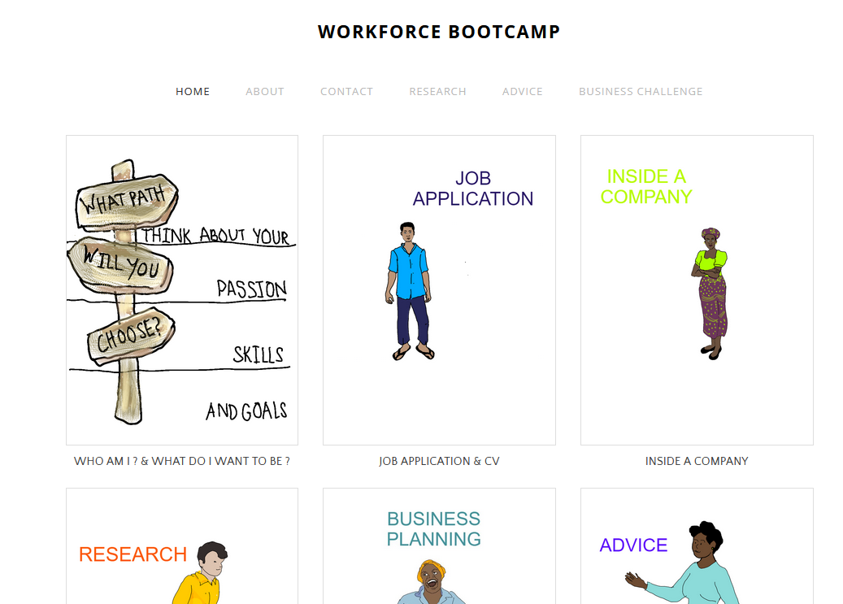
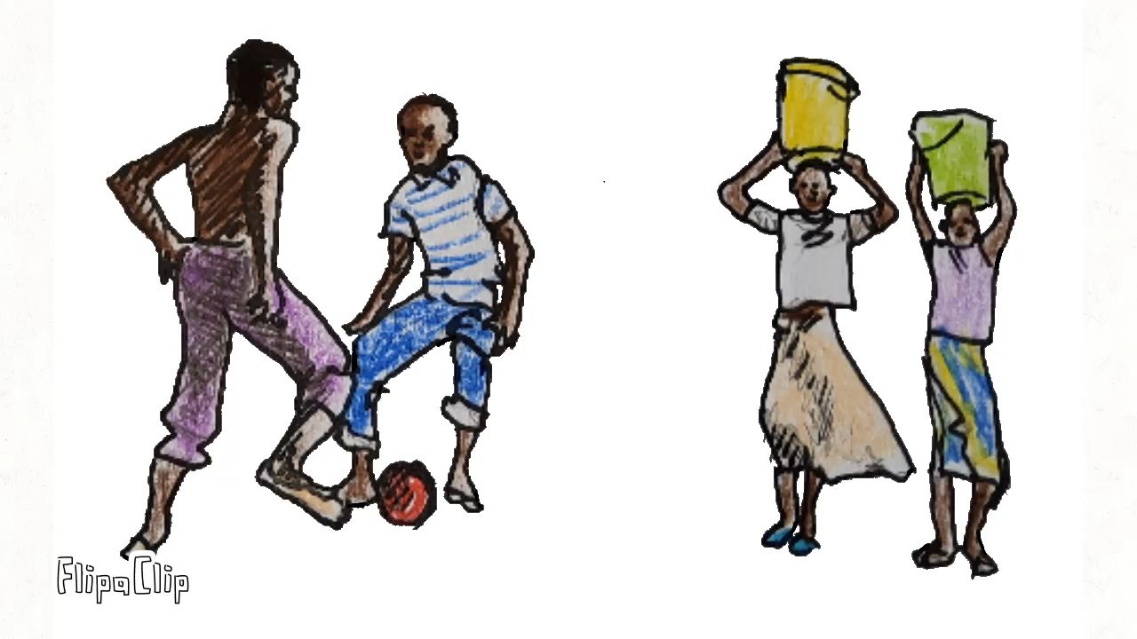
Notes:
In 2016 I joined GIZ in Western Kenya as a development worker at Bukura Agricultural College, where I taught career guidance. For that I developed our own website,
https://workforce-camp.weebly.com/
After becoming grandparents in 2021 we decided to return to Germany and joined HSWT, where I am in charge of developing digital learning materials together with our African partners. For this I also do my own artwork and small animations

Slide 22
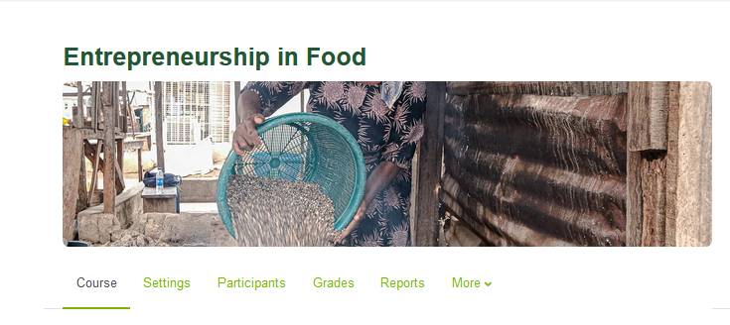
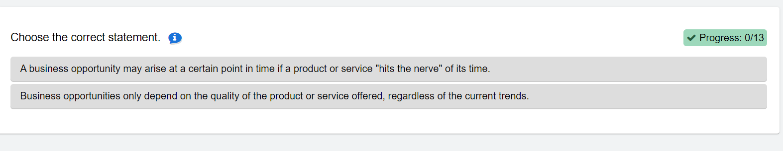


Notes:
One result of this is the entrepreneurship in food online course, that we have taught in tandem with Hawassa university.
file:///C:/Users/hswt993anj/Downloads/Let&%23039%3bs%20summarize.....html

Slide 23

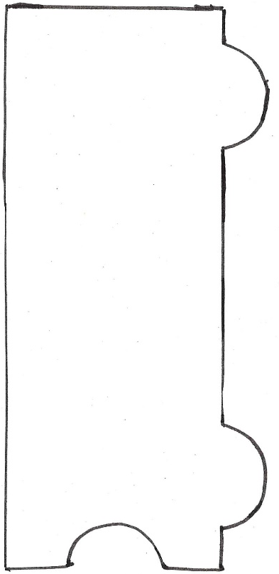


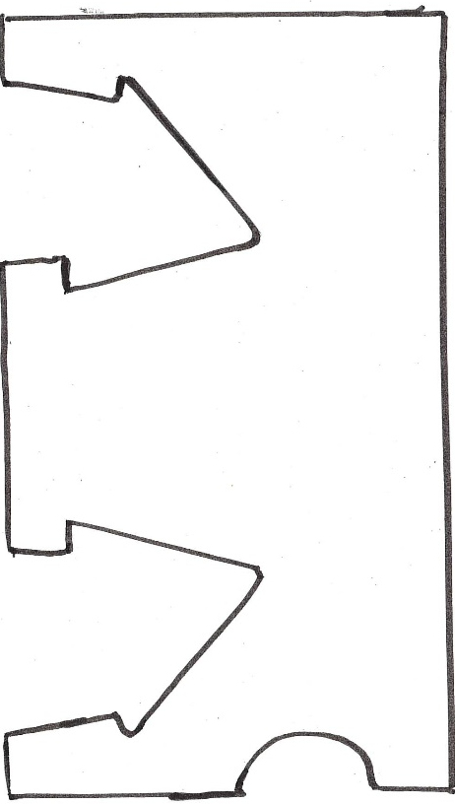














Customer Relationships
Key Activities
Key
Partners
Value Prosposition
Customer Segments
Key Resources
Channels
Brand Name
& Logo
Cost Structure
Revenue Streams
Notes:
During my work I have become a big fan of the business canvas, and I will use it also during our 5 days here to tackle some of the questions:
Who are the students & youths we are targeting as participants in Agri-Mocks activities?
Which of their problems do we offer to solve or which need do we satisfy?
How do we work together to prepare our programs and activities? Where and how will we offer our activities? How do we reach our target groups?
What do we need to be able to do this? Do we need help or support from our wider network?
How can we do this within our budget and within the timeframe of the next lumpsum payment, which will only come after we have accomplished 40% of our deliverables.

Slide 24
AGRI-MOCKS KOM
DEVELOP A PROTO PERSONA
Introduce your students/youth participants
Interactive - Day 1 - 28.04.2025

Slide 25


Slide 26
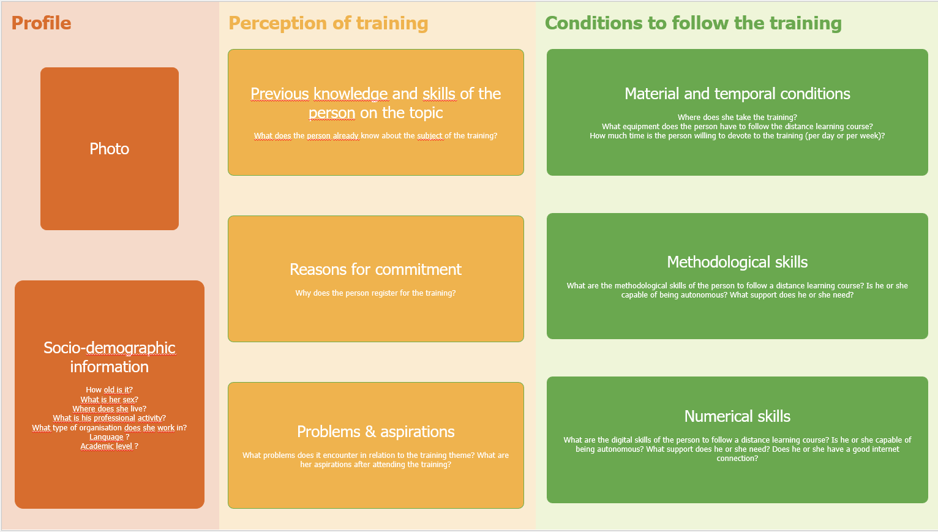

Slide 27
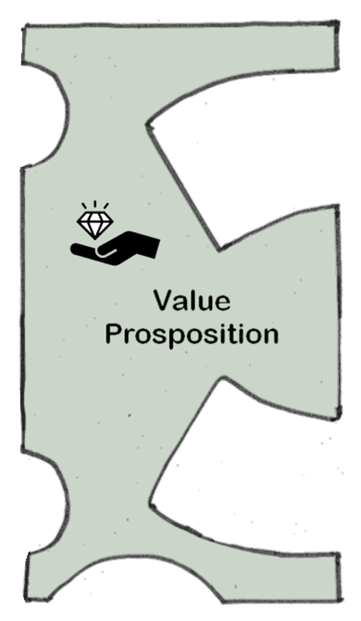

Slide 28
AGRI-MOCKS KOM
LOGISTICS
Day 1 - 28.04.2025

Slide 29
Logistical issues
Hotel & Transport
Meals & Payments
Timetable
Roles during the KOM
Leading sessions on Day 5 (committees and FOP)
Any other open Questions

Slide 30
AGRI-MOCKS KOM
Reporting: GA, CA, Sigma, Finances & Co
Anja & Tarja
Day 2 - 29.04.2025 (morning)

Slide 31
Let’s….
create a safe space
be open to receiving thoughts and perspectives from everyone
treat others fairly and with respect

Slide 32

Project Management
and Financial Procedures
Dr. Tarja Dworrak, Centre for Research and Knowledge Transfer
International Research Management
29.04.2025
Notes:
Links always in a brighter green or in the notes

Slide 33




Within the Erasmus+ Programmes
Extending the reach
Technology-enabled learning across cultures
→ Inclusive and accessible internationalization strategies
→ Contribution to the digital transformation of higher education
Capacities for digital pedagogy and global networking
Institutional goals for internationalization
Weihenstephan-Triesdorf University of Applied Sciences | Agri-Mocks
Notes:
Virtual exchange compliments the traditional mobility of Erasmus+ and extends the reach
VE = technology-enabled, people-to-people dialogues and collaborative learning across cultures
Goals:
Inclusive and accessible internationalization strategies
Contribution to the digital transformation of higher education and youth work
Benefits:
Expand international collaboration without high logistical or financial effort
Align with institutional goals for diversity, inclusion, and internationalization
Build capacities for digital pedagogy and global networking.

Slide 34


Governance Structure EU Funded Projects
Grant Agreement (GA)
= consortium +
European Commission
Consortium Agreement (CA)
= between the consortium
External obligations
Internal obligations
Weihenstephan-Triesdorf University of Applied Sciences | Agri-Mocks
Notes:
1. Grant Agreement (GA)
Between the EC and the Coordinator (on behalf of the consortium)
Legal contract setting out the rules of the Erasmus+ funding
Defines:
Overall project scope, objectives, and budget
Eligibility rules and reporting requirements
Payment structure (Lump Sum model in this case)
The coordinator is legally responsible for:
Communicating with the EC
Submitting reports
Distributing funds to partners based on implementation
2. Consortium Agreement (CA)
Between all project partners – internal governance
Defines how the consortium will work together
Customizable – adapted to project size and complexity
Specifies:
Partner roles and responsibilities
Decision-making processes (e.g. voting rules)
Internal communication and reporting procedures
Conflict resolution and liability clauses
Distribution of lump sum shares (who gets what, when)

Slide 35


Lump Sum Funding Model
WP
WP
WP
Deliverable
Deliverable
Deliverable
Deliverable
Deliverable
Deliverable
Deliverable
Deliverable
Deliverable
Weihenstephan-Triesdorf University of Applied Sciences | Agri-Mocks
Notes:
How it Works
The grant is broken into work packages or activities
Each work package is linked to:
Expected results or deliverables
A fixed amount of funding
Funds are paid if the results are delivered and accepted
→ If not, that part of the lump sum may be reduced or rejected
Reporting Under Lump Sum
Focuses on what was done, not how much it cost
You must prove implementation, e.g.:
Participation records
Meeting reports or recordings
Learning content, videos, screenshots, publications
No financial documents (invoices, payslips, etc.) are submitted to the EC
Implications for Partners
Each partner is responsible for:
Implementing agreed activities
Providing evidence of delivery
Internal payments (from coordinator to partners) are often linked to milestones
Your share of the lump sum is defined in the Consortium Agreement
The estimated lump sum breakdown does not prescribe how the EU contribution is to be used by the beneficiaries. It shows the amounts that the EACEA commits to pay if the action is implemented properly, regardless of the costs actualy incurred.

Slide 36
Lump Sum Funding Model: Assessing WP
Activities carried out
Quality of the deliverables
Achievement of the objectives and expected outcomes
→ WP Completed vs. Not Completed
All taks/deliverables completed Or Equivalent tasks reaching the same result All partners completed it Deviations: are justified | Can be finished and declared later on in any subsequent report Partially completed: show the % of completion Explanation in the final report
Weihenstephan-Triesdorf University of Applied Sciences | Agri-Mocks

Slide 37
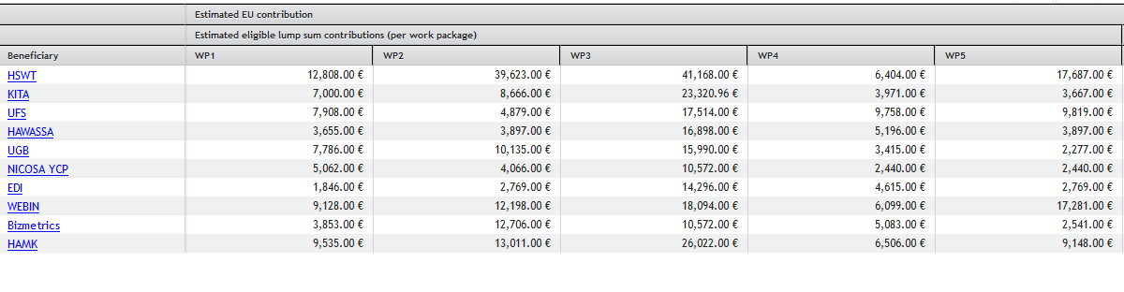
Lump Sum Funding Model: WP Costs per Partner
Deliverable
Deliverable
Deliverable
Deliverable
Deliverable
Deliverable
Deliverable
Deliverable
Deliverable
Weihenstephan-Triesdorf University of Applied Sciences | Agri-Mocks
Notes:
Screenshot from the Portal

Slide 38




Roles and Responsibilities
Coordinator
EU
Communicate
Share updates, inform the coordinator in case of delays, changes, or risks
Project Partners
Weihenstephan-Triesdorf University of Applied Sciences | Agri-Mocks
Notes:
Coordinator (Weihenstephan-Triesdorf University)
Main contact with the EC
Legally responsible for the Grant Agreement
Coordinates overall project activities and quality assurance
Submits progress and final reports
Collects and validates deliverables from partners
Distributes lump sum shares according to the Consortium Agreement
Organises meetings and supports communication
Does the continuous reporting
Project Partners
Carry out the activities assigned in the application and Consortium Agreement
Ensure quality and timely delivery of outputs and milestones
Provide evidence of implementation (photos, agendas, materials, participation logs, etc.)
Share updates and progress with the coordinator
Participate actively in project meetings and collaborative tasks
Inform the coordinator in case of delays, changes, or risks

Slide 39
Project Timeline and Milestones
Sent 40% of the budget
Deadline 1. Report:
29.9.26
End 1st Period: 31.7.26
Begin 1.2.25
Continuous Reporting Portal: Deliverables should be regularly uploaded in the portal before the reporting deadline.
Check, send 40% of the budget
Deadline 2. Report:
31.3.28
End 2nd Period: 31.1.28
Begin 1.8.26
Check, send final payment
Weihenstephan-Triesdorf University of Applied Sciences | Agri-Mocks
Notes:
For additional prefinancings (if any), the amount due, schedule and modalities are also set out in
the Data Sheet (see Point 4.2). However, if the statement on the use of the previous prefinancing
payment shows that less than 70% was used, the amount set out in the Data Sheet will be reduced by
the difference between the 70% threshold and the amount used.
VERY IMPORTANT: Deliverables should be regularly uploaded in the portal before the reporting deadline.
Continuous Reporting = periodic uploading of results
Periodic Reporting Module = linked to payment

Slide 40
Q&A
?
!
Weihenstephan-Triesdorf University of Applied Sciences | Agri-Mocks
Notes:
Further communication

Slide 41
Thank you for your interest.
Dr. Tarja Dworrak
29.04.2025

Slide 42
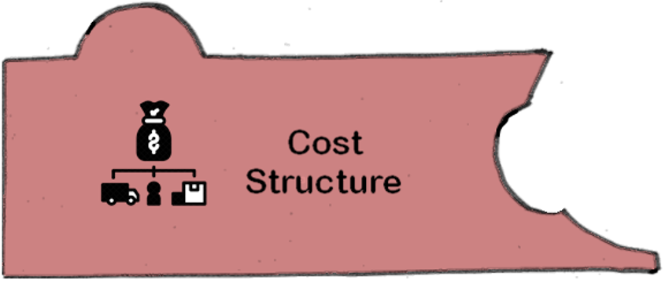


Slide 43
Transfers
 | 1. payment (40%) | WP 1 costs | WP2 costs | 2. payment (40%) | WP3 costs | WP 4 costs | WP 5 costs | Final payment
HSWT |  | 12,8008.00 | 39,623.00 |  | 41,168.00 | 6,404.00 | 17,687.00
KITA | 18,649.53 | 7,000.00 | 8,666.00 | 18,649.53 | 23,320.00 | 3,971.00 | 3,667.00 | 9,324.76
UFS | 19,951.86 | 7,908.00 | 4,879.00 | 19,951.86 | 17,514.00 | 9,758.00 | 9,819.00 | 9,975.93
HAWASSA | 13,417.80 | 3,655.00 | 3,897.00 | 13,417.80 | 16,898.00 | 5,196.00 | 3,897.00 | 6,708.9
UGB | 15,841.14 | 7,786.00 | 10,135.00 | 15,841.14 | 15,990.00 | 3,415.00 | 2,277.00 | 7,920.57
NYCOSA | 9,831.59 | 5,062.00 | 4,066.00 | 9,831.59 | 10,572.00 | 2,440.00 | 2,440.00 | 4,915.79
EDI | 10,517.93 | 1,846.00 | 2,769.00 | 10,517.93 | 14,296.00 | 4,615.00 | 2769.00 | 5,258.96
WEBIN |  | 9,128.00 | 12,198.00 |  | 18,094.00 | 6,099.00 | 17,281.00
BizMetrics | 14,096.16 | 3,853.00 | 12,706.00 | 14,096.16 | 10,572.00 | 5,083.00 | 2,541.00 | 7,048.08
HAMK | 25,688.99 | 9,535.00 | 13,011.00 | 25,688.99 | 26,022.00 | 6,506.00 | 9,148.00 | 12,844.49

Slide 44
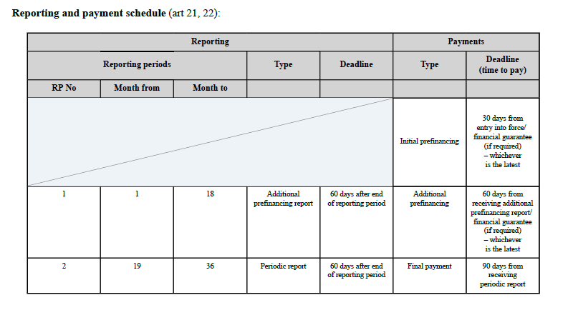









Payment schedule
Month 18 = August 2026
+ 60 days = October 2026
+ 60 days = December 2026
+ 90 days = July 2028
Month 36 = February 2028
+60 days = April 2028

Slide 45
Staff Effort in Person-Months
Partner | WP1 | WP2 | WP3 | WP4 | WP5 | Total | 40% | 80%
HSWT | 2 | 5 | 5 | 1 | 3 | 16 | 6.4 | 12.8
KITA | 2 | 3 | 8 | 2 | 3 | 18 | 7.2 | 14.4
UFS | 1 | 1 | 4 | 2 | 3 | 11 | 4.4 | 8.8
HAWASSA | 2 | 3 | 8 | 4 | 3 | 20 | 8 | 16
UGB | 4 | 4 | 7 | 3 | 2 | 20 | 8 | 16
NYCOSA | 3 | 5 | 7 | 3 | 3 | 21 | 8.4 | 16.8
EDI | 2 | 3 | 8 | 5 | 3 | 21 | 8.4 | 16.8
WEBIN | 2 | 4 | 5 | 2 | 4 | 17 | 6.8 | 13.6
BizMetrics | 1 | 5 | 4 | 2 | 1 | 13 | 5.2 | 10.4
HAMK | 1 | 2 | 4 | 1 | 2 | 10 | 4 | 8
Total: | 20 | 35 | 60 | 25 | 27 | 167 | 66.8 | 133.6

Slide 46
Staff Effort in Person-Months
1 year = 220 working days
1 person-month = 220/12 = 18.33 working days
1 working day = 8 hours
=> 1 person-month = 18.33 x 8 hours

Slide 47
Staff Effort in Person-Hours
Partner | WP1 | WP2 | WP3 | WP4 | WP5 | Total | 40% | 80%
HSWT | 293.28 h | 733.2 h | 733.2 h | 146.64 h | 439.92 h | 2346.24 h | 938.5 h | 1877 h
KITA | 293.28 h | 439.92 h | 1173.12 h | 293.28 h | 439.92 h | 2639.52 h | 1055.52 h | 2111 h
UFS | 146.64 h | 146.64 h | 586.56 h | 293.28 h | 439.92 h | 1613.04 h | 645.22 h | 1290.44 h
HAWASSA | 293.28 h | 439.92 h | 1173.12 h | 586.56 h | 439.92 h | 2932.8 h | 1173.12 h | 2346.24 h
UGB | 586.56 h | 586.56 h | 1026.48 h | 439.92 h | 293.28 h | 2032.8 h | 813.12 h | 1626.24 h
NYCOSA | 439.92 h | 733.2 h | 1026.48 h | 439.92 h | 439.92 h | 3079.44 h | 1231.78 h | 2463.56 h
EDI | 293.28 h | 439.92 | 1173.12 h | 733.2 h | 439.92 h | 3079.44 h | 1231.78 h | 2463.56 h
WEBIN | 293.28 h | 586.56 h | 733.2 h | 293.28 h | 586.56 h | 2492.88 h | 997.15 h | 1994.3 h
BizMetrics | 146.64 h | 733.2 h | 586.56 h | 293.28 h | 146.64 h | 1906.32 h | 762.53 h | 1525.06 h
HAMK | 146.64 h | 293.28 | 586.56 h | 146.64 h | 293.28 h | 1466.4 h | 586.56 h | 1173.12 h
Total: | 2932.8 h | 5132.4 h | 8798.4 h | 3666 h | 3959.28 h | 24488.88 h | 9795.55 h | 19591.1 h

Slide 48
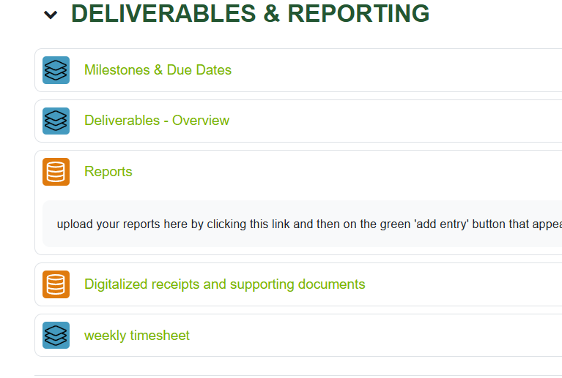
Time Sheet Keeping
https://wbmoodle.hswt.de/mod/onlyofficeeditor/view.php?id=175529

Slide 49
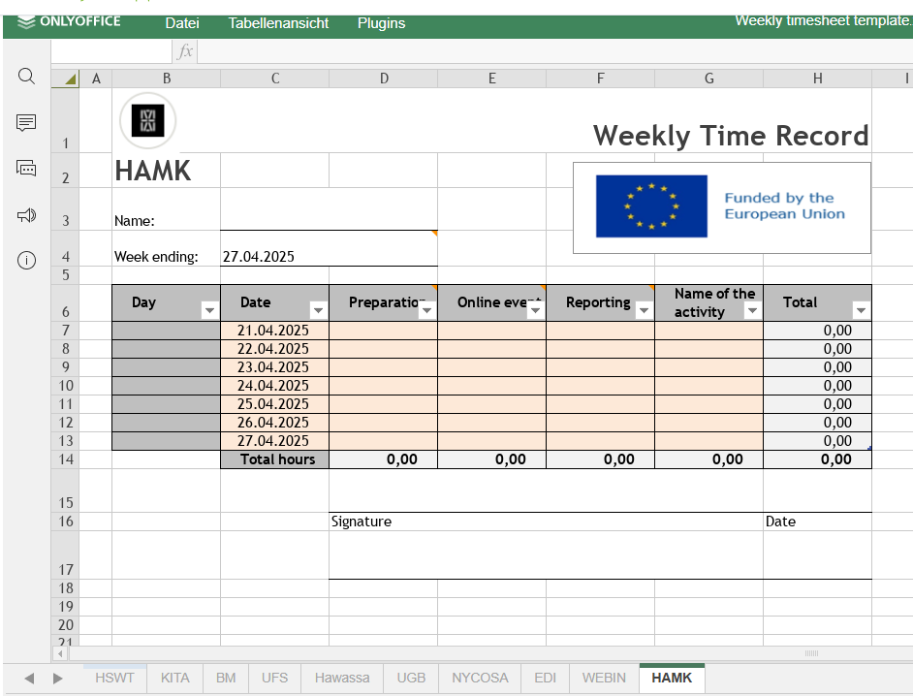
Time Sheet Keeping

Slide 50
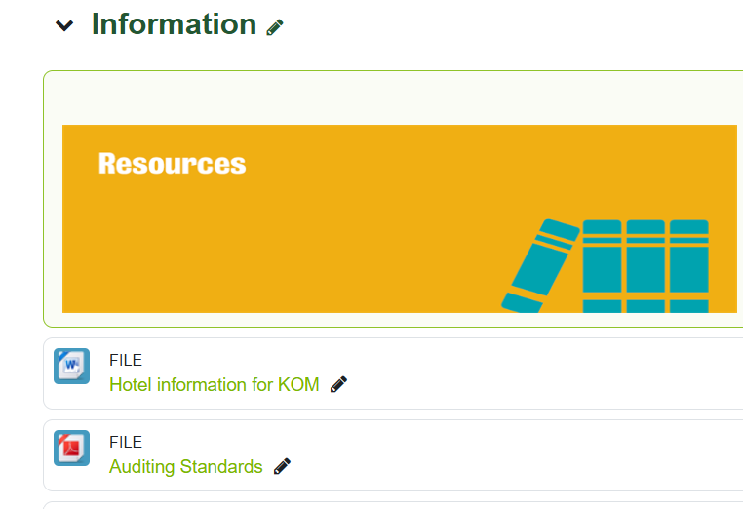
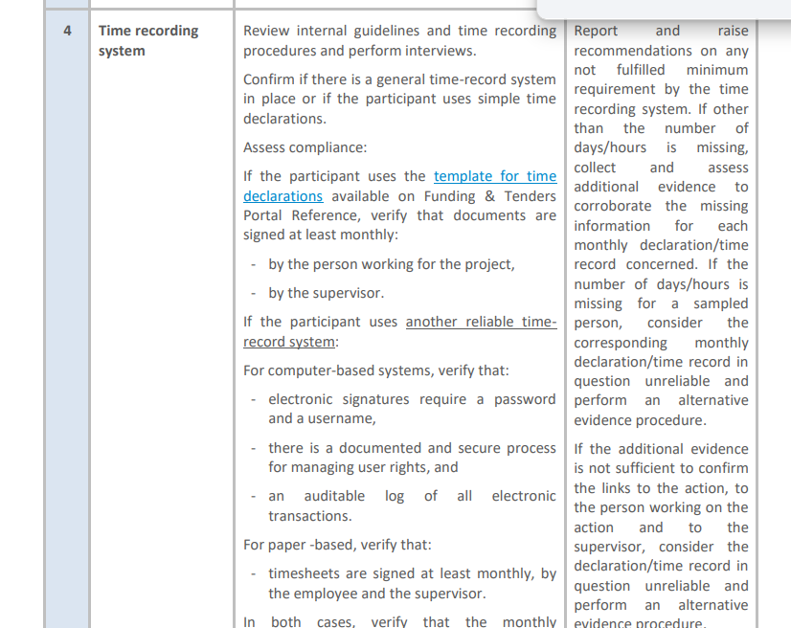
Time Keeping requirements
EU Audit Question Catalog.pdf

Slide 51
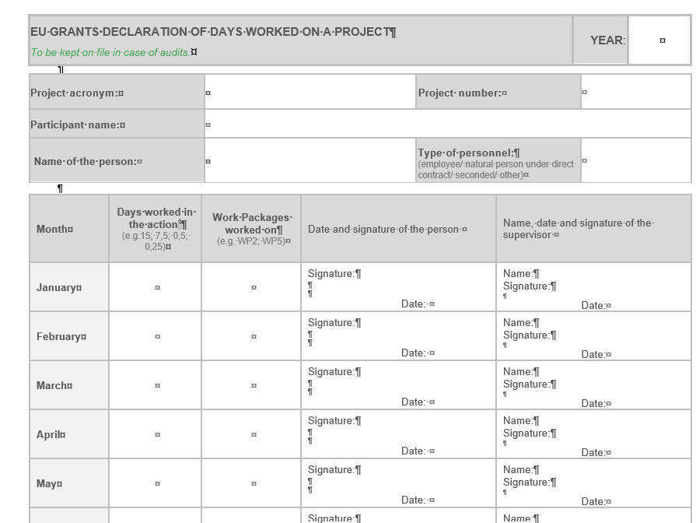
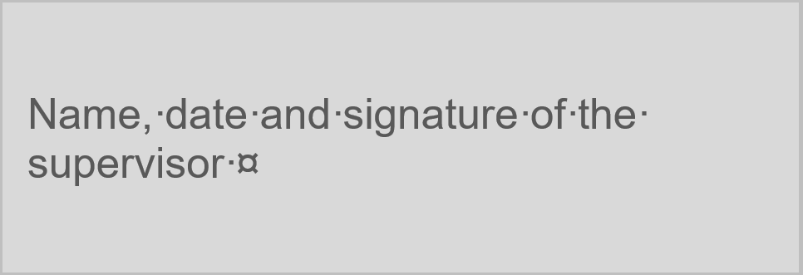
Time Keeping EU format

Slide 52
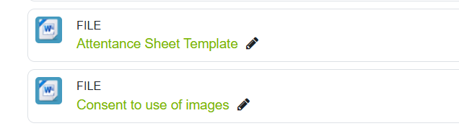
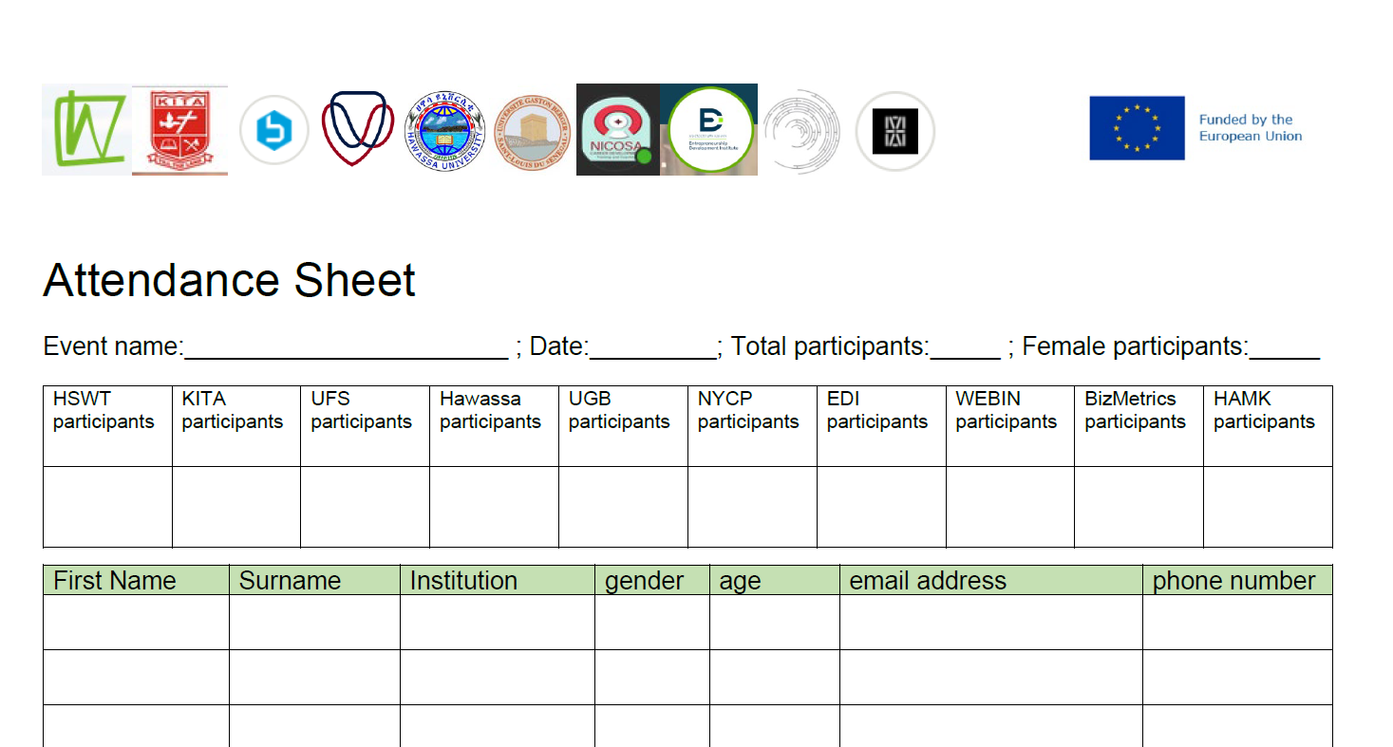
Attendance Record Keeping

Slide 53
Input 1
The Power of Feedback
Anja
Day 2 – 29.04.2025 (morning)

Slide 54


Slide 55
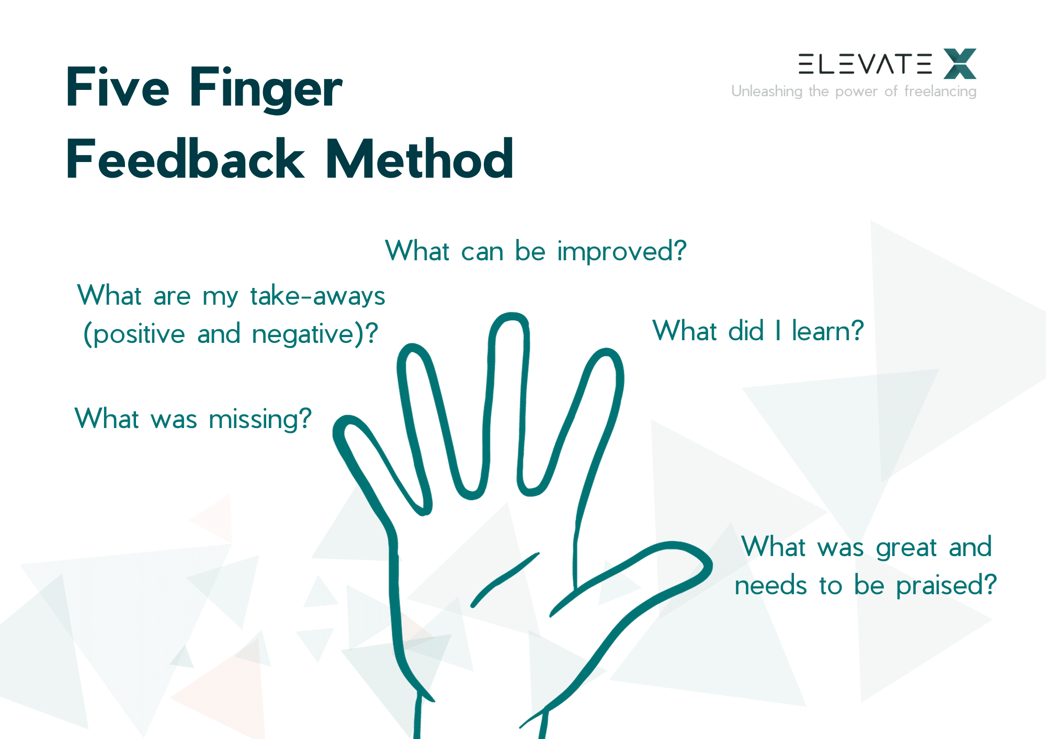
Five Finger
Feedback Method

Slide 56
AGRI-MOCKS KOM
Quality Architecture
WEBIN
Day 2 – 29.04.2025 (afternoon)

Slide 57
AGRI-MOCKS KOM
Project Management Structure
WEBIN
Day 2 – 29.04.2025 (afternoon)

Slide 58
ERASMUS Virtual Exchange (EVE)
AGRI-MOCKS
Strategic Planning Workshop
Anja
Day 3 – 30.04.2025 (morning)
Notes:
Anja

Slide 59
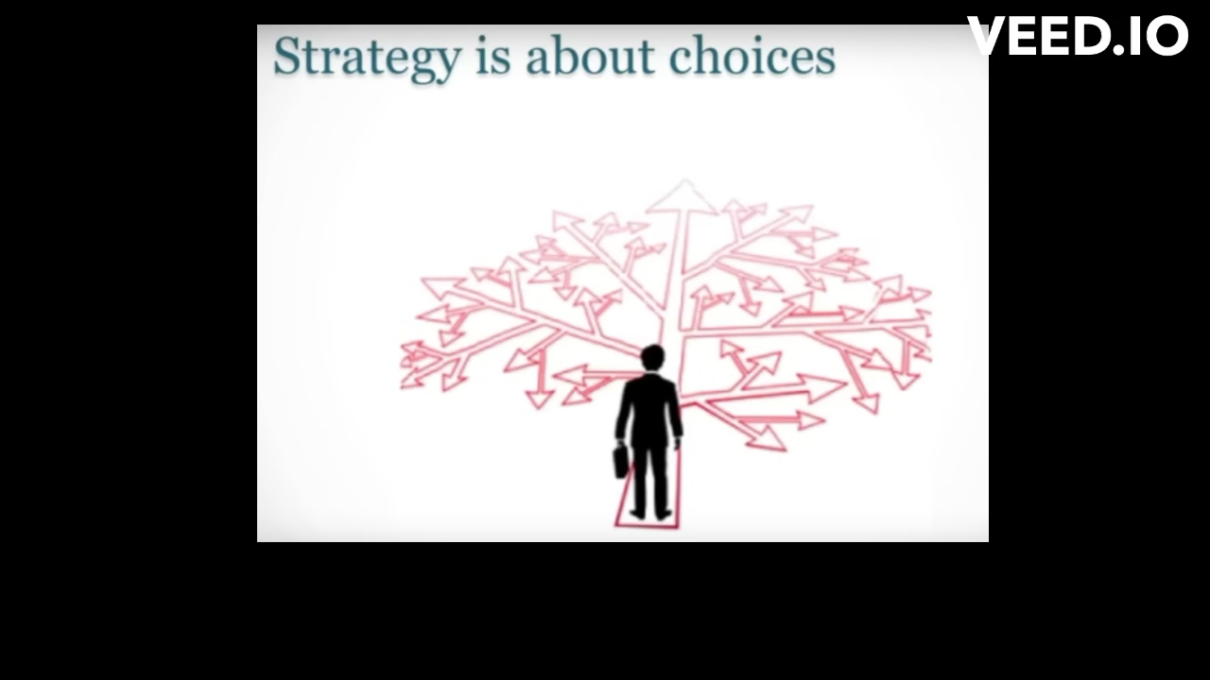
Strategy is about choices
Notes:
When we were visiting Marina and Marlies the other day I thought that developing a strategy is a bit like developing a new recipe. You look at the food that you have and taste it and decide what to do to improve it. I hope we can do that – at least in part– here today. My objective for this workshop is to develop a kind of roadmap, to make sure we are all on the same page, and moving in the same direction. And specifically for myself, I would like to make sure that the things that I am doing are getting me / us towards where we want to go.

Slide 60

Agri-Mocks Roadmap
Where we want to be
Two weeks course to become a Google Adwords expert.
Jan 2028
are we
on track?
getting
there
Oct
2027
July
2026
What we
need to
do first
Where
we are
Apr
2025
Aug
2025
© TemplateLab.com
Notes:
To do that I would like to use this kind of timeline approach
Jan 2026 WP2 deliverables (e-internship developed with VE-space)
Aug 2025 Del. 2.1 trainers have received capacity building trainings

Slide 61
Where
we are
April/May
2025
Notes:
Where we first look at where we currently are

Slide 62

What are we good at
individually?
Notes:
And to help us get a better understanding of each others’ unique skills, I would like to create a picture of the things we do well.
Could somebody please take a markerpen and add the skills to the puzzle pieces as they get mentioned?

Slide 63
Input 2: Barriers & Enablers in EVE
Factors in online learning design
Anja
Day 3 – 30.04.2025 (morning)

Slide 64
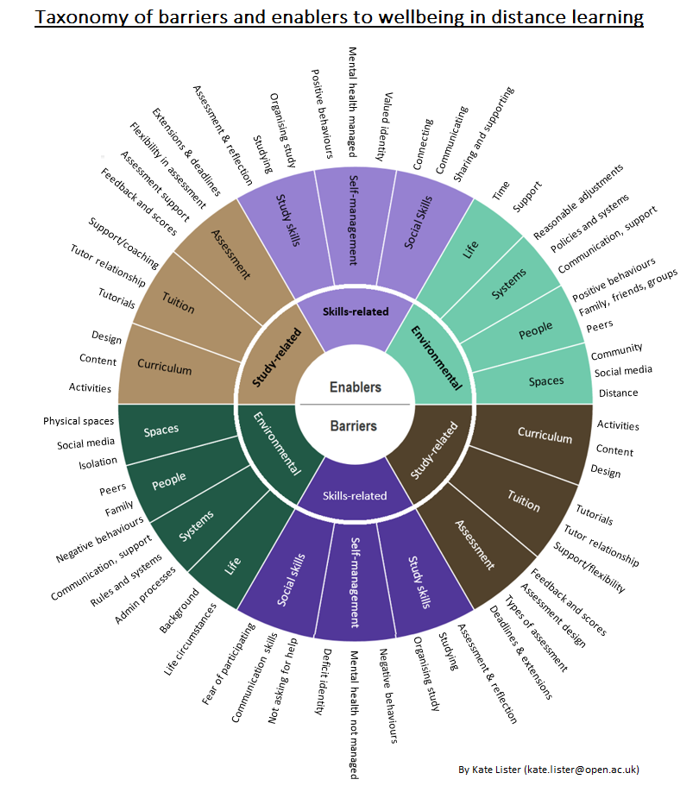
Enablers
__________
Barriers
Notes:
Curriculum design was critical; Structure, routine and flexibility within curriculum design were recurrent enablers
Forums were highlighted as an enabler; students perceive that they can get support on a forum
In the tuition category, tutors were mentioned both positively and negatively. They were enablers if they genuinely cared, showed enthusiasm and commitment, and if students knew they had the tutor’s support
It seems to be important to recreate in the online setting the kind of free flow dialogue, a discussion that you get in a face-to-face environment
Assessments being clearly worded was mentioned as extremely important. Unclear assessment instructions or criteria were extremely triggering anxiety for students.
Feedback is seen as an enabler if lecturer and students managed to develop a relationship based on trust

Slide 65
Enablers
__________
Barriers
Notes:
students and tutors both highlighted workload as a barrier: Even perceived workload which causes a panic mode; too much to do, can’t cope!’
Activities within the curriculum could be challenging, collaborative activities in particular when participants don’t like to interact with people.
Tutors were viewed as problematic if they were unkind or patronizing, if they were ‘really not helpful’, if they ‘told off’ the student or if students were given different advice from the tutor and the moderators
Exams were exclusively mentioned as a barrier.
Negative feedback, and the fear of negative feedback, were highlighted as barriers.

Slide 66
Enablers
__________
Barriers
Notes:
acquirement of skills or confidence in skills were seen as an enabler. This category was broken down into study skills, social skills, and self-management skills.
Social skills refer to how students related to other people in their courses.
Study skills were both a key enabler when present, and a clear barrier when not. Students needed help to learn how to study effectively, how to take notes and how to revise, or even learning to concentrate for longer, and to learn time management skills. Once these skills were acquired they became enablers as students reported growing confidence.
Self-management skills related to positive behaviours, students’ confidence and sense of identity and belonging. An important aspect of identity was recognising growth and success. Taking time to celebrate successes was just as important as managing expectations.
Mental Health management in the form of e.g. taking part in positive activities provided, collecting souvenirs, reminders and outputs (including photo albums, common facebook page or website, group song, etc.) from positive activities were mentioned as beneficial

Slide 67
Enablers
__________
Barriers
Notes:
lack of skills caused distress or a barrier. Social skills related barriers were primarily in terms of communication, not asking for help, and fear of participating in forums and tutorials, which for some caused anxiety.
Study skills were both a key enabler when present, and a clear barrier when not. Students needed help to learn how to study effectively, how to take notes and how to revise, or even learning to concentrate for longer, and to learn time management skills. Once these skills were acquired they became enablers.
Absence of study skills was a clear barrier.

Slide 68
Enablers
__________
Barriers
Notes:
There was a fine line between the distance environment being a barrier or an enabler. In an online setting it is important to establish a link between the participants and a feeling of belonging and pride to associate with the people met and activities conducted. For many students not having to attend an in-person class was seen as positive and enabling.
Social media was generally seen as a positive space.
University systems, structures and administrative processes were strongly felt as both barriers and enablers. Understanding the need for certain structures, reminders of deadlines, assistance in filling in forms, offering learning materials in different formats, etc. can change these into enablers.
Communication from the institution needs to be forthcoming and proactive to be enabling.
People clearly had the power to be a positive or negative influence on study or wellbeing. Peers were generally an enabler;
Life circumstances were enablers if students had time and support to be able to study.

Slide 69
Enablers
__________
Barriers
Notes:
‘Isolation’ was a clear barrier for students.
Communication from the institution was often seen as a clear barrier.
Peers were felt to be a barrier if students felt they were ‘being judged and disliked’
General life circumstances had enormous potential to be barriers. Barriers included work, bereavement, family or relationship issues, illness, pregnancy and maternity, and also background issues such as economic status and coming to terms with sexuality.
A key finding of this study is that barriers and enablers were found in the majority of themes, implying that aspects of the study can be both barriers or enablers for mental wellbeing and study success, depending on who is experiencing them and how. Crucially, this implies that there is potential for many of the barriers students experience to become enablers; for example, assessment feedback was a barrier for students when it was negative, but was an enabler when it was constructive and took place in an environment of trust. Similarly, lack of study skills was a barrier, but confidence in study skills was an enabler. This presents an interesting contrast to individualistic interventions, such as aiming to reduce assessment-related stress with a mindfulness intervention (Galante et al., Citation2018), implying instead that the assessment design could require investigation.

Slide 70

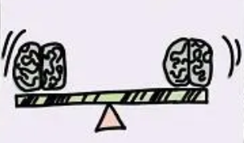








FROM THE WORK OF NANCY KLINE
„More Time to Think“
HOW TO THINK BETTER
ATTENTION
EQUALITY
EASE
APPRECIATION
ENCOURAGEMENT
Listening without interruption is an art of creation
Our thinking is different & equal
You cannot think in a hurry. Create freedom from rushing.
Appreciate 5x more than you criticize
Eliminating competition improves thinking
INCISIVE
QUESTION
INFORMATION
FEELINGS
DIVERSITY
PLACE
What are you denying that would liberate your thinking?
Fear prevents thinking. Laughter helps.
People will think for themselves
Remove false, limiting assumptions
The place – and your body - matters

Slide 71
Input 3: New ways in learning
Some ideas for Agri-Mocks activities
Anja & Emad Helmy
Day 3 – 30.04.2025 (afetrnoon)

Slide 72
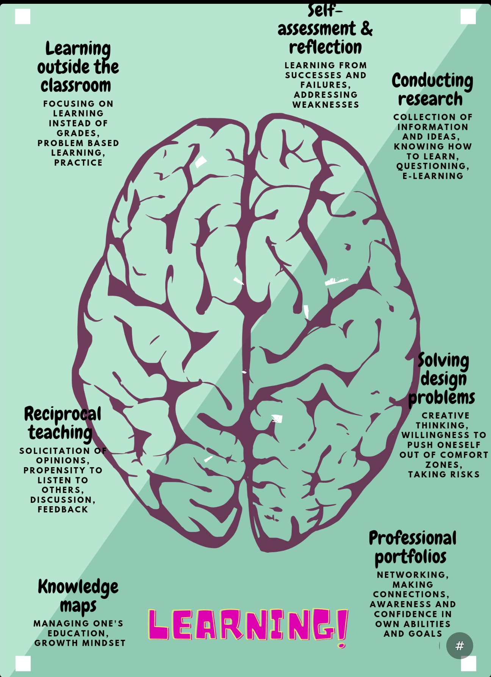








Slide 73
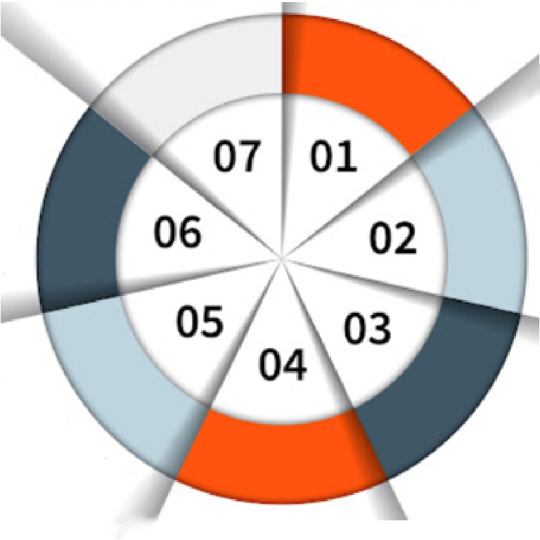
Gamification
of moodle
Keep me posted, be social
Virtual classroom
Create a blog
Digital citizenship
Youtubers,
Create songs with AI
Simulations
Notes:
Keep me posted
Create a common social media account for your class where participants can post about something they’ve been learning and be social
Create a blog
Encourage students to contribute regularly then share their posts on several sociual media sites. They may also comment to other’s posts.
Simulations to learn from virtaul company settings
YouTubers
Create a youTube channel and let students create videos e.g. of interviews, roleplays, AI-generated songs etc. to be posted there. Again, share across other social media
Digital Citizenship
Teach students how to create a professional online portfolio (Linkedin profile), how to fill in digital CVs for online job applications, do & don’ts to present yourself on social media (recruiters check out online profiles of applicants)
Virtual classroom Bring classes from different countries together
Gamification of learning platforms to get learners ‚hooked‘ to learning

Slide 74
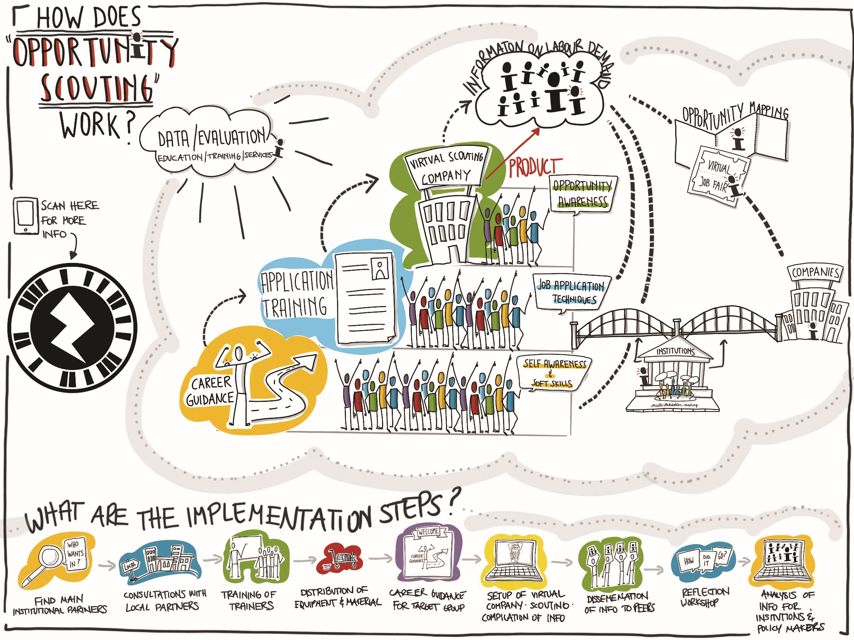
meet Emad
Notes:
https://hswt.zoom.us/j/4278250055?omn=98057317483

Slide 75
ERASMUS Virtual Exchange (EVE)
AGRI-MOCKS
Dissemination and Communication
UFS
Day 3 – 30.04.2025 (afternoon)

Slide 76

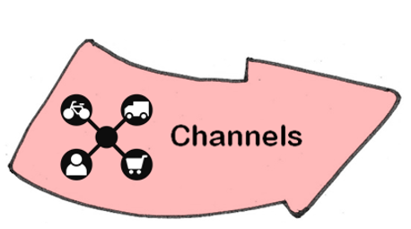

Slide 78

Notes:
Should we have our own logo?

Slide 79
ERASMUS Virtual Exchange (EVE)
AGRI-MOCKS
Unpacking the Work Packages
Interactive Workshop
Day 4 – 01.05.2025 (morning)

Slide 80



Slide 81
Agri-Mocks Work Packages
WP2
WP4
EVE Designing & Capacitating
Newcomers
Ensure large-scale dissemination of key messages and VE-opportunities
Support scaling & transfer of
VE-opportunities outside of the consortium
Communication, Dissemination & Exploitation
Strengthen capacity of teaching staff & youth workers
Develop e-internship program
with learning materials
WP1
WP5
WP3
Setting Off
Management & Quality Architecture
Conduct preparatory activities and make project ready for implementation
Implementation of e-internships
Enhance entrepreneurial learning, employability & civic participation of
2500 youth & students through
virtual exchanges & e-internship
Ensure smooth & effective project management and high quality performance & delivery

Slide 82
https://app.zenkit.com/home

Slide 83
WP Responsibility
UGB
HSWT
Milestones
Implementation package adopted & distributed to partners
FoP group established
Deliverables
May 2025
Administration manual for social network accounts
Project Quality architecture toolkit
Inception report containing 4 thematic reports & recommendations
WP1
Setting Off

Slide 84
WP2
WP Responsibility
Hawassa
HAMK
Milestones
E-internship developed with VR-platform, materials, instructions & learning resources, and approved for admission and implementation
Deliverables
Jan 2026
E-internship curricular
Set of training reports from webinars for staff
Virtual co-working space
Set of e-internship reckognition tools
Gender sensitive and social inclusion supportive call
ToT training report
Training report from EVE development staff training
EVE Designing & Capacitating
Newcomers

Slide 85
WP Responsibility
KITA
NYCOSA
Milestones
Selection of successful applicants completed & applicants informed about admission to
e-internship
Deliverables
Feb 2026 – Jan 2028
Set of report from e-debates
Implementation reports of e-internship Spring & Fall 2026
Implementation reports of e-internship Spring & Fall 2027
Zip-file cont. min. 4 draft proposals for EVE (35% complete)
Transformative learning toolkit on e-internships
Set of evaluation reports of 4 editions of e-internship
WP3
Implementation of e-internships

Slide 86
WP4
WP Responsibility
EDI
UFS
Milestones
Implementation package adopted & distributed to partners
Deliverables
July 2025 – Jan 2028
Set of video testimonials
Alumni network of students & youth multipliers
Green paper educational and sector policy & practice improvements
Set of 3 merged newsletters
Set of institutional program transfer agreements
Communication, Dissemination & Exploitation

Slide 87
WP Responsibility
HSWT
WEBIN
Milestones
Partner project staff trained to apply PQA methodology in project implementation, individual meetings with each partner completed
Deliverables
Feb 2025 – Jan 2028
Progress quality report #1
Project sustainability strategy with MoUs
Progress quality report #2
External evaluation report
WP5
Management & Quality Architecture

Slide 88
ERASMUS Virtual Exchange (EVE)
AGRI-MOCKS
Developing the Gantt Chart
Interactive Workshop
Day 4 – 01.05.2025 (afternoon)

Slide 89
ERASMUS Virtual Exchange (EVE)
AGRI-MOCKS
Appointing Committees
Day 5 – 02.05.2025 (morning)

Slide 91
ERASMUS Virtual Exchange (EVE)
AGRI-MOCKS
Listing potential FOPs
Day 5 – 02.05.2025 (morning)

Slide 92
