Slide 1

WELCOME
The Meeting will start at 2pm CET
(In a few minutes)
Thank you for your patience!

Slide 2
WELCOME
Training of Trainers (ToT)
for Virtual Facilitators and Mentors June 8th – 10th, 2026
Day 2:
Communication, Online Presence and Managing Discussions - Yitna
Effective Mentorship: Roles, Skills, and Supporting Mentee Development - Anja

Slide 3









E-INTERNSHIP
ERASMUS virtual exchange program
End Date: first Quarter of 2028
Number of participants: 2500 young adults
Participating partners:
Coordinated by:

Slide 4

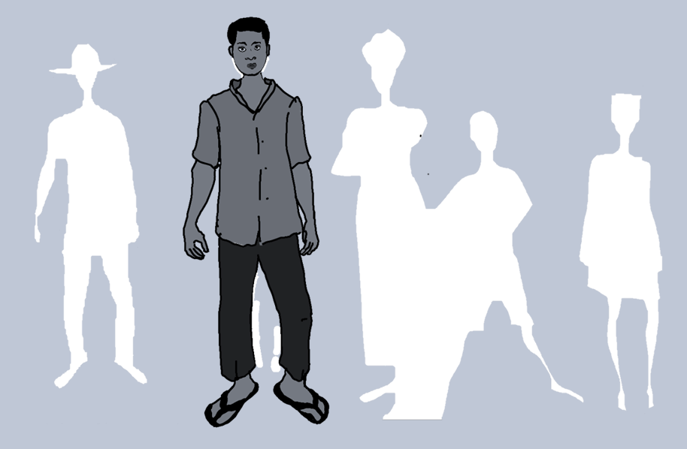
Being a Mentor
Anja Weber
Facilitator and Menor ToT
June 2026

Slide 5
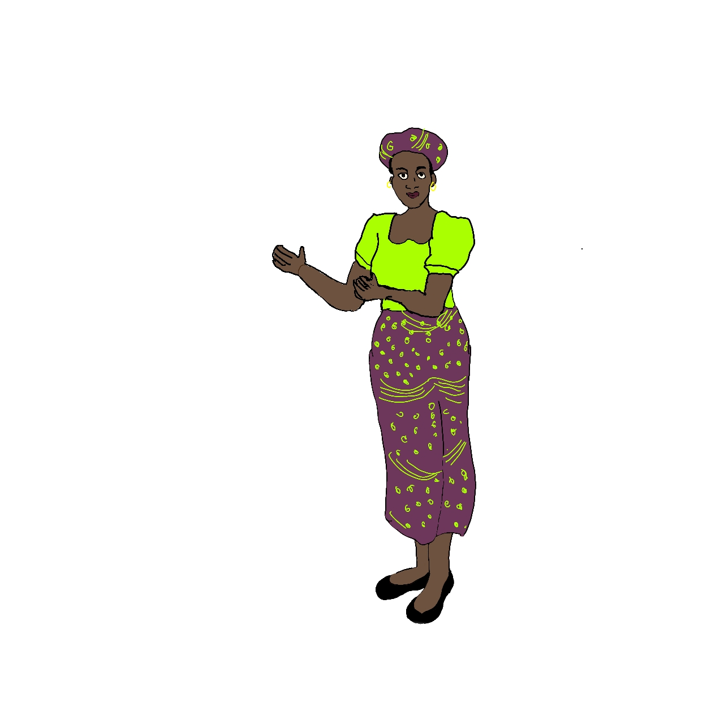
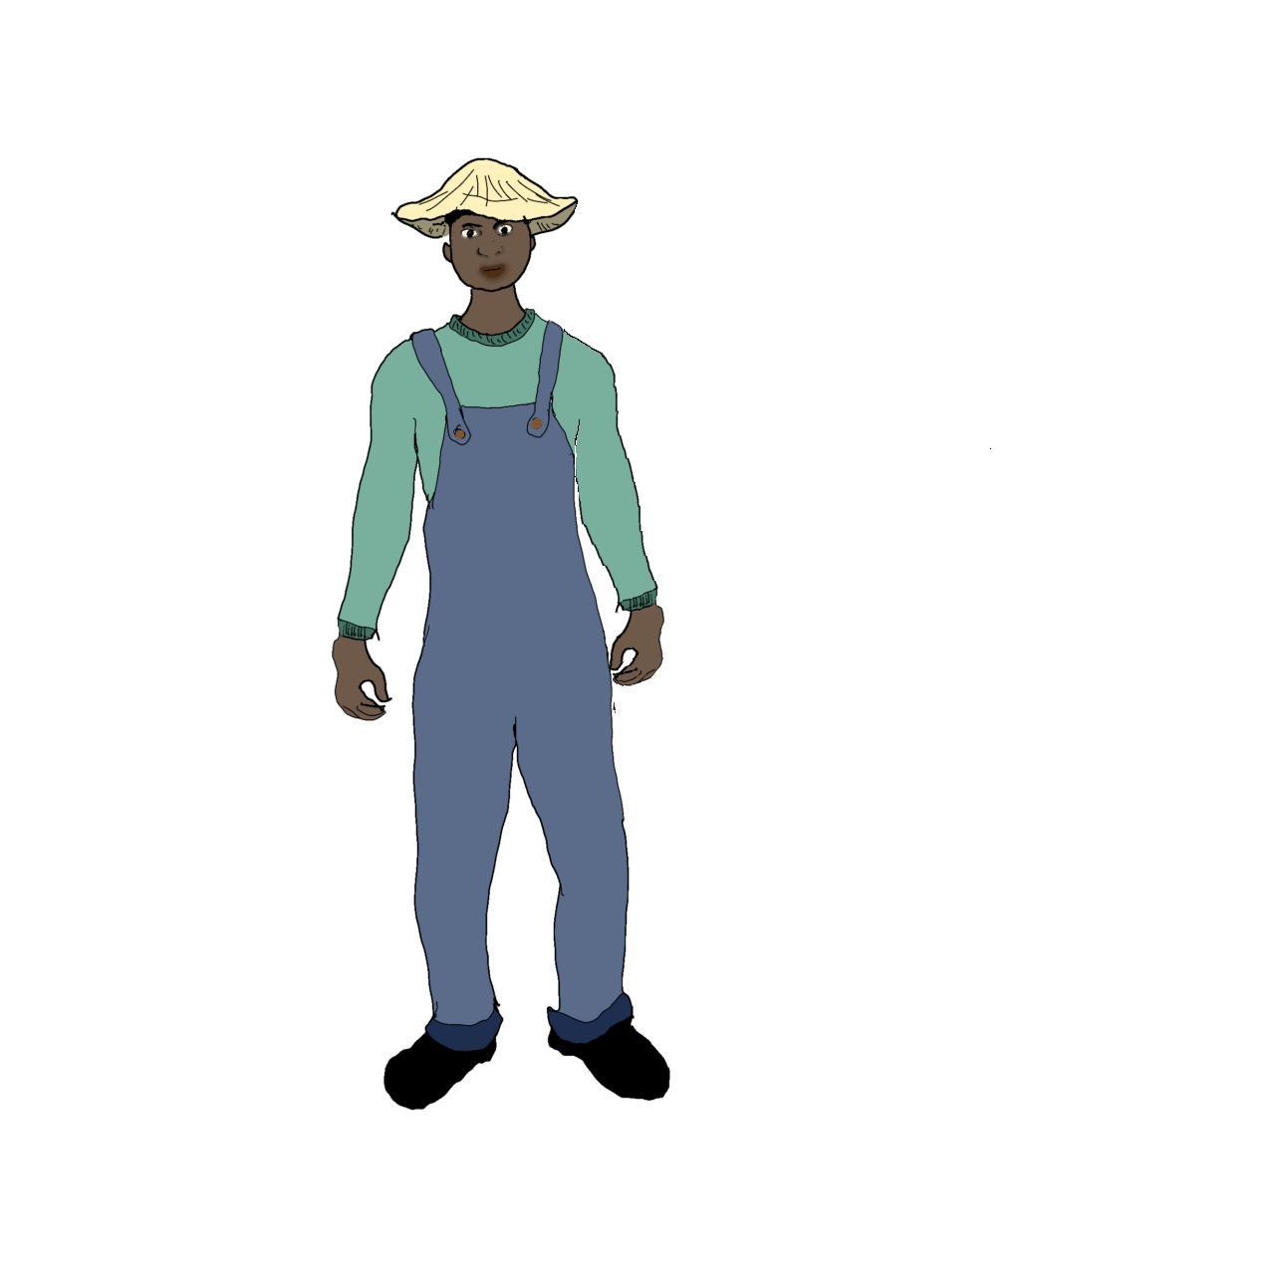
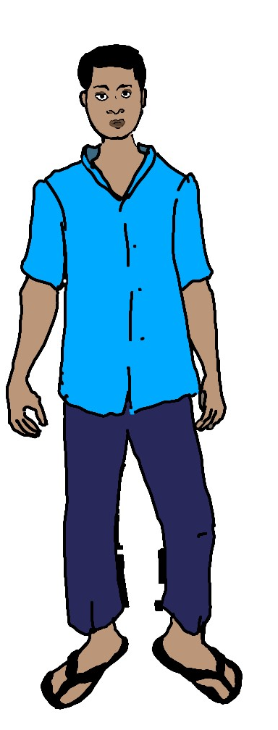
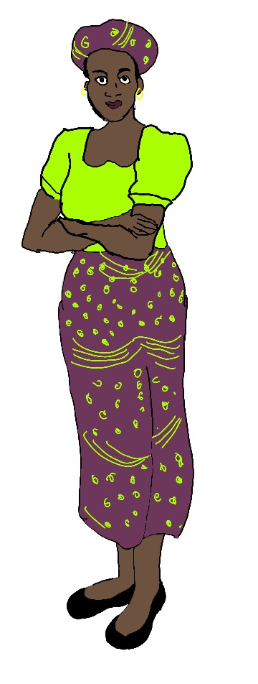
Being a Mentor
Notes:
Connect to previous sessions (course structure + online facilitation)
Clarify: Today is about the human and developmental side of mentoring

Slide 6
Quick poll:
Who already has
mentoring and facilitation experience?
Notes:
Also: how confiden’t are participants with zoom tools? Show how to create and run a zoom poll/quiz

Slide 7
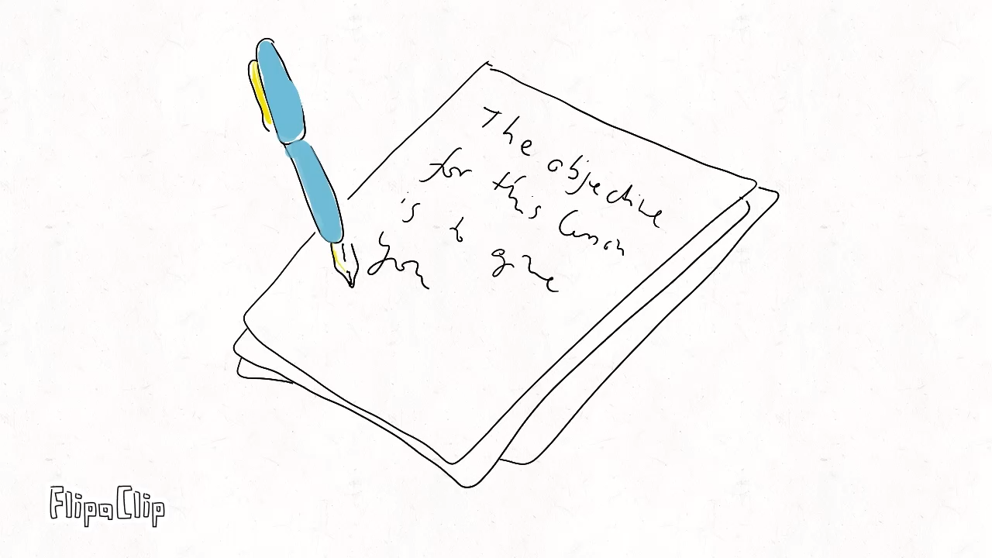
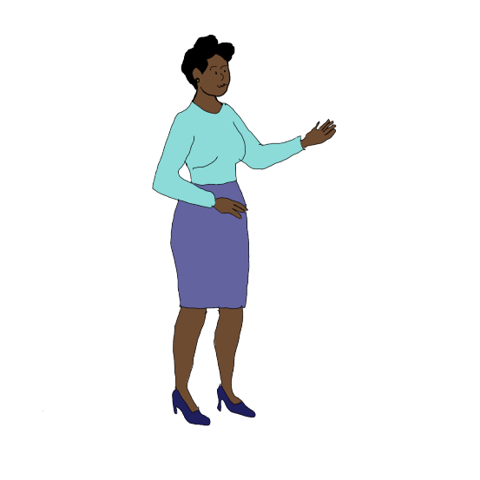
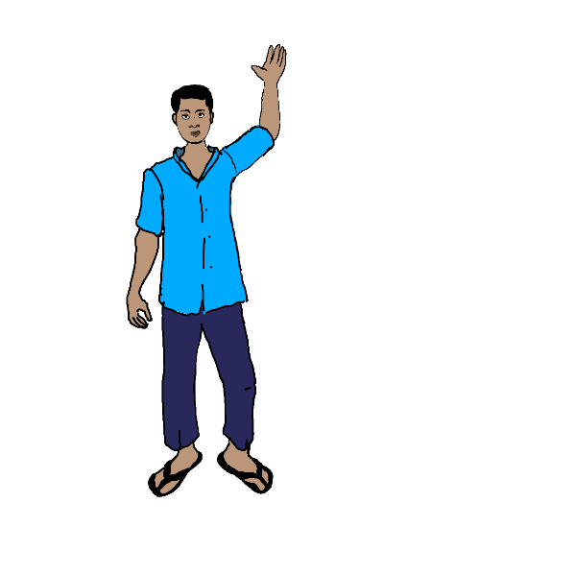
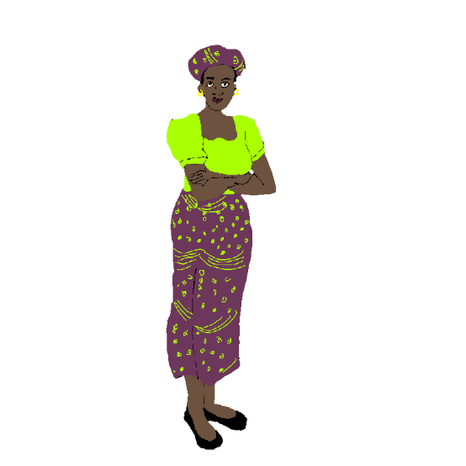

Role of a mentor –
What mentoring is (and is not)
Principles of adult learning
Core mentoring skills
Basic technical online skills
Notes:
The objective of today’s training is to
give you an overview of the role of a mentor,
Reflect a little on the principles of adult learning
Provide you wiz´th some core men´toring skills
As well as along the way teach you some technical onlinefacilitation skills.

Slide 8

What comes to your mind
when thinking about
Mentorship?
(Please write in the chat)
Notes:
Let’s try an exercise that helps you to quickly check in with an online audience. A wordcloud. Please write your associations as single words in the chat. Do you know how to find and open the chat? I will copy your input from there and use a word cloud wizard to create a word cloud.
https://www.wordclouds.com/

Slide 9

https://www.wordclouds.com/

Slide 10
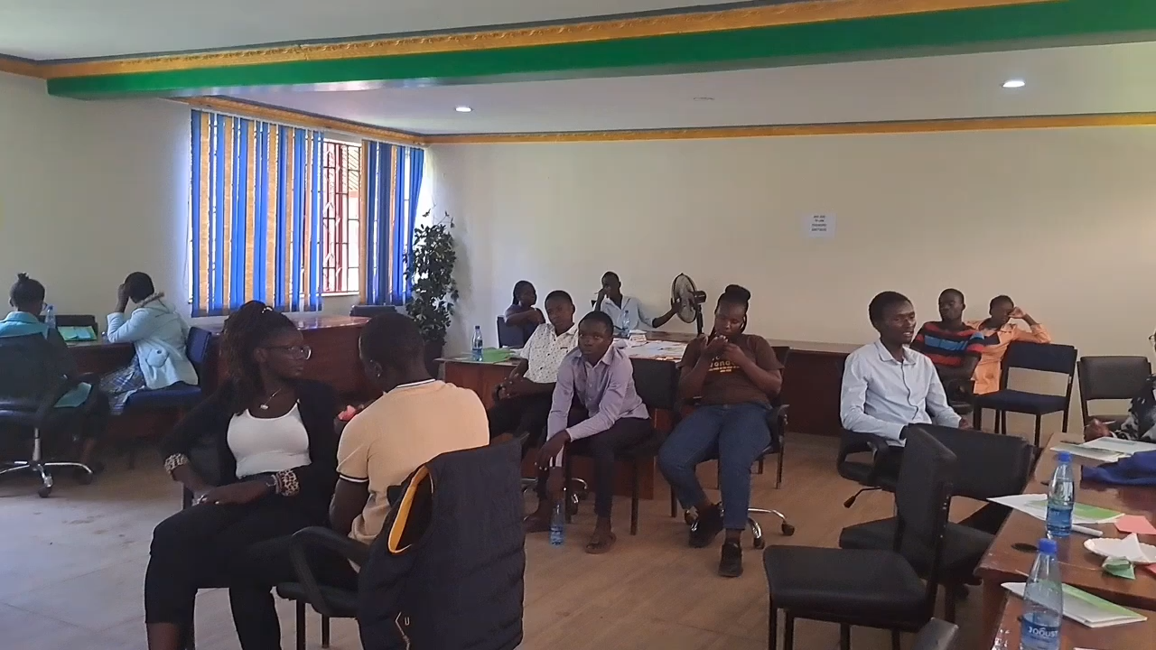
Notes:
Some of the mentors that I have trained before came up with this little song about being a mentor. We used AI to create the song and uploaded it on youtube. (click to start)

Slide 11
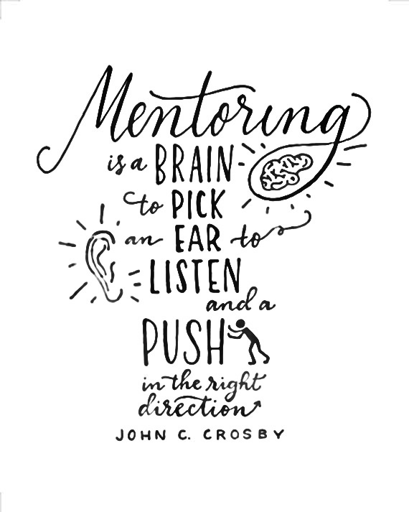
Notes:
I really like this short definition of what mentorship is: a brain to pick, an ear to listen and a push in the right direction!

Slide 12
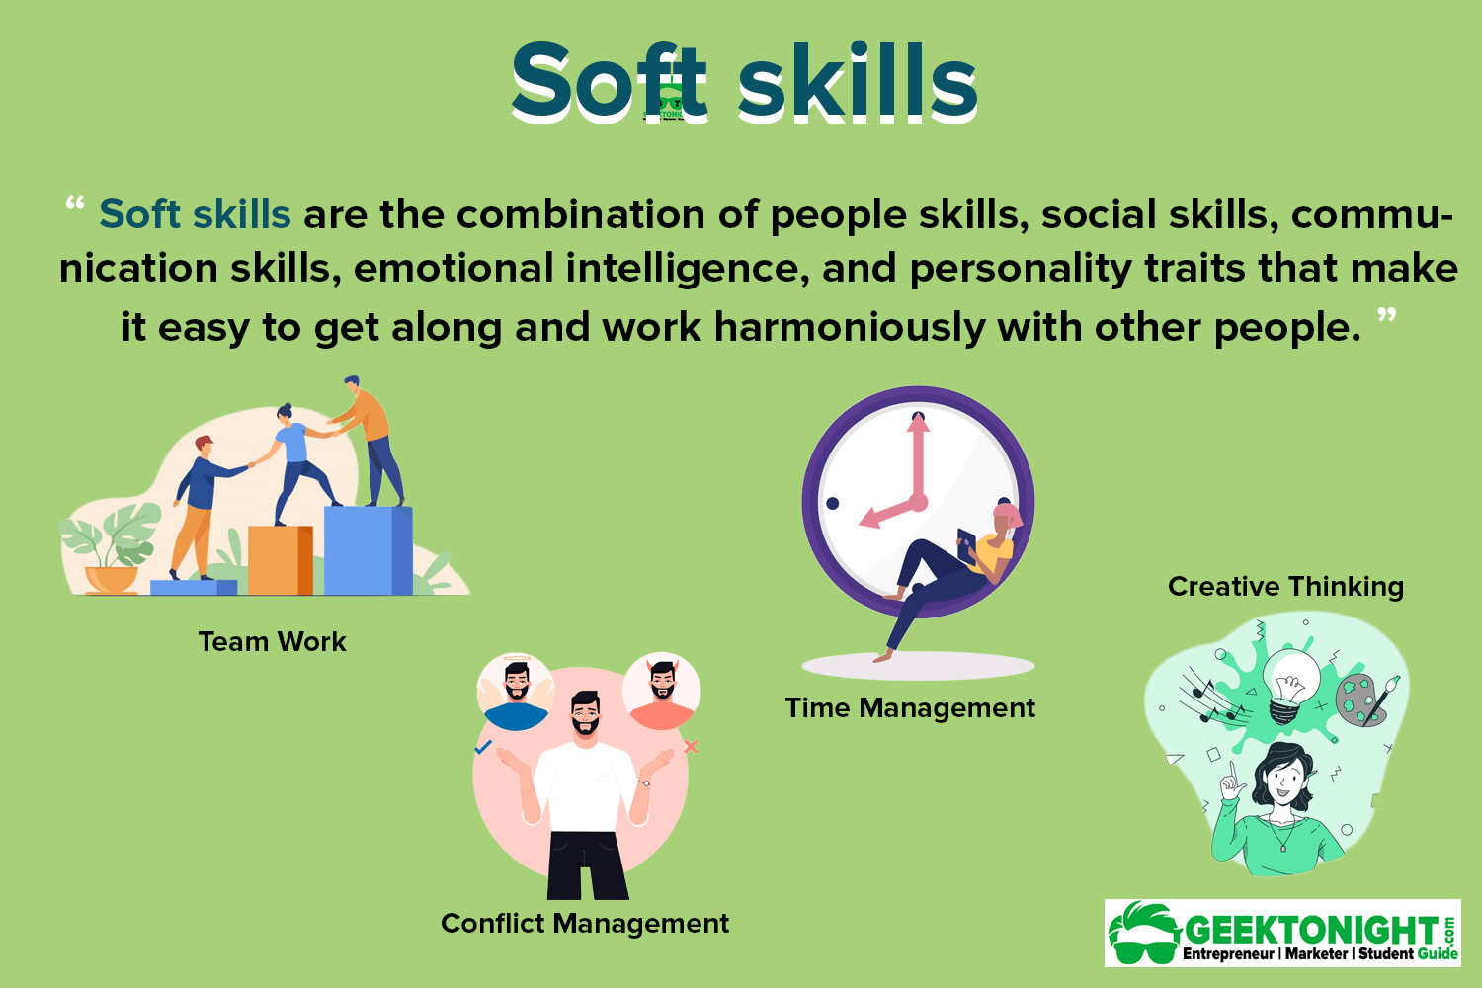
What are the typical developmental needs and challenges of young adults?
Need for learning opportunities
Need for confidence, identity, belonging
Empathy
Adaptability
Lack of organizational and self-organizational skills
Receptive to Feedback
Self Management
Fear of failure, silence in groups (interculturalcommunication barriers), overwhelm
Problem solving
Lack of experience
Notes:
To be benefitial., mentoring needs to be adapted or if you wish customized to the needs of the mentee.
What are the Developmental needs and Typical challenges young adults face?
Need for confidence, identity and belonging
Fear of failure, silence in groups (especially in foreign language and intercultural settings) and overwhelm,
They often lack organizational and self-organizational skills,
And need opportunities to learn and experience in safe environments.
Mentors help teach and develop soft skills

Slide 13
RANSPARENCY
T
R
U
S
T
ESPECT
NITY
HOW YOU CARE
RUST BUILDING
Notes:
One thing that mentees often mention as important for their relationship with their mentor is trust. How do zou build trust? (click`)
Transparency, be open, be honest, be vulnerable
Respect their opinions, their time, their work
Work, succeed and fail as a team, do not allow gossip
People don‘t care how much you know until they know how much you care,
Plan and hold regular trust building activities

Slide 14
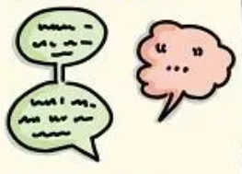
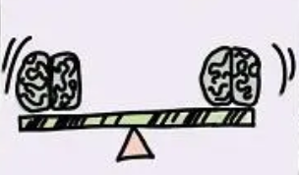
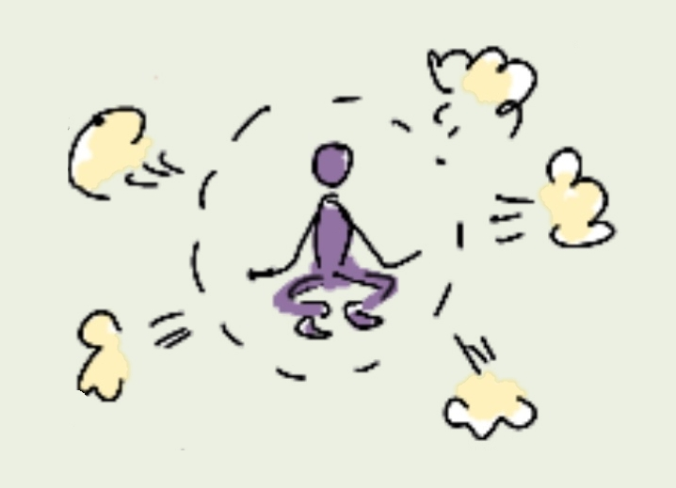

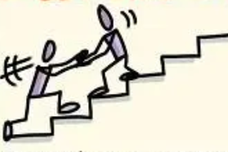


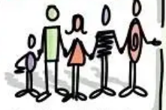
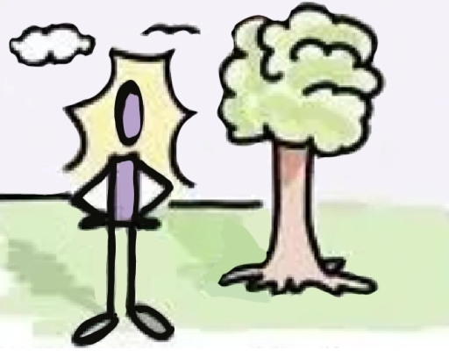

HOW TO THINK BETTER
People think best when they feel fully heard
3 Core Behaviors (that we can easily incorporate into online sessions):
Give full attention – no interruptions, no fixing, no steering.
Create ease – slow down, remove pressure, allow silence.
Ask liberating questions – “What assumption might be limiting your thinking?”
FROM THE WORK OF NANCY KLINE
„More Time to Think“
ATTENTION
EQUALITY
EASE
APPRECIATION
ENCOURAGEMENT
Listening without interruption is an art of creation
Our thinking is different & equal
You cannot think in a hurry. Create freedom from rushing.
Appreciate 5x more than you criticize
Eliminating competition improves thinking
INCISIVE
QUESTION
INFORMATION
FEELINGS
DIVERSITY
PLACE
What are you denying that would liberate your thinking?
Fear prevents thinking. Laughter helps.
People will think for themselves
Remove false, limiting assumptions
The place – and your body - matters

Slide 15
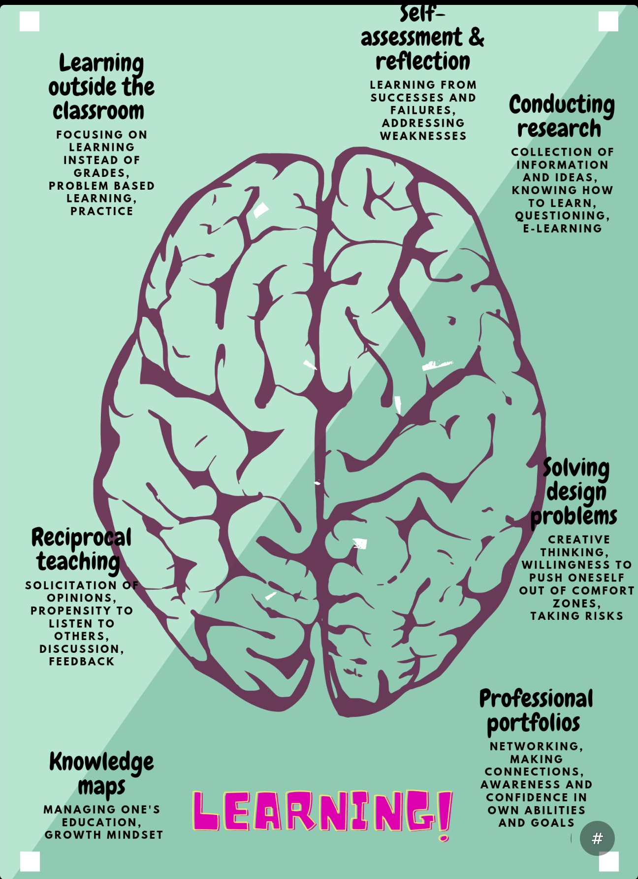



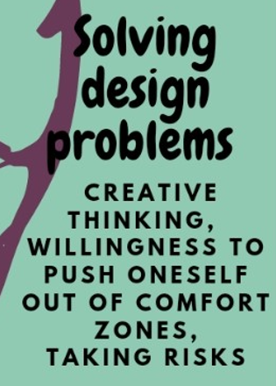



Notes:
Young adults learn best through problem solving.
They are also already in a position to teach each other and to learn from discussions and feedback.
We can assist by showing them how to map out and document their learning journey,
Part of which is self reflection
Young adults should learn how to find and acquire information, especially in today’s overwhelming Mr. Google and Mrs Wikipedia landscape
AgriMocks offers an opportunity to try out business ideas in a safe environment
And helps participants to connect with each other, with mentors andentrepreneurs around the wold, which we should highlight as a networking opportunity

Slide 16

rules & regulations
Focus on relationship
Mentorships need to be built on trust and respect. Mentoring sessions are confidential.
As a mentor, offer support rather than direction.
Practice active listening
Mentors do not solve the mentees’ problems or offer solutions. Instead, help your mentees to discover their own solutons. Make sure you are hearing correctly what they are saying so that they feel understood.
Meet consistently and follow up
Mentors must commit to 90 min online sessions per week six week in a row. Hold your mentees accountable. Mentors must also plan to attend a 1.5 hour review sessions per term to help improve the training.
What a mentor does not need to do
Mentors are not supposed to assist their mentees financially or with other resources than knowledge, information, wisdom, patience, networking opportunities, etc.
Notes:
What does that mean for us as mentors? What should we do, and what should we not do?

Slide 17
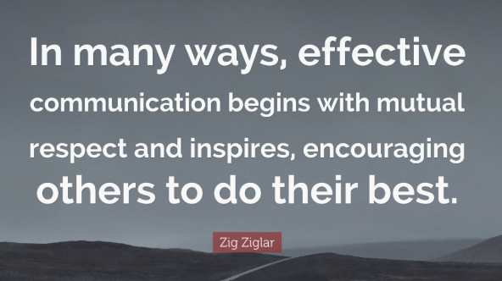
Modelling professional Communication
Setting expectations early
Teaching communication etiquette
Modeling professional behavior
Encouraging quieter participants and equal participation
Helping mentees connect theory → practice → project
Helping mentees manage time

Slide 18
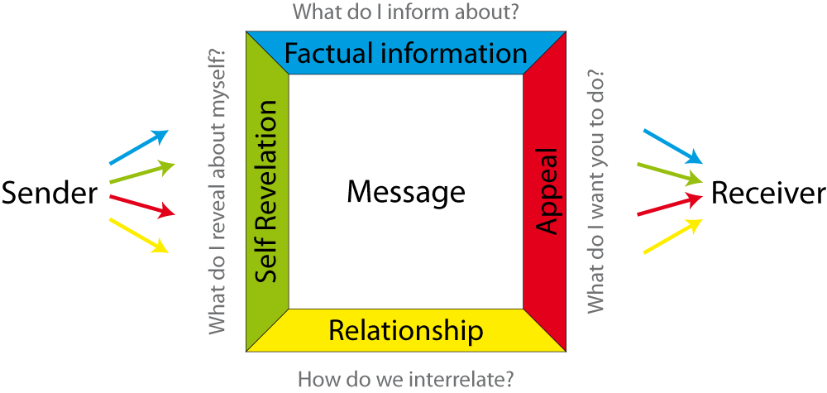
Communication model by Schulz v. Thun

Slide 19
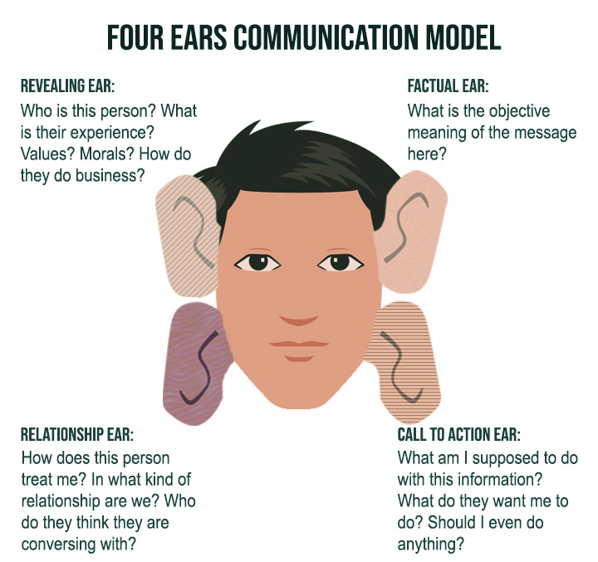

Slide 20
Exercise – What did you hear?
Factual Information
Self-Revelation of the speaker
Appeal to Listener
“I lost my car keys….”
Relationship

Slide 21
4 Types of Communication
Passive
Aggressive
Passive Aggressive
Assertive
No control
Needs control
Feels out of control
Knows that you can only
control yourself
Silence
You messages
Side remarks
I messages

Slide 22


Are you already
going home?
How would the same message sound in the 4 different types?
Passive –
Silence (just a look)
Aggressive –
(you message) “…..”
Passive-Aggressive –
(Snide side remark) “…”
Assertive –
(I message) ”....”
Notes:
Aggressive –
“Are you ALREADY going HOME?” Do you expect me to finish by myself, You are always the first to leave
“Passive aggressive “Some people .. W´the work doesn’t finish itself
Assertive “I will always leave soon.! I need help finishing this.”

Slide 23

Asking Questions

Slide 24
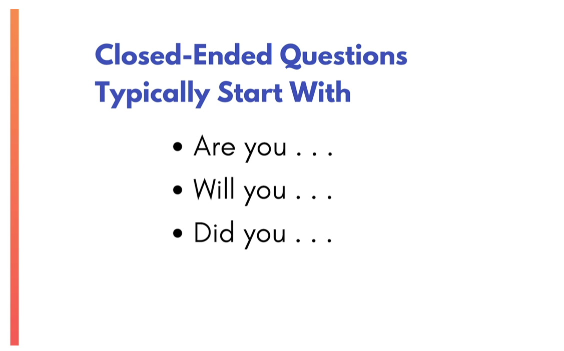

Slide 25
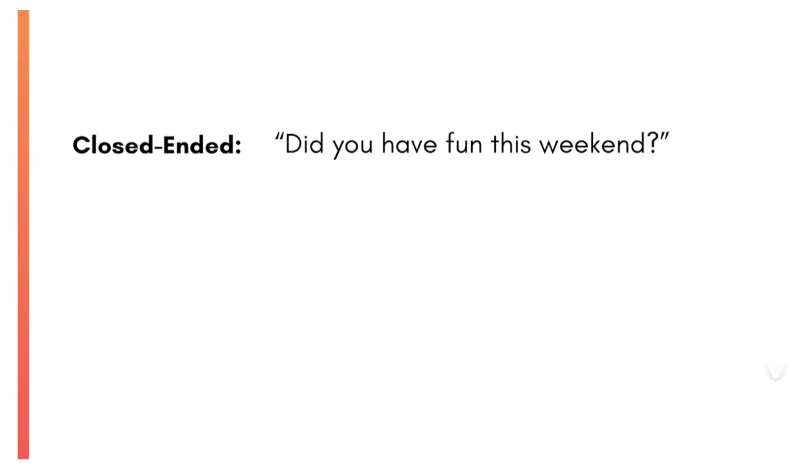
Notes:
Exercise. Let 2 people try to have this kind of converstation

Slide 26
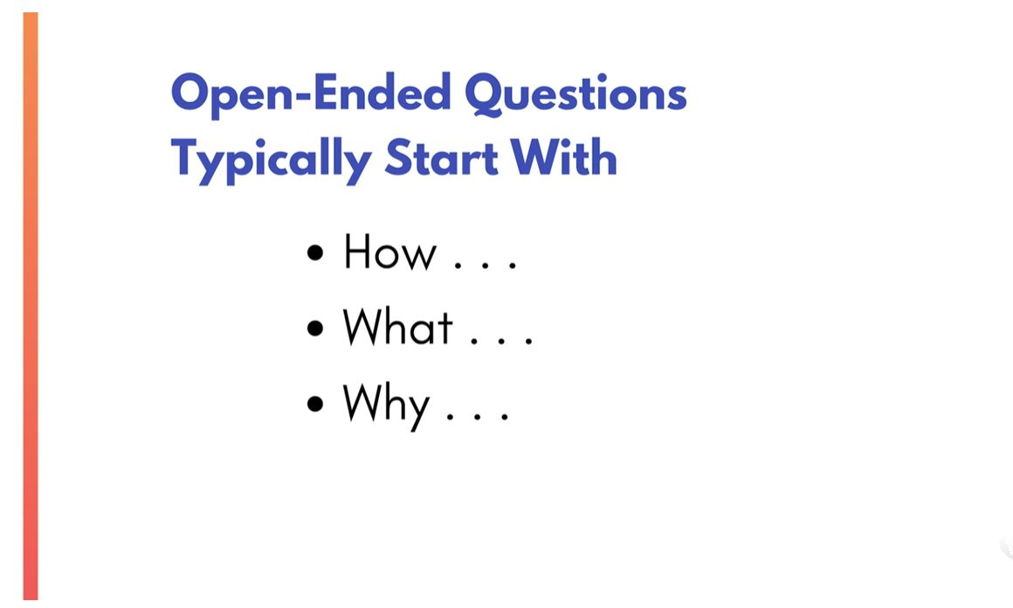

Slide 27
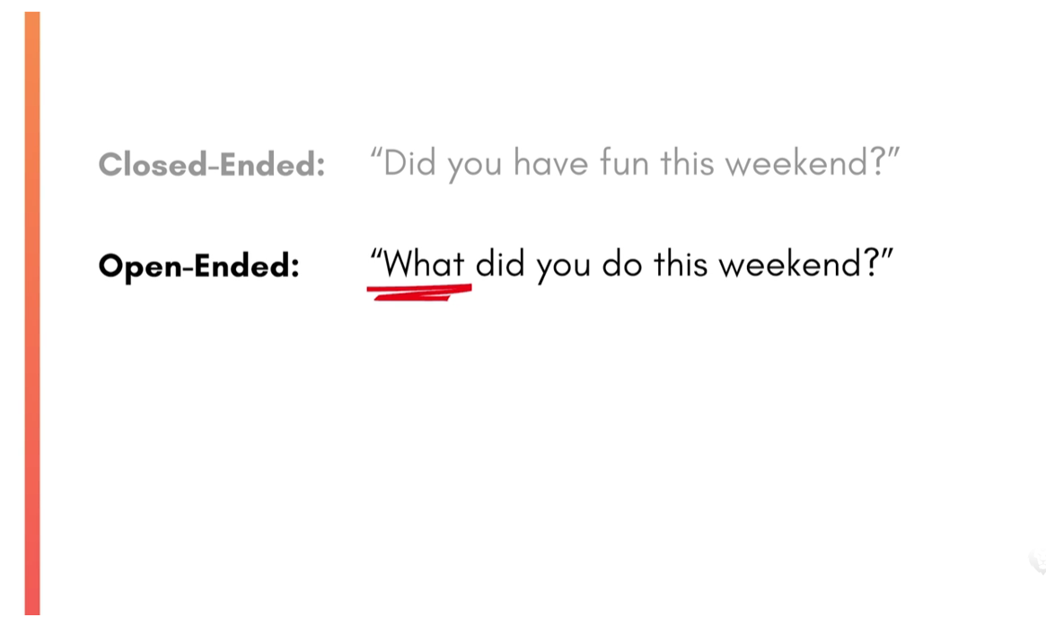

Slide 28

Assertive Listening
in online settings

Slide 29

Active Listening
Waiting for your turn to talk
Listen to understand
Notes:
Hold the space for the conversation. The coachee will start with what is present and familiar to them. Listen to understand, ask if necessary. Dont comment.
So if I understand you correctly…
Correct me if I am wrong, what you are trying to say is…
Ask question to let the coachee reach down deeper towards the hidden, uncomfortable issues. like, how does that feel like right now, what would happen when/if…/ what does that remind you of …
If the coachee makes a problem statement, may be a root cause analysis is a good way to understand the problem better and find a solution

Slide 30
How to practice it
Listen fully
Maintain eye contact, avoid interrupting, and pay attention to tone and emotion.
Notes:
Hold the space for the conversation. The coachee will start with what is present and familiar to them. Listen to understand, ask if necessary. Dont comment.
So if I understand you correctly…
Correct me if I am wrong, what you are trying to say is…
Ask question to let the coachee reach down deeper towards the hidden, uncomfortable issues. like, how does that feel like right now, what would happen when/if…/ what does that remind you of …
If the coachee makes a problem statement, may be a root cause analysis is a good way to understand the problem better and find a solution

Slide 31
How to practice it
Reflect back
“So what I’m hearing is…”
or
“It sounds like you’re feeling…”
Notes:
Hold the space for the conversation. The coachee will start with what is present and familiar to them. Listen to understand, ask if necessary. Dont comment.
So if I understand you correctly…
Correct me if I am wrong, what you are trying to say is…
Ask question to let the coachee reach down deeper towards the hidden, uncomfortable issues. like, how does that feel like right now, what would happen when/if…/ what does that remind you of …
If the coachee makes a problem statement, may be a root cause analysis is a good way to understand the problem better and find a solution

Slide 32
How to practice it
Clarify
Ask questions that help you understand the deeper meaning, not just the surface words.
Notes:
Hold the space for the conversation. The coachee will start with what is present and familiar to them. Listen to understand, ask if necessary. Dont comment.
So if I understand you correctly…
Correct me if I am wrong, what you are trying to say is…
Ask question to let the coachee reach down deeper towards the hidden, uncomfortable issues. like, how does that feel like right now, what would happen when/if…/ what does that remind you of …
If the coachee makes a problem statement, may be a root cause analysis is a good way to understand the problem better and find a solution

Slide 33
How to practice it
Share your perspective
Use I-statements:
“I feel…”
“I need…”
“My view is…”
Notes:
Hold the space for the conversation. The coachee will start with what is present and familiar to them. Listen to understand, ask if necessary. Dont comment.
So if I understand you correctly…
Correct me if I am wrong, what you are trying to say is…
Ask question to let the coachee reach down deeper towards the hidden, uncomfortable issues. like, how does that feel like right now, what would happen when/if…/ what does that remind you of …
If the coachee makes a problem statement, may be a root cause analysis is a good way to understand the problem better and find a solution

Slide 34
How to practice it
Stay respectful and calm
Assertive ≠ aggressive.
You’re aiming for clarity,
not dominance.
Notes:
Hold the space for the conversation. The coachee will start with what is present and familiar to them. Listen to understand, ask if necessary. Dont comment.
So if I understand you correctly…
Correct me if I am wrong, what you are trying to say is…
Ask question to let the coachee reach down deeper towards the hidden, uncomfortable issues. like, how does that feel like right now, what would happen when/if…/ what does that remind you of …
If the coachee makes a problem statement, may be a root cause analysis is a good way to understand the problem better and find a solution

Slide 35

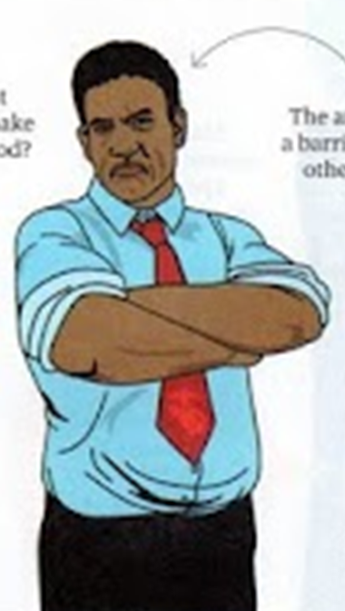
Exercise – What do you ‘hear’?
^^^^^^^^^^
Notes:
Active listening online is harder because mentors lose many of the cues they rely on in person — body language, micro‑expressions, energy shifts, subtle signals of confusion or discomfort.

Slide 36
“What makes online mentoring harder/easier?”
Working in Break-out Rooms
Notes:
Typical challenges in online internships: motivation, time management, communication gaps

Slide 37
Present your thoughts
Working in Breakout groups on Whiteboards

Slide 38
Active Listening online
Must be more intentional, more explicit, and more structured.
“Online, active listening is not just hearing the words — it’s compensating for everything we can’t see. It means showing the mentee that you are fully present, even through a screen.”
Presence must be visible
Understanding must be verbalized
Empathy must be explicit
Silence must be managed, not feared
Distractions must be reduced
Notes:
Active listening online is harder because mentors lose many of the cues they rely on in person — body language, micro‑expressions, energy shifts, subtle signals of confusion or discomfort.

Slide 39
Mentoring Session Outline
Part 1: Building the relationship (not more than 1 minute)
Part 2 A: Defining the scope (establish the topic for the session)
Part 2 B: Define the objective (establish the goal for the session)
Part 3 A: Analyzing the problem:
Part 3 B: Solution Finding Process/ “Unearthing” the solution
Part 4 A: Identifying the solution
Part 4 B: Commitment to change
Part 5: Let the mentee summarize the commitment and action plan.
Ensure it is specific by asking when? How? If necessary.
Part 6: Closing of session

Slide 40
Let’s practice
Work in pairs in breakout rooms and try to simulate a coaching session.
The mentor leads the process (see outline) through guiding questions.
The mentee leads the content and finds the solution.

Slide 41

Notes:
Give structured feedback (e.g., “What’s strong / What’s unclear / What’s next”)
Encourage iteration and resilience

Slide 42
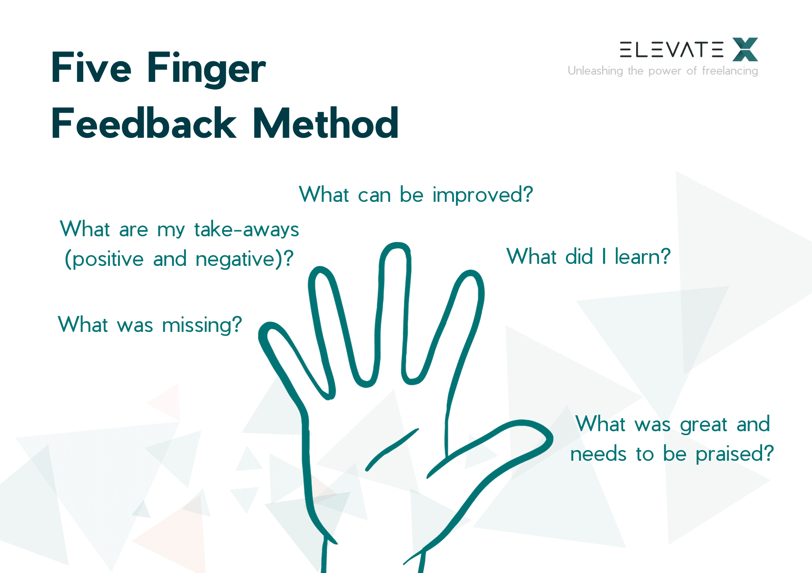
Five Finger
Feedback Method
Notes:
Giving supportive but honest feedback

Slide 43
Break-Out Session
(Working with Whiteboards)
“Discuss which elements are important for mentorship work in AgriMocks”

Slide 44

How to prevent drop-outs?
Behavioral signs
Camera off often
Delayed responses
Short, one‑word answers
Not volunteering ideas
Missing small tasks or deadlines
Not asking questions
Early warning signs of disengagement
Participation signs
Not contributing to team discussions
Letting others speak for them
Turning up late or leaving early
Not engaging in chat or reactions
Emotional signs
Low energy or flat tone
Irritation or defensiveness
“I don’t know” becoming frequent
Avoiding eye contact

Slide 45
How to prevent drop-outs?
Model vulnerability
Mentors can say:
“I don’t have all the answers either.”
“It’s okay to be unsure — that’s part of learning.”
Make the space predictable
Young adults feel safer when they know:
the session structure
what’s expected
how long things take
Consistency builds trust.
How to Create Psychological Safety
Set explicit norms
“All ideas are welcome.”
“We don’t interrupt.”
“Questions are a sign of engagement.”
Psychological
safety online
must be designed,
not assumed.
Normalize mistakes
“This stage is confusing for everyone.”
“You’re not behind — you’re learning.”
Use structured turn‑taking
This prevents dominant voices from taking over:
“Let’s hear from each person for 30 seconds.”
Validate contributions
“That’s a helpful point.”
“Thanks for sharing that — it adds a lot.”

Slide 46
Encourage peer support
Pair them with a supportive teammate
Let them co‑work in breakout rooms
How to prevent drop-outs?
Slow down the pace
“Let’s take this one step at a time.”
“What’s the part that feels heaviest right now”
When a mentee is overwhelmed, mentors should avoid “fixing” and instead co‑regulate.
Handling disengagement or overwhelm
Reduce pressure
“You don’t need to be perfect — just present.”
“It’s okay to ask for help.”
Break tasks into micro‑steps
“What’s one thing you can do in the next 24 hours”
“Let’s choose the smallest next action.”
Offer options
“Would you prefer to work on the problem statement or the user insights first”
“Do you want to speak now or type in the chat”
Follow up with a short message after the session: “You did well today.”

Slide 47
How to prevent drop-outs?
Reach out privately
A short, warm message works wonders:
“I noticed you seemed a bit quiet today. How are you doing”
“Anything I can support you with this week”
Re‑engagement is about invitation, not pressure
How to Re‑Engage Mentees
Young adults disengage when overwhelmed. Mentors can say:
“Let’s pick one small thing you can do before next session.”
“What feels manageable right now”
Give them a meaningful role
People re‑engage when they feel needed:
“Could you lead the next check‑in”
“Would you summarize the team’s ideas”
Reconnect them to purpose
“What part of this project feels most interesting to you”
“What would you like to get out of this experience”
Celebrate small wins
Even tiny progress helps rebuild momentum.

Slide 48
How to prevent drop-outs?
Keep them simple and fast
Examples:
“One word for your energy today.”
“What’s one thing on your mind as we start”
“On a scale of 1–5, how present do you feel right now
Check‑ins are the mentor’s most powerful tool for reading the room.
How to run effective check‑ins
Ask follow‑up questions
If someone says “2/5”:
“Thanks for sharing. Anything you need from us today”
Use visual or interactive tools
Emojis
Polls
Chat responses
Quick reactions
These lower the barrier for shy participants.
Use check‑outs too
“What’s one thing you’re taking away”
“What’s one small step you’ll take next”
Normalize all answers
“All numbers are welcome.” “Thanks for being honest.”
Notes:
Let’s use the emoji function in zoom. Do you all know where to find and how to post an emoji? Those who know, please explain to and guide the others. I would like to see an emoji from each of you that reflects how you feel about todays training.

Slide 49

Activity:
2 Groups
Provide
Career Guidance
for
Anna
Bella

Slide 50
Chimamanda Ngozi Adichie:
The danger of a single story | TED
https://youtu.be/D9Ihs241zeg
Anna-Bella
B: Comes from a poor family.
A: She is a student at Kenyatta University.
B: She is in her last year of her bachelor in soil science course.
A: She works hard to finish her studies as soon as possible,
B: but she struggles to find funding for her school fees
A: and looks forward to her first job at Soil Cares.
B: Sometimes she feels overwhelmed.
A: She thinks having more work experience would be helpful.

Slide 51





Awareness of diverse
backgrounds
Asking develop-
mental and
reflective
questions
Encouraging mentees
to bring their full selves
Supporting inter-
cultural communication
Avoiding assumptions

Slide 52
Exercise: Appreciate
All group members are taken to breakout rooms and match up in pairs.
The timer is set to 1 min.
Each pair decides who shall receive praise. The other person gives praise to his/her partner for 1 min straight.
After 1 min receivers are given a moment to write down the praise they have received, then everyone moves to a different breakout room.
Continue for several rounds until everyone has received praise.

Slide 53
Thank you very much for your interest in becoming a Mentor!
Anja Weber
anja.weber@hswt.de
Notes:
Connect to previous sessions (course structure + online facilitation)
Clarify: Today is about the human and developmental side of mentoring

