Slide 1

Deliverables & Tasks
Deliverables & Tasks
Progress Report
21st May 2025
Progress Report
21st May 2025

Slide 2
Project Start 01.02.25

Slide 3
Project Start 01.02.25

Slide 4
T1.1.1 Creation of workplan (Gantt chart) HSWT
Project Start 01.02.25

Slide 5
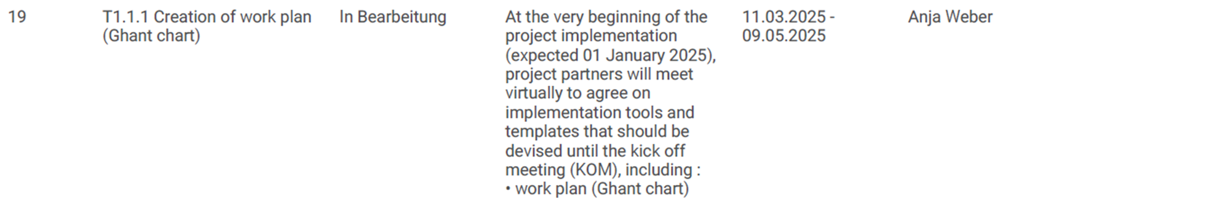
T1.1.1 Creation of workplan (Gantt chart) HSWT
Project Start 01.02.25

Slide 6
T1.1.1 Creation of workplan (Gantt chart) HSWT
Project Start 01.02.25

Slide 7
T1.1.1 Creation of workplan (Gantt chart) HSWT
Project Start 01.02.25
T1.1.2 Creation of initial framework for sustainability plan development

Slide 8
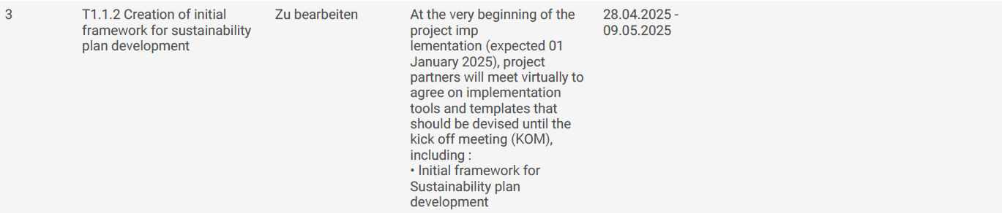
T1.1.1 Creation of workplan (Gantt chart) HSWT
Project Start 01.02.25
T1.1.2 Creation of initial framework for sustainability plan development

Slide 9
T1.1.1 Creation of workplan (Gantt chart) HSWT
Project Start 01.02.25
T1.1.2 Creation of initial framework for sustainability plan development

Slide 10
T1.1.1 Creation of workplan (Gantt chart) HSWT
Project Start 01.02.25
T1.1.2 Creation of initial framework for sustainability plan development
T1.2 Organization of KOM
EDI

Slide 11
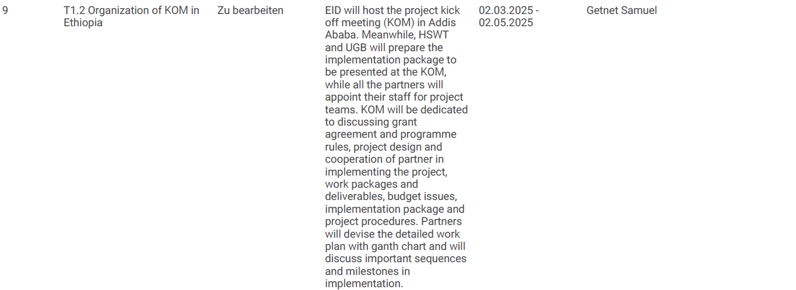
T1.1.1 Creation of workplan (Gantt chart) HSWT
Project Start 01.02.25
T1.1.2 Creation of initial framework for sustainability plan development
T1.2 Organization of KOM
EDI

Slide 12
T1.1.1 Creation of workplan (Gantt chart) HSWT
Project Start 01.02.25
T1.1.2 Creation of initial framework for sustainability plan development
T1.2 Organization of KOM
EDI

Slide 13

T1.1.1 Creation of workplan (Gantt chart) HSWT
Project Start 01.02.25
T1.1.2 Creation of initial framework for sustainability plan development
T1.2 Organization of KOM
EDI

Slide 14
Project Start 01.02.25

Slide 15
KOM
28.04 - 02.05.25

Slide 16
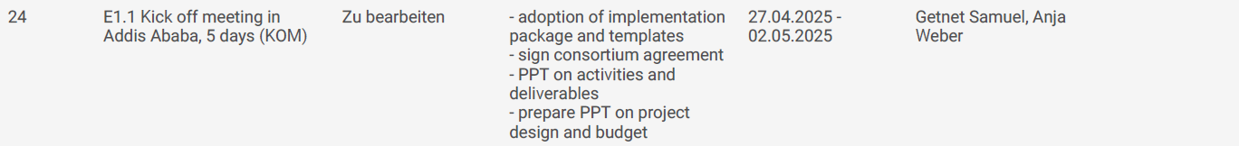
KOM
28.04 - 02.05.25

Slide 17
KOM
28.04 - 02.05.25

Slide 18
T1.1.4 Creation of Dissemination Plan
UFS, EDI
KOM
28.04 - 02.05.25

Slide 19
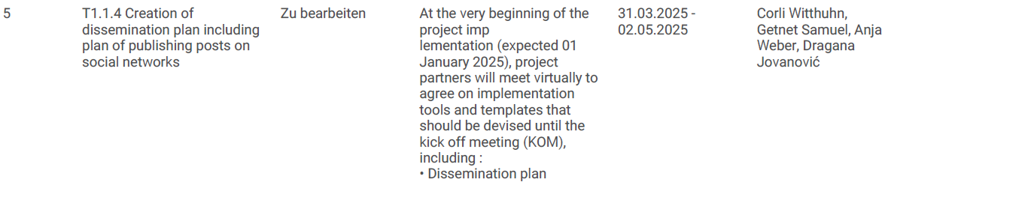
T1.1.4 Creation of Dissemination Plan
UFS, EDI
KOM
28.04 - 02.05.25

Slide 20
T1.1.4 Creation of Dissemination Plan
UFS, EDI
KOM
28.04 - 02.05.25

Slide 21
T1.1.4 Creation of Dissemination Plan
UFS, EDI
KOM
28.04 - 02.05.25
T1.3.1 Project Team Formation

Slide 22
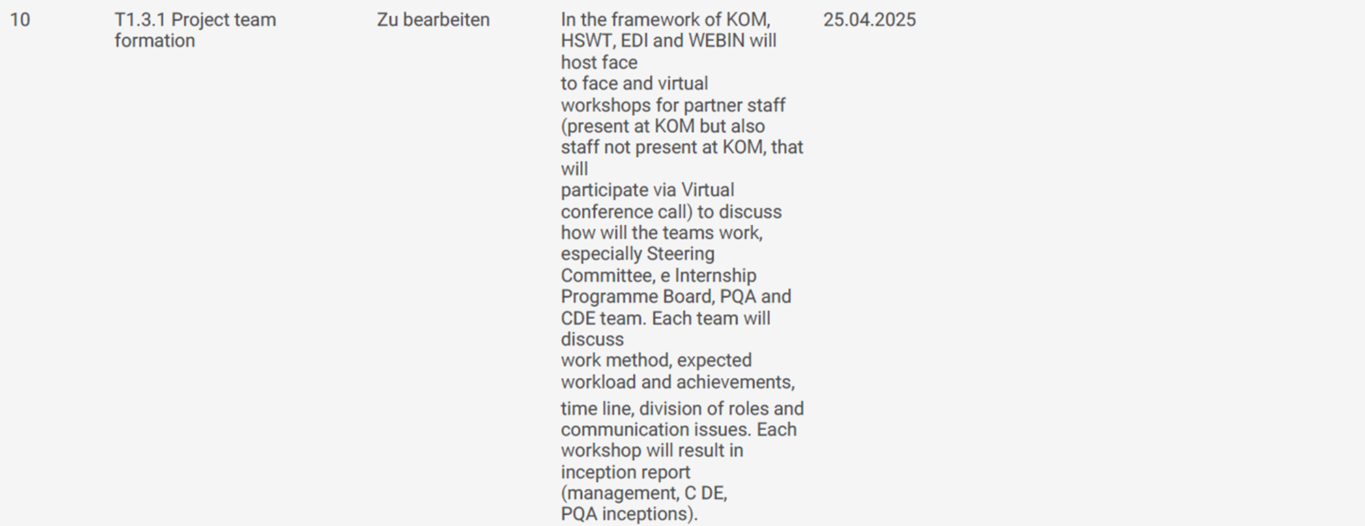
T1.1.4 Creation of Dissemination Plan
UFS, EDI
KOM
28.04 - 02.05.25
T1.3.1 Project Team Formation

Slide 23
T1.1.1 Creation of workplan (Gantt chart) HSWT
KOM
28.04 - 02.05.25
T1.3.1 Project Team Formation

Slide 24
T1.1.4 Creation of Dissemination Plan
UFS, EDI
KOM
28.04 - 02.05.25
T1.3.1 Project Team Formation
T1.1.5 Creation of Guidelines for constitution of project structures

Slide 25
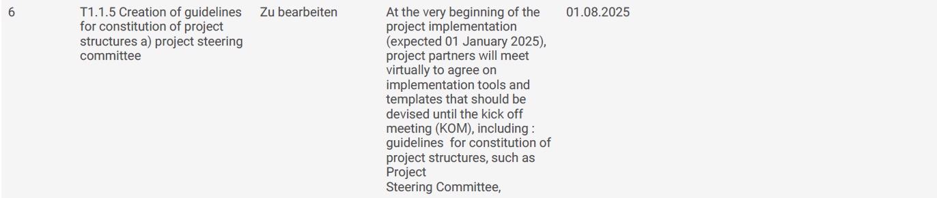
T1.1.4 Creation of Dissemination Plan
UFS, EDI
KOM
28.04 - 02.05.25
T1.3.1 Project Team Formation
T1.1.5 Creation of Guidelines for constitution of project structures

Slide 26
T1.1.4 Creation of Dissemination Plan
UFS, EDI
KOM
28.04 - 02.05.25
T1.3.1 Project Team Formation
T1.1.5 Creation of Guidelines for constitution of project structures

Slide 27
T1.1.4 Creation of Dissemination Plan
UFS, EDI
KOM
28.04 - 02.05.25
T1.3.1 Project Team Formation
T1.1.5 Creation of Guidelines for constitution of project structures

Slide 28
KOM
28.04 - 02.05.25

Slide 29
Milestone 1
Implementation Package adopted & distributed to partners
HSWT
31.05.2025

Slide 30
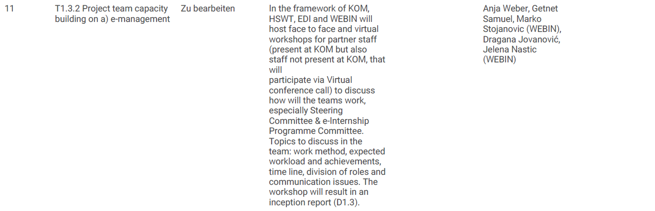
Milestone 1
Implementation Package adopted & distributed to partners
HSWT
31.05.2025

Slide 31
Milestone 1
Implementation Package adopted & distributed to partners
HSWT
31.05.2025

Slide 32
Milestone 1
Implementation Package adopted & distributed to partners
HSWT
31.05.2025

Slide 33
D1.2
Manual for Social Media Network Accounts
EDI

Slide 34
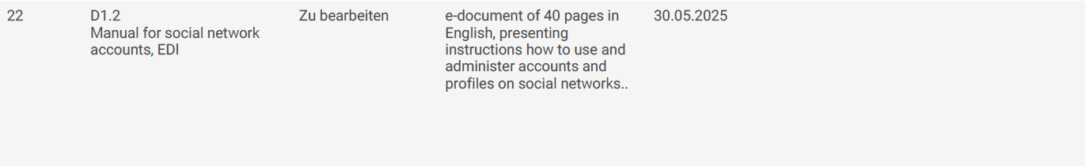
D1.2
Manual for Social Media Network Accounts
EDI

Slide 35
D1.2
Manual for Social Media Network Accounts
EDI

Slide 36
T1.1.5
Constitution of CDE Team
D1.2
Manual for Social Media Network Accounts
EDI

Slide 37
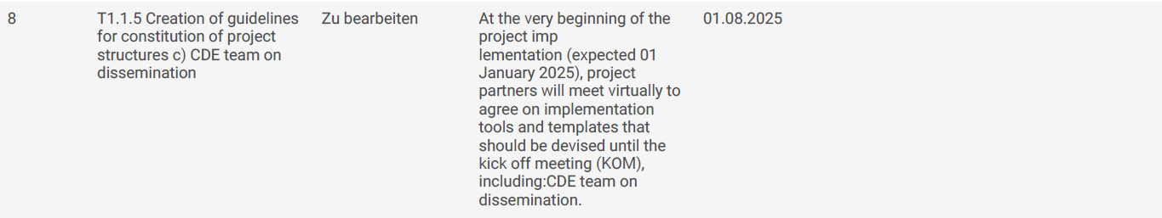
T1.1.5
Constitution of CDE Team
D1.2
Manual for Social Media Network Accounts
EDI

Slide 38
T1.1.5
Constitution of CDE Team
D1.2
Manual for Social Media Network Accounts
EDI

Slide 39
T1.1.5
Constitution of CDE Team
D1.2
Manual for Social Media Network Accounts
EDI
T1.5.1 Creation of Manual for project accounts & social media profiles

Slide 40
T1.1.5
Constitution of CDE Team
D1.2
Manual for Social Media Network Accounts
EDI
T1.5.1 Creation of Manual for project accounts & social media profiles

Slide 41
T1.1.5
Constitution of CDE Team
D1.2
Manual for Social Media Network Accounts
EDI
T1.5.1 Creation of Manual for project accounts & social media profiles

Slide 42
T1.1.5
Constitution of CDE Team
D1.2
Manual for Social Media Network Accounts
EDI
T1.5.1 Creation of Manual for project accounts & social media profiles
T1.5.2 Creation of project accounts & social media profiles

Slide 43
T1.1.5
Constitution of CDE Team
D1.2
Manual for Social Media Network Accounts
EDI
T1.5.1 Creation of Manual for project accounts & social media profiles
T1.5.2 Creation of project accounts & social media profiles

Slide 44
T1.1.5
Constitution of CDE Team
D1.2
Manual for Social Media Network Accounts
EDI
T1.5.1 Creation of Manual for project accounts & social media profiles
T1.5.2 Creation of project accounts & social media profiles

Slide 45
T1.1.5
Constitution of CDE Team
D1.2
Manual for Social Media Network Accounts
EDI
T1.5.1 Creation of Manual for project accounts & social media profiles
T1.5.2 Creation of project accounts & social media profiles
T1.3.2 Project Team Capacity building on dissemination

Slide 46
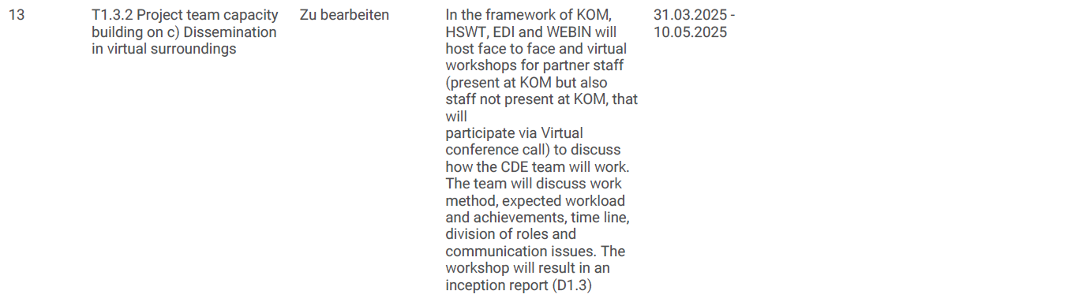
T1.1.5
Constitution of CDE Team
D1.2
Manual for Social Media Network Accounts
EDI
T1.5.1 Creation of Manual for project accounts & social media profiles
T1.5.2 Creation of project accounts & social media profiles
T1.3.2 Project Team Capacity building on dissemination

Slide 47
T1.1.5
Constitution of CDE Team
D1.2
Manual for Social Media Network Accounts
EDI
T1.5.1 Creation of Manual for project accounts & social media profiles
T1.5.2 Creation of project accounts & social media profiles
T1.3.2 Project Team Capacity building on dissemination

Slide 48
D1.2
Manual for Social Media Network Accounts
EDI

Slide 49
D1.1
Project Quality Architecture (PQA) Toolkit
WEBIN

Slide 50

D1.1
Project Quality Architecture (PQA) Toolkit
WEBIN

Slide 51
D1.1
Project Quality Architecture (PQA) Toolkit
WEBIN

Slide 52
T1.1.3 b)
PQA Matrix
D1.1
Project Quality Architecture (PQA) Toolkit
WEBIN

Slide 53
T1.1.3 b)
PQA Matrix
D1.1
Project Quality Architecture (PQA) Toolkit
WEBIN

Slide 54
T1.1.3 b)
PQA Matrix
D1.1
Project Quality Architecture (PQA) Toolkit
WEBIN

Slide 55
T1.1.3 b)
PQA Matrix
T1.1.3 c)
E-Instruments
D1.1
Project Quality Architecture (PQA) Toolkit
WEBIN

Slide 56
T1.1.3 b)
PQA Matrix
T1.1.3 c)
E-Instruments
D1.1
Project Quality Architecture (PQA) Toolkit
WEBIN

Slide 57
T1.1.3 b)
PQA Matrix
T1.1.3 c)
E-Instruments
D1.1
Project Quality Architecture (PQA) Toolkit
WEBIN
T1.3.2
Project Team Capacity Building on PQA

Slide 58
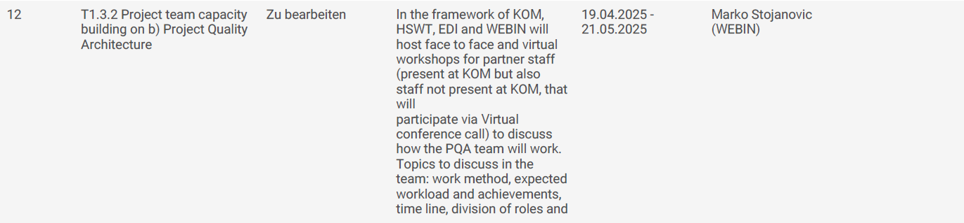
T1.1.3 b)
PQA Matrix
T1.1.3 c)
E-Instruments
D1.1
Project Quality Architecture (PQA) Toolkit
WEBIN
T1.3.2
Project Team Capacity Building on PQA

Slide 59
T1.1.3 b)
PQA Matrix
T1.1.3 c)
E-Instruments
D1.1
Project Quality Architecture (PQA) Toolkit
WEBIN
T1.3.2
Project Team Capacity Building on PQA

Slide 60
D1.1
Project Quality Architecture (PQA) Toolkit
WEBIN

Slide 61
Milestone 2
Contact List of FoPs
UGB
31.05.2025

Slide 62
Milestone 2
Contact List of FoPs
UGB
31.05.2025

Slide 63
Milestone 2
Contact List of FoPs
UGB
31.05.2025

Slide 64
D1.3
E-document containg 4 thematic reports

Slide 65
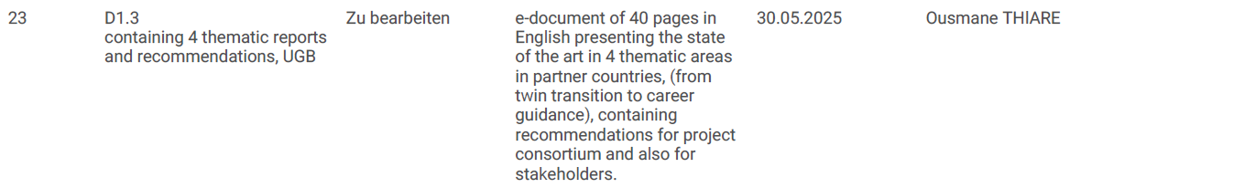
D1.3
E-document containg 4 thematic reports

Slide 66
D1.3
E-document containg 4 thematic reports

Slide 67
T1.6
Drafting 4 thematic reports in national tontexts
D1.3
E-document containg 4 thematic reports

Slide 68
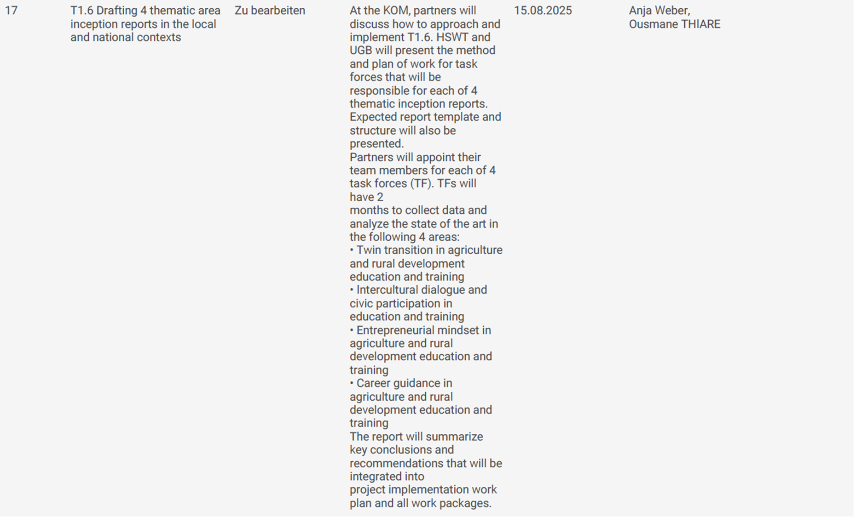
T1.6.
Drafting 4 thematic reports in national tontexts
D1.3
E-document containg 4 thematic reports

Slide 69
T1.6
Drafting 4 thematic reports in national tontexts
D1.3
E-document containg 4 thematic reports

Slide 70
T1.6
Drafting 4 thematic reports in national tontexts
D1.3
E-document containg 4 thematic reports
T1.7
Virtual presentation of key-findings of tematic report

Slide 71
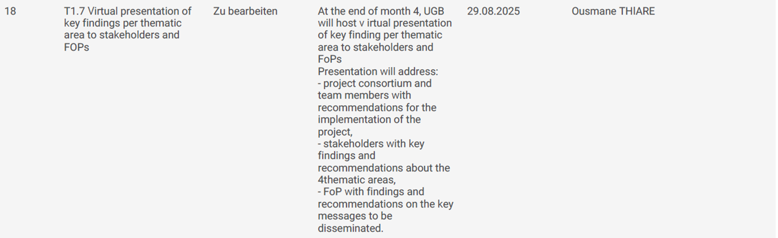
T1.6
Drafting 4 thematic reports in national tontexts
D1.3
E-document containg 4 thematic reports
T1.7
Virtual presentation of key-findings of tematic report

Slide 72
T1.6
Drafting 4 thematic reports in national tontexts
D1.3
E-document containg 4 thematic reports
T1.7
Virtual presentation of key-findings of tematic report

Slide 73
D1.2
Manual for Social Media Network Accounts
EDI

Slide 74
Deadline:
31.05.2025

Slide 75
D1.1
Project Quality Architecture (PQA) Toolkit
WEBIN

Slide 76
Deadline:
31.05.2025

Slide 77
Milestone 2
Contact List of FoPs
UGB
31.05.2025

Slide 78
Deadline:
31.05.2025

Slide 79
D1.3
E-document containg 4 thematic reports

Slide 80
Deadline:
31.05.2025
Let’s get started!

