Slide 1
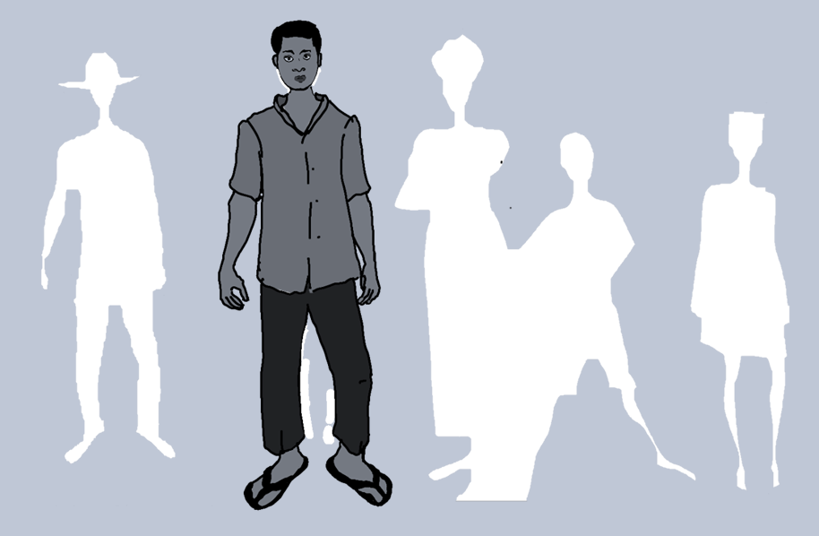
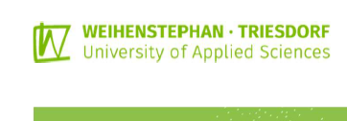
Setting up a
Peer-Mentorship Program
Anja Weber
October 2024
JOOUST, Kenya

Slide 2

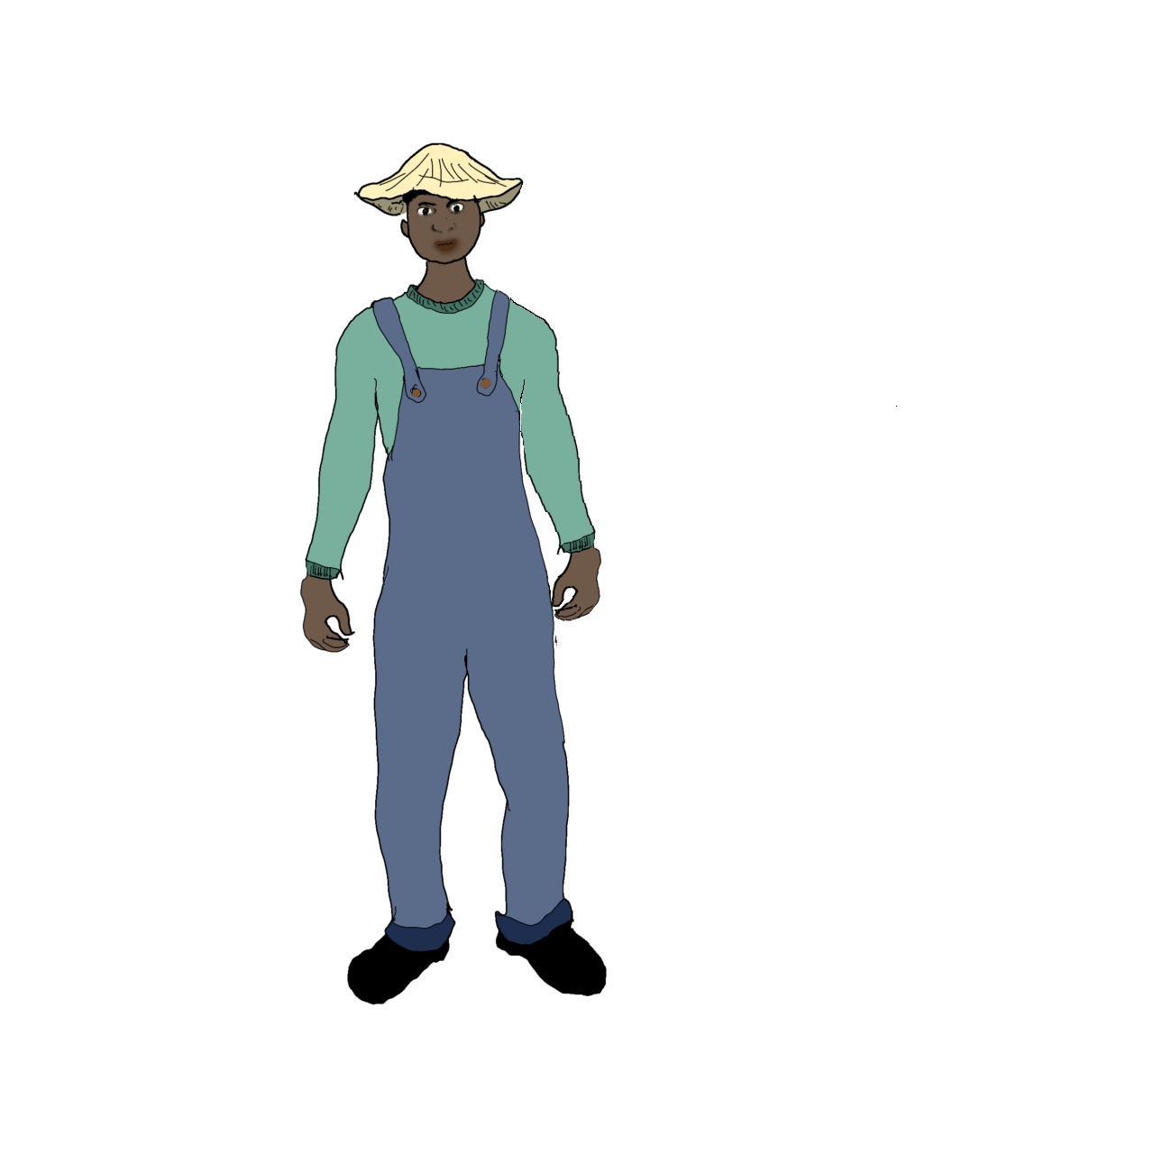


Setting up a
Peer-Mentorship Program

Slide 3
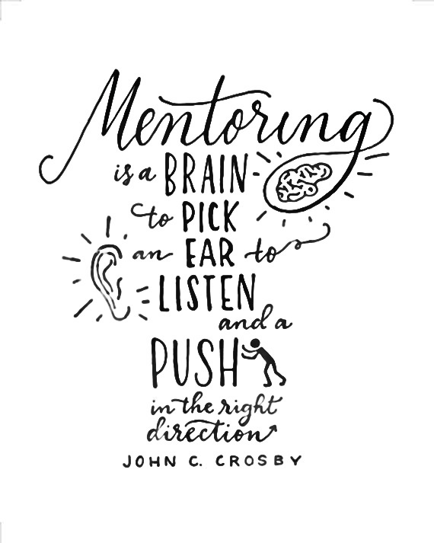

Slide 4
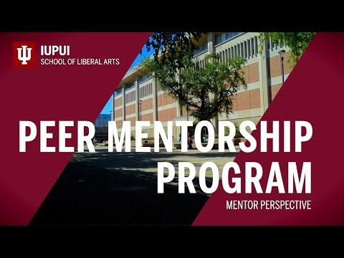

Slide 5

What comes to your mind
when thinking about
Peer-Mentorship?
achievement
success
freshman
community experience
friendship belonging
involvement
fun Peerhelpful
expectations
future
guide
growth
Mentor

Slide 6

The
Mentorship
Network
Supervisor
Partners
Staff member
Lecturer
Mentor
Mentor
Employers
Alumni
Mentee
Mentee

Slide 7



Why?
Who?
How?
Describe your current status

Slide 8
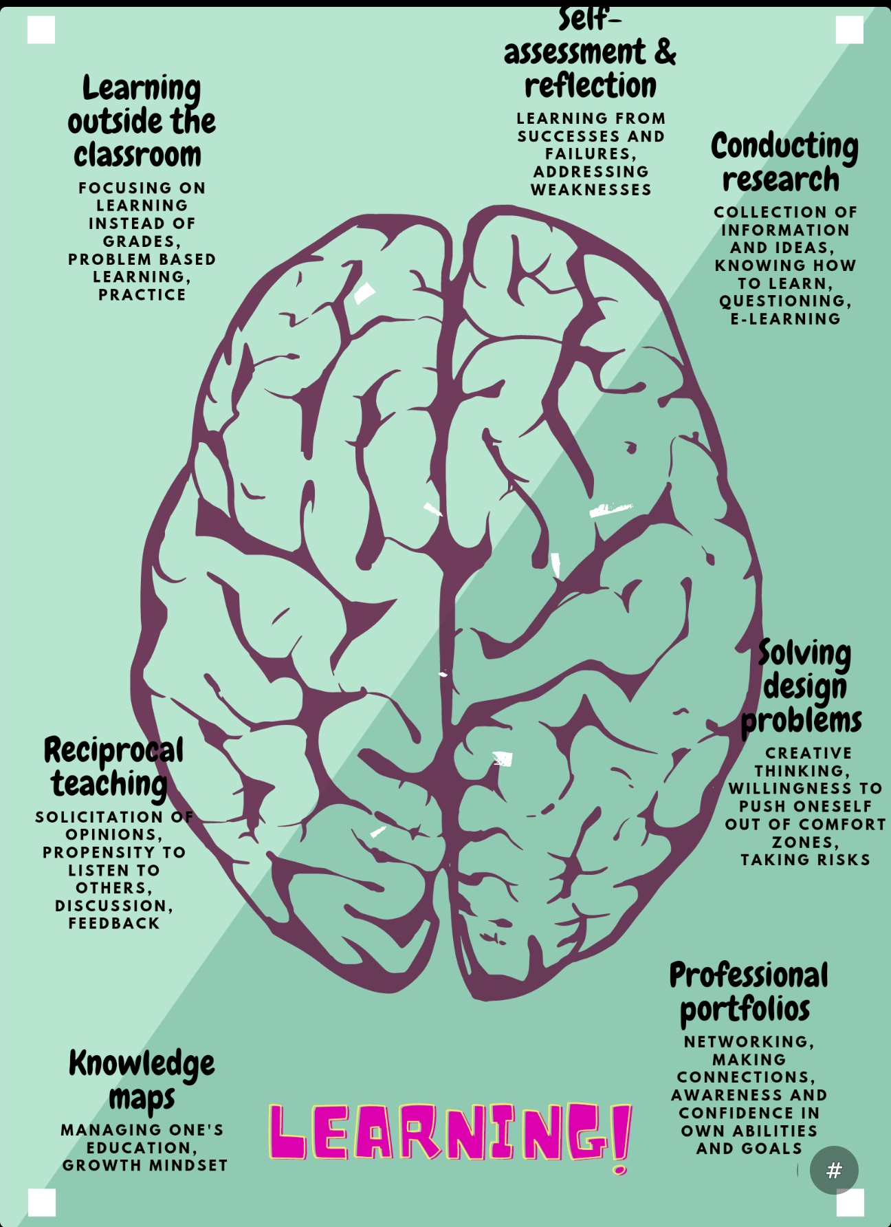
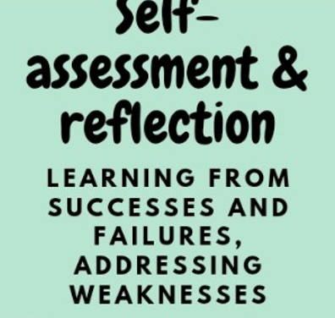
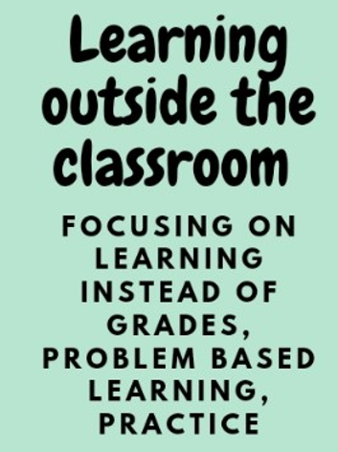

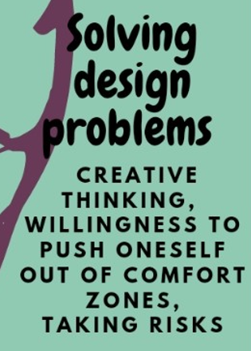




Slide 9

Activity:
2 Groups
Provide
Career Guidance
for
Anna
Bella

Slide 10
Chimamanda Ngozi Adichie:
The danger of a single story | TED
https://youtu.be/D9Ihs241zeg
Anna-Bella
A: Comes from a poor family.
B: She is a student at JOOUST.
A: She is in her last year of her bachlor in soil science course.
B: She works hard to finish her studies as soon as possible,
A: but she struggles to find funding for her school fees
B: and looks forward to her first job at Soil Cares.
A: Sometimes she feels overwhelmed.
B: She thinks having more work experience would be helpful.

Slide 11
High-level steps to starting a mentorship program
2.
Choose a
program format
4.
Automate selection / pairing
(big brother/sister,
group mentoring,
1 on 1 peers,
student-led sessions, etc.)
(info leaflets,
info/recruiting events,
induction week,
roling match-making, etc.)
6.
Solicit feedback
1.
5.
(collect regularly,
evaluate,
adapt/adjust,
inclusivity, etc.)
Set a high-level goal
Select training content
3.
(reduce drop-outs,
increase engagement,
improve academic success,
easier transition into work, etc.)
(career guidance topics,
coaching techniques,
communication techniques,
updated handbook, etc.)
Assign roles
(maintain database,
expert input sessions,
oversight, etc.)

Slide 12

Time Travel
Defining Goals from the End
Today
Next week
Next year
Future
do now
do next
do
next +1
.
.
.
first
step
last -4
step
last -3
step
last -2
step
last -1
step
last
step
.
.
.

Slide 13
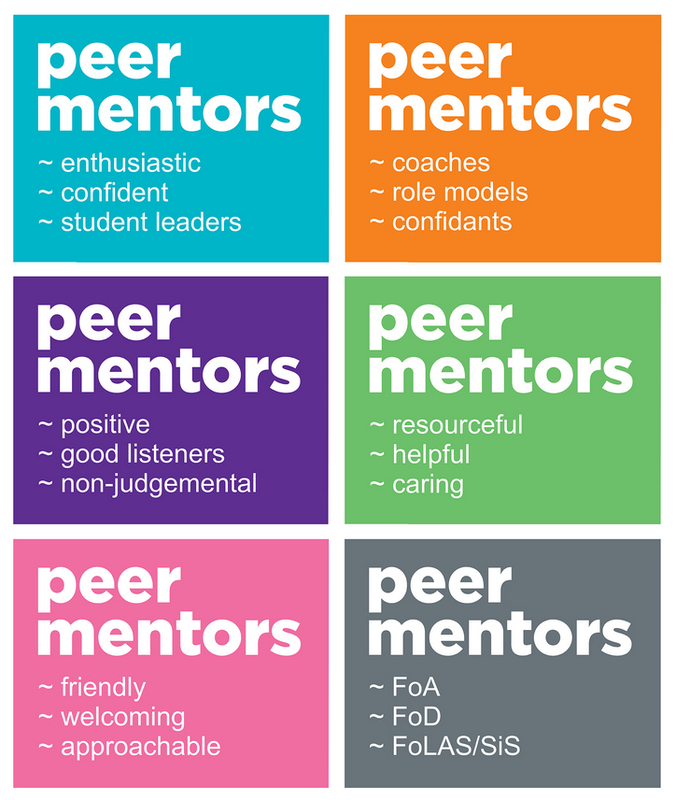

Who is a
Great Peer Mentor?
reaching out
empowering
engaging

Slide 14
How To Be A Great Peer Mentor
Being a great mentor involves commitment and work. Here are eight steps you can take to become a great peer mentor:
1. Focus on relationship
Mentorships need to be built on trust and respect. As a mentor, offer support rather than direction.
2. Meet consistently and follow up
Set up a meeting schedule that works for you both and stick to it. Connect between sessions to build your relationship.
3. Share goals and experiences
Connect over similar goals and experiences. Share your own ambitions with your mentee. You can both encourage each other and may be able to help each other along the way.
4. Hold each other accountable
Take brief notes during your meetings of what to follow up on so you don’t forget and hold each other accountable.
5. Coach each other; share what you learn
Offer feedback to each other to enhance learning. Share resources you’ve enjoyed, such as articles, TED talks or books.
6. Create peer mentoring groups
Meet regularly in peer mentoring groups to learn about specific topics.
7. Practice active listening
Help your mentee to feel understood by hearing what they are saying and repeating it back to them.
8. Confidentiality
Keep things that your mentee shares with you confidential.

Slide 15
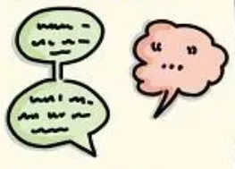









HOW TO THINK BETTER
FROM THE WORK OF NANCY KLINE
„More Time to Think“
ATTENTION
EQUALITY
EASE
APPRECIATION
ENCOURAGEMENT
Listening without interruption is an art of creation
Our thinking is different & equal
You cannot think in a hurry. Create freedom from rushing.
Appreciate 5x more than you criticize
Eliminating competition improves thinking
INCISIVE
QUESTION
INFORMATION
FEELINGS
DIVERSITY
PLACE
What are you denying that would liberate your thinking?
Fear prevents thinking. Laughter helps.
People will think for themselves
Remove false, limiting assumptions
The place – and your body - matters

Slide 16


Slide 17
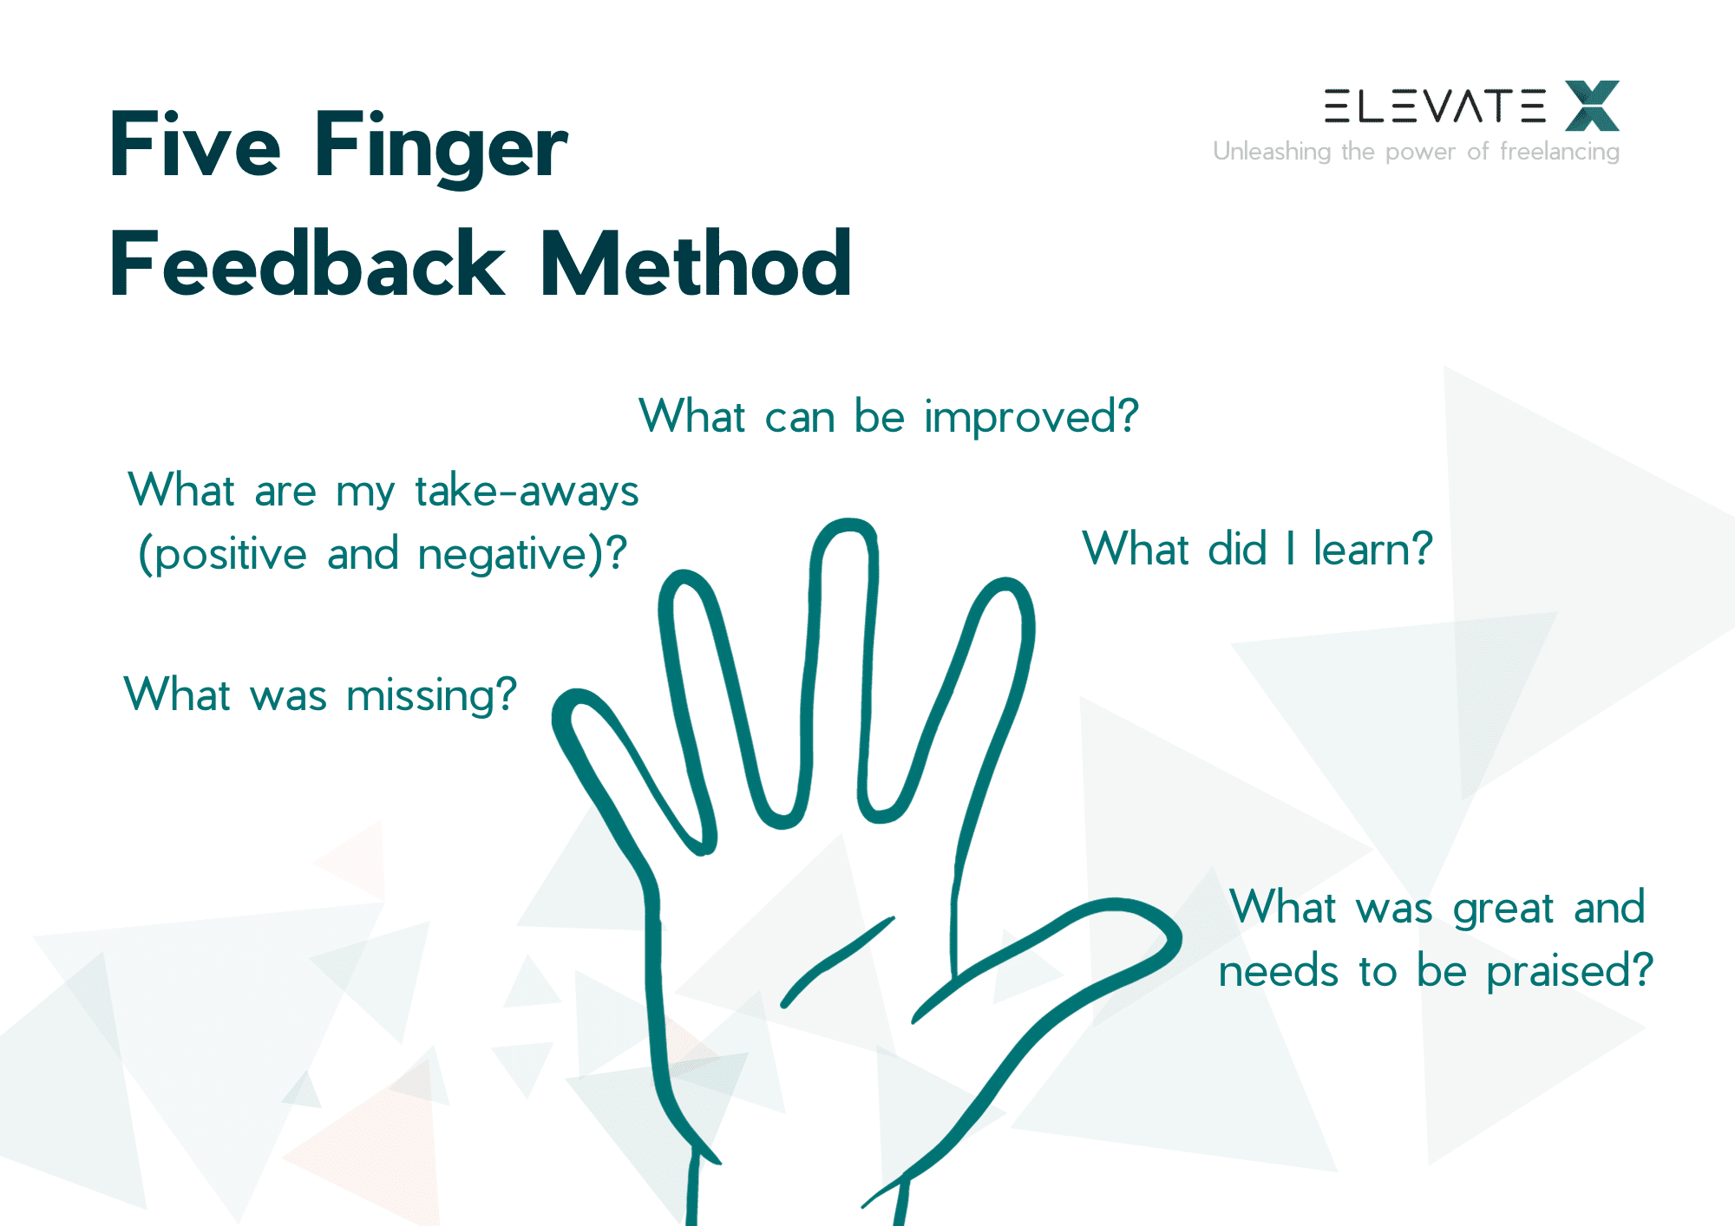
Five Finger
Feedback Method

Slide 18
Mentoring sessions are private and confidential. However, when a student’s health or well-being is in question, mentors have to report to the appropriate authority to provide the mentee with the best care possible.
Mentors must commit to at least 1 hour of office hours per week for their semester of service (excluding breaks and holidays). Mentors must also plan to attend a 1.5 hour training per term, and later help develop the next set of training materials.

Slide 19
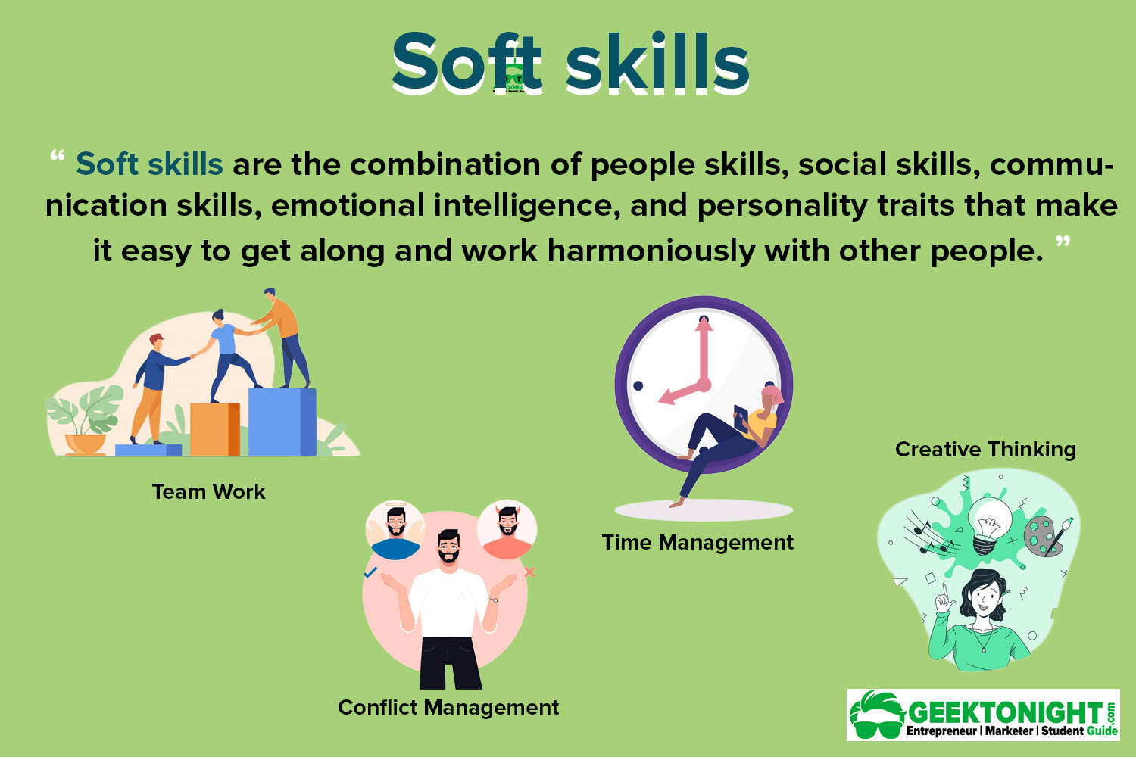
Empathy
Adaptability
Receptive to Feedback
Self Management
Problem solving

Slide 20
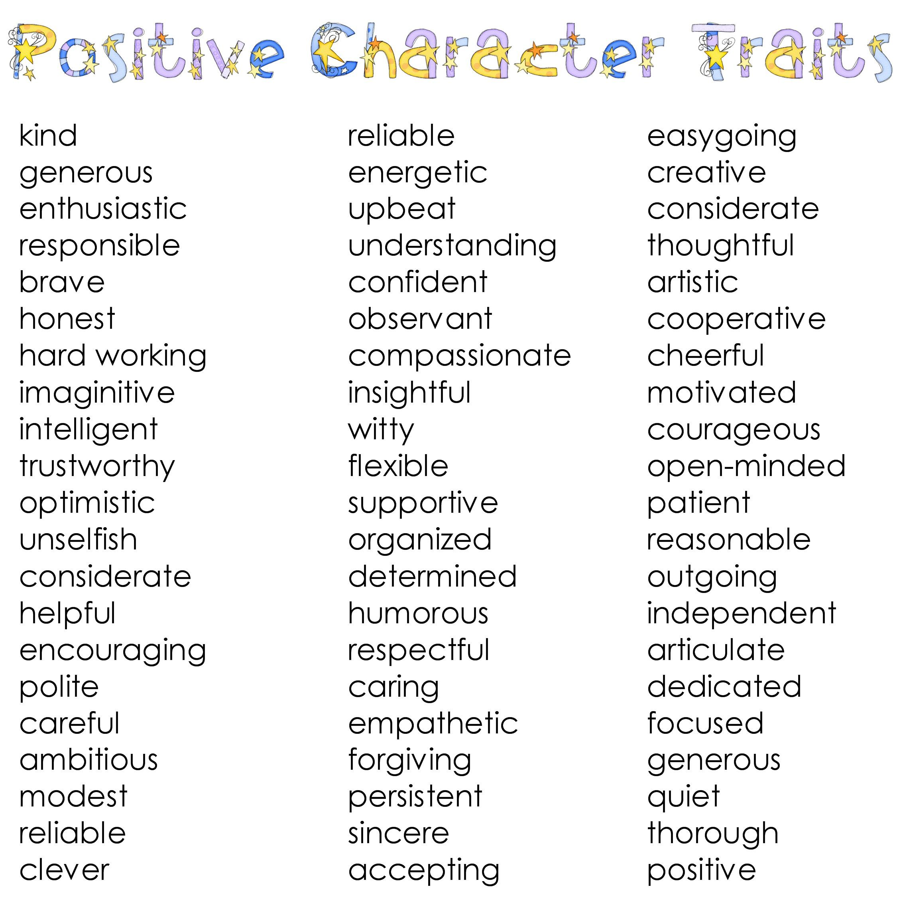


Slide 21
You can read about Myers-Briggs personaliy types and check out your own personality type here

Slide 22
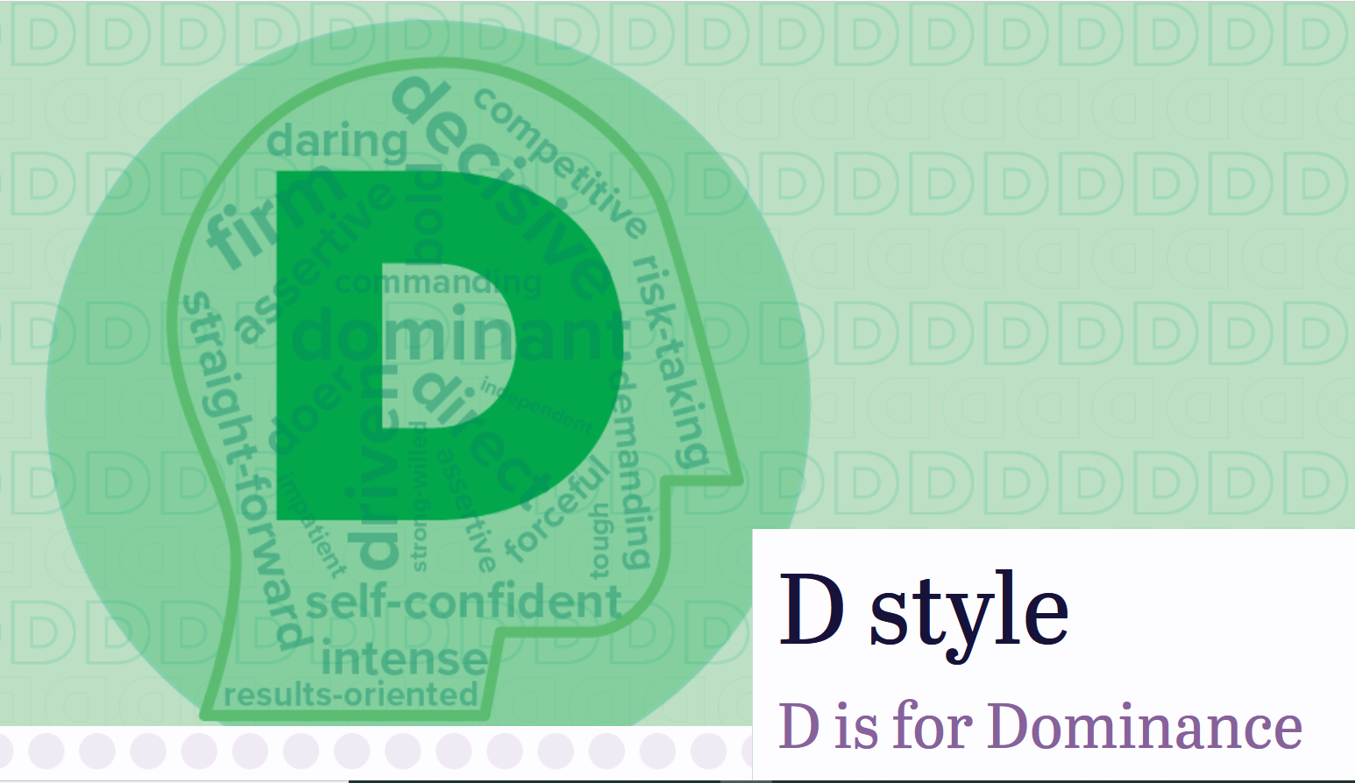
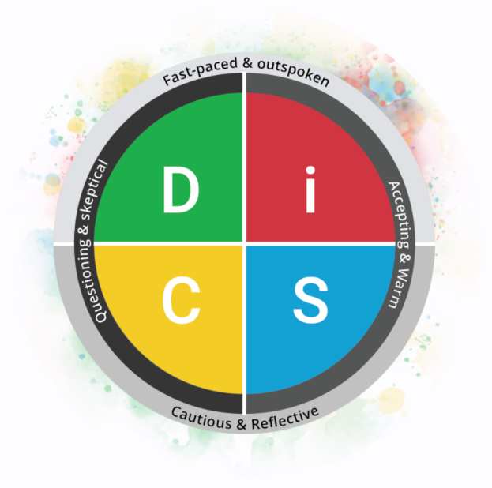
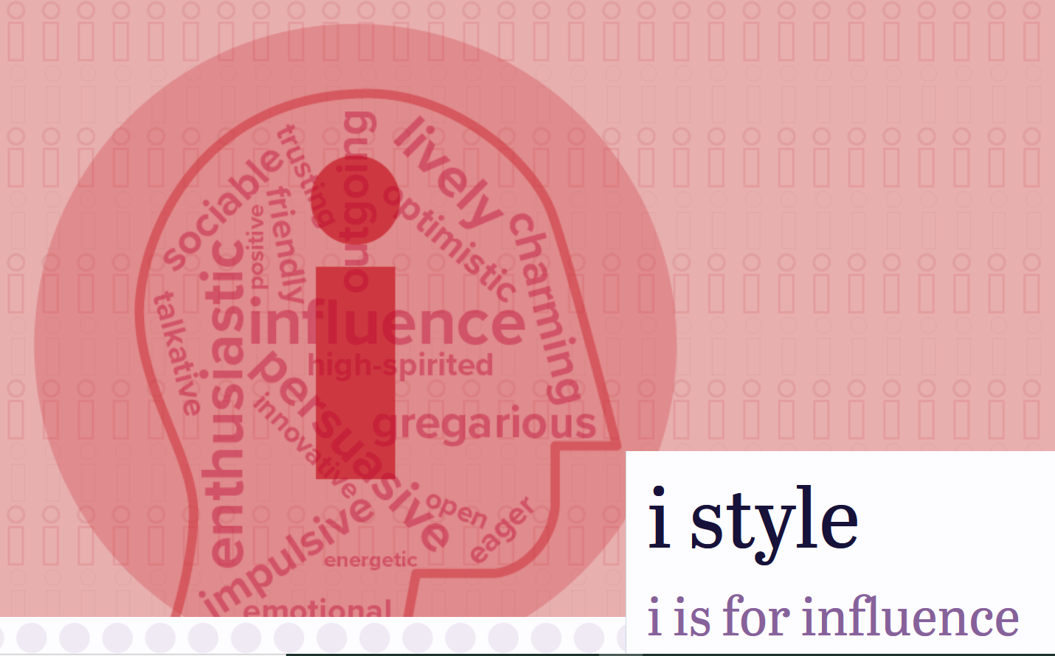
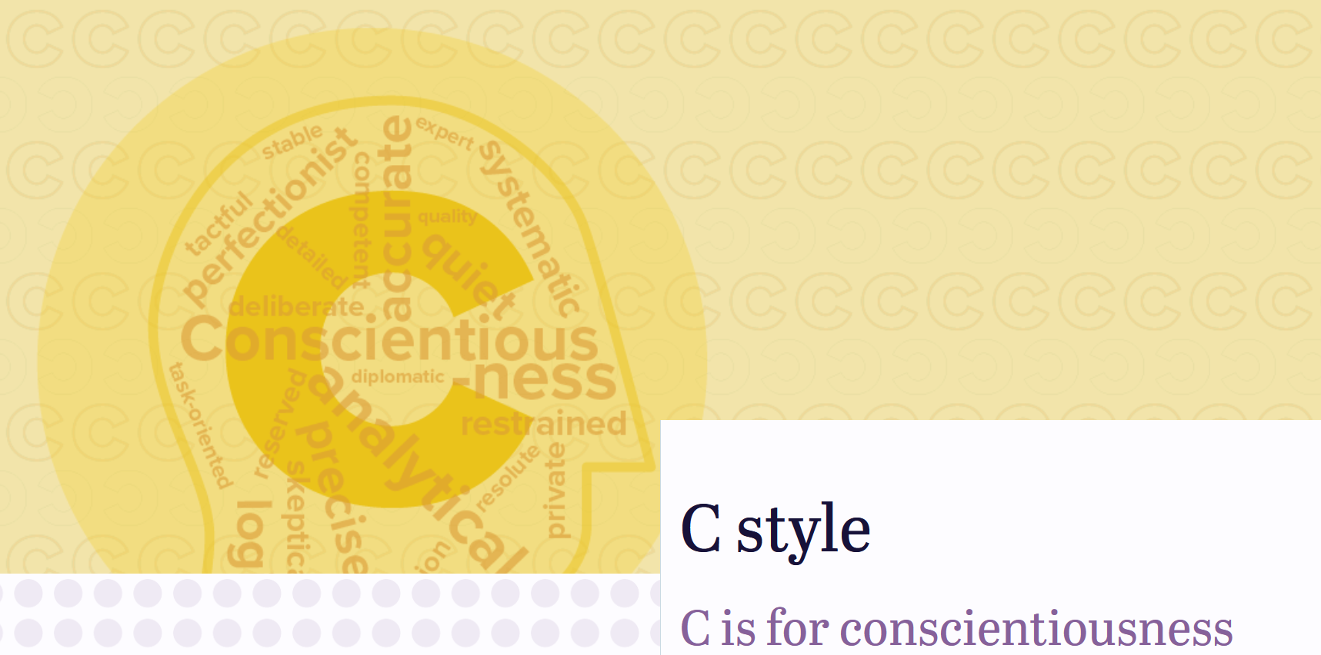
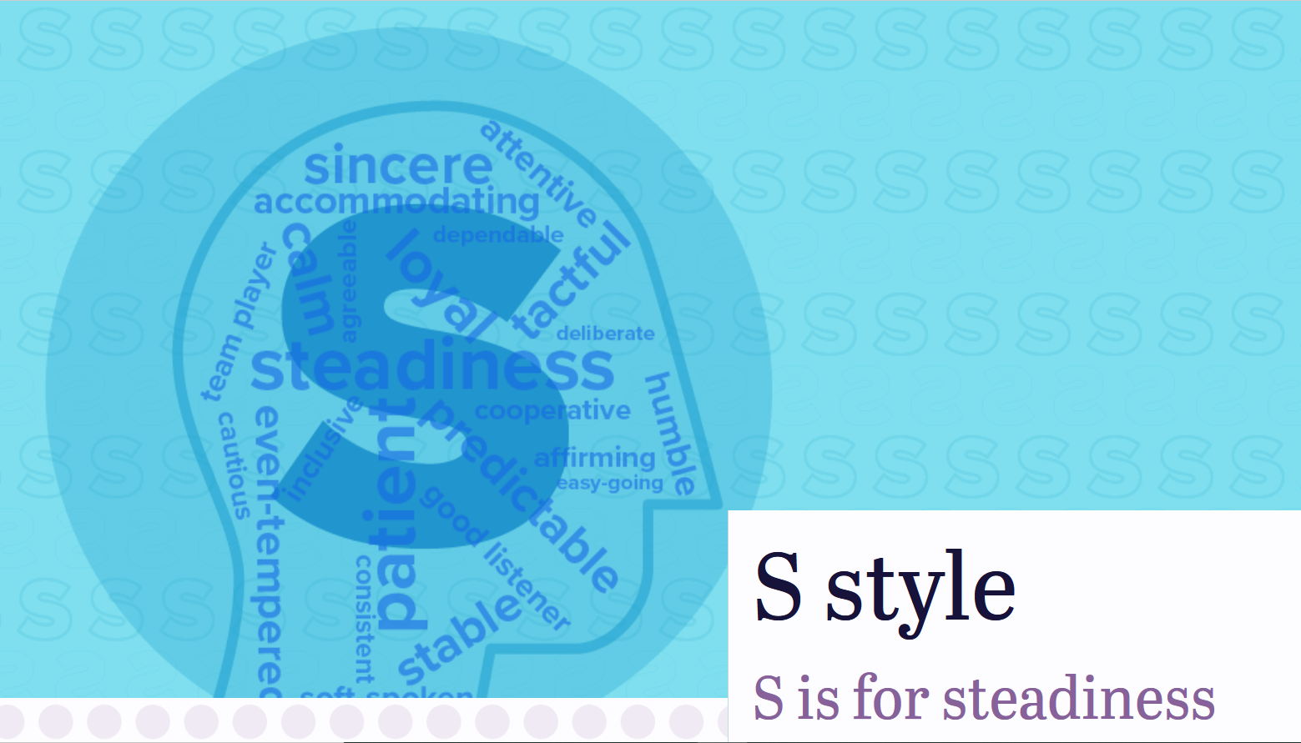
methodical
diligent
strive to produce superior results
motivated by challenges & quality work
like showing their expertise
value stability, accuracy & objectivity
prefer logic & facts
stressed by uncertainty & taking risks
fear making mistakes in front of others
dislike feeling vulnerable
need to have private time
need to work on acknowledging others’ feelings
even-tempered nature
consistent/steady pace
patient & humble
cooperative & dependable
ensure everyone gets along
like stability & sticking to a plan
prioritises collaboration & support
values trust & loyalty
stressed by working without clear guidelines
dislikes arguing for their point of view
fears rapid change and bold decisions
choose to ignore problems
assertive & take action
direct & outspoken
skepticial
keep things moving
determined & ambitious
fast-paced
like challenges & competition
value personal freedom
dislike strict rules
want to have control over a situation
fear being seen as vulnerable or being taken advantage of
expressive
impulsive & fast-paced
extrovert
enthusiastic & energetic
friendly & charming
like novelty and excitement
value relationships & coaching
driven by popularity/approval
prioritize action & collaboration
dislike being isolated
stressed by giving negative feedback

Slide 23
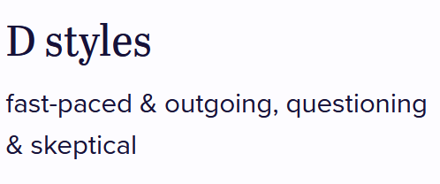
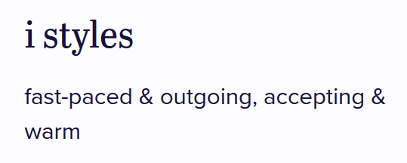
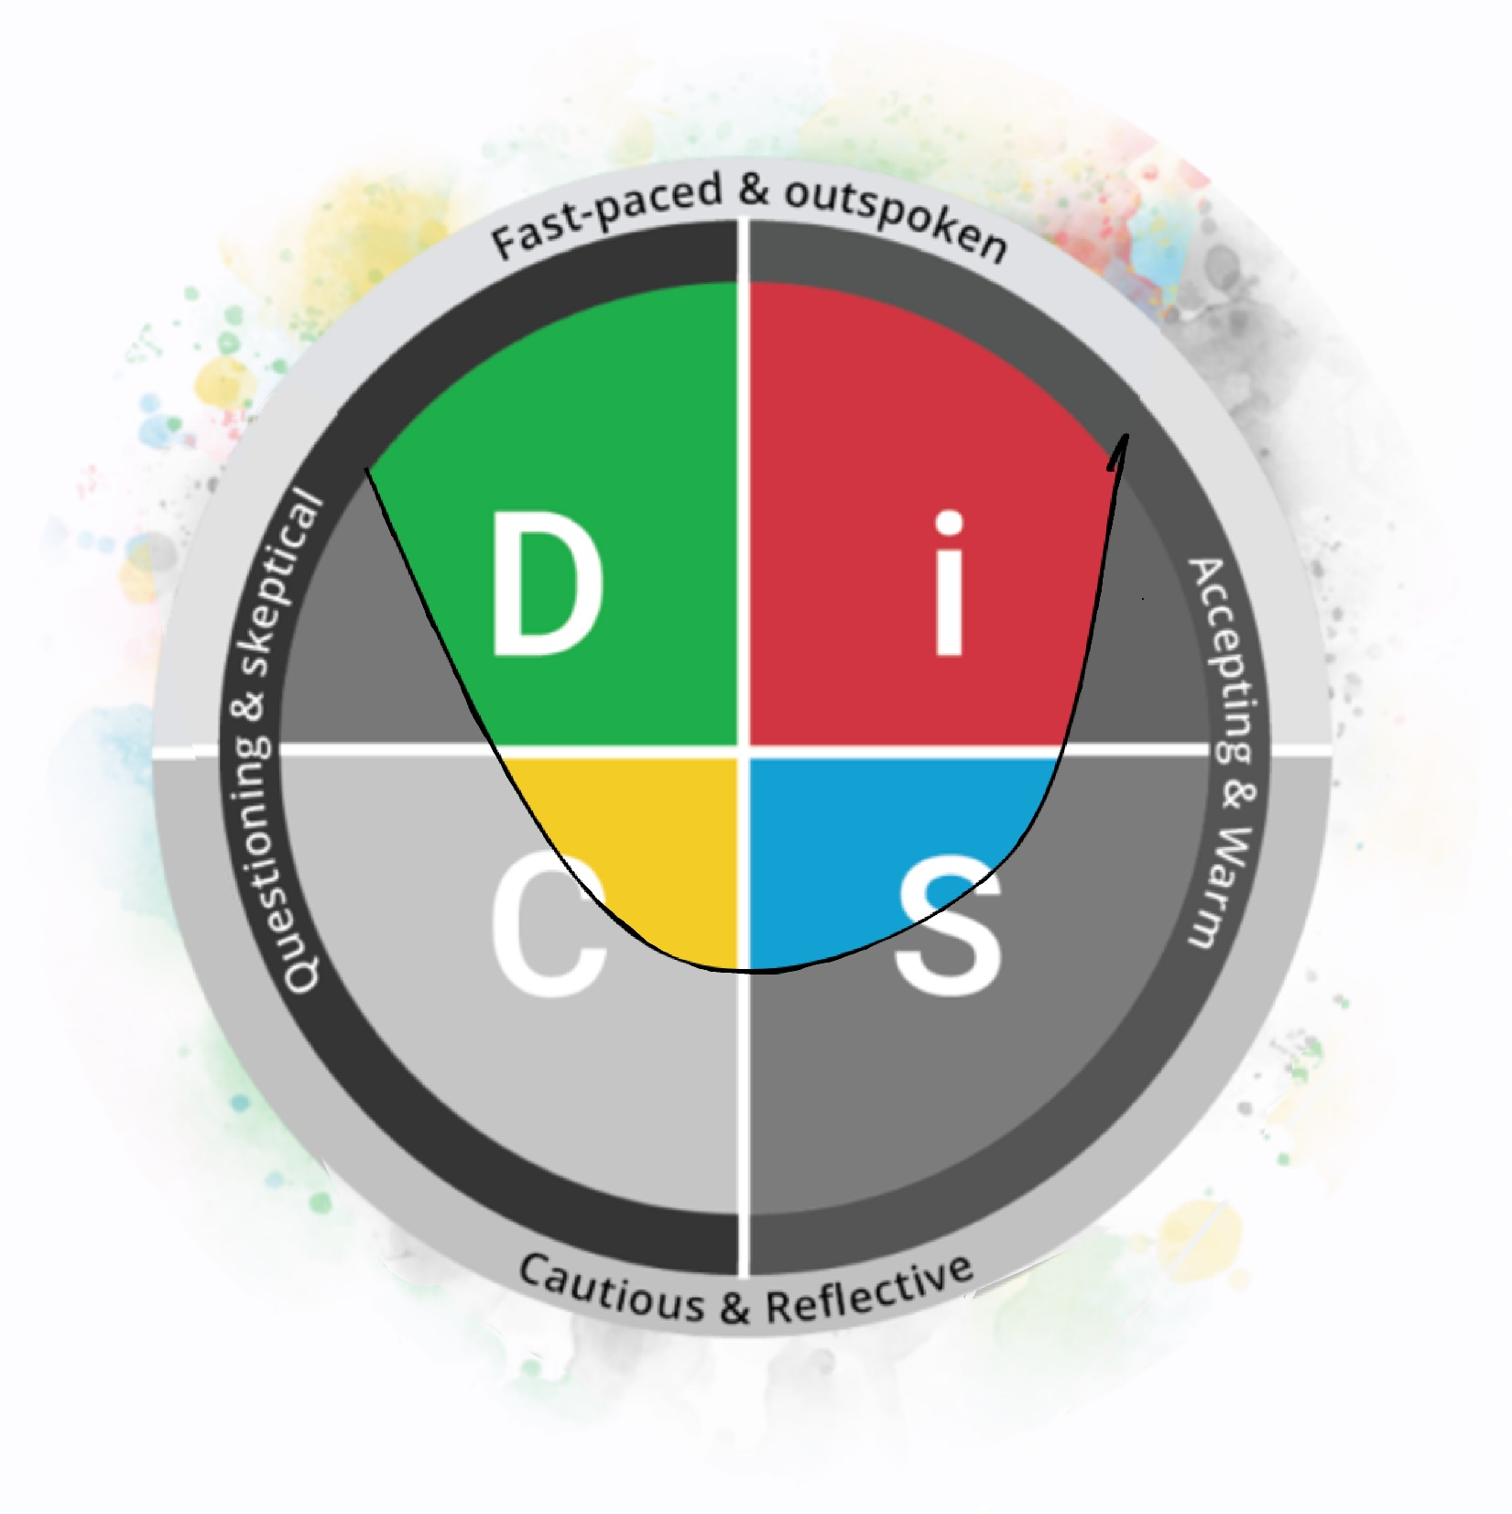
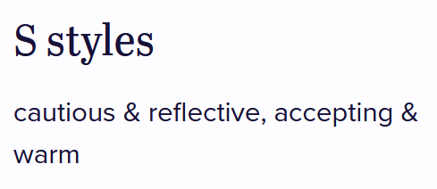
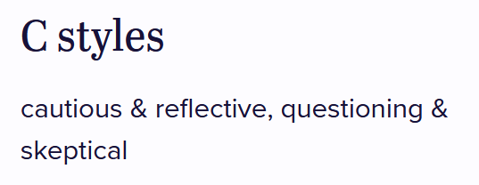
ACTION
RESULTS
ENTHUSIASM
People with D personalities tend to be confident and place an emphasis on accomplishing bottom-line results.
People with i personalities tend to be more open and place an emphasis on relationships and influencing or persuading others.
CHALLENGE
COLLABORATION
ACCURACY
SUPPORT
People with C personalities tend to place an emphasis on quality, accuracy, expertise, and competency.
STABILITY
People with S personalities tend to be dependable and place an emphasis on cooperation and sincerity.

Slide 24
Free career test - online
Free Personality Test
Notes:
https://www.yourfreecareertest.com/career-tests/free-career-test-for-students/
https://www.16personalities.com/free-personality-test

Slide 25


the C.V. or resúmé should not exceed one page (or the number of pages specified in the job offer specifications); make sure that spacing and punctuation are even and consistent throughout the document
First name (Middle name) Surname
Street & house nr or POB number • ZIP code City, Country
+phone number• email@address
Personal Statement
A highly motivated student from country with great interest in (name topic relevant to job application e.g.:) renewable energies. Looking for (state the position you are seeking, e.g.:) an internship with the goal to (state your aspiration, relevant to the employer, e.g.:) contribute to sustainable projects in order to fight against climate change.
Education
The personal statement is always written in the 3rd person! It can consist of: experience, job-specific skills & a representation of what you want to contribute to the job you are aiming for. Please adapt individually to each point.
mm/20yy – present
Name of University, City
(State your final degree, e.g.:) MSc / B. Sc. Name of the course
Relevant Coursework: (name a few classes relevant to job application)
Name of secondary school, City
(State your final degree, e.g.:) A levels / high school diploma
Examples: MSc; MA; BSc; BA; MBA; A levels; BE; high school diploma; Vocational training; university entrance qualification; etc.
mm/20yy – mm/20yy
Experience
mm/20yy - mm/20yy
Organization Name, City position title
(List a few activities/resposibilities that are relevant to the job application, e.g.:)
independently developed a …
responsible for compilation of monthly performance report
Organization Name, City
position title
(List a few activities/resposibilities that are relevant to the job application, e.g.:)
coordinated and facilitated …on a weekly basis
supported and advised ….
start each activity with an "action verb“; use past tense for past activities and present tense for ongoing activities
mm/20yy - mm/20yy
Skills
fluent: C1, good working knowledge: B2, working knowledge: B1, basic skills A1-2; especially outside Europe, the Common European Framework of Reference for Languages from A1 to C2 is little known, which is why the description of language skills makes sense
Languages
English (add the level of mastery, e.g.:) fluent / good working knowledge
(Name other relevant languages you speek), e.g.:) French (basic skills)
(Name any relevant software you are fa,miliar with, e.g.:) MS Office
full, clean license
this information is only necessary if the driver's license is advantageous because you need to use a vehicle or travel on the job
Computer / Software Driver’s license
Academic Honors / Awards
20yy
(List any other certificates or rewards, e.g.:) received research grant by the DAAD (German Academic Exchange Service)
Stays Abroad
mm/20yy - mm/20yy (mention any stays abroad, e.g.:) work and travel in Canada
Community Service / Volunteer Work
mm/20yy - present
Mention all relevant community work, that provides any form of work experience or shows your character, e.g.:) leading local youth group in nature conservancy association to conduct environmental projects

Slide 26

the English CV is not dated and not signed! think in advance about who you could give as a reference and contact them beforehand to ask for their permission to be used as a reference. Alternatively you van write: available upon request
Interests and Activities
(e.g.:) Painting, Dancing, Traveling
References (Names and contact information of ideally one or two professors or employers who can give positive witness about your personality and work ethics.)
Listing interests is optional, but can be a good way to start a conversation or share your hobbies
Tip: Have your finished cover letter improved by DeepL Write – for better spelling and expression or let the free AI writing
assistant Grammarly help you.
You can also use ChatGPT to customize your existing CV or cover letter to a certain job description. Upload the job description in the chat as well as your CV or cover letter (you can also activate "Browse with Bing" or the WebPilot plugin so that ChatGPT can read the web pages and directly refer to the website where the job offer is posted). Then use the following prompts:
Prompt:
Make suggestions on how I can improve my resume to get this job: [LINK TO JOB POSTING]
Resume: [COPY/PASTE YOUR CURRENT RESUME]
Prompt:
Rewrite the [SECTION TITLE] section on my resume based on your suggestions above.
Now customize your resume section by section and create your new resume with the texts written by ChatGPT.

Slide 27
Diana Meyer
Weihenstephaner Berg 5 • 86354 Munich, Germany
+49 178 1234 56 • diana.meyer@freenet.de
Contact Person Company Name Street Address City, State Zip code
Please use the same letter head in your cover letter and C.V/resume
March 27, 2010
Application for an internship for 22 weeks starting in September 2020
Dear Mr./Ms./Dr. Last Name of Addressee,
Opening Paragraph
Open with a compelling paragraph that tells a story and catches the reader's attention. Therefore, communicate your passion and why you are applying for this job/to this company. You may say how you found out about it, and ask for consideration based on your unique skills and experiences you have to offer. If you were referred by someone state that here. Make a general statement what qualifies you most for the job and if possible how you will be able to contribute. Please avoid talking about what you want from them or what you want to gain from this position. Keep in mind that it should be interesting for the reader.
2nd Paragraph
Begin by stating your degree programme, name of your university and what year of study you are currently in. You may also explain your study programme and tell the reader it includes plenty of practical experience and exercises.
In this section, you want to build a direct connection between the company's needs and your background and skills. Stress what you have to offer. Identify those parts of your experience and expertise that will interest THIS particular employer (refer to the job description if possible). You can draw attention to relevant course work, special projects and campus activities if they show direct relationship to this position. You may also mention experience from previous employments or apprenticeships.
Do not restate what's in your resume/C.V., rather expand upon a specific project or accomplishment.
3rd Paragraph
Highlight your personal qualities and social skills and convince the employer that you have the qualities and skills to succeed at this specific company. Relate your interests/social skills to what you know about the company. You may also explain how you gained those skills (e.g. on a side job while waitressing you proved to work well under pressure etc.). Experience through extracurricular involvement, summer jobs, volunteering or travel may also be included in this paragraph.
Closing Paragraph
Request an interview (through video conference or phone if abroad), or tell the reader that you will contact them soon in order to schedule a mutually convenient time to talk. Thank the reader for their time and consideration.
Sincerely,
Your Signature (scanned) Type Your Name
If you do not know the contact's gender you may use the person's full name. Always try to find the name of a specific contact person. Ensure that you have the correct spelling of the individual's name. If your research is unsuccessful substitute one of the following: Dear Sir or Madam, Dear Hiring Manager
Why year? Because we cannot assume everyone is familiar with semesters, some countries have trimesters; therefore it's better if you state the year.
Before you're done, make sure...
- to proofread for typos and run spell check
- not to explain what the employer can do for you, instead what you can do for them
- to avoid lengthy paragraphs of more than 5 to 7 lines. Keep your sentences simple and to the point.
- to check that it says clearly what you want it to say. Are there any sections that are hard to read or follow? If yes, try to simplify the language, use shorter sentences.

Slide 28
Power Verbs
(Verbs in bold letters are best suited to describe achievements)
More Verbs for Accomplishments achieved expanded improved pioneered reduced (losses) Resolved (problems) restored spearheaded transformed operationalized | Communication addressed arbitrated arranged authored collaborated convinced corresponded developed directed drafted edited enlisted formulated influenced interpreted lectured mediated moderated negotiated persuaded promoted publicized reconciled recruited spoke translated wrote | Technical assembled built calculated computed designed devised engineered fabricated maintained operated overhauled programmed remodeled repaired solved upgraded | Financial administered allocated analyzed appraised audited balanced budgeted calculated computed developed forecasted managed marketed planned projected researched | Helping assessed assisted clarified coached counseled demonstrated diagnosed educated expedited facilitated familiarized guided motivated referred rehabilitated represented
Management administered analyzed assigned attained chaired consolidated contracted coordinated delegated developed directed evaluated executed improved increased organized oversaw planned prioritized produced recommended reviewed scheduled strengthened supervised
 |  | Teaching adapted advised clarified coached communicated coordinated demystified developed enabled encouraged evaluated explained facilitated guided informed instructed persuaded set goals stimulated trained | Creative acted conceptualized created customized designed developed directed established fashioned founded illustrated initiated instituted integrated introduced invented originated performed planned revitalized shaped | Clerical or Detail Oriented approved arranged catalogued classified collected compiled dispatched executed generated implemented inspected monitored operated organized prepared processed purchased recorded retrieved screened specified systematized tabulated validated
 | Research clarified collected critiqued diagnosed evaluated examined extracted identified inspected interpreted interviewed investigated organized reviewed summarized surveyed systematized

Slide 29
Tip | Application by e-mail: how to be convincing even with your subject line
"When applying for a job, is it only the qualification that counts? No: career experts say that the subject line of the email decides whether it is opened.
Many companies accept applications via an online tool or by email.
Application by mail: The first hurdle is the subject line
When you apply to a company by email, the subject line is the first point of contact you have with the recruiter. It is therefore a bad idea to leave the subject line completely blank, as career experts tell the US magazine Businessinsider. The subject line is the factor that recipients use to decide whether and when to read an email. Likewise, the tone in which recipients react to the email depends on the subject line, informs Businessinsider. By the way, there is also a favourable day for applications by e-mail, choose Tuesday in the morning for your application.
The subject line of the e-mail should be short and clearly formulated.
Make sure that you only write the most important information in the subject line, it should not be a complete sentence with a greeting. This wastes important space, and recruiters will not be able to classify your e-mail at first glance. Such irritation can lead to your e-mail being pushed into the background and not being considered. So keep it as short as possible. Another advantage of this is that your subject line will not be shortened if the recipient checks his or her mails on the smartphone, where less of the subject line is displayed than in the e-mail programme on the laptop.
Application by mail: Career experts say your name can go in the subject line
Write the subject line right at the beginning of your email, so on the one hand you can't forget it and on the other hand you already set the tone of your application. You should definitely mention the reason for your email and the job.
A career expert also recommends in Businessinsider to write your own name in the subject line. If you use simple keywords in the subject line, it is more likely that your email will be found using the search function of the email programme. This helps if the mail is not moved directly to the appropriate folder or marked after the first reading. By the way: If there is a reference number for your desired job, you should also write this in the subject line.
Application by mail: Have you already had contact? Make a reference to this
If you have already had contact with the recipient of the e-mail or the company at a job fair or through a telephone call, make the reference to this in the subject line. This can lead to the recipient remembering you or prioritising your mail because you have already been in contact with the company.
Three things you should avoid - subject line of the mail
Starting a sentence in the subject line and ending it in the body of the mail.
      Writing the subject line entirely in capital letters.
      Using filler words.
If you are looking for a new job, you will certainly write several applications, but you should not blindly copy and paste. Take the time to read through everything again - including the subject line. Make sure there are no spelling mistakes. It is also important that it is either a general formulation or that you have targeted the subject line to the relevant company."

