Slide 1

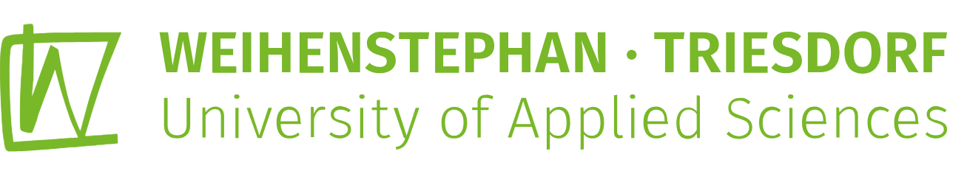

AGRI-MOCKS Project Hawassa University
Mastering Opportunities- Scouting, Career-guidance and Key-job Skills in Agriculture
Creating A virtual Internship program
April, 2025
Addis Baba Ethiopia

Slide 2
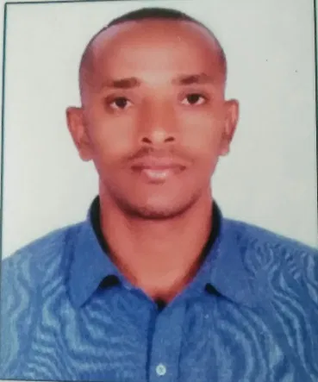
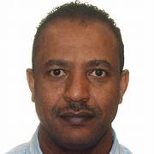
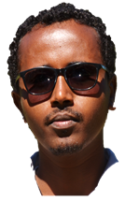
AGRIMOCKS Hawassa University
Dr Zerihun Demirew
Member
Anbes Tenaye.
Member
Tirusew Teshale.
Member
Yitna Tesfaye
Project Coordinator

Slide 3
Born & Raised in Arbaminch – Home of Lakes Abaya & Chamo – rich in fruits, fish & natural beauty (but really hot!)
Family Guy – Husband & father of two wonderful kids
Academic & Trainer – Lecturer, Head of Business Incubation Centre, PhD student in Economics.
Researcher – Focused on Agri-economics, Digital learning, climate change, and rural livelihoods.
Role on AGRI-MOCKS Project – Coordinator, trainer on entrepreneurship, coffee simulator (Business Smart), mentorship, and communication & networking.
Yitna Tesfaye

Slide 4
Member, trainer, & mentor in AGRI-MOCKS Project.
Lecturer: Econometrics, Research Methodology, Agro-Economics.
Researcher: Food security, productivity, Efficiency, and economic analysis.
  Sustainability Journal (2025): Adoption of Orange-Fleshed Sweet Potato (OFSP).
  Irrigation and Drainage (2024): Efficiency analysis in crop production techno.
  Applied Food Research (2023): Chickpea variety adoption in Southern Ethiopia.
Consultant: work with international organizations (CIP, ILRI, ICARDA, etc.).
Data Analyst and Software trainer:
Software: STATA, SPSS, R, E-Views, Excel, SurveyCTO, ODK, Kobo, etc.
Multilingual: English (Fluent), Amharic (Native), Norwegian (Basic).
Professional Member: American Economic Association, Ethiopian Economic Association, Canadian Agricultural Economics Society.
Anbes Tenaye.
Member

Slide 5
Teaching, research, student supervision, and community service over 19 years of academic experience in Expertise in bioenergy science, biotechnology, biofuel production, and plant genetic conservation
College Dean of Agriculture, Hawassa University
Supervise PhD and MSc students
Academic Background:
  PhD in Bioenergy Science
  MSc in Biotechnology
Research Focus & Contributions:
  Biofuel and Biodiesel Production
  Biotechnological Tools for Plant Improvement
  Agricultural Sustainability
Participated in numerous conferences, workshops, and training programs
Member, trainer, & mentor in AGRI-MOCKS Project.
Dr Zerihun Demirew
Member

Slide 6
Born & Raised in Hawassa – Known for its scenic location on Lake Hawassa
Family Guy – Husband & father of two wonderful kids
  In fact from ONE beautiful WIFE
Academic: Lecturer, and HoD of Agricultural Economics @ HU
Researcher – Focused on Agri-economics, Valuation, True cost accounting, and Rural livelihoods.
Trainer: ToT on Delivering Applied Entrepreneurship Training (Mentoring), Coffee simulator (Business Smart), and Entrepreneurship (ETW).
Role on the Project – Member Trainer and Mentor

Slide 7
