Slide 1
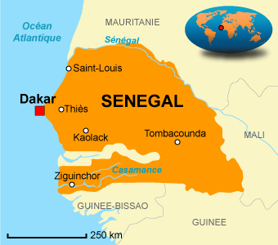
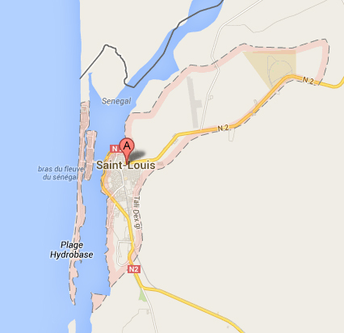
Université Gaston Berger of Saint-Louis

Slide 2
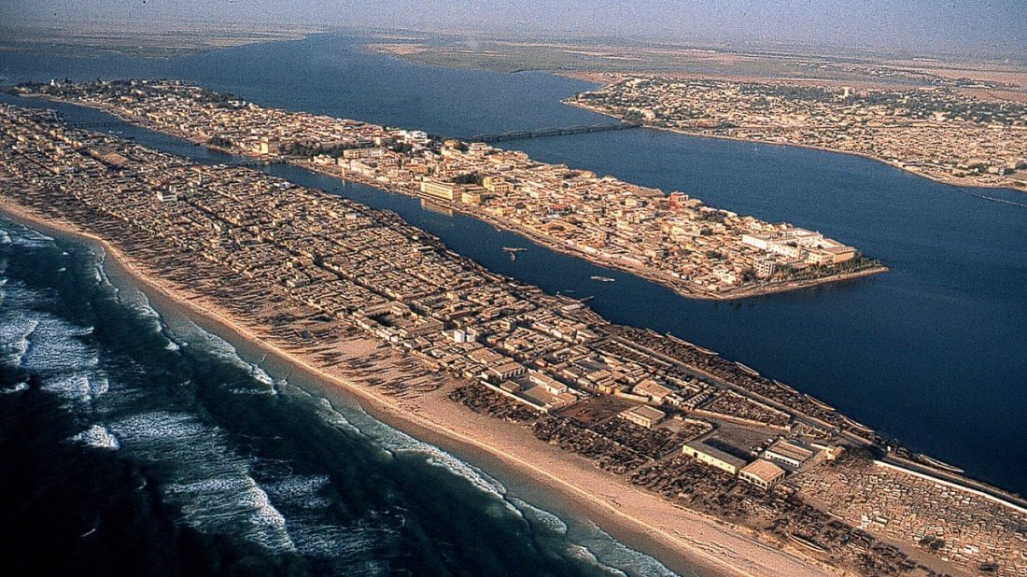
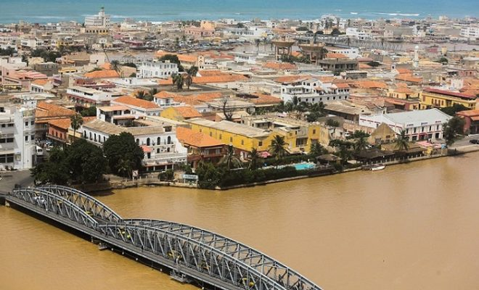
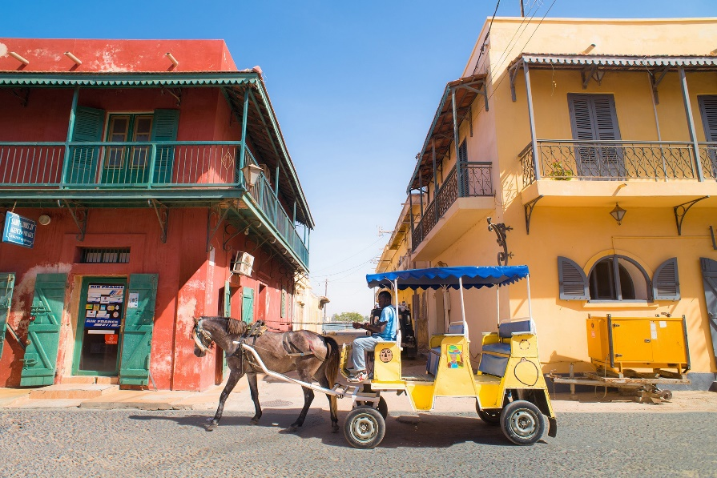
Université Gaston Berger of Saint-Louis
Saint louis was the first capital of Senegal, dedicated world heritage of humanity by UNESCO.

Slide 3
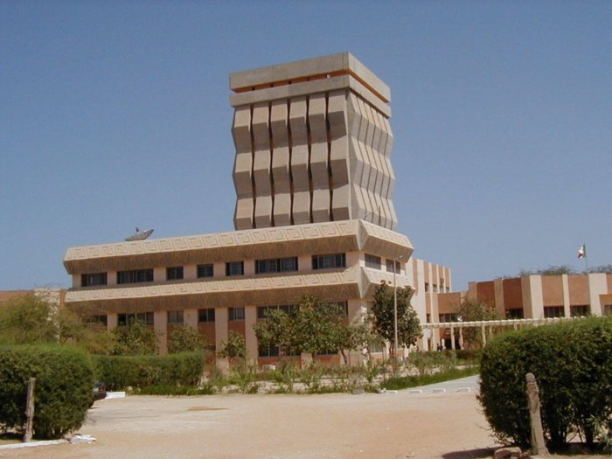
Université Gaston Berger of Saint-Louis
1990: first cohort of 600 students,
UGB extends over 240 hectares and is located about 12 km from the town of Saint-Louis

Slide 4

AGRI-MOCKS KOM
Introduction
Who is on your team
  Andre Diatta : Agronomy - Soil fertility - Agroforestry - Sustainable Agriculture
  Anicet MANGA : Agronomy
  Cesar BASSENE : Botany
  Saidou Nourou SALL : Soil biochemistry and ecology
  El Hadji Abdoul Aziz NDIAYE : Economist
  Ousmane THIARE : Computer scientist
What is the background and strength of your institution
  Experience in European projects. UGB is involved in many H2020, Horizons and ERASMUS research projects. We are currently involved in BASIS, URBANE, MASSTER, OPPORTUNITY, etc.
What is your institution‘s role in the project
  Work on all the tasks in which we are involved
  WP1 : Lead: UGB - Co-lead HSWT
    To conduct preparatory activities and make project ready for implementation
Hochschule Weihenstephan-Triesdorf | Agri-Mocks | 2025
Notes:
Anja

Slide 5
AGRI-MOCKS KOM
What will you bring to the team/project
  Regular attendance at meetings
  Commitment of the entire team to the success of the project
  Target group
    Master's degree in food safety risk prevention and management
    Master's degree in agricultural production and processing
    Available until August 31, 2025 (afterwards, they go on placement)
Hochschule Weihenstephan-Triesdorf | Agri-Mocks | 2025
Notes:
Anja

